Slide 1
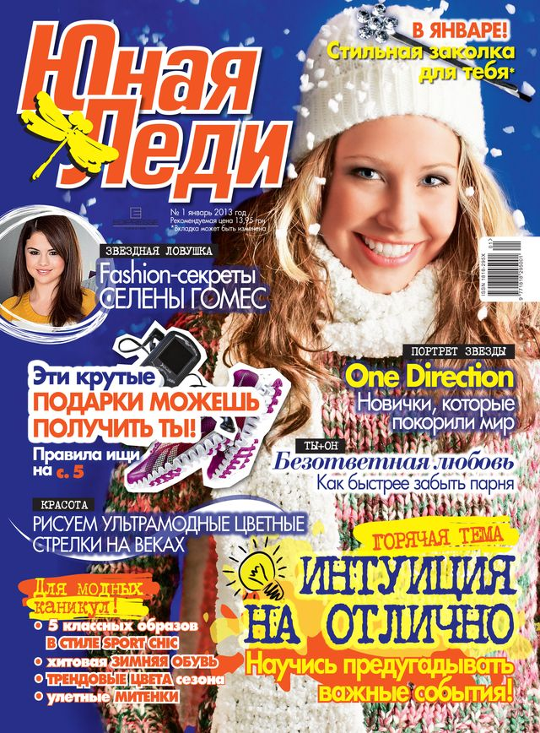
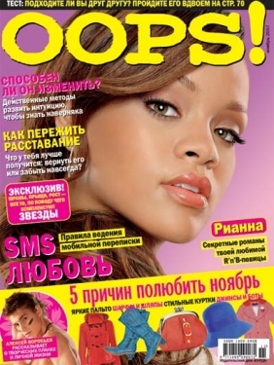
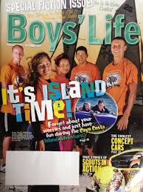
Magazines

Slide 2
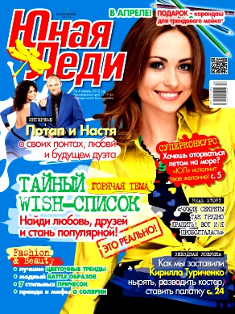
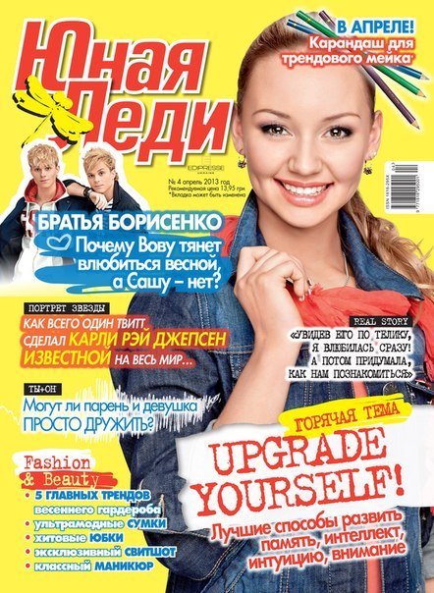
I want to tell you about magazines.
Today we have many newspapers, magazines and books.
Girls like to read news about fashion, handmade, music and films.
Boys like to read news about cars, new technology, games and sport.
But everyone has his favourite magazine and my favourite magazine is «Young lady».

Slide 3
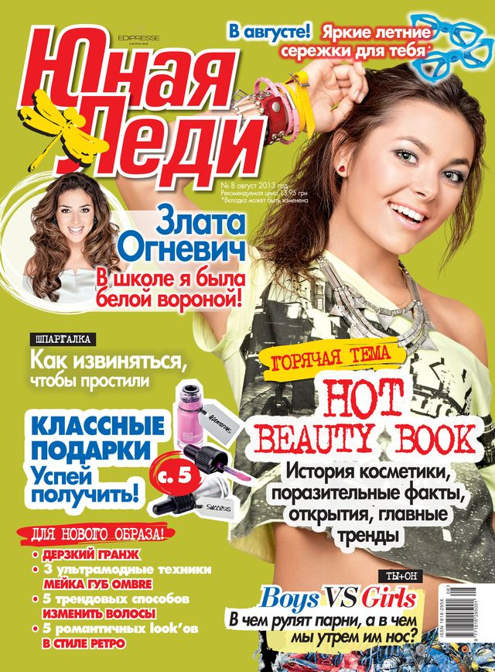
This magazine is about…
…about new trends, make-up, handmade, pop stars and celebrities, new technology, films, music etc.. There are many tests and story of ordinary people. And you can see a lots of advice about everything. In the end you can find crossword and horoscopes.

Slide 4
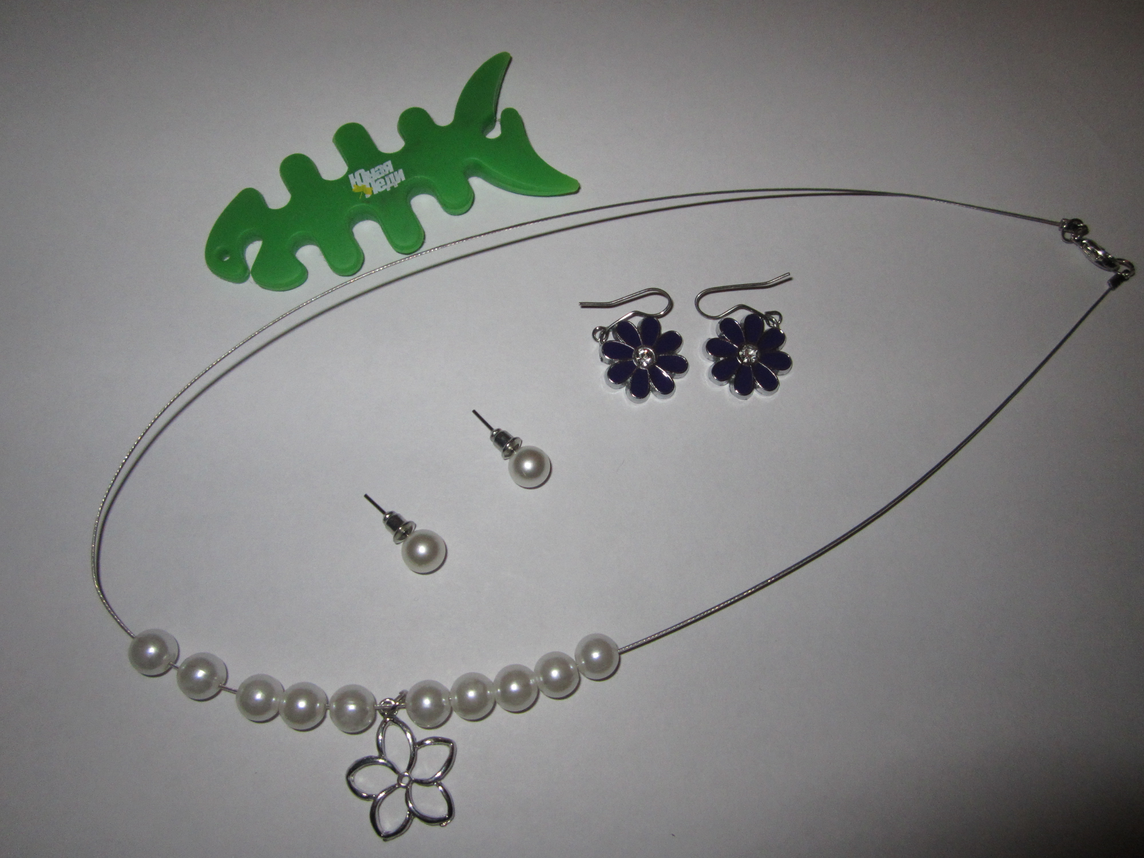
And
when you buy this magazine you can find little present: braslet, earrings or something like this.

Slide 5
I think…
… this text is very interesting and everyone has such favourite magazine.

Slide 6

Questions
Questions
What did I tell about?
What is the name of my favourite magazine?
What you can find in the end of the magazine?
What do I think about this text?

Slide 7


