Slide 1
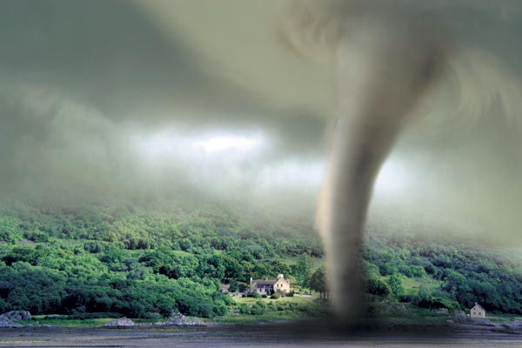
Natural disasters
Prepared
Vladyslav Suprun, 10-B

Slide 2
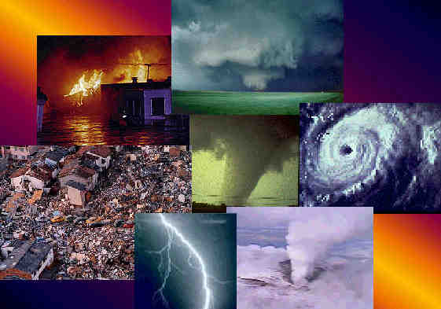
What is natural disaster?
A natural disaster is a major adverse event resulting from natural processes of the Earth.

Slide 3
Types
An avalanche
A drought
A typhoon
A volcanic eruption
A flood
A tsunami
An earthquake
A tornado
A famine
A landslide

Slide 4
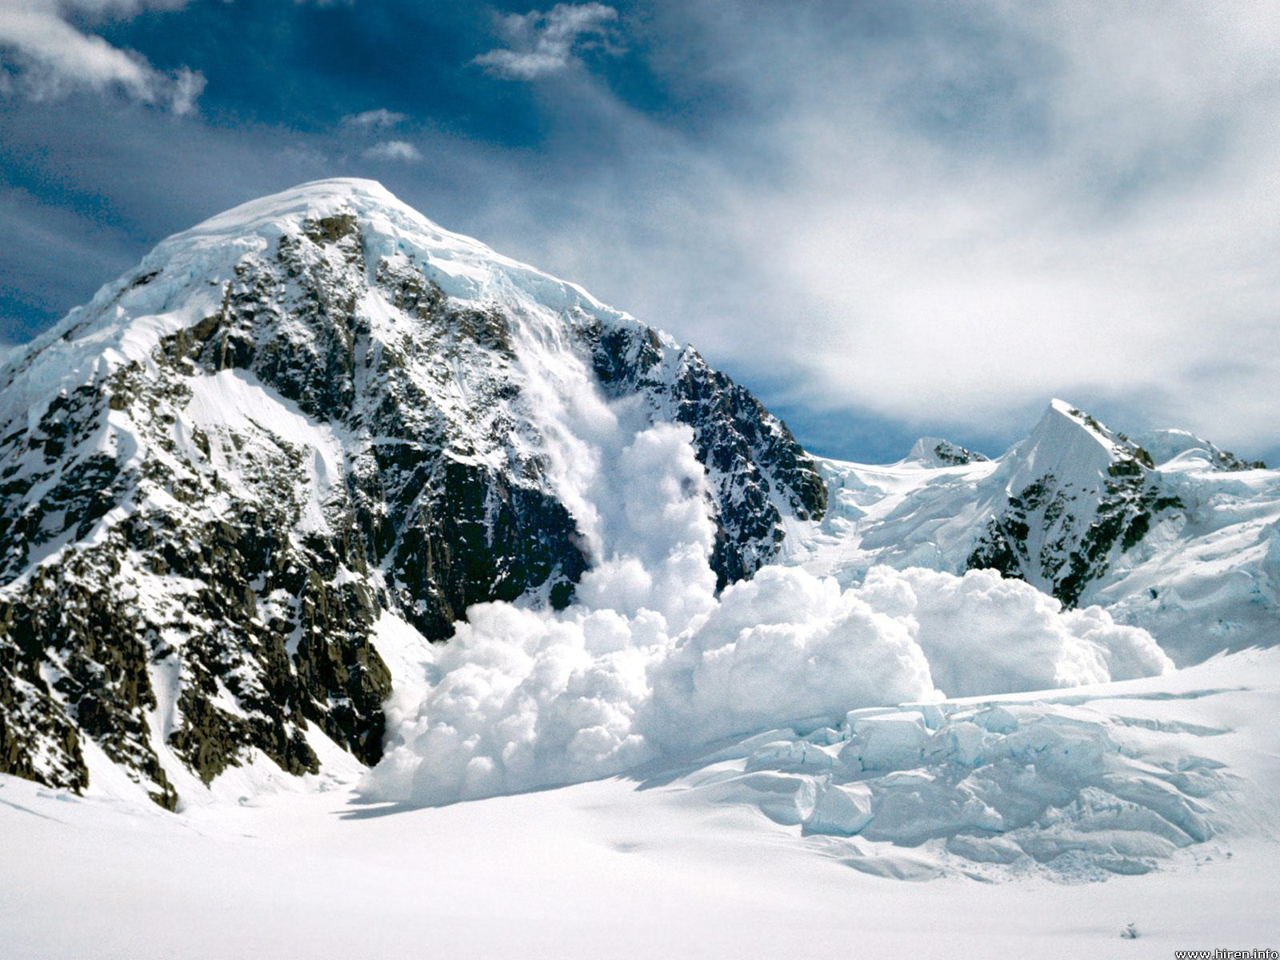
An avalanche

Slide 5
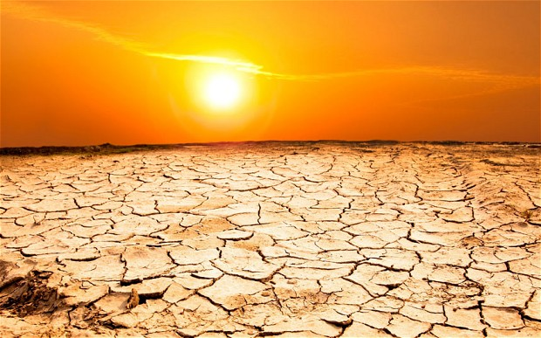
A drought

Slide 6
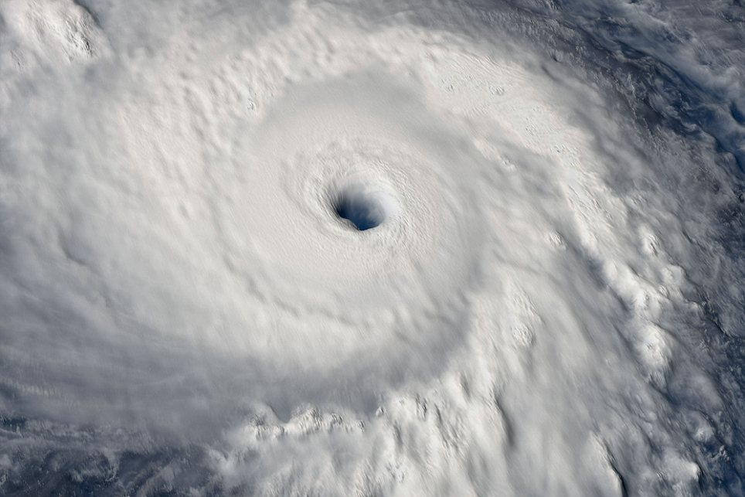
A typhoon

Slide 7
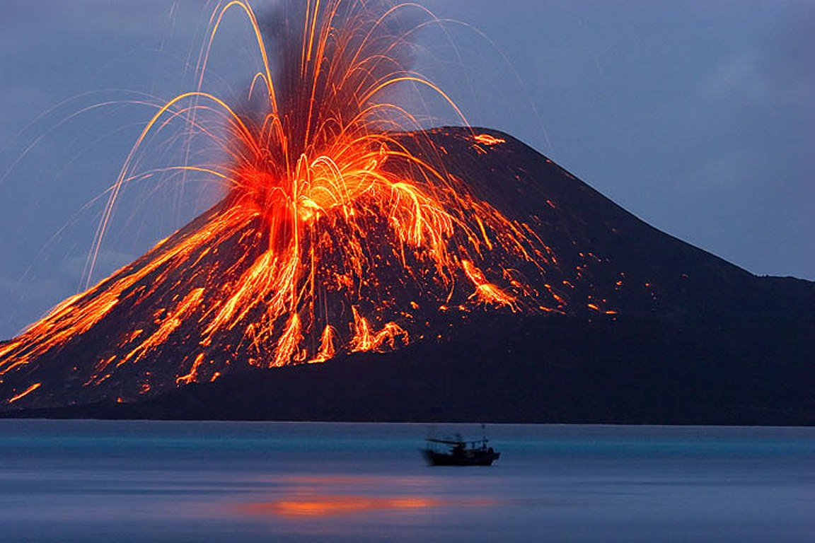
A volcanic eruption

Slide 8
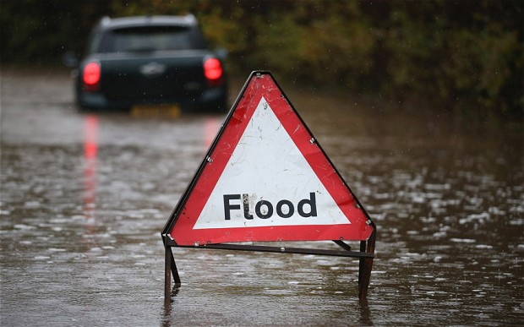
A flood

Slide 9
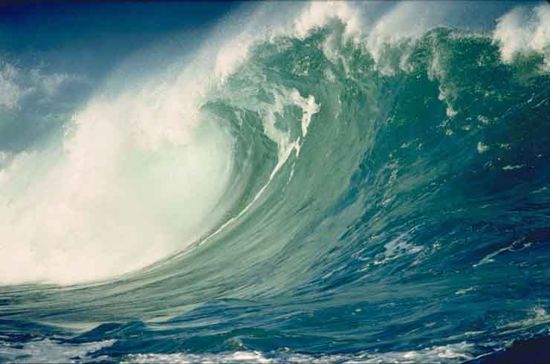
A tsunami

Slide 10
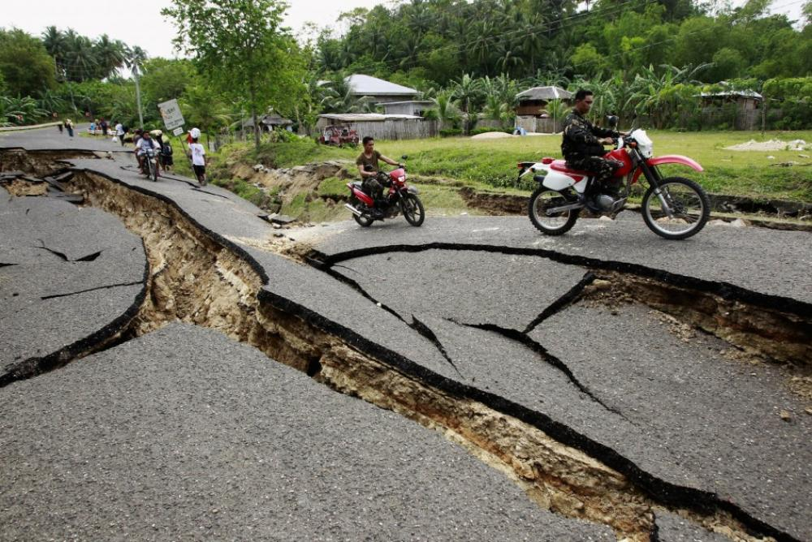
An earthquake

Slide 11
A tornado

Slide 12
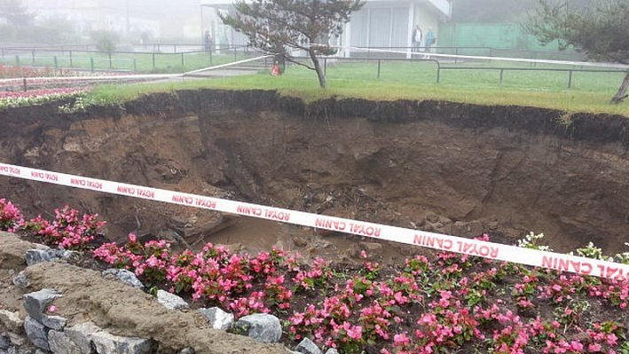
A landslide

Slide 13
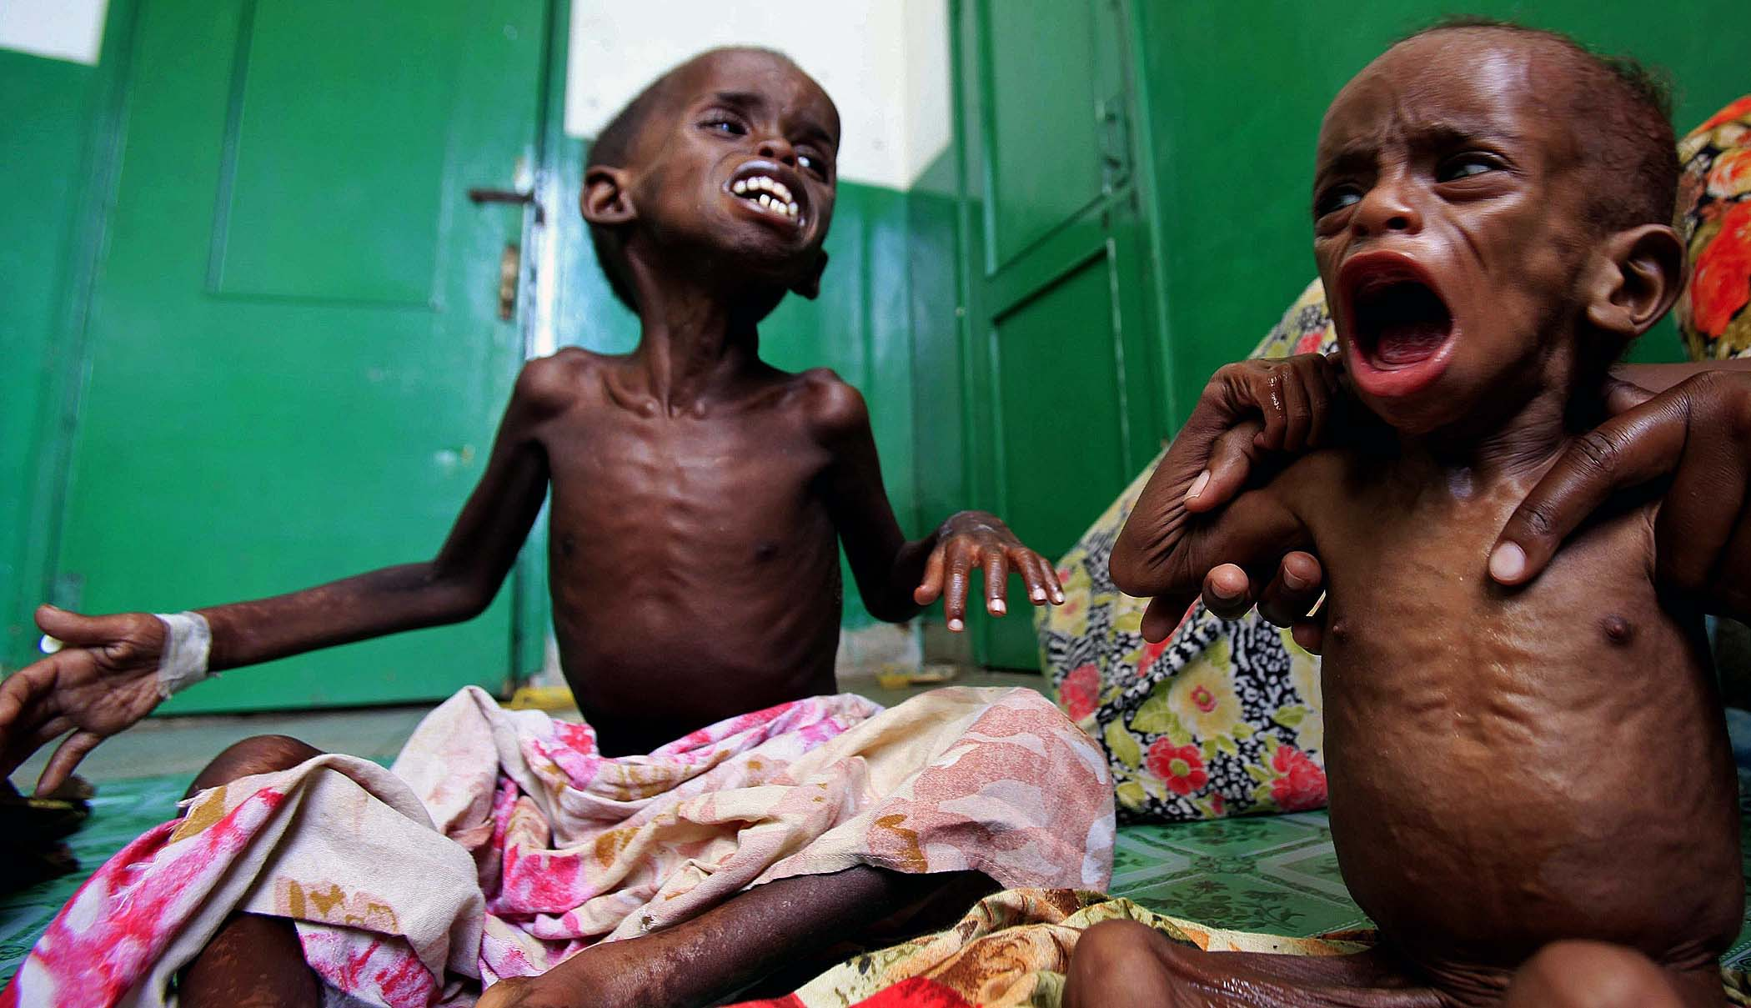
A famine

Slide 14
The costs of natural disasters — lives lost, homes
destroyed, economies disrupted... But there is reason for hope. By understanding how and where these natural events occur, we can build and live safely on the Earth, and by providing real-time information about floods, earthquakes, and other hazards, we can respond effectively when disaster strikes. We should build stronger, safer communities that are resistant to natural disasters.

Slide 15
Thank you for your attention!

