Slide 1
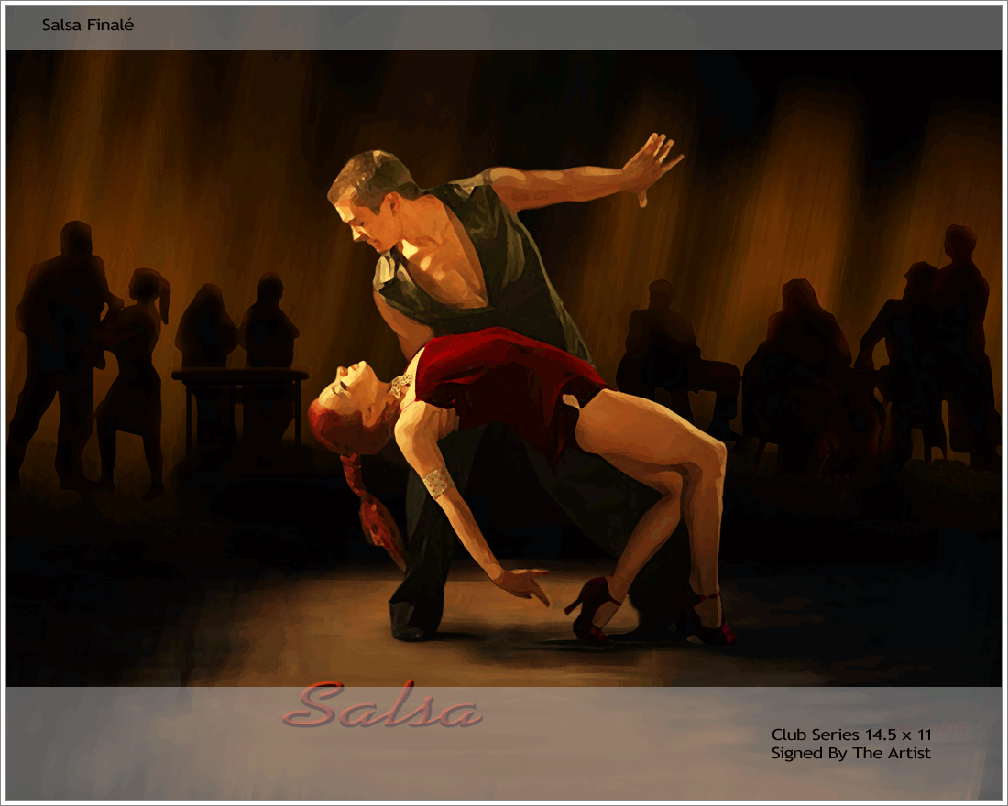

Rhythm of salsa

Slide 2

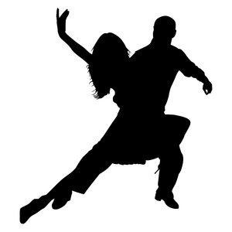
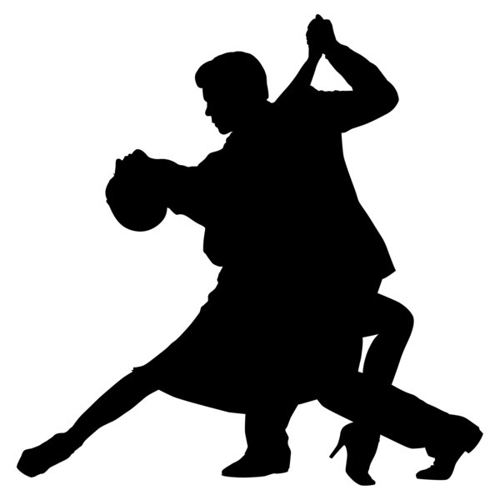
Salsa is a popular form of social dance that originated in New York with strong influences from Latin America, particularly Cuba and Puerto Rico. The movements of salsa have its origins in Cuban Son, Cha cha cha, Mambo and other dance forms, and the dance, along with the music, originated in the mid-1970s in New York. It is commonly danced to salsa music, although the steps can be danced to any type of music with an 8-count rhythm.

Slide 3
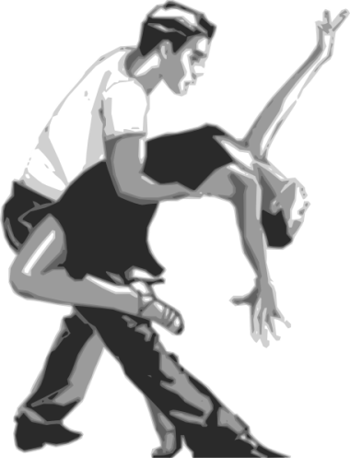
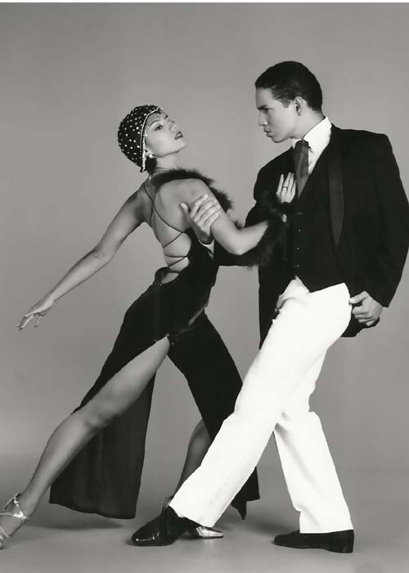

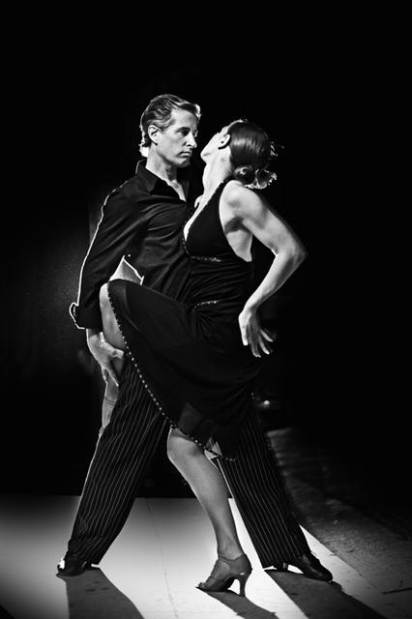
Salsa Dancing Locations
Salsa dance socials are commonly held in night clubs, bars, ballrooms, restaurants, and outside, especially if part of an outdoor festival. Salsa dancing is an international dance that can be found in most metropolitan cities in the world.

Slide 4
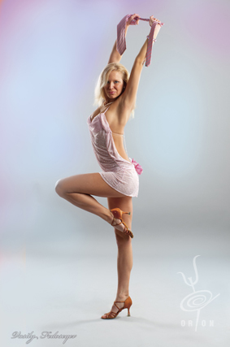


Salsa Dancing Styles
1.Colombian style
2. Cuban style
3. Miami style
4. Los-Angeles style
5. New York style

Slide 5
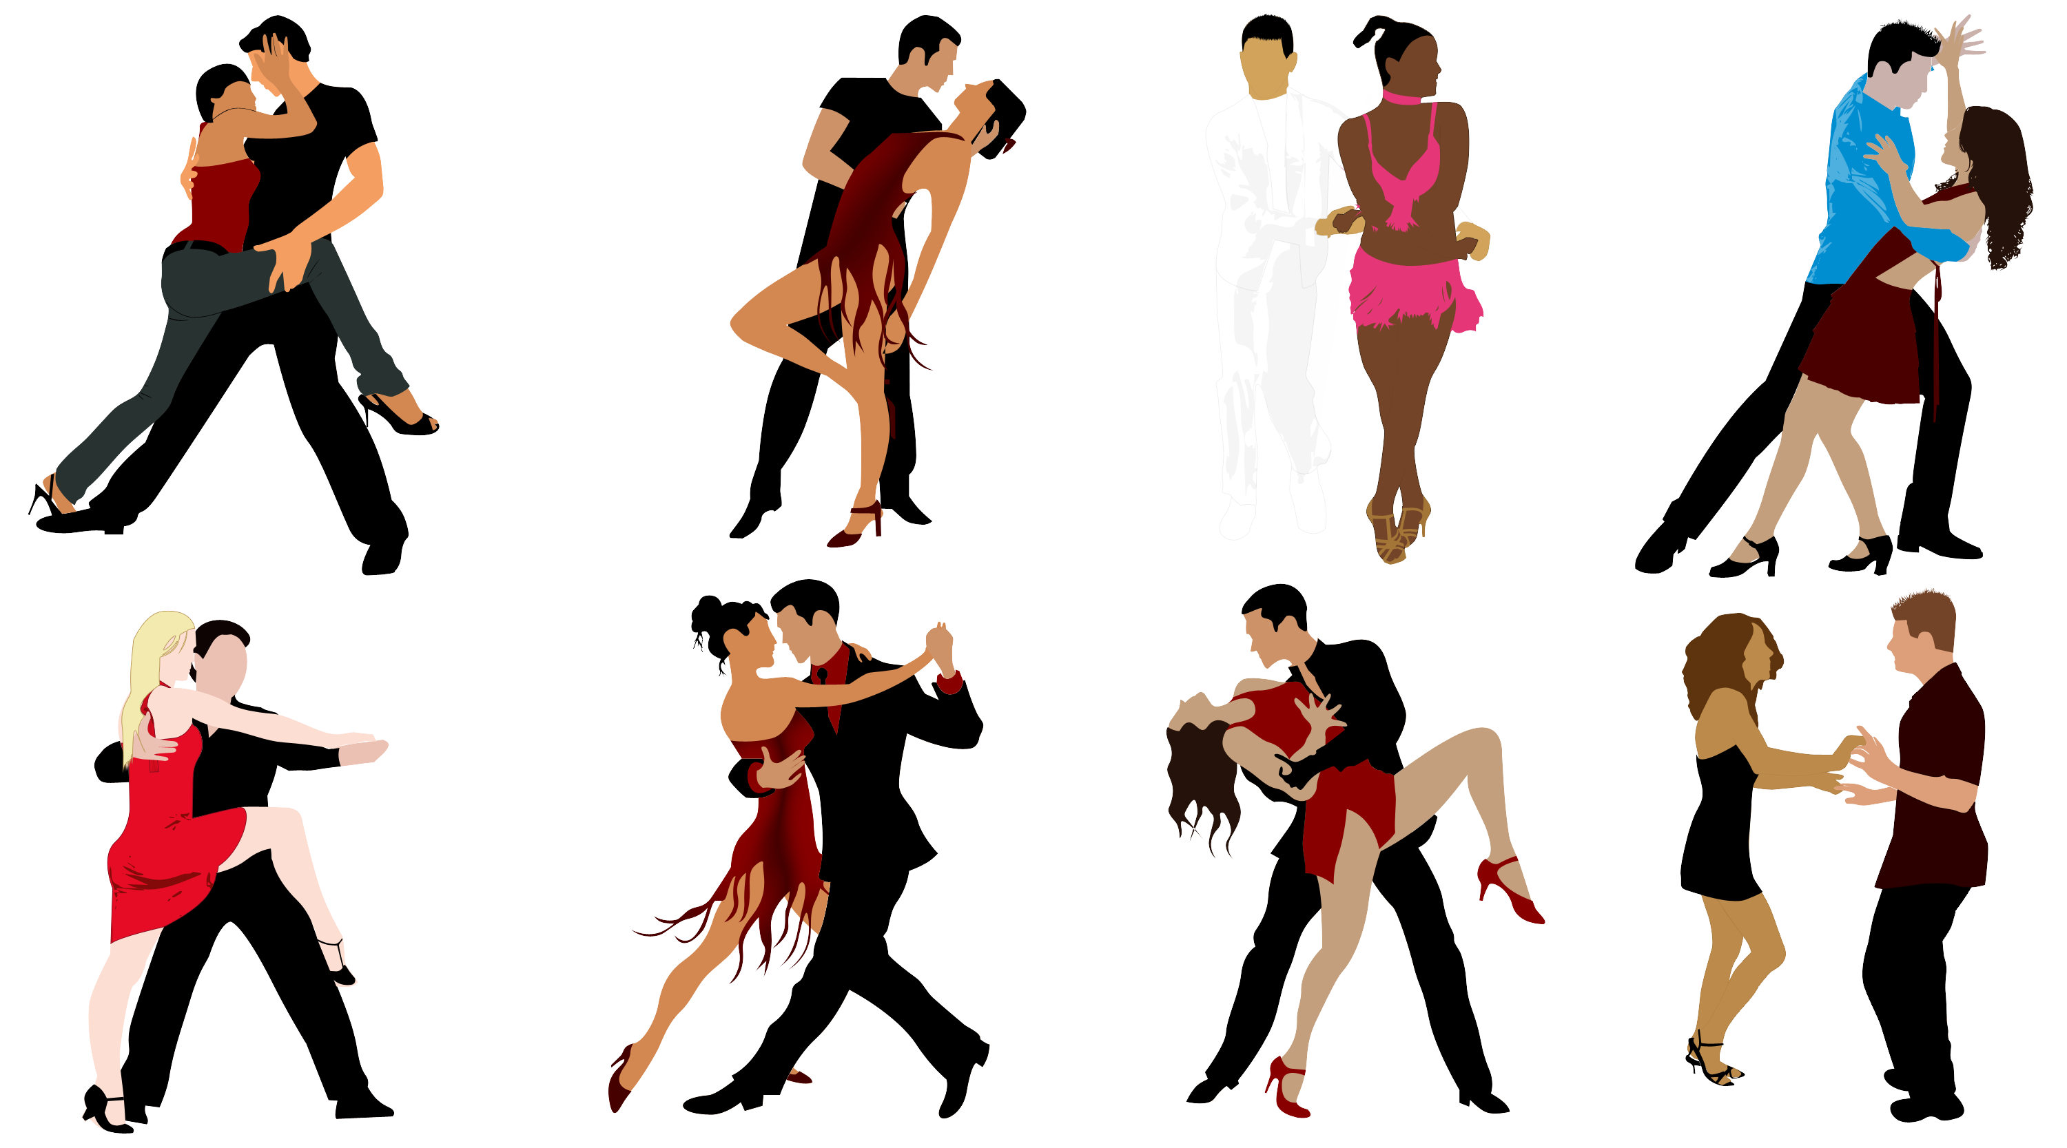
In many styles of salsa dancing, as a dancer changes weight by stepping, the upper body remains level and nearly unaffected by the weight changes. Weight shifts cause the hips to move. Arm and shoulder movements are also incorporated. The Cuban Casino style of salsa dancing involves significant movement above the waist, with up-and-down shoulder movements and shifting of the ribcage.

Slide 6

Thank you for attention

