Slide 1
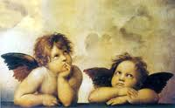
Fresco

Slide 2
History
Fresco is any of several related mural painting types, executed on plaster on walls, ceilings or any other type of flat surface. Frescoes first developed in the ancient world and continued to be popular through the Renaissance. Declining in popularity, they enjoyed something of a revival in the 20th century.

Slide 3
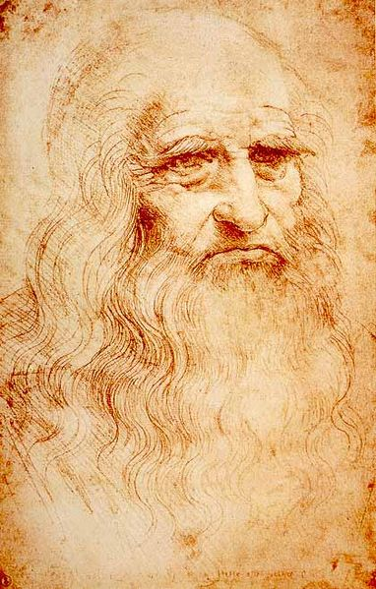
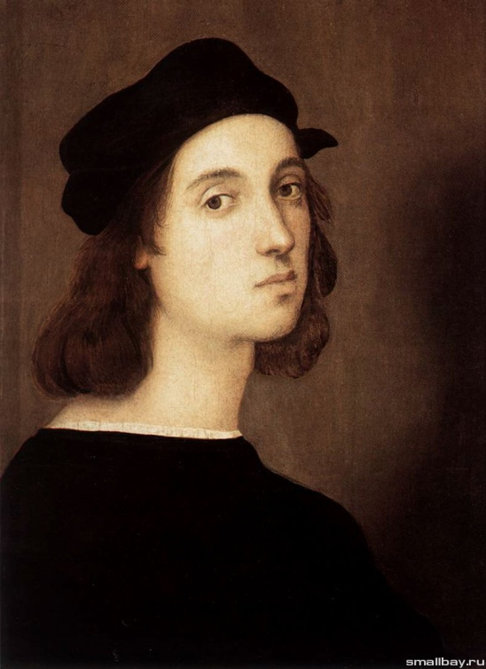
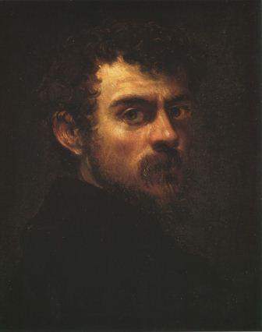
The most popular painters:
Michelangelo, Raphael, Vasari, Tintoretto, Luca Giordano and Giovanni Battista Tiepolo, Leonardo da Vinci ...

Slide 4
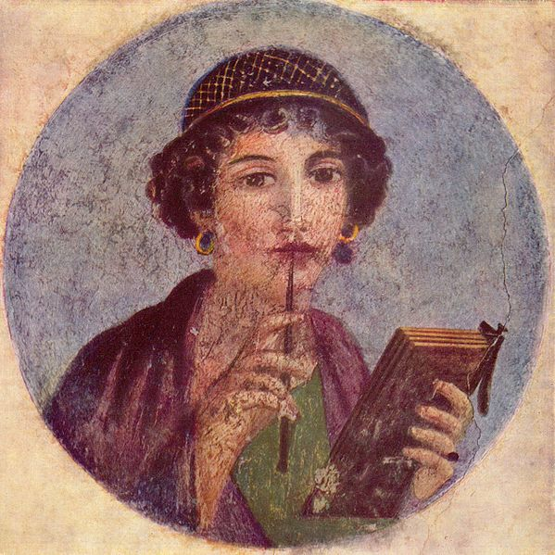
Fresco of "Sappho" from Pompeii.

Slide 5
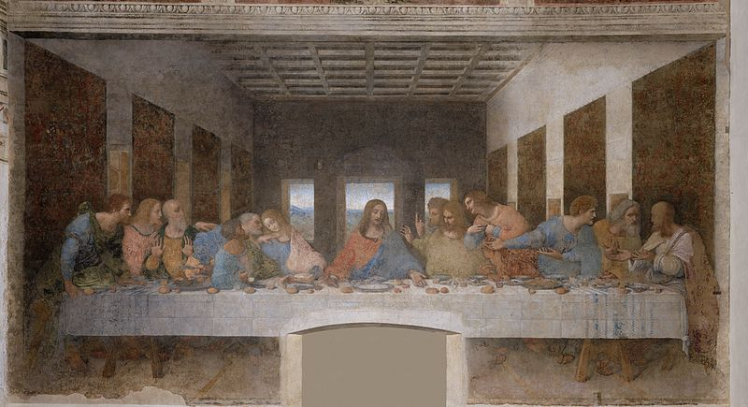
The Last Supper is a painting painted between 1496 to 1498 by Leonardo Da Vinci in the refectory of the Dominican convent of Santa Maria delle Grazie.

Slide 6
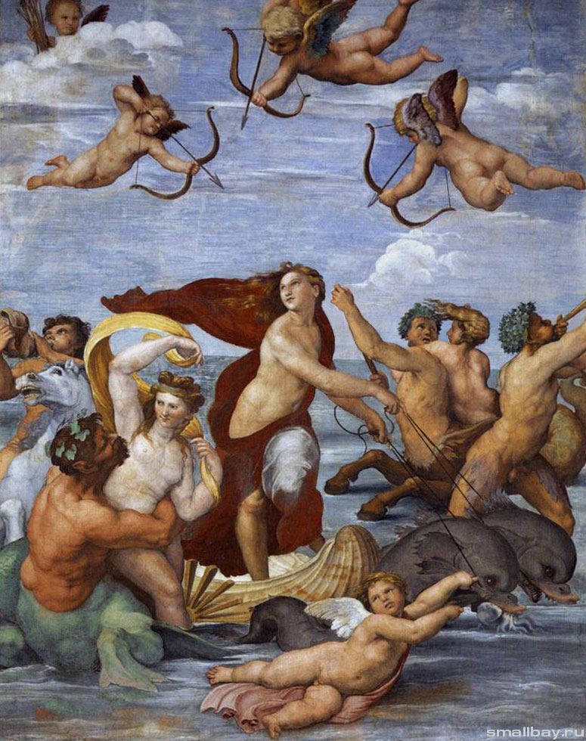
“Triumph of Galatea” Raphael

