Slide 1
The most dangerous jobs

Slide 2
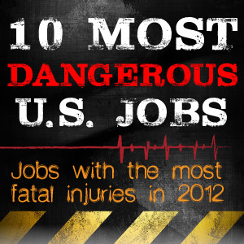
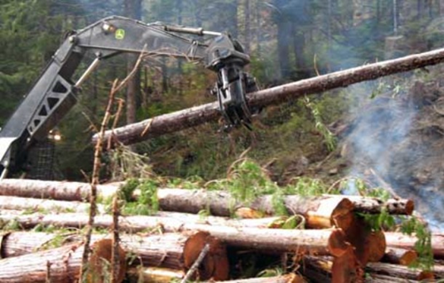
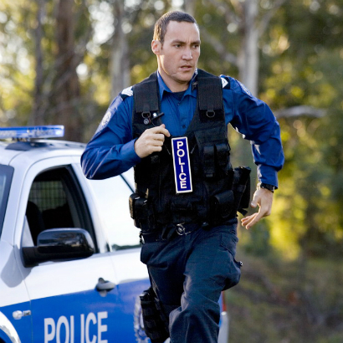
I think everyone knows about the professions such as a doctor, an economist, a nurse, and more, but do you know what the most dangerous profession, and what with a lower level of stress.
I asked my friends about it and they answered:
The most dangerous job:
Miner
Builder
Pilot
Driver
Forester
Police man
I want to give my list of the most dangerous jobs…

Slide 3
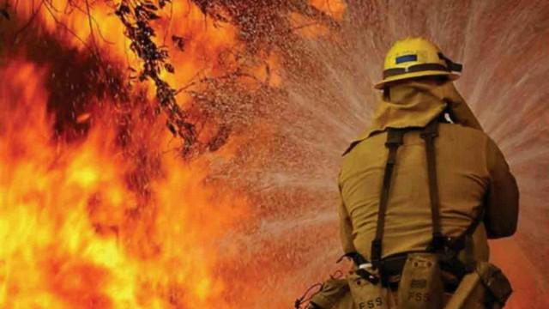
Firefighters
Risk of work:
Three categories:
1) physical
2) chemical
3) Psychological
According to experts, the most dangerous profession for mental health - a trade firefighter

Slide 4
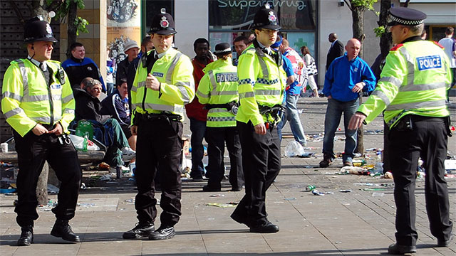
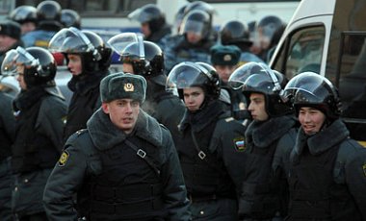
Police Officers
Unfortunately they are probably not the most popular public servants in many parts of the world, and yes, corruption is real…but some people really do put their lives on the line for others.
Risk of work:
1) Physical
2) Psychological

Slide 5
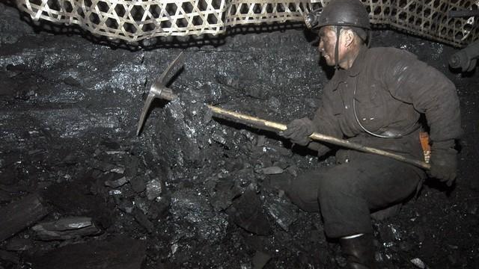
Miner
Risk of work:
Many years of work=poor health
Collapses in mines= Death or severe injuries
Psychological
P.S. Very small salary which does not correspond to risk

Slide 6
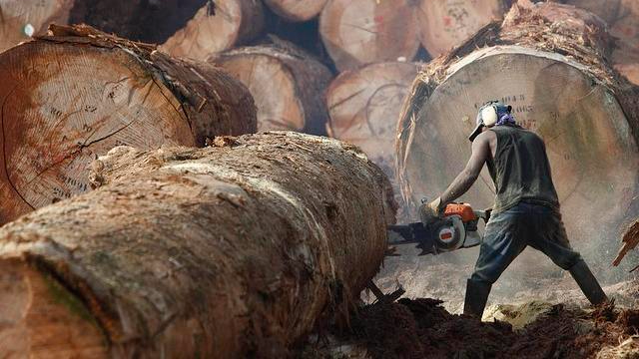
Lumberjack
Along with deep sea fishing, the logging industry is a long time source of workplace danger. Big trees, sharp saws, and hard hours are not a good mix.
Risk of work:
1) Physical
2) Psychological

Slide 7
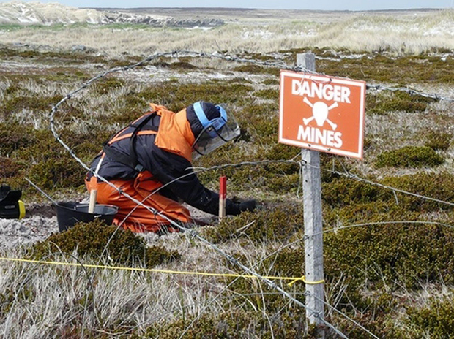
Sapper
In the period from 1996 to 2002 during demining activities have killed more than 500 people.
Risk of work:
1) Physical
2) Psychological

Slide 8
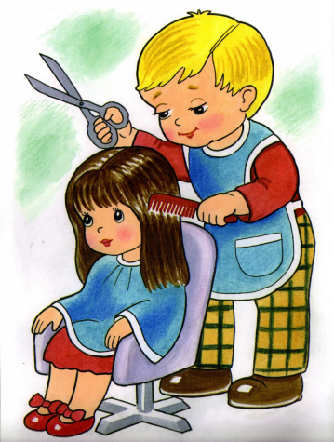
Also at the end I want to provide a list of the most calmest profession.
Web-programmer (100%)
Makeup artist (100%)
Cultural studies (100%)
Repairer-(100%)
Finance Manager (100%)
Baker (60%)
Masseur (50%)
Librarian (34%)
Hairdresser (33%)
Seamstress (29%)
Cook (28%)
An auto mechanic (25%)
Electricians (22%)
Confectioner (20%)
The Economist (17%)

Slide 9
Thank you for your attention!
Made by Bonk Veronika

