Slide 1
The best museums in the world

Slide 2
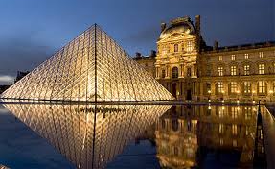
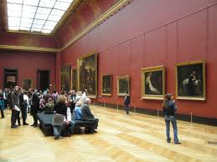
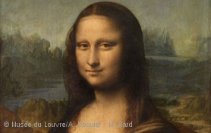
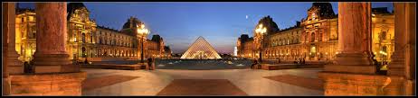
Louvre
1
The Louvre in Paris is one of the world’s largest and most visited art museums in the world. Its exhibits come from such diverse origins as ancient Egypt, classical Greece and Rome, medieval Europe and Napoleonic France. Its most famous exhibit, of course, is Leonardo da Vinci’s painting of the Mona Lisa.

Slide 3
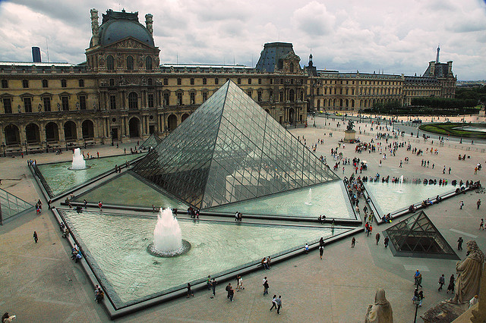

Slide 4
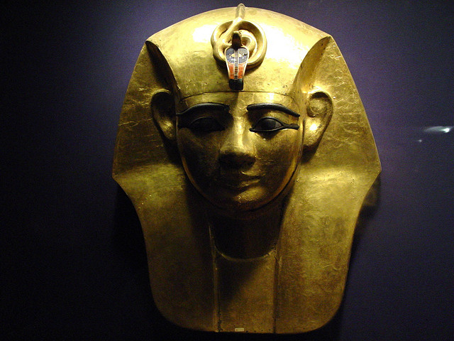
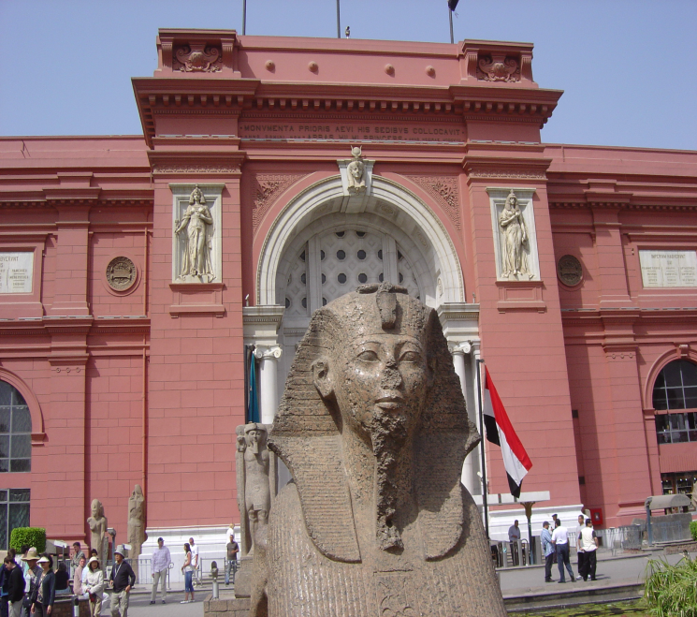
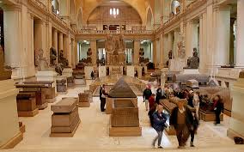
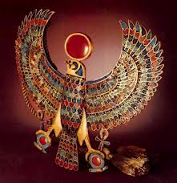
Egyptian Museum
2
Home to at least 120,000 items of ancient Egyptian antiquities, the Egyptian Museum in Cairo is one of the world’s best museums.

Slide 5
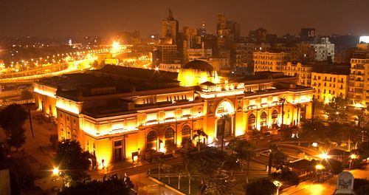

Slide 6
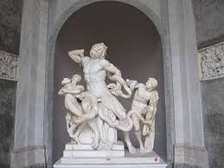
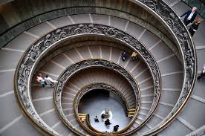
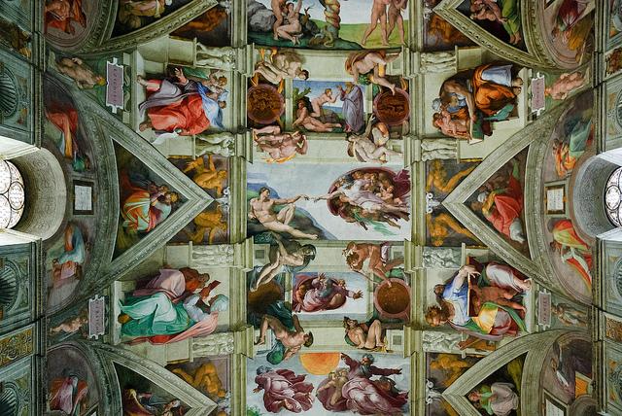
Vatican Museums
3
Founded by Pope Julius II in the 6th century, the Vatican Museums inside the Vatican City in Rome are among the best museums in the world. The museums are most famous for the spiral staircase, the Raphael Rooms and the exquisitely decorated Sistine Chapel. Under the patronage of Pope Julius II, Michelangelo painted the chapel.

Slide 7
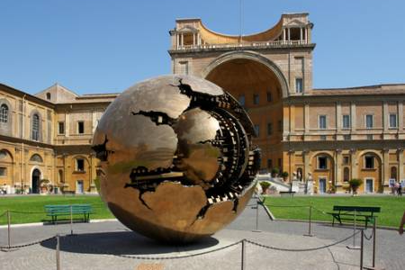

Slide 8
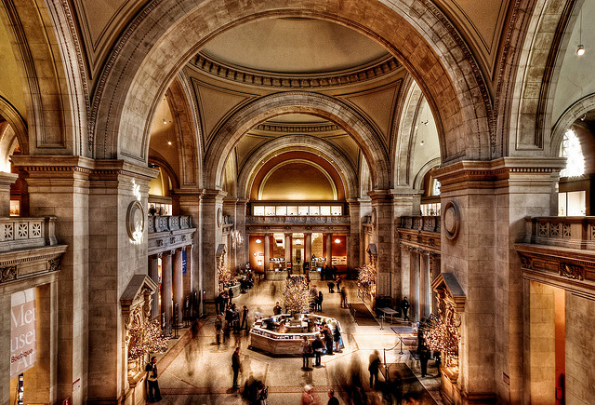
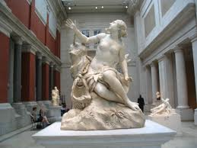
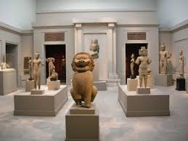
Metropolitan Museum of Art
4
The Metropolitan Museum of Art, also known as The Met, is an art museum located on the eastern edge of Central Park in New York City.

Slide 9


Slide 10
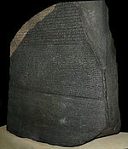
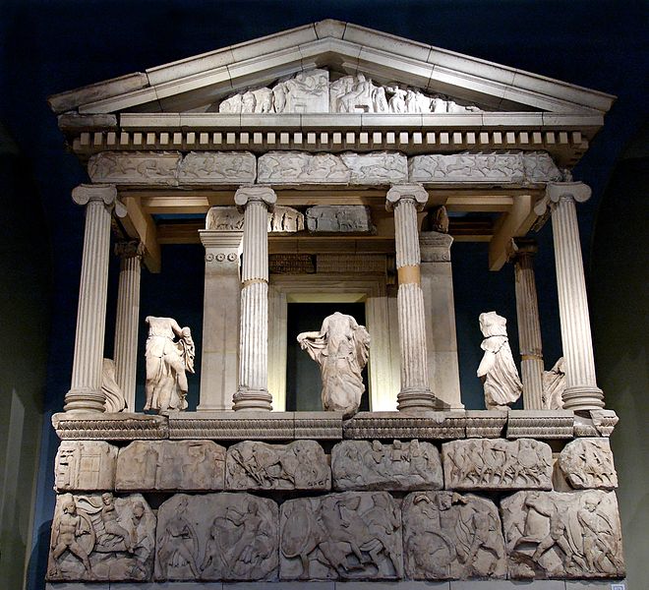
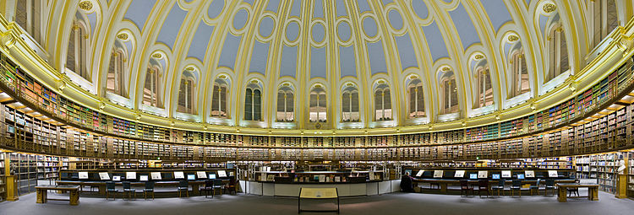
British Museum
5
Established in 1753, the British Museum in London is a museum of human history and culture. Its one of the top destinations in London.

Slide 11
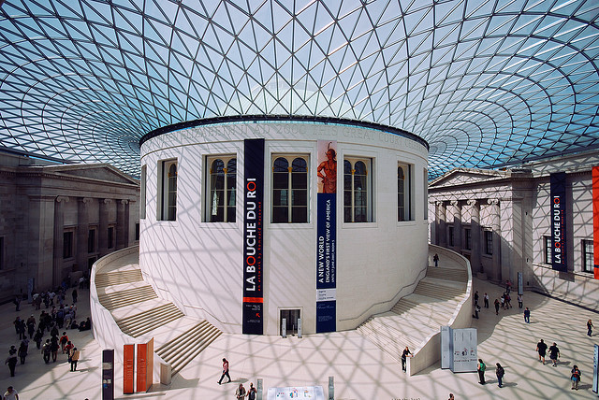

Slide 12
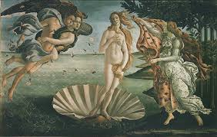
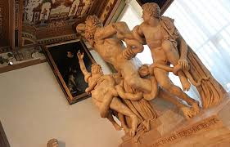
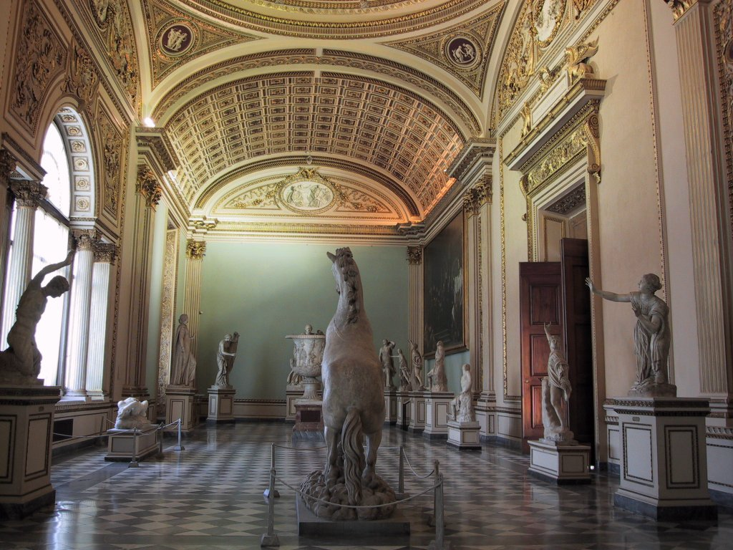
Uffizi Gallery
6
The Uffizi Gallery in Florence, Italy, is one of the oldest and most famous art museums in the world. It is housed in the Palazzo degli Uffizi which was constructed in the 16th century as the offices for the Florentine magistrates.

Slide 13
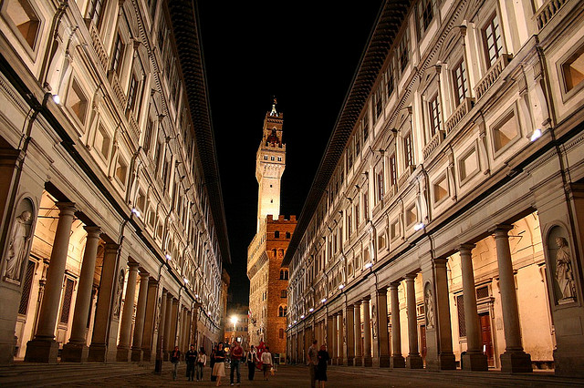

Slide 14
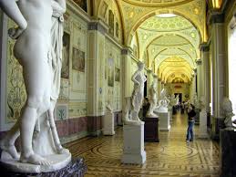
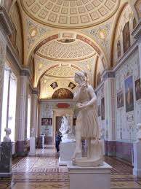
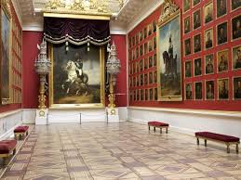
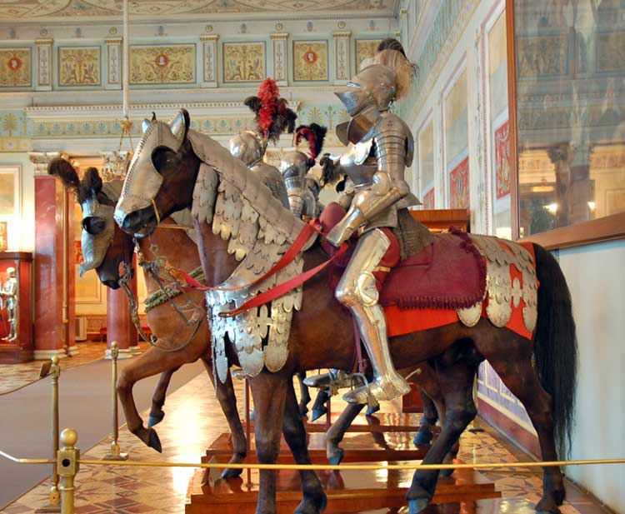
Hermitage Museum
7
Founded in 1764 by Catherine the Great, the Hermitage Museum in Saint Petersburg, Russia is a massive museum of art and culture showing the highlights of a collection of over 3 million items spanning the globe

Slide 15
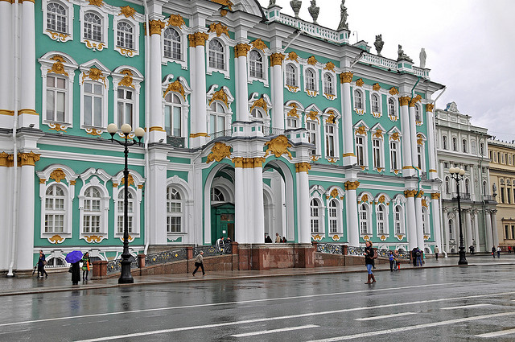

Slide 16

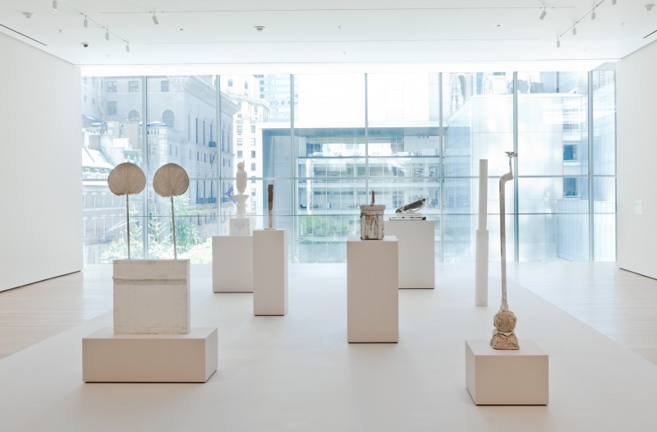
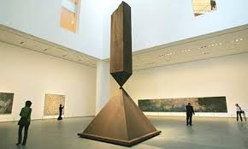

Museum of Modern Art
8
The Museum of Modern Art (MoMA), located in Midtown Manhattan in New York City, is often identified as the most influential museum of modern art in the world.

Slide 17
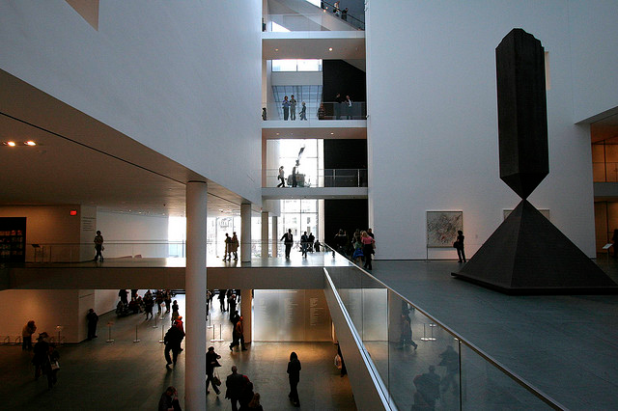

Slide 18
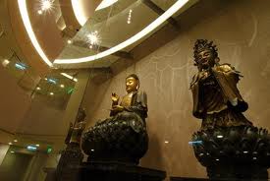
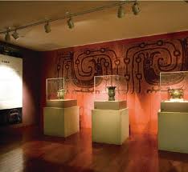
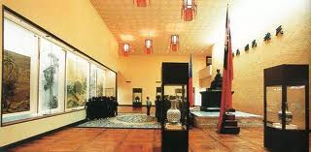
National Palace Museum
9
The National Palace Museum in Taipei has the largest collection of ancient Chinese artifacts and artworks in the world.

Slide 19


Slide 20
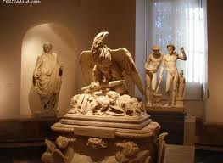

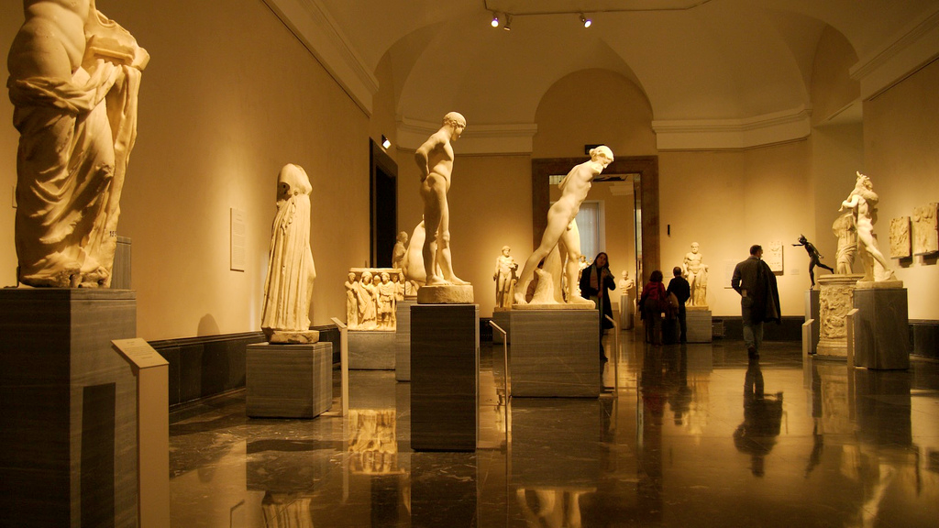
Prado Museum
10
One of the top museums in Spain, The Prado Museum in Madrid features some of the best collections of European art, from the 12th century to the early 19th century.

Slide 21
