Slide 1
Maleficent
Prepared
A student of 10th class

Slide 2
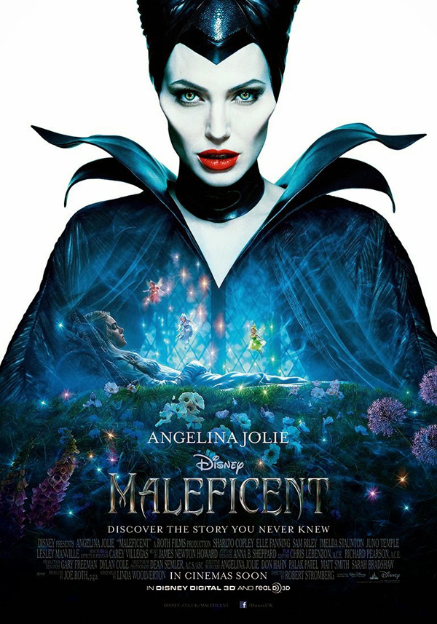
Fantasy fiction film directed
by Robert Stromberg at the studio "Walt Disney"
in 2014. The film is a remake of the Disney animated film in 1959 "Sleeping Beauty";
It outlines the story from the perspective of the evil fairy
Maleficent, played by American
actress Angelina Jolie. Also took part
In the film actors El Fanning, Sharlto Copley, Juno Temple, Sam Riley and others
in the U.S. Premiere of the film took
place on May 30, 2014. In Russia,
the film was released a day earlier,
May 29, 2014

Slide 3
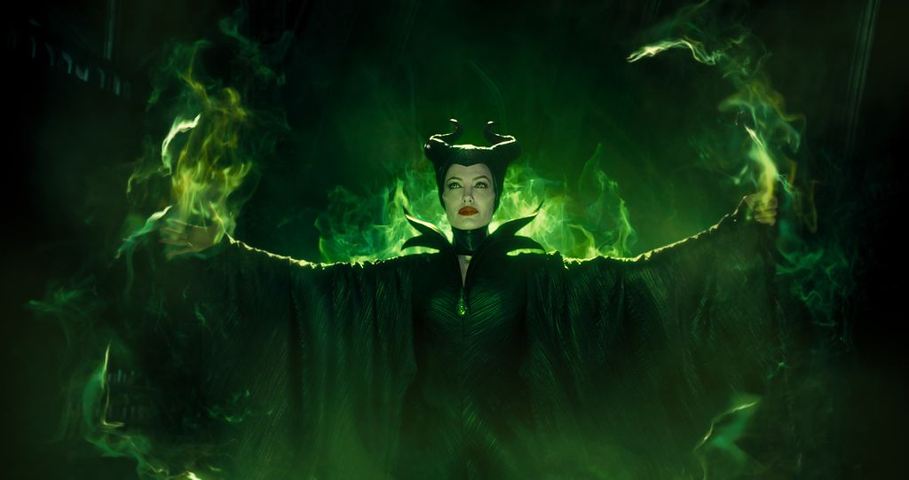
Story
Young sorceress Maleficent led their lives in an enchanted swamp, surrounded by fantastic creatures, but one day everything changed ... In her world invaded by people who brought destruction and chaos, and Maleficent had to defend his subjects, calling upon the powerful dark forces. In the heat of battle Maleficent imposed a terrible curse on the newborn king's daughter, the beautiful Aurora. But seeing how the little princess grows, Maleficent begins to doubt the correctness of his act - in fact, probably, Aurora can breathe new life into a magical forest kingdom.

Slide 4
Cast
Angelina Jolie - Maleficent
Ella Purnell - young Maleficent
Izobell Molloy - Maleficent in childhood
El Fanning - Aurora
Vivienne Jolie-Pitt - five year old Aurora
Eleanor Worthington Cox - eight-Aurora
Sharlto Copley - Stefan
Jackson Buse - young Stephen
Michael Higgins - Stefan childhood
Imelda Staunton - Notgrass
Lesley Manville - Flitl
Juno Temple - Fislvit
Sam Riley - Diaval
Brenton Tueytes - Philip
New Hannah - Leila
Kenneth Krenhem - King Henry

Slide 5
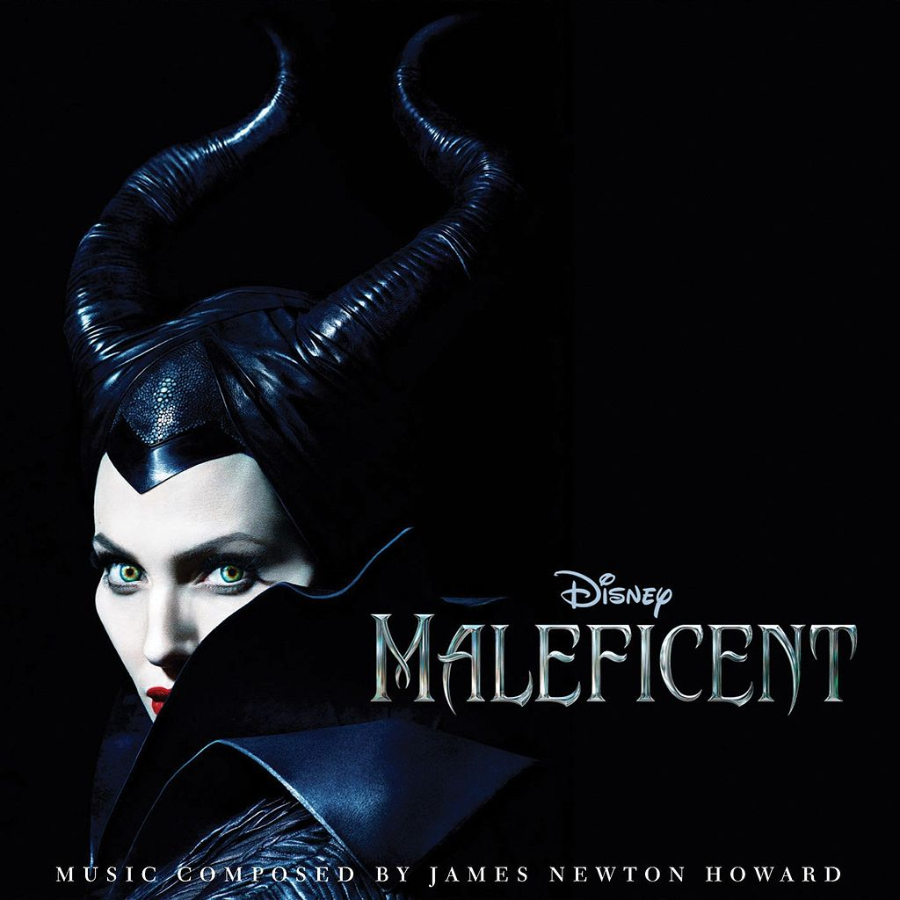
Music
Musical score for the film "Maleficent" was written by American composer James Newton Howard. The official soundtrack was released on May 27, 2014. January 23, 2014 it was announced that singer Lana Del Rey record a cover version of the song «Once Upon a Dream» from the original cartoon in 1959 as the main soundtrack. Lana Del Rey was chosen singer song itself Angelina Jolie. The single was released on January 26.

Slide 6
Critical reaction
The film received mostly positive reviews from critics. Robbie Collin of Publishing «The Telegraph» wrote in his review that "a new interpretation of Sleeping Beauty lacks true charm, but Angelina Jolie save the situation." Some Russian bloggers visited the preview screening, also expressed positive feedback. At the same time it was suggested that the film "a mile redolent of radical feminism on the verge muzhenenavistnichestva. The presence of women in the life of the main characters carries either destructive or neutral useless character ", and that" talk about the lesbian subtext of the film, even in an environment far removed from the religious fanaticism of the materialists can not be avoided. "
In Russia, the film received mostly positive reviews. Correspondent Denis Korsakov from the newspaper "Komsomolskaya Pravda" in his review wrote, "that" Maleficent "- a great tale, maybe the best Hollywood fairy tale, which appeared on the screens for many years." Radio commentator "Vesti FM" Anton Dolin wrote, "that the film contains heretical dualism that conceals all the obvious disadvantages and makes the film, if not absolutely a success, but it is certainly very interesting and like nothing on earth." Sergei Obolonkov columnist of the magazine «The Hollywood Reporter» in his review described "" Maleficent "fairy tale that despite the wrenching story, quite capable not only of interest to young viewers, but also evoke a certain curiosity among their parents."

Slide 7
Did you know that ...
May 12, 2009 it was reported that Brad Bird engaged in the project, based on the Walt Disney animated film "Sleeping Beauty" (1959), whose history is retold on behalf of Maleficent with Angelina Jolie as Maleficent itself. In January 2010 it was reported that Tim Burton may be the director of this project. In May 2011, it became clear that Burton left the project. Disney studio began to look for a replacement, and a potential candidate was David Yates. January 6, 2012 Disney studio has officially announced that the project will be directed by Robert Stromberg.
Angelina Jolie said she grew up on cartoons studio Disney, and especially liked her "Sleeping Beauty" (1959). She also said that the character Maleficent always bring her in horror, but still admired.
This is the first Disney movie to many actors, including Angelina Jolie, Imelda Staunton, Sharlto Copley, Brenton Tueytes, Juno Temple, as well as writer Paul Dini, Miranda Richardson and Elle Fanning.
Initially, the movie director was supposed to be Tim Burton.

Slide 8
Angelina Jolie has admitted that in the makeup and costume looked so intimidating that outright frightened children on the set. One child even said, "Mom, please, ask this wicked witch is not talking to me." One only daughter Jolie, Vivienne Jolie-Pitt, who plays the role of Princess Aurora in infancy was not scared.
Jude Law was considered for the role of King Stephen.
Operator "Maleficent" became Dean Semler, who filmed directing Angelina Jolie's "In the Land of Blood and Honey" (2011).
In the role of a little princess Aurora starred Vivienne Jolie-Pitt, daughter of Angelina Jolie and Brad Pitt.
The film is the directorial debut of Robert Stromberg.
Angelina Jolie has worked with costume designers and makeup artists to create a formidable form Maleficent. Disney studio executives objected, hoping to take advantage of the beauty of Jolie for marketing purposes, but the actress insisted that her character must save frightening features Maleficent from the cartoon "The Sleeping Beauty" (1959).

Slide 9
Emma Thompson and Judi Dench were considered on the role of fairies.
Logan Marshall-Green, George Blagden, Gael Garcia Bernal and Jim Sturgess considered for the role, which eventually went to Sam Riley.
"Maleficent" (2014) - the first live-action film for Paul Dini in his career writer.
Shortly before the death of Richard D. Zanuck offered him to become a producer of this film.
Patrick Stewart could get a role in this film.
For 400 years, the tale of Sleeping Beauty paraphrased under different names around 1000, if you include some medieval beliefs. Easy to trace the evolution of the character. Her features veiled in the French prose romances unknown author "Perseforest" 1527, and in the tale of the Italian writer Giambattista Basile, entitled "The sun, moon and Talia," which was included in a collection of "Tale of Tales" ("Pentameron"). The chapters in this collection are the first printed stories. In 1697 his version of history offered by Charles Perrault in his book "Tales of Mother Goose" - it was called "The Beauty sleeping in the woods." In 1812, the brothers Grimm, Wilhelm and Jacob Grimm substantially reworked plot Perrault. Story of the beautiful princess who fell victim of evil spells, called "Shipovnichek." Why Maleficent began to become the personification of the female incarnation of absolute evil is now difficult to establish. The tale describes Basile queen jealous and vengeful villain, but she was married to the King, and not had a witch who cast a spell on the entire royal family. Perrault turned villain in the evil witch, this version of the story is the closest classic film Disney. In addition, Perrault introduced readers tale Prince Charming. New hero became important, and perhaps essential element tales - because only his kiss could remove evil spells from Sleeping Beauty.

Slide 10
Filming began June 11, 2012 on the famous British studio Pinewood Studios. Most of the picture was filmed on the grounds of the studio. For five months crew "invaded" six pavilions, several square kilometers of field sites, as well as some other production areas.
One of the survey sites became an ancient castle - exactly recreated, both inside and outside, a copy of the majestic buildings that Disney animators drew in 1959. Sex in the castle lined with marble. In the original animated film Castle combines several architectural styles. The creators of the film "Maleficent" (2014) could not afford it, because modern audience would not believe in the existence of the castle, which would combine Victorian, Gothic and Romanesque styles of architecture. They had to stop the choice on one style and stick to it afterwards. It was also a hybrid, but a much more logical: a kind of Prague Romanesque style with clear lines. Also suspended were invented support, linking all the rooms of the castle and become a connecting link.
In total for the film was over 2,000 costumes sewn by hand literally.
According to producer Joe Roth, they would not have to make a film, if Angelina Jolie refused to play a major role.

Slide 11
Review
Tales are different - good and evil, friendship and enmity, love and betrayal. But almost every fairy tale is always uniquely accents - each character takes the side or good or evil. Therefore, as a child, everything seems easier - no halftone, only black and white.
The evil witch has always been evil. Princess - lovely. Evil will be defeated, and the love story end wedding. That's why grown-up children and often angers the obvious absurdity lies - tales lie! And if they do not, something back. Why, tell me, was the evil witch? And if it is so, then why the princess left a chance for salvation, and not one fell swoop destroyed her and the entire kingdom?
In this regard, "Maleficent" - a wonderful tale! The authors were, so to speak, into the stream. In a world where heroes are tired of ideal and slowly began to turn them villains appeared, finally, psychologically realistic characters - not overdone hero, not exaggerated scoundrel, but absolutely real and it is humanly understandable. Though topped two horns and wings on his back.

Slide 12
Watch is not only adults who want magic, but do not want makeweight in the form of sugary fairy deception. It must be shown and children - not all the evil that it seems. All is not gold that glitters. When they are ready, of course. It is very healthy and proper history of the formation of friendship, love and greatness.
Well, Jolie - certainly this role it! Even with the sharp cheekbones makeup and other attributes it looks natural. Awesome beauty, I would say. Frightening and beautiful.
Thank you for your attention!

