Slide 1
Folk remedies for common illnesses

Slide 2
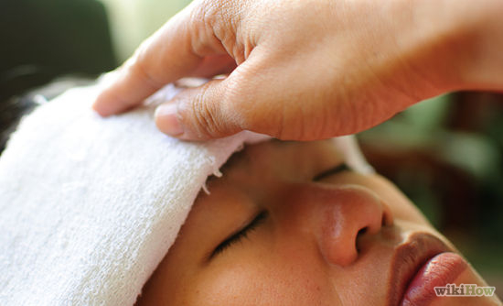
Treating headaches
Attachment to the forehead headbands with slices of raw potato, fresh cut cabbage leaves.
Also can help fresh blackcurrant juice.
Applied to the temples large copper coins.
Head massage.

Slide 3
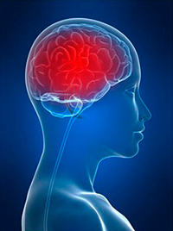
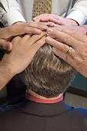
Rituals of headaches
Rituals can be read as a patient, and the means which it will accept (oil, water, etc.). Sometimes it is the last resort, when everything has been tried! The patient must believe in the effectiveness of this method.

Slide 4
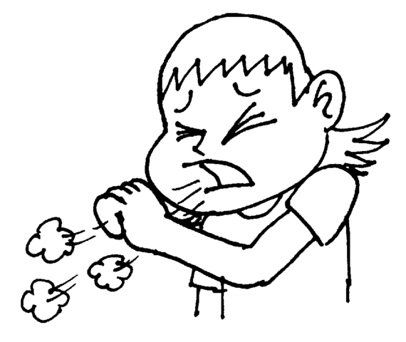

Treatment for cough
Good medical effect have leaves and roots of plantain . It is necessary to prepare a decoction on a water bath for rinsing and use up to ten times per day.
It is necessary to rub the chest warm sunflower oil, cover a woolen scarf and put a heating pad on top. For 2-3 times cough will pass.
Under a blanket you must breathe aroma of fresh onions for 15 minutes.

Slide 5


Extreme treatments for running nose
Bury your nose clean onion or garlic juice - unpleasant, but incredibly effectively.
Compress of gauze , soaked in kerosene and position as insoles in warm woolen socks.
Treatment with hydrogen peroxide - the dosage is important, and reaction of each organism is also very important.

Slide 6

Treatment of dental pain
Applied to the sick tooth pieces of raw beets.
Chewing the root, stem or leaf of plantain
From the side of the sick tooth in the ear you must put root of plantain and keep it there until the disappearance of pain.

Slide 7
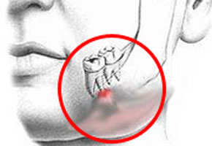
4) Pressure on the carotid artery under the lower jaw of the patient on the side of the tooth. Keep up the pain calming down.
5) Mix equal amounts of salt, onion and garlic. The resulting slurry was put on the aching tooth, covering the top with cotton for 10-15 minutes.

Slide 8

Treatment of injuries
Apply to the affected area sliced ​​potatoes.
Boil 500 g white beans, mash well and apply 1-2 times on bruised place.
Dab to the affected area viper fat.
Recommended to put fresh cabbage leaves to the affected area 1-2 times a day.

Slide 9
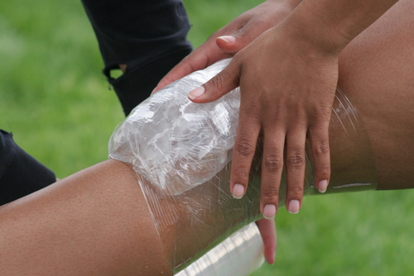
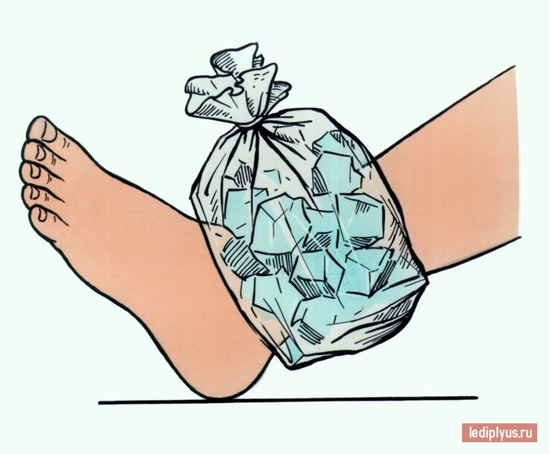
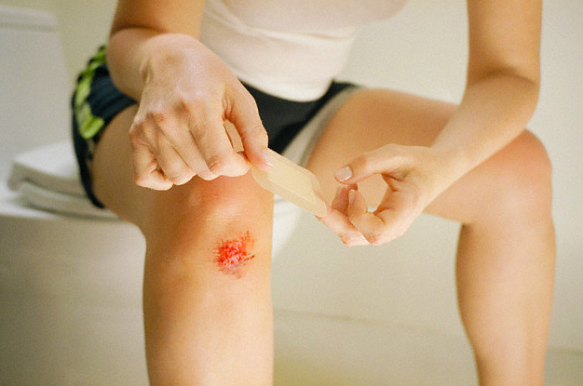

Slide 10
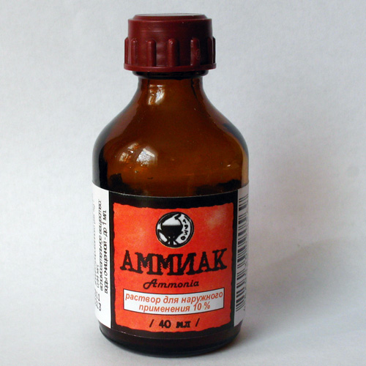
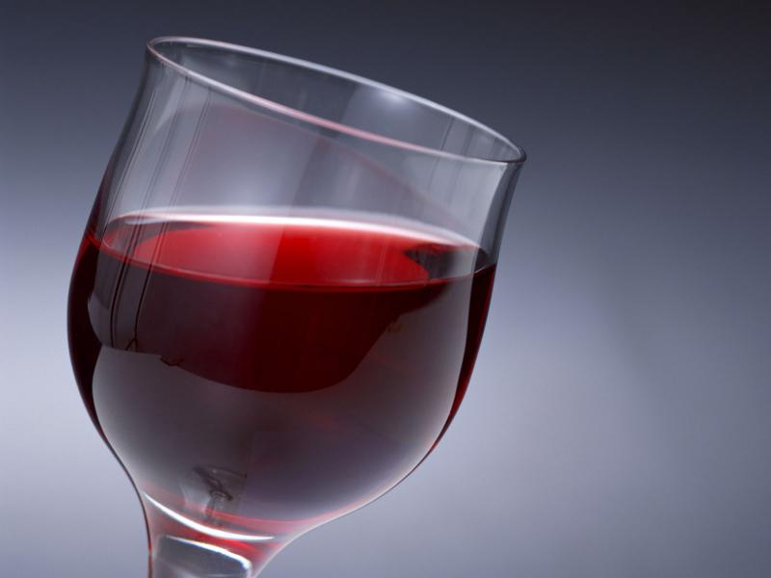
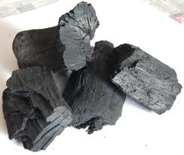
The main antidote for poisoning
Ammonia - against alcohol, bitter almonds, hydrocyanic acid.
Wine - against harmful fumes and poisonous mushrooms.
Charcoal - against the rotten fish, tainted meat, poisonous mushrooms, poisonous shellfish, acids.

Slide 11
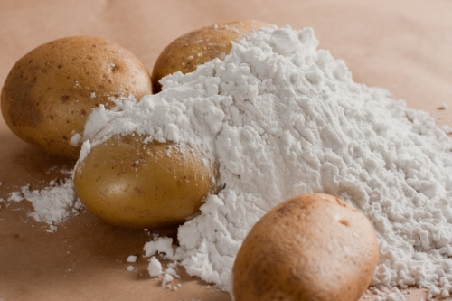
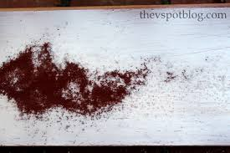
Iron rust - against arsenic.
Starch - against poisoning of iodine preparations
Magnesia - against acids.

