Slide 1
My Future Profession

Slide 2
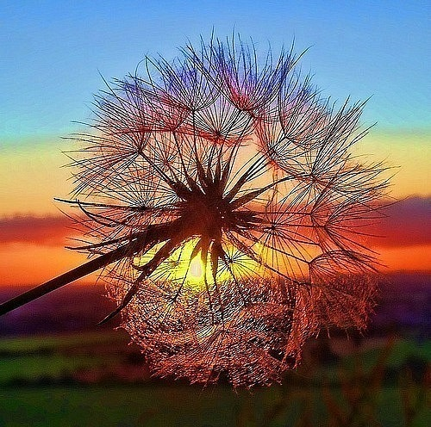
FUTURE?
I decided to be a journalist. I think
it is an interesting and useful profession.

Slide 3

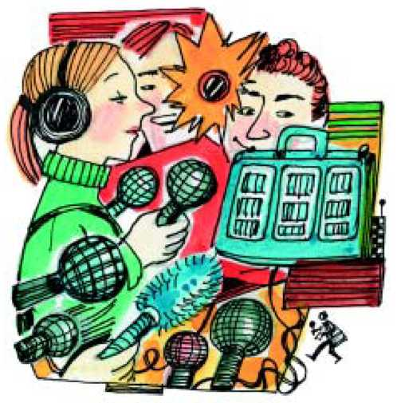
I like to watch TV, listen to the radio, read newspapers and magazines.
I like everything which connected with mass media.

Slide 4
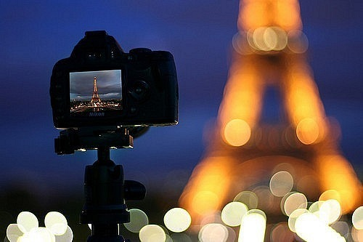
I like the profession of a journalist.
They meet many people. They try to
understand what is going on in the
world, or the country, or the city and
try to explain it to other people.

Slide 5
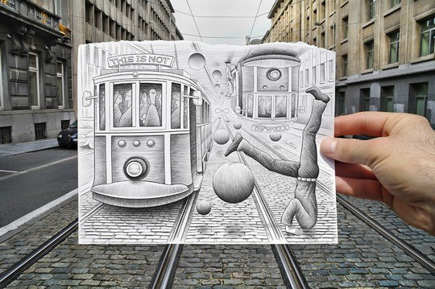
I think that the work of a journalist is very much like that of historian. A historian studies and tries to explain events of the past and a journalist does the same about the present.
But for me to be a journalist is much more interesting than to be a historian because you deal with real events that are happening right now so you can even influence them.

Slide 6
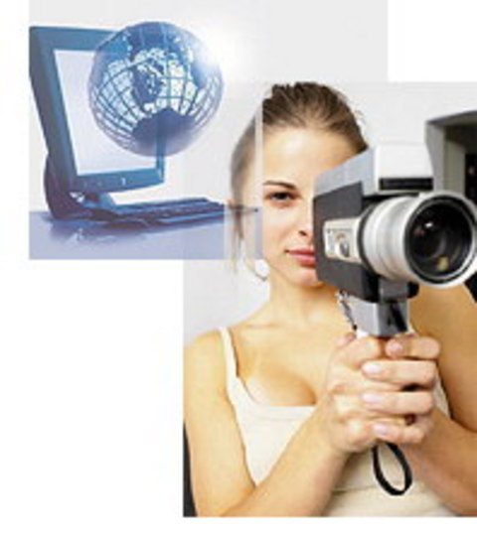
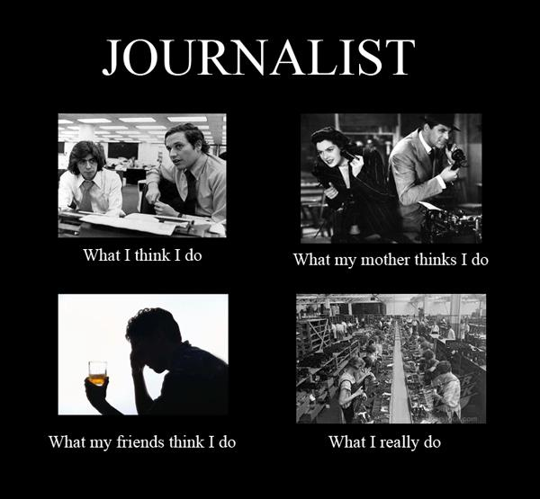
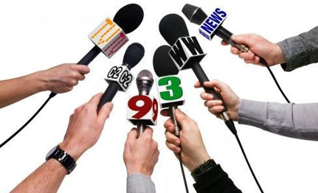
So journalists can influence the history. That is why I want to be a journalist.

