Slide 1
Summer holidays
by Katerina Zagorodnya
Olya Korneeva

Slide 2
Introduction
We’d like to tell you about our last summer holidays.
We always very much wait to the summer season.
Long before the beginning of the summer we planned how we spend it.
Summer is a wonderful time, when all possibilities are open to us.

Slide 3
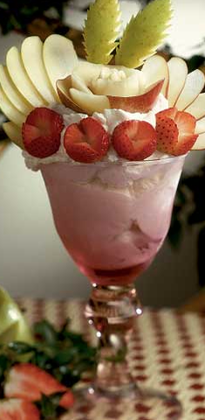
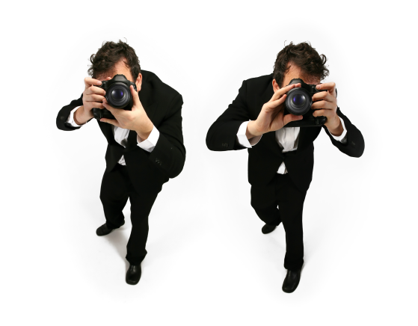
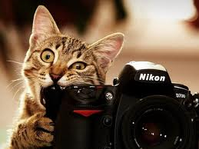
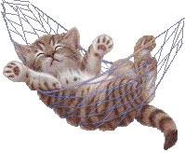
Body of the narration
We were glad, that we didn’t have to make up early. But we never stay in bed long in a bright summer morning. Each day was full of small joys. In the first week we decided make a photo session. We had a lot of pleasure. When the weather was good, we went the park. There we rode the rides, photographed, ate ice-cream.

Slide 4
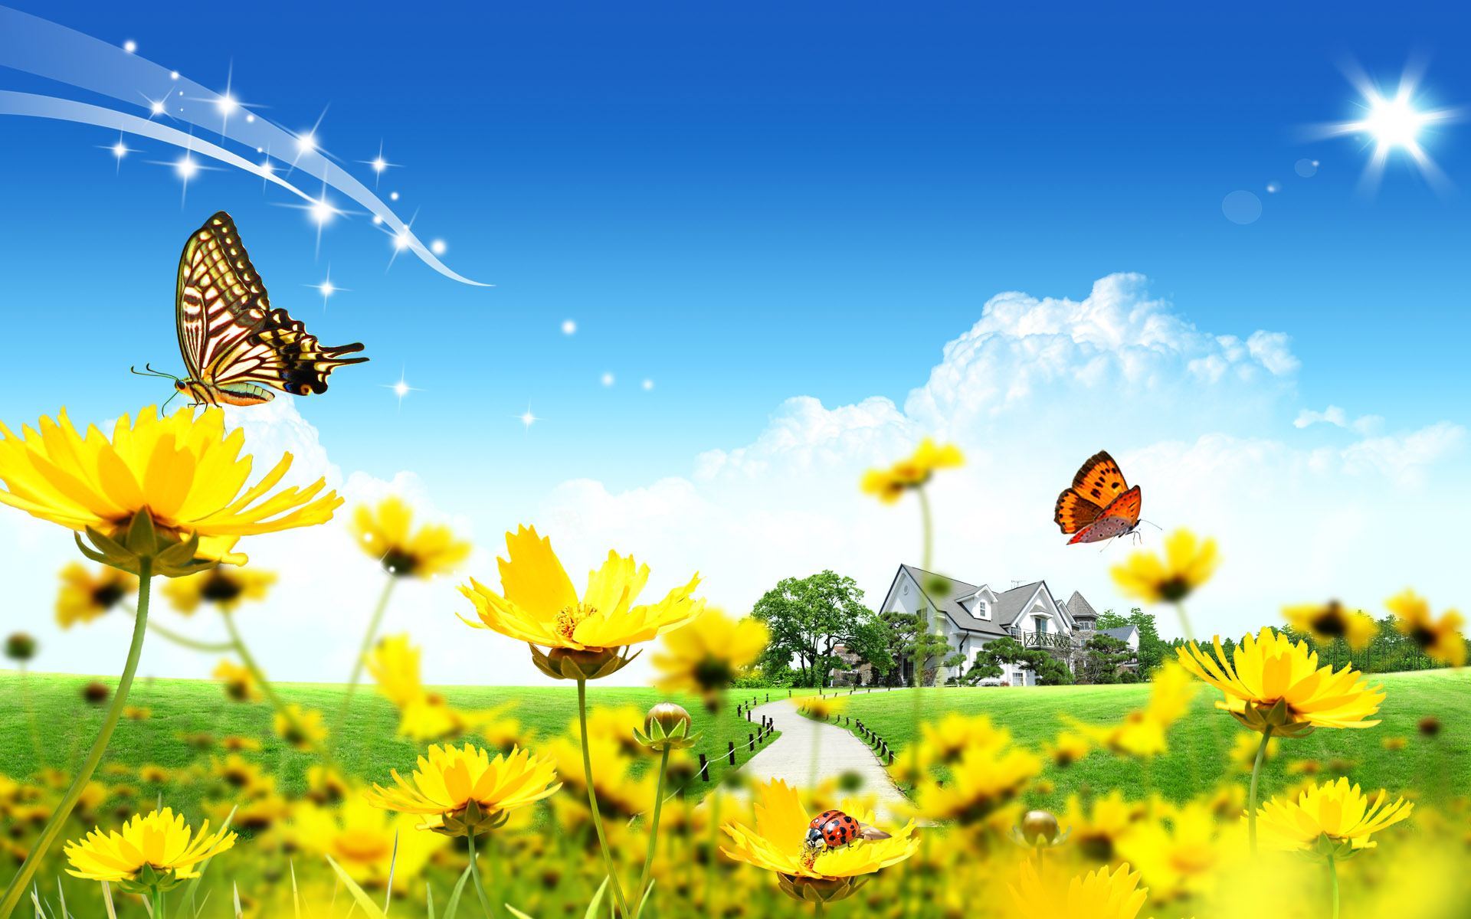

Slide 5
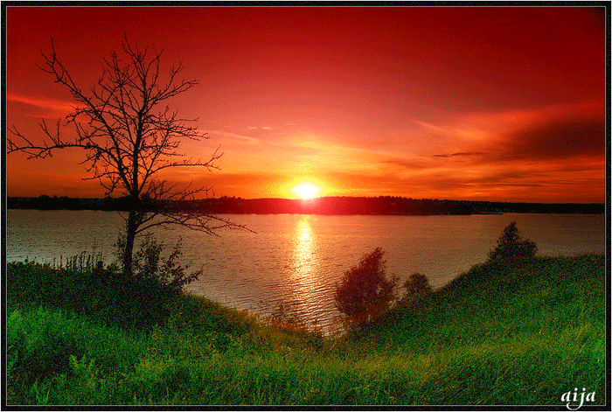
In the summer we visited our grandparents. We helped clean up around the house to our grandparents. When we finished household work, we and our friends went to the river. We swam, sunbathed and played with our friends on the bank of the river. It was hot. The weather was wonderful.

Slide 6
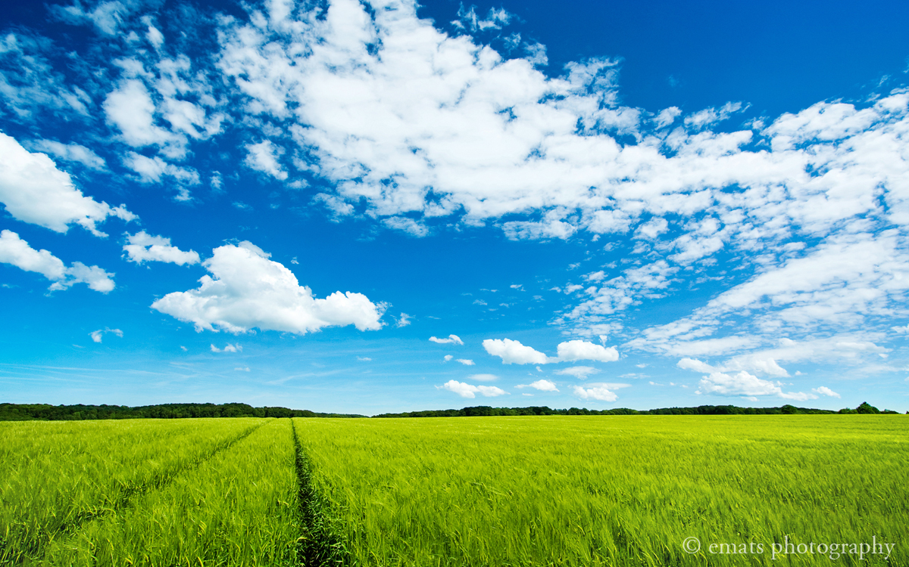

Slide 7
When the first forest berries ripened, we went to gather blueberries. We picked two baskets of blueberries. One piece of the blueberries we left for jam and from the rest berries we cooked delicious cocktails. We lived there for about a month and did not even notice when the time came for us to return home. It was a wonderful rest. We hope that next summer we will go there again.

Slide 9
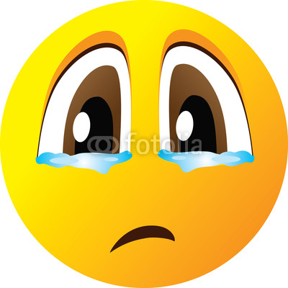
Conclusion
When the summer was over, we were sad because it passed too fast.

Slide 10
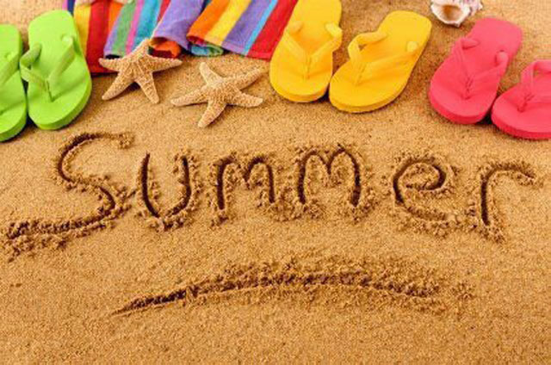
Wonderful rest...
But we felt that we were ready to go back to school. We were happy to meet with our friends and teachers. It was exciting.

Slide 11
Thank you for your attention!

