Slide 1
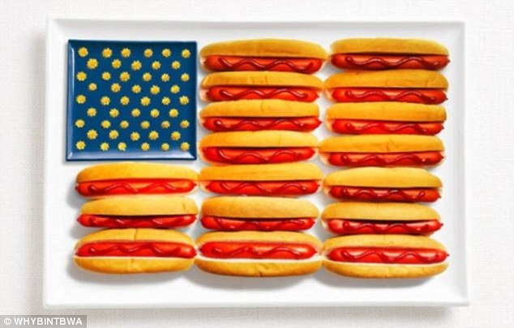
AMERICAN CUISINE
AND
RESTAURANTS
CREATED BY Tania Bezkrovnaia 11-B

Slide 2
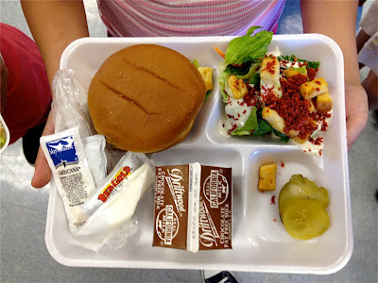
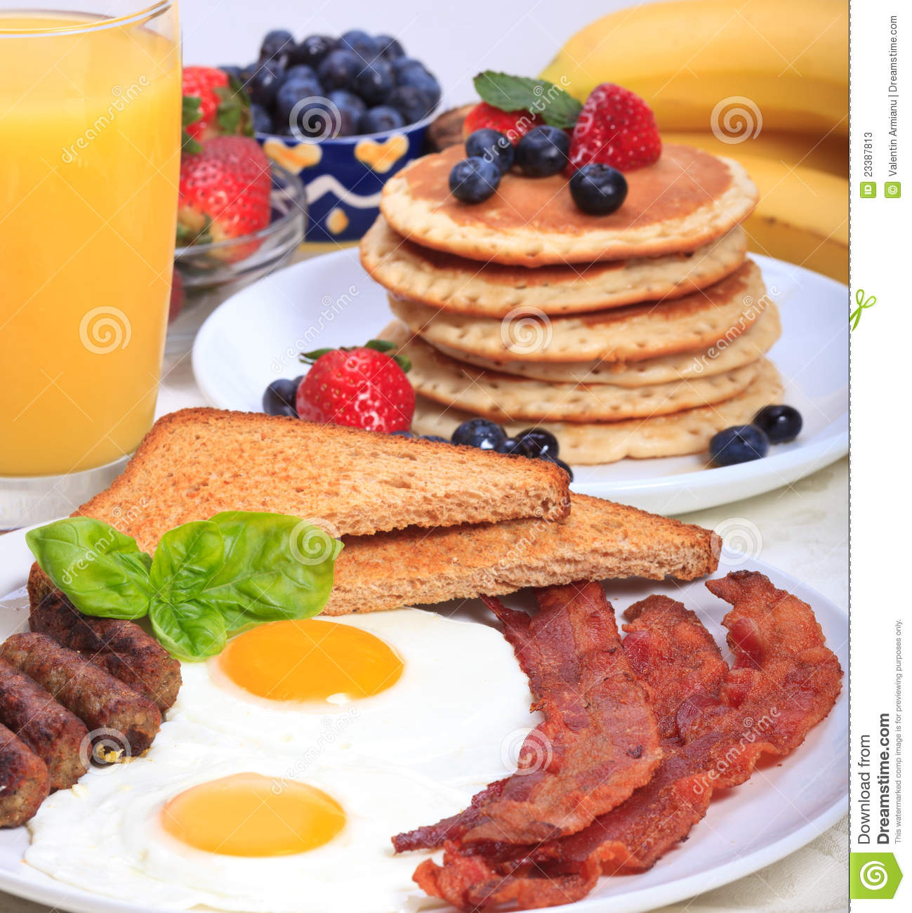
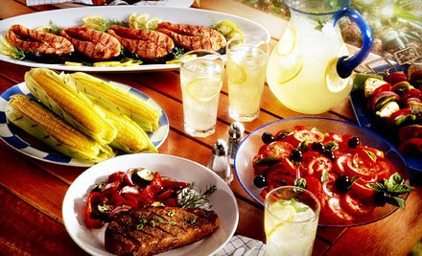
Americans eat a lot. They have three meals a day:

Slide 3
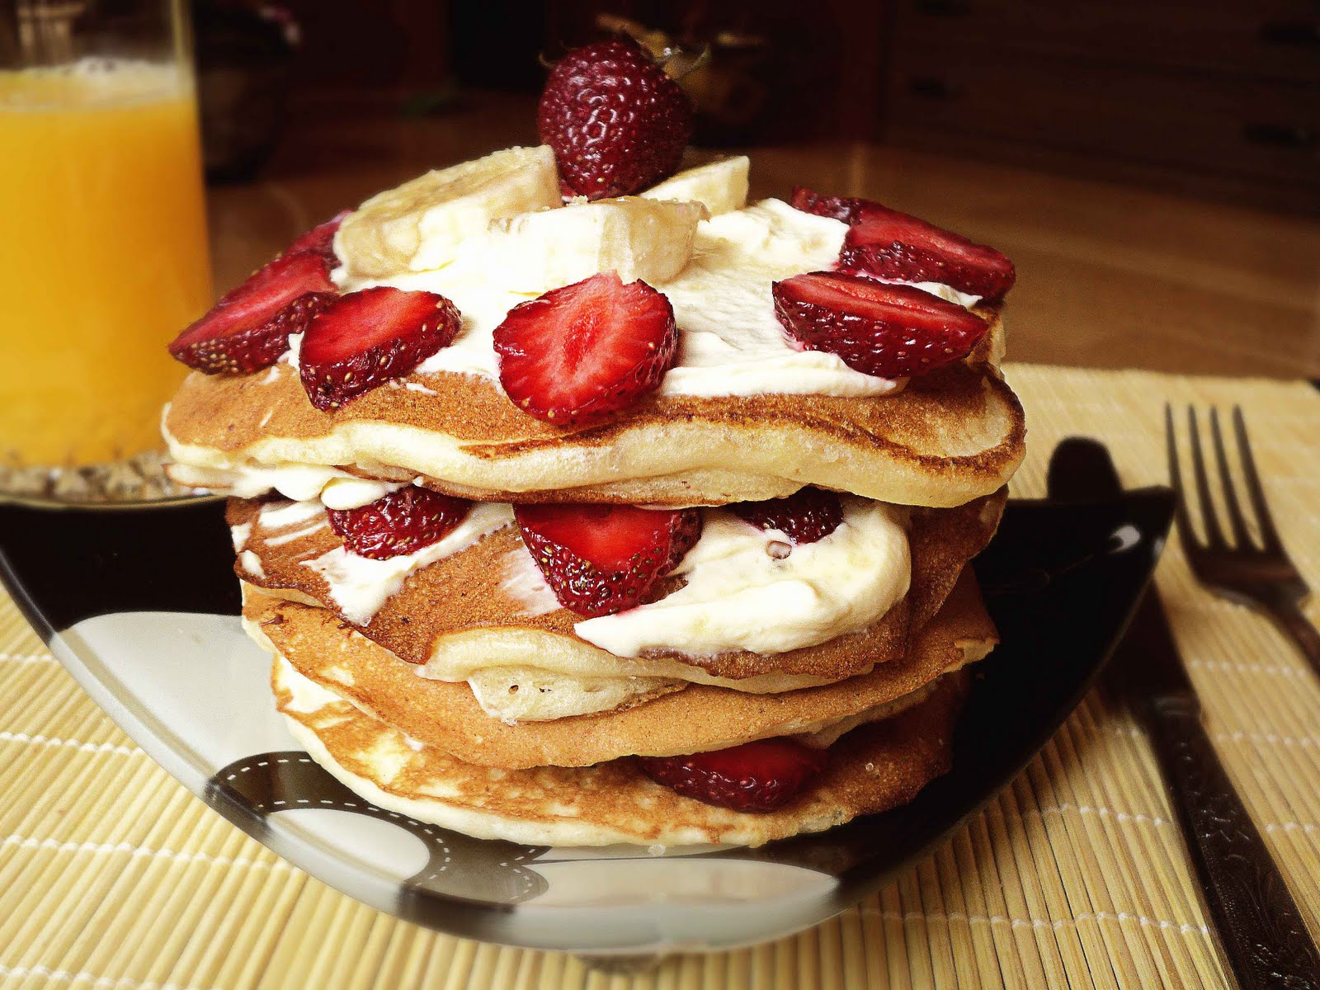

Slide 4
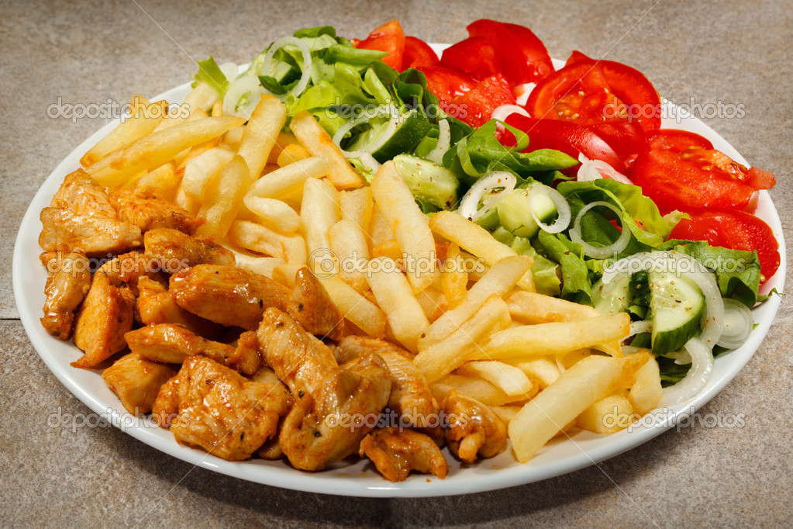

Slide 5
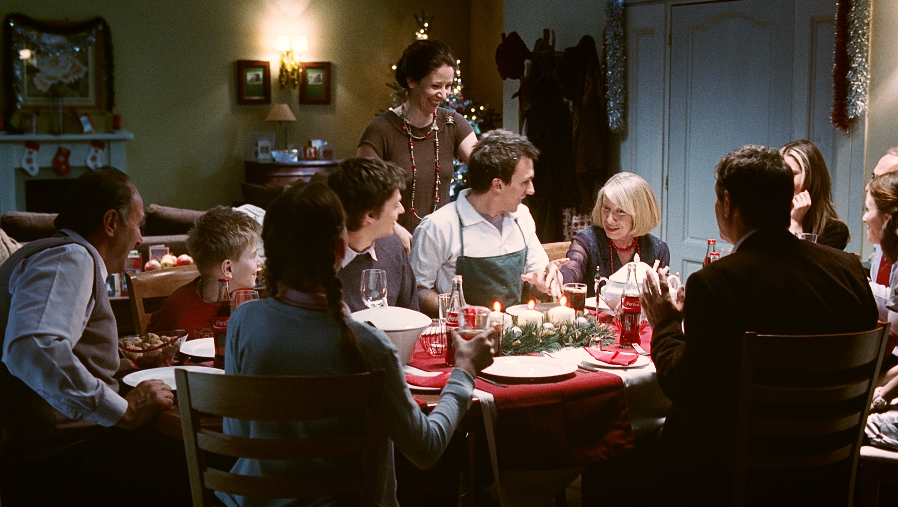

Slide 6
RESTAURANTS

Slide 7
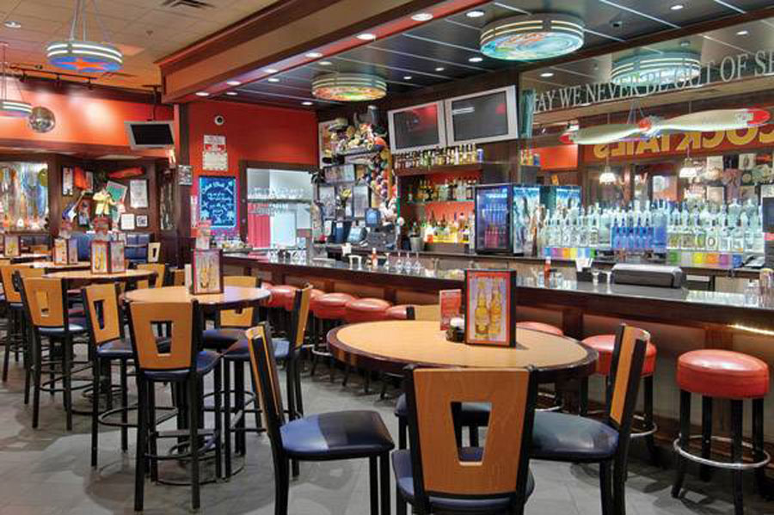
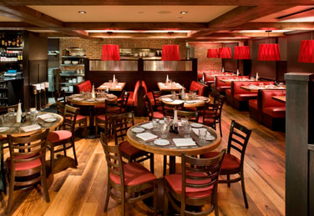
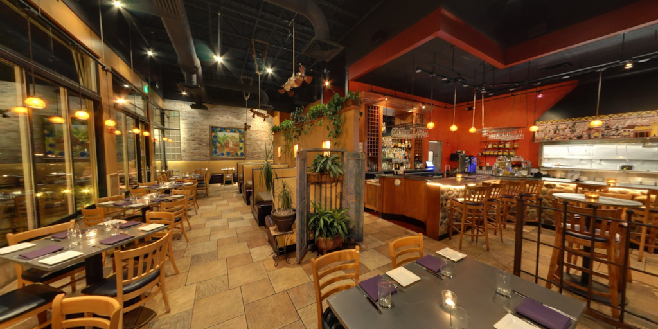
Most of Americans don't eat home but prefer to go to restaurants. They can choose from many kind of restaurants. There is a great number of ethnic restaurants in the United States. Italian, Chinese and Mexican food is very popular.

Slide 8
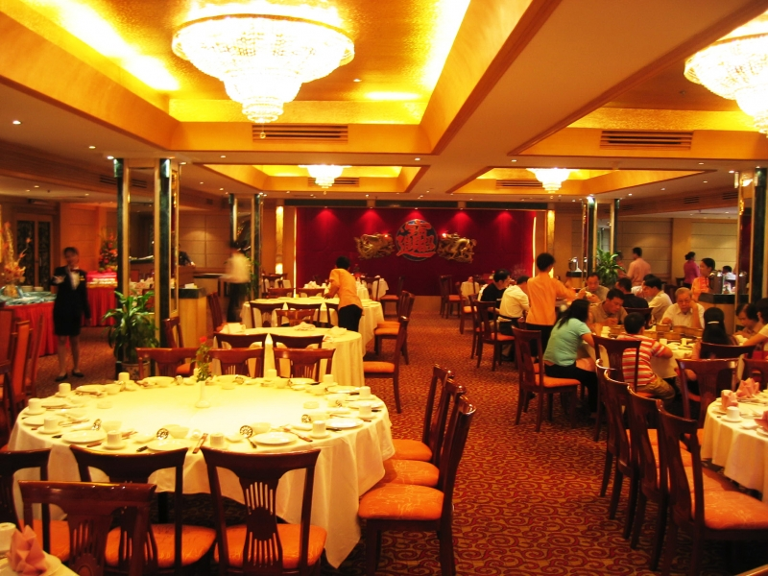

Slide 9
FAST FOOD RESTAURANTS

Slide 10
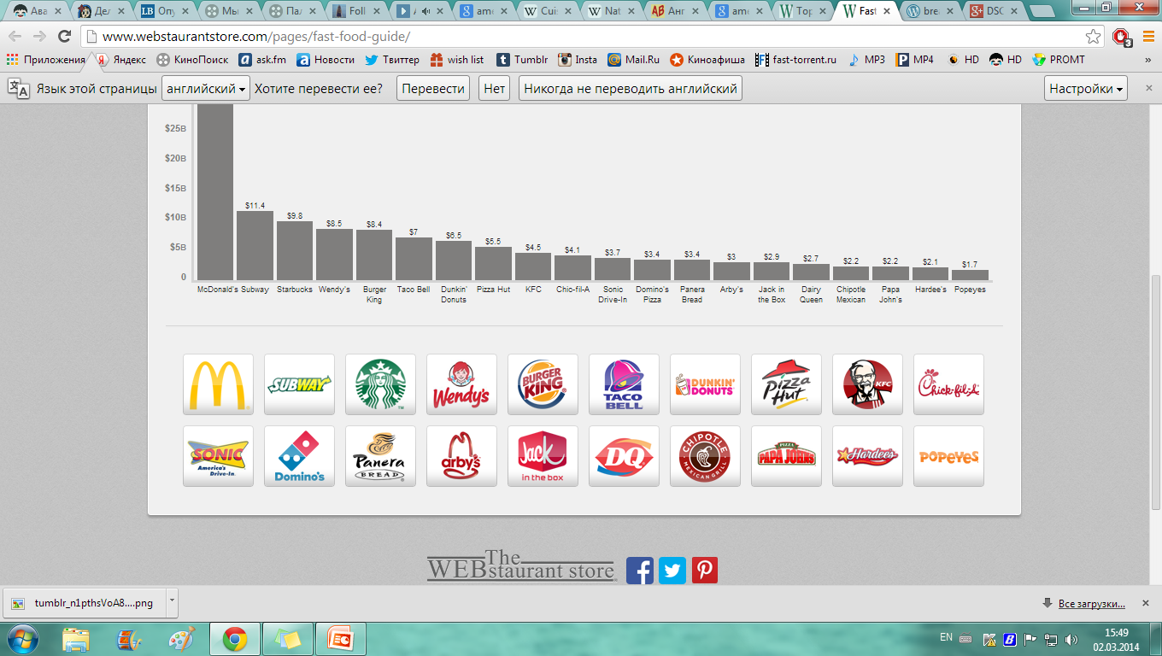

Slide 11
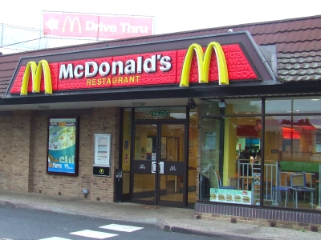

Slide 12
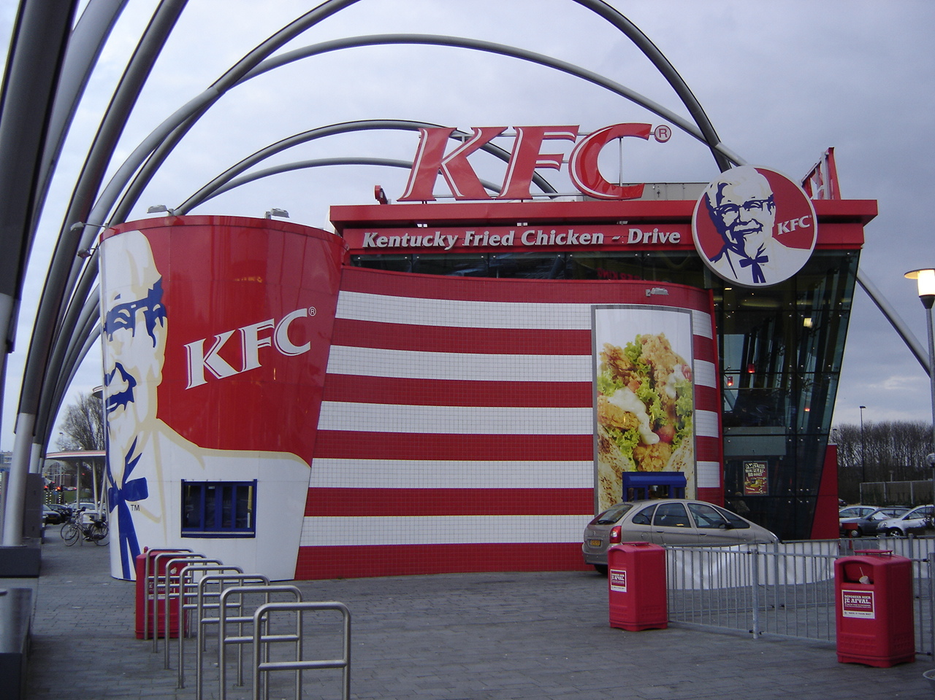

Slide 13
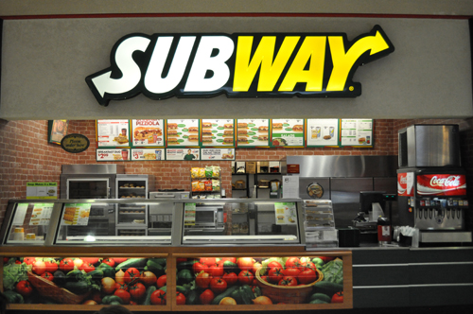

Slide 14
TRADITIONAL FOR CHRISTMAS AND THANKSGIVIN DAY DINNERS

Slide 15
