Slide 1
White TIger

Slide 2
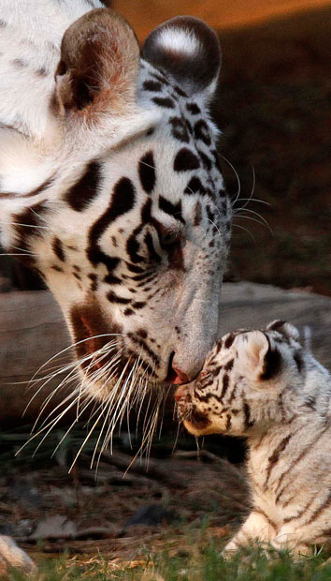
The White Tiger is a subspecies of Tiger. It lives in North and Central India, Nepal and Burma.
White tigers are rarely seen in the wild, and only twelve of them have been spotted in India since last one-hundred years. Tigers have a life-span of 10-15 years
The frequency of white tigers - one individual at 10,000 with a normal color. About 130 white tigers are contained in captivity of which about 100 - in India.

Slide 3
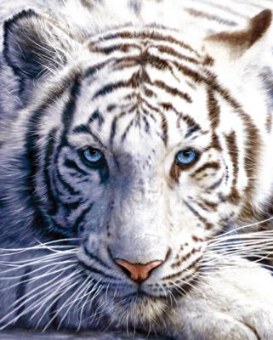
The White Tiger is a large and powerful animal that can weigh up to 300kg and reaches more than 3 meters in length. These beautiful tigers are often much larger than their orange brothers and sisters. Males are larger than females. White tigers have a distinctly pink nose, blue eyes and of course a white or creamy colored fur with black or dark brown stripes that run vertically along it's body. The actual colour depends on where in the world the tiger is situated.

Slide 4
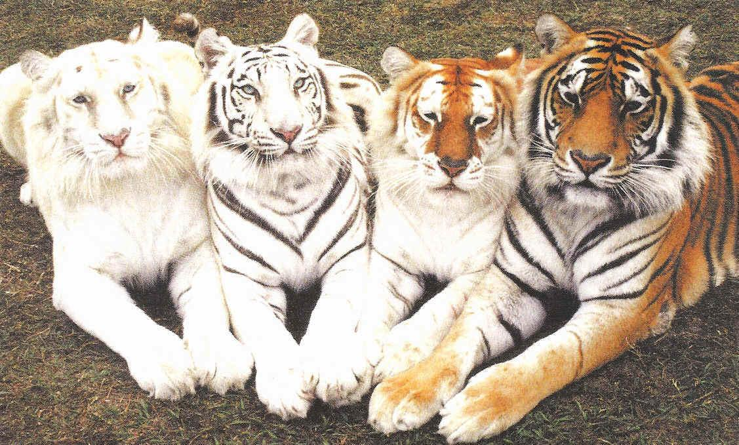
REMEMBER
With their appearance, they are often characterized as albino, but this is not true. An albino tiger would be pure white, without the stripes.

Slide 5
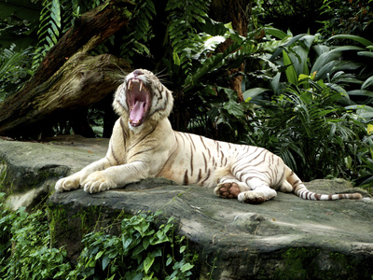
Behaviour
Like other Tiger species, the White Tiger is a solitary animal as this allows this large predator to sneak up on prey more effectively in the dense jungle. Although the White Tiger is not nocturnal, they do the majority of their hunting at night as this also helps them to hunt more successfully. White Tigers have incredible hearing and sight which, along with their stealth, helps them when hunting in the jungle in the dark. Each Tiger occupies a large territory that is marked by claw marks on trees, and can be up to 75 square miles in size.

Slide 6
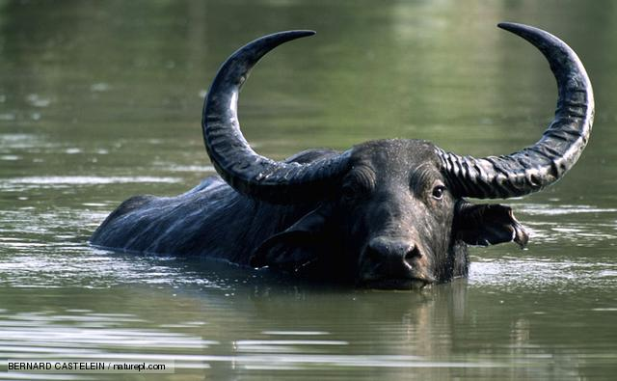
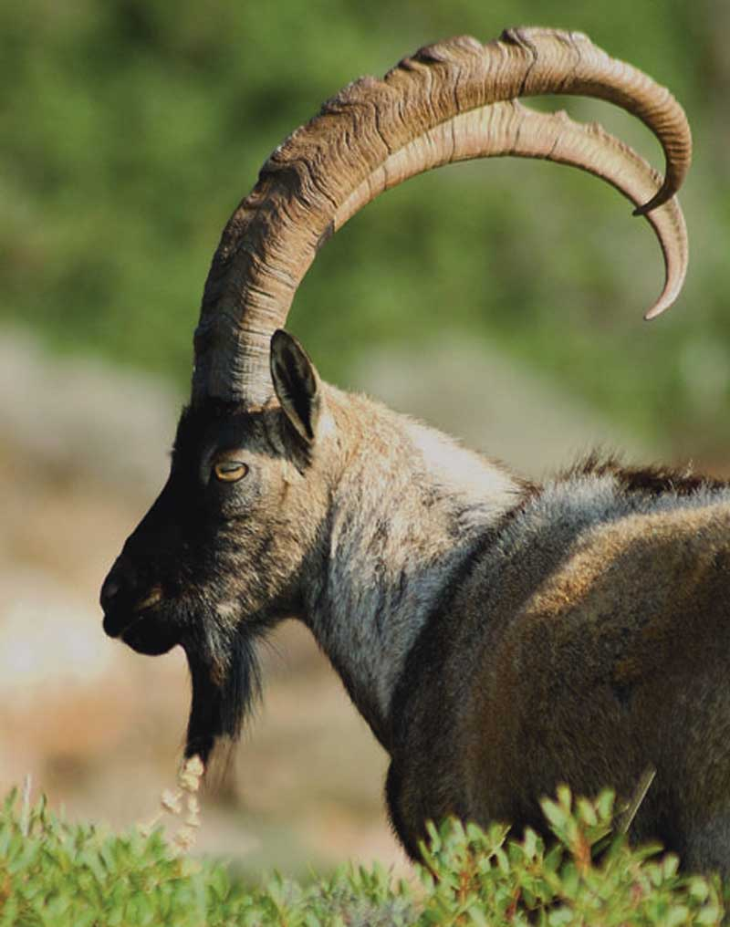
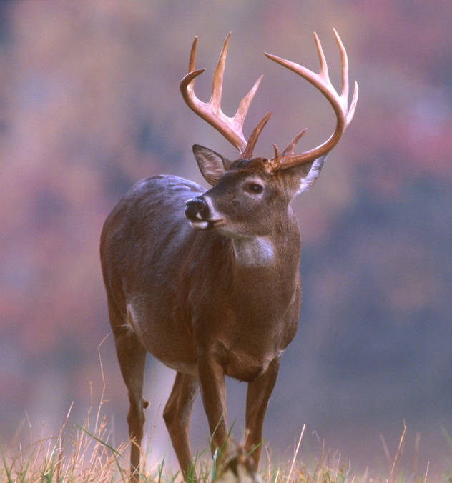
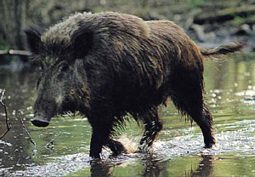
The White Bengal tigers eat water buffalo, goat, deer and wild boar. Their diet in captivity is mainly chicken, horsemeat or kangaroo meat five days a week. They also fast on bones twice a week in captivity.
Water buffalo
Goat
Deer
Wild boar

Slide 7
Causes of Endangerment
Solutions
Habitat loss, poaching, and expansion of human population have together contributed to their being endangered. They are widely hunted for their body-parts, which are used in traditional Chinese medicines.
Due to shortage in their numbers, this species of animal has been inbreeded. About 80 percent of the White tiger cubs are born with serious birth-defects and they soon die. It has resulted in high mortality and disabilities.
World Wildlife Federation (WWF) and many other wildlife organizations are working with the support of the government for the cause of protecting them from becoming extinct.
Due to increasing number of genetic problems, the Species Survival Plan (SSP) coordinators are not in favor of continuing the breeding of White tiger in their managed programs.

Slide 8
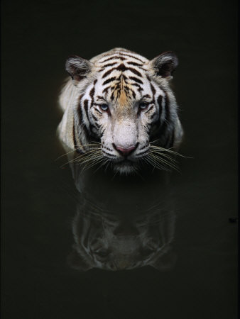

Slide 9
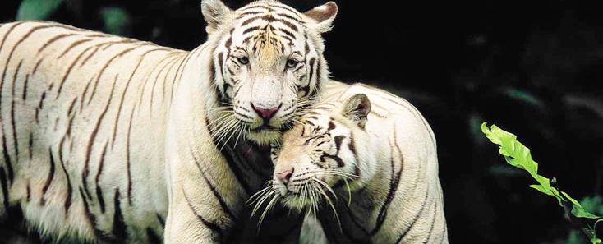

Slide 10
Interesting facts
There are more tigers held privately, as pets, than there are in the wild.
The tiger is the biggest species of the cat family and white tigers tend to be larger than the normal orange-colored tigers.
Most tigers have more than 100 stripes.
They can swim very well.
A tiger can consume as much as 40 kg of meat in one feeding. Compare that to 200 hamburgers!
You can hear a tiger roar over a mile away!
Tigers can see in the dark six times better than people can. They can also see in color.
Tiger cubs are born blind and weigh only about 1 kg. They live on milk for 6-8 weeks before the female begins taking them to kills to feed, but they do not begin making their own kills until about 18 months of age.
July 29th is celebrated as Global Tiger Day.

Slide 11
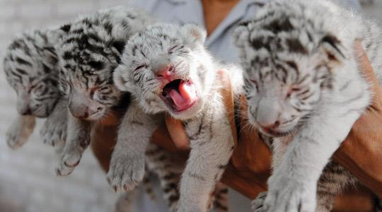
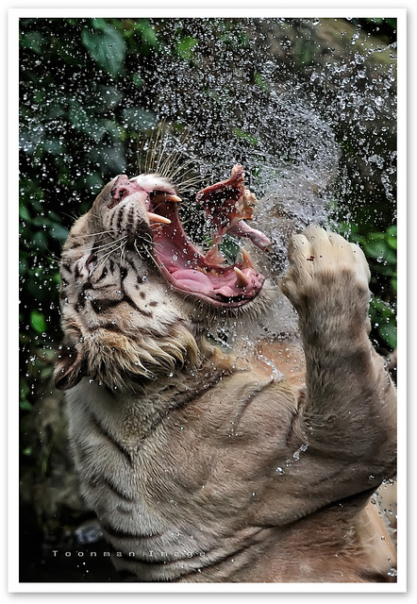
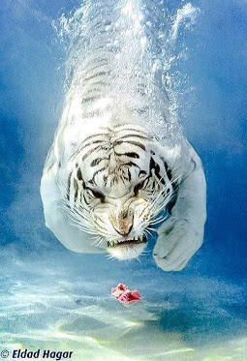
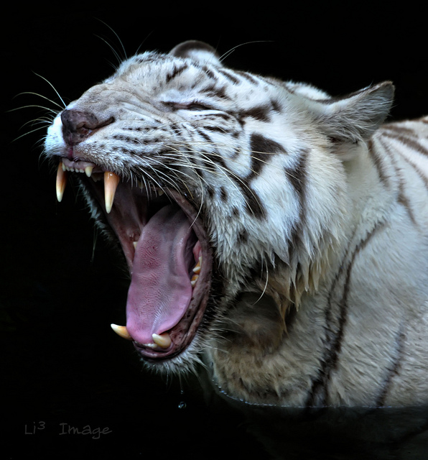

Slide 12
Some more unusual animals

Slide 13

Heron(Цапля)

Slide 14
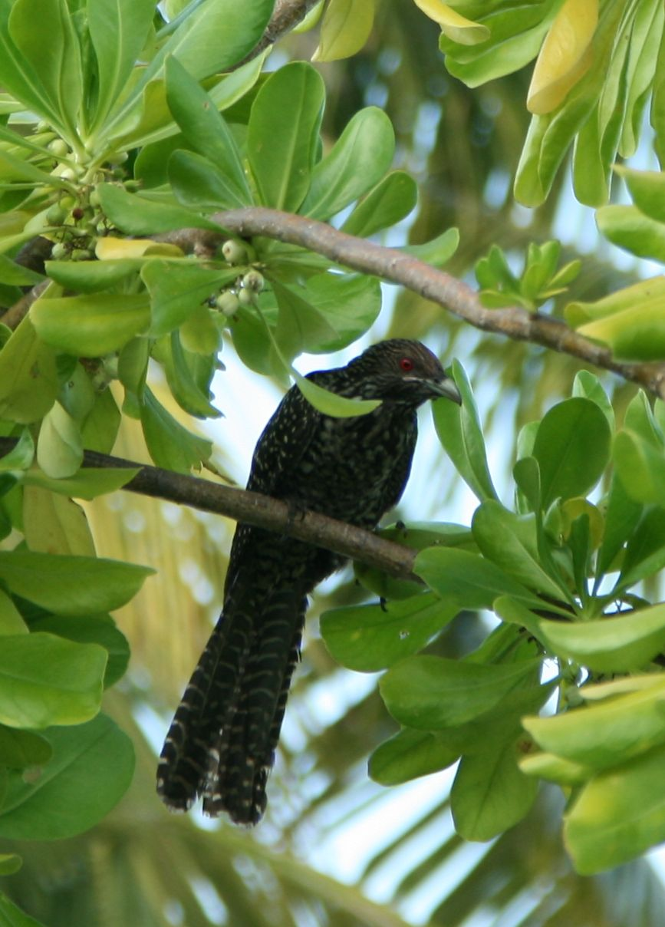
Black Bird

Slide 15
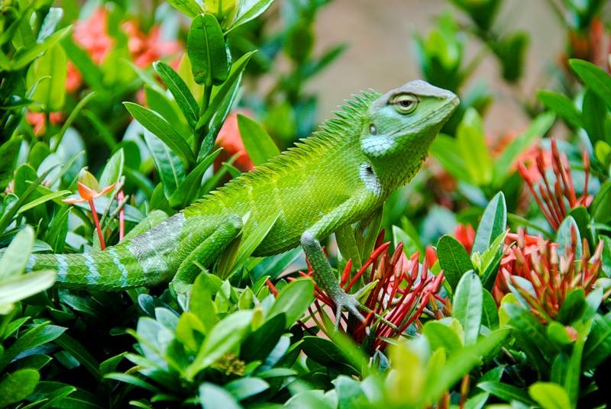
Lizard

Slide 16
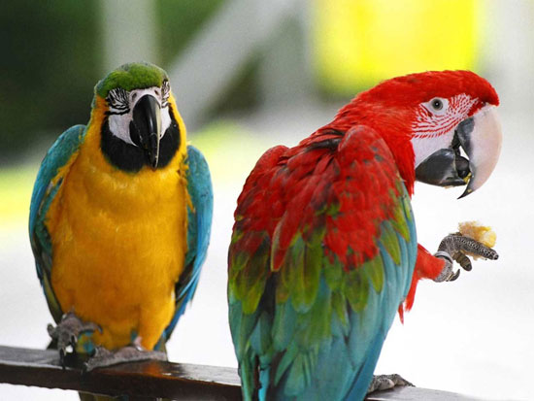
Parrots

Slide 17
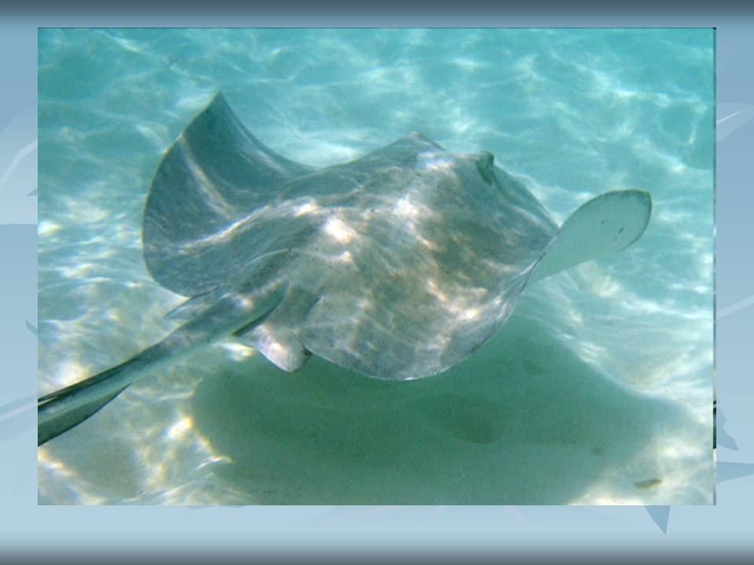
Scate(Скат)

Slide 18
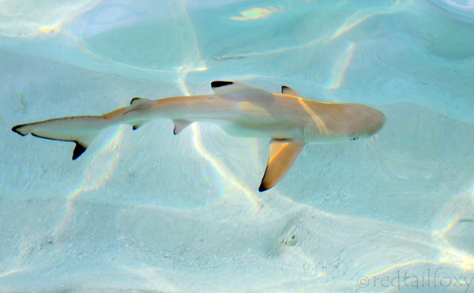
Shark

Slide 19
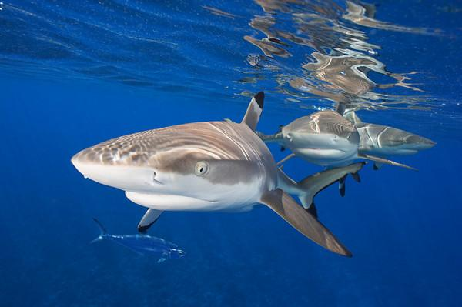
Sharks

Slide 20
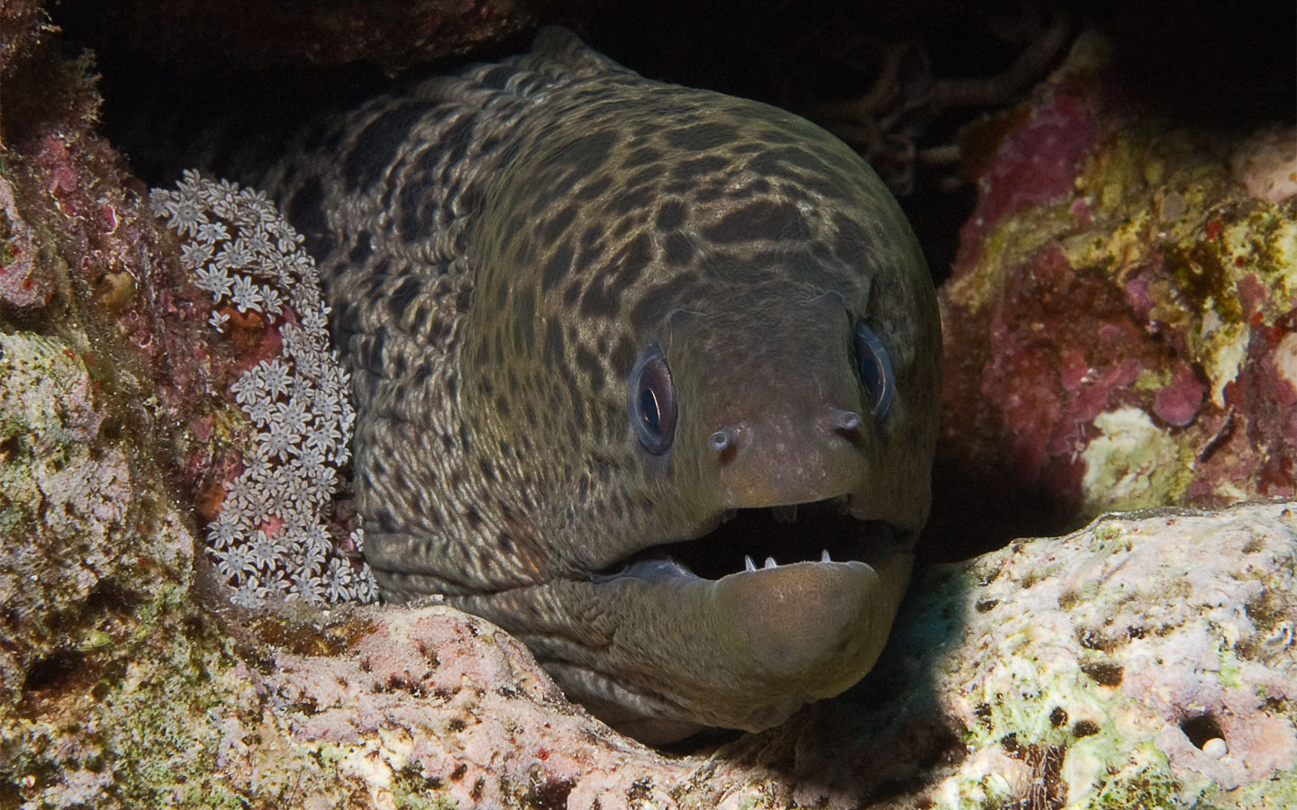
Moray(Мурена)

Slide 21
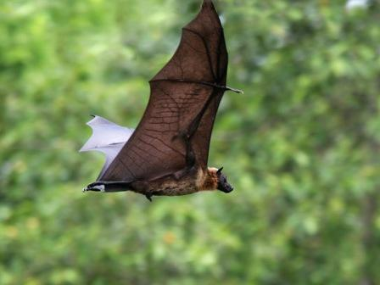
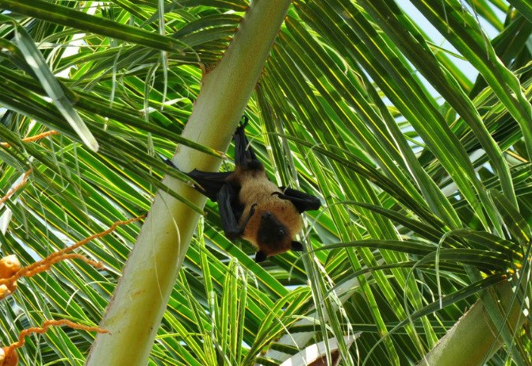
Flying Fox

Slide 22
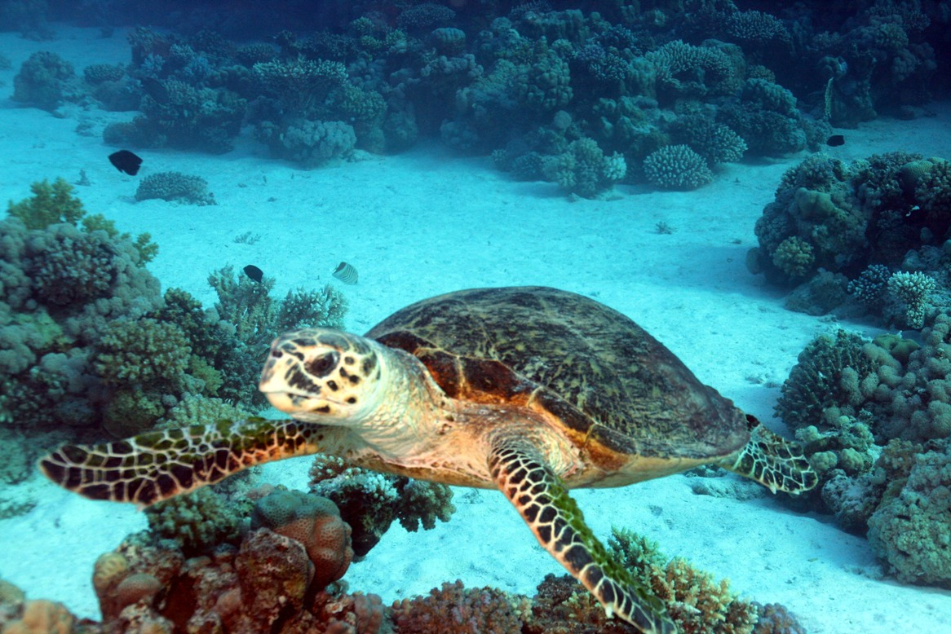
Turtle

Slide 23
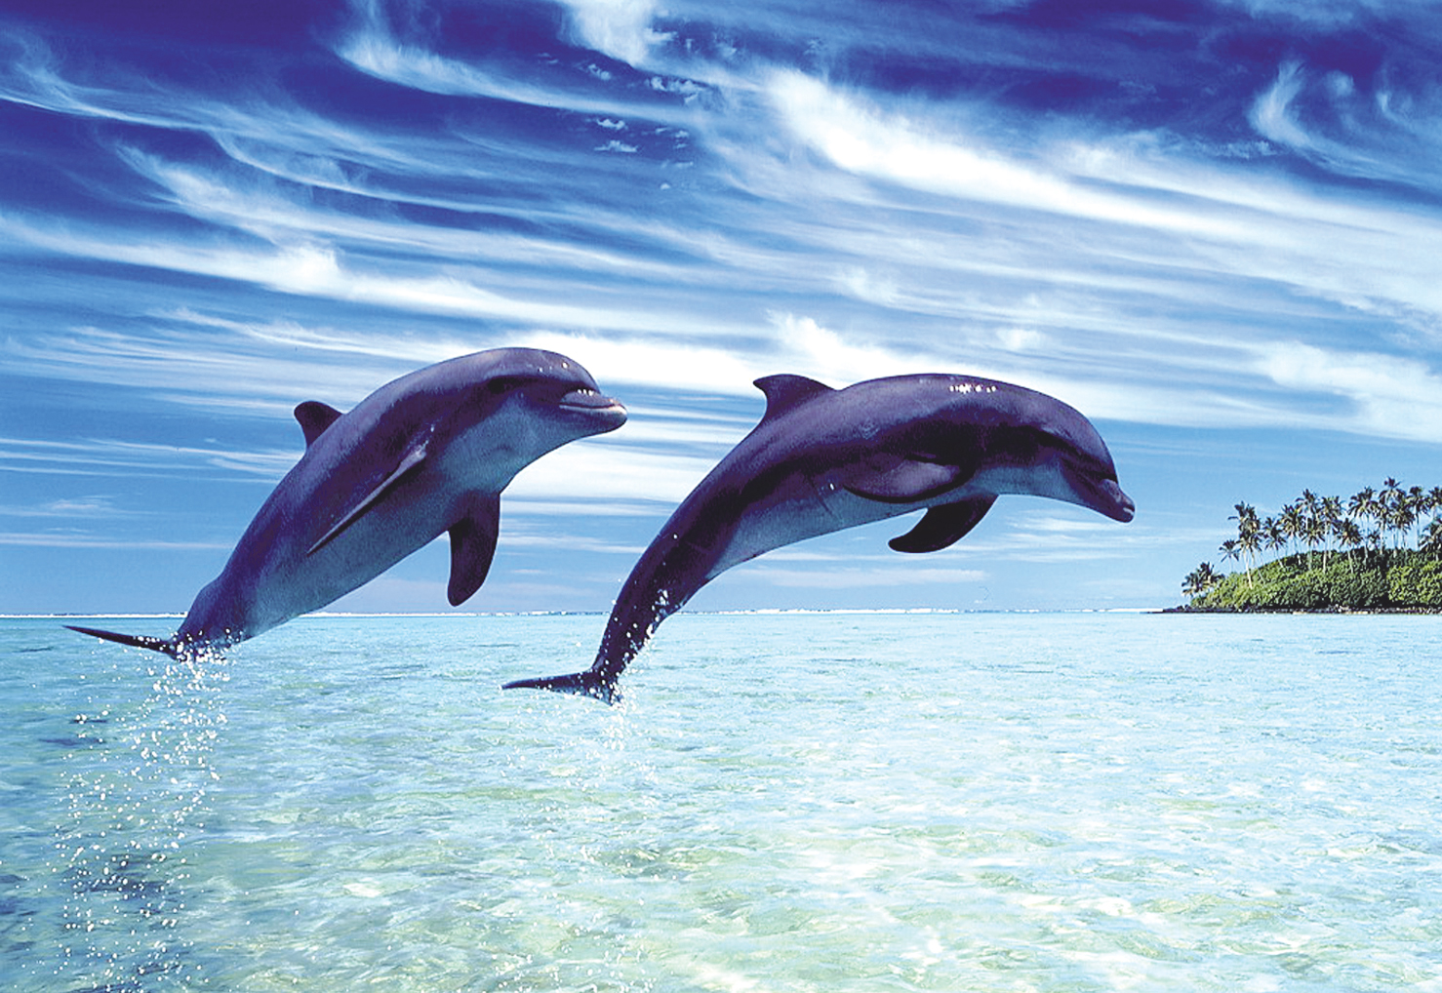
Dolphins

Slide 24
Thank you for your attention

