Slide 1
Міністерство освіти і науки, молоді та спорту України
Спеціалізована школа №298 Оболонського району м. Києва
Творча презентація з курсу за вибором
«Гіди – перекладачі» на тему :
«St. Andrew's Church»
Виконала учениця 10-А класу
Родзінська Тетяна
Київ 2013

Slide 2
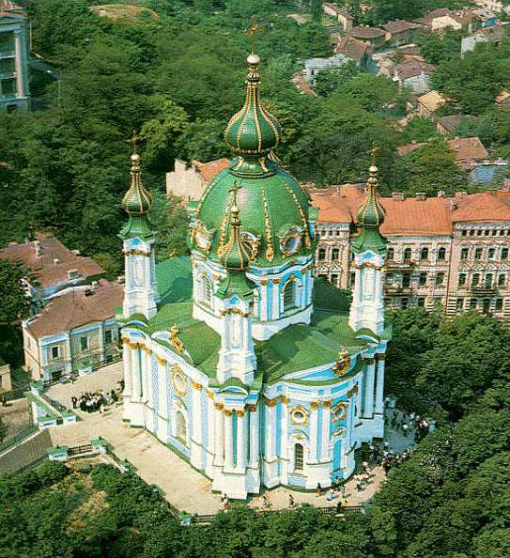

Slide 3
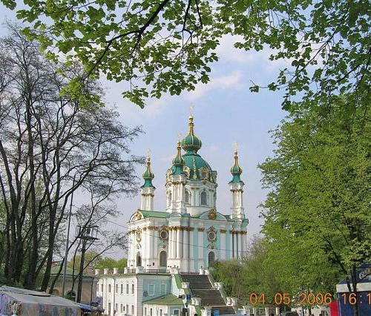
There is a legend that the place of the present-Dnepr was the sea. When St.. Andrew came to Kiev and put it on the mountain, where now stands the church of St. Andrew's cross, the whole sea went down. But some of it remained hidden under the mountain.
The St Andrew's church has no bells, because, according to legend, the first strike the water would wake up and flood not only Kyiv, but also all of the Left Bank.

Slide 4
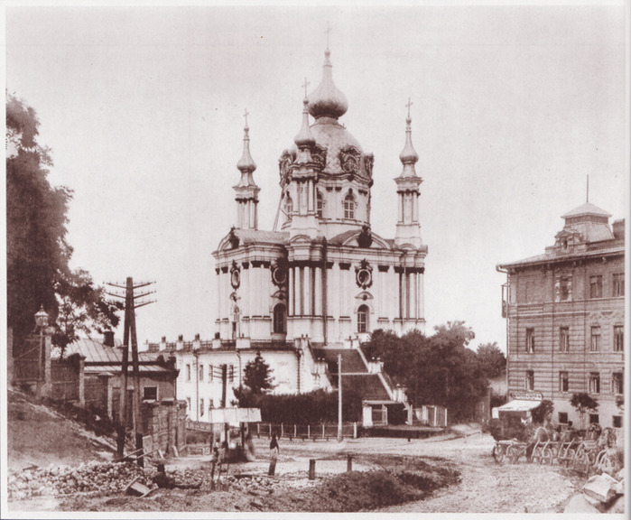
Baroque Pearl - St. Andrew's Church founded in 1744 in connection with the arrival of Elizabeth I. in Kiev. St. Andrew's Church was built in 1749 - 54 years. designed by Rastrelli at Mount St. Andrew, in the beginning of Andrew's descent. It is the only surviving work of the architect Ukraine. Construction was led by architect I.Michurin

Slide 5
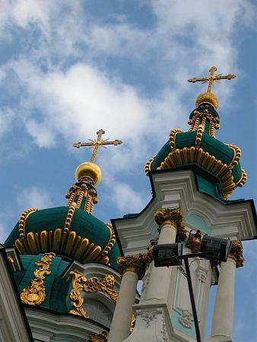
Domed five-domed church has the shape of a cross, which is placed in the corners of the decorative tower on massive pillars, which plays the role of the buttresses. Outside buttresses adorned with pilasters and covered with three pairs of columns with Corinthian capitals of the order.

Slide 6
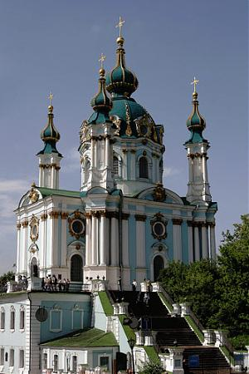
By Andrew's Church from the street is steep iron stairs. The entire mass of the church is based on the two-storey house stilobat with eight rooms on each floor, the walls of which are the foundation of the church. Around the church - a balustrade, which offers a picturesque view of the Dnieper.

Slide 7
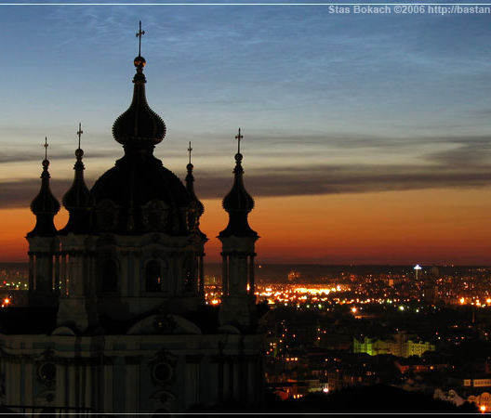
The internal framing of St. Andrew's Church, designed by Rastrelli, close to the style of Rococo. Since 1958, St. Andrew's Church is the branch of the Sofia Museum. In 1978-79. was held the next restoration.

