Slide 1
10 best
British films

Slide 2

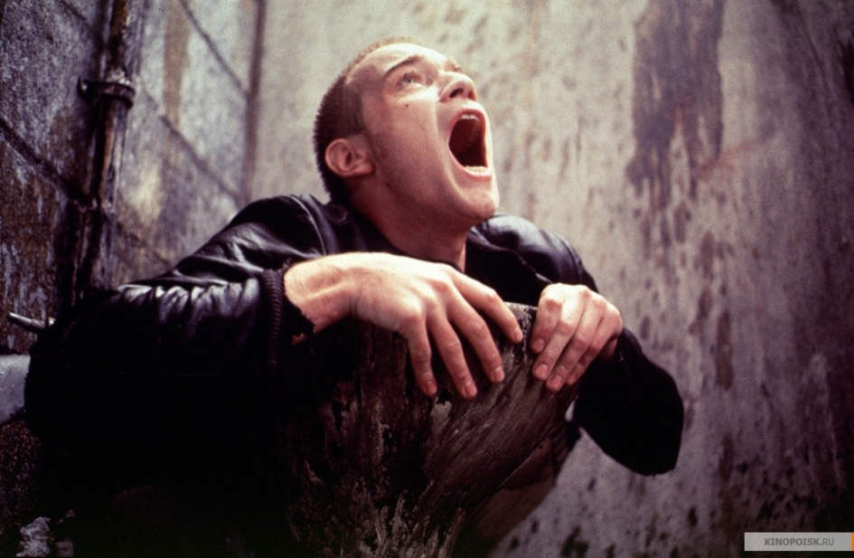
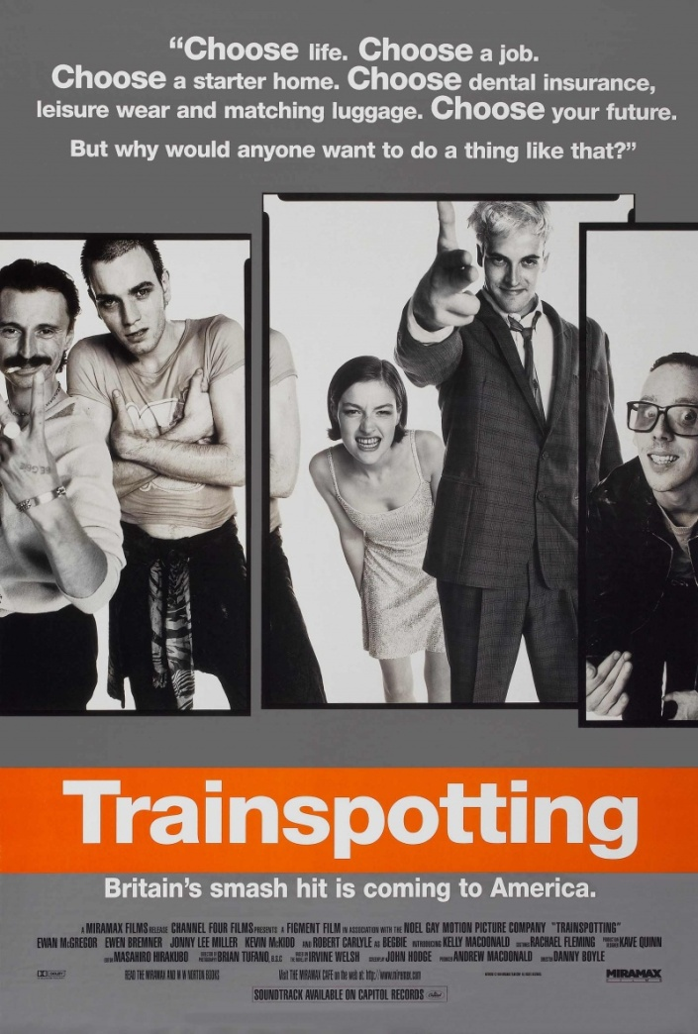
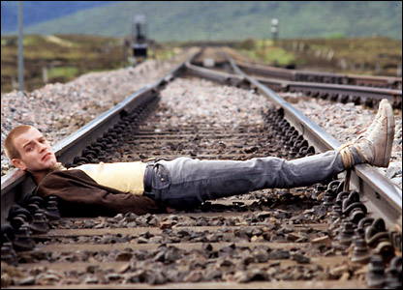
"Trainspotting" is an adaptation of the eponymous novel by Irvine Welsh, tells the story of a drug addict Mark Renton (played by Ewan McGregor) and his friends. Both the film and the book received cult status both at home and abroad.
Screenwriter Josh Hodge got pictures for "Trainspotting" prize of the British Academy of Film and Television Arts for Best Screenplay.

Slide 3

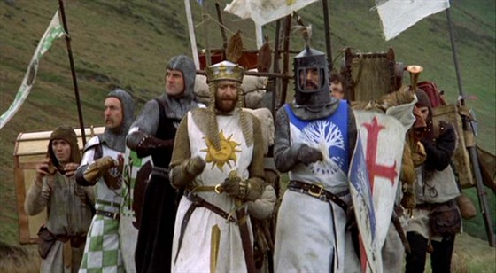
Monty Python and the Holy Grail - 1975 British film of the comic troupe Monty Python comedy, in which many human values ​​are being questioned. Humorous play on the famous legend of King Arthur, his associates and their wanderings in search of Holy Grail. On the way to the king across obstacles such as county peasant anarcho-syndicalists, the Black Knight, who even after the loss of arms and legs refused to admit defeat, and a group of French-mockers, ensconced in the castle of the Holy Grail.

Slide 4

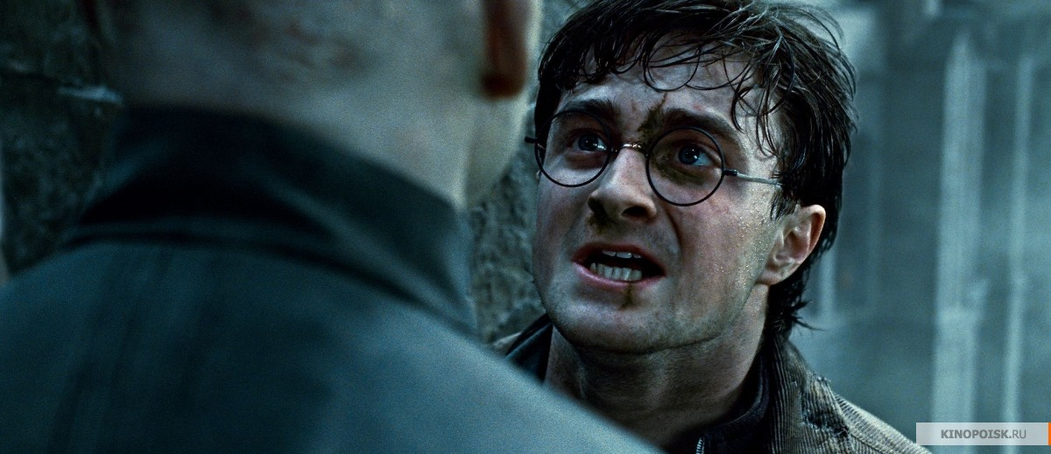
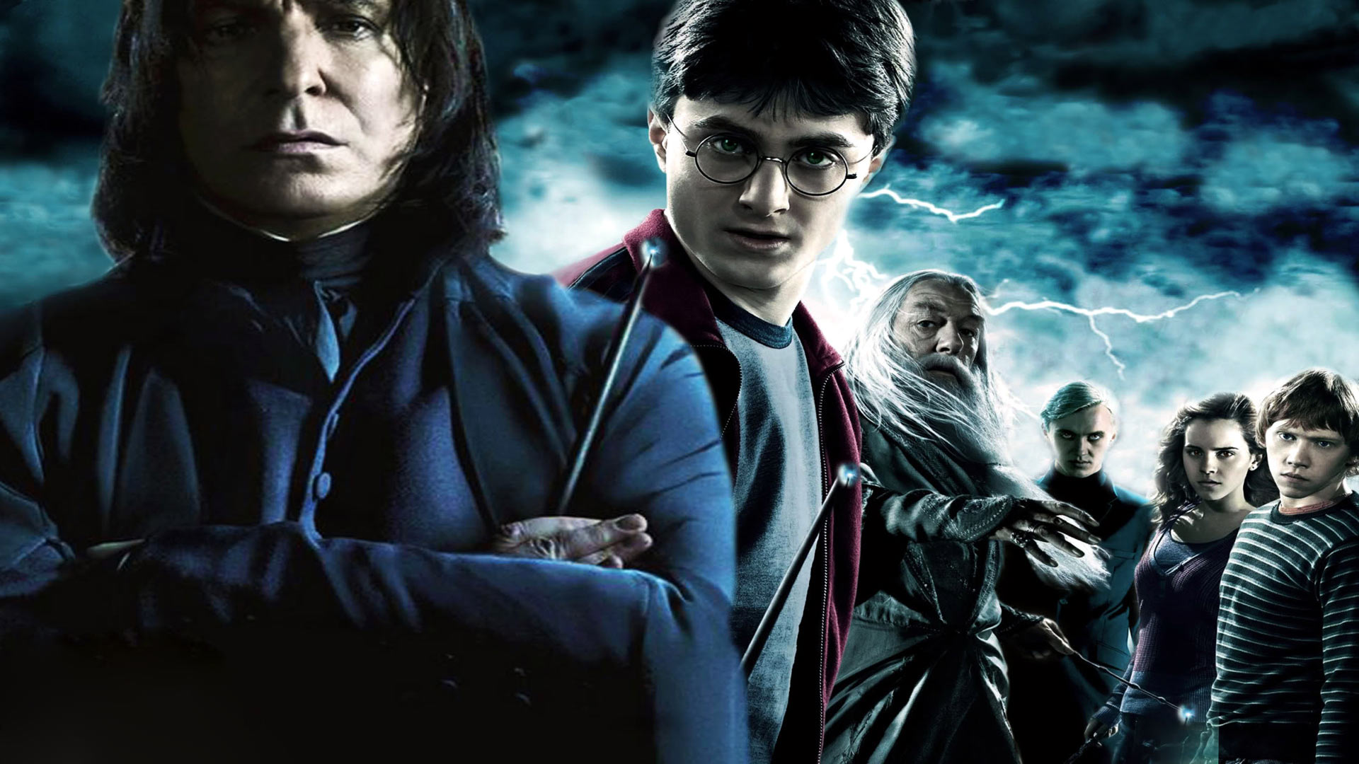
Harry Potter and the Deathly Hallows: Part II
In the grand final chapter the battle between good and evil forces in the world of wizards develops into a general war. Rates have never been so high, and seek asylum - so complex. And perhaps it is Harry Potter have to sacrifice everything in the final battle with Volan de Mort. Our hero is able to save the world? And all ends here.

Slide 5

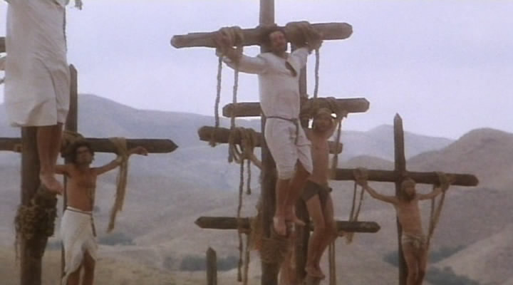
Monty Python’s Life of Brian
This picture parodies various fanatical movement: feminists, religious fanatics, suicide bombers, nationalist, political populists. The film tells the story of Brian Cohen (Graham Chapman), a young Jew born in the same place and at the same time as Jesus Christ, and subsequently mistaken for the Messiah.

Slide 6
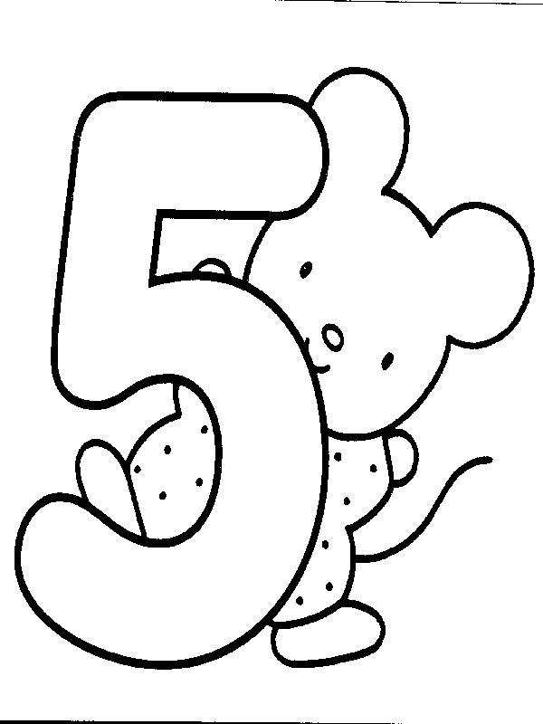
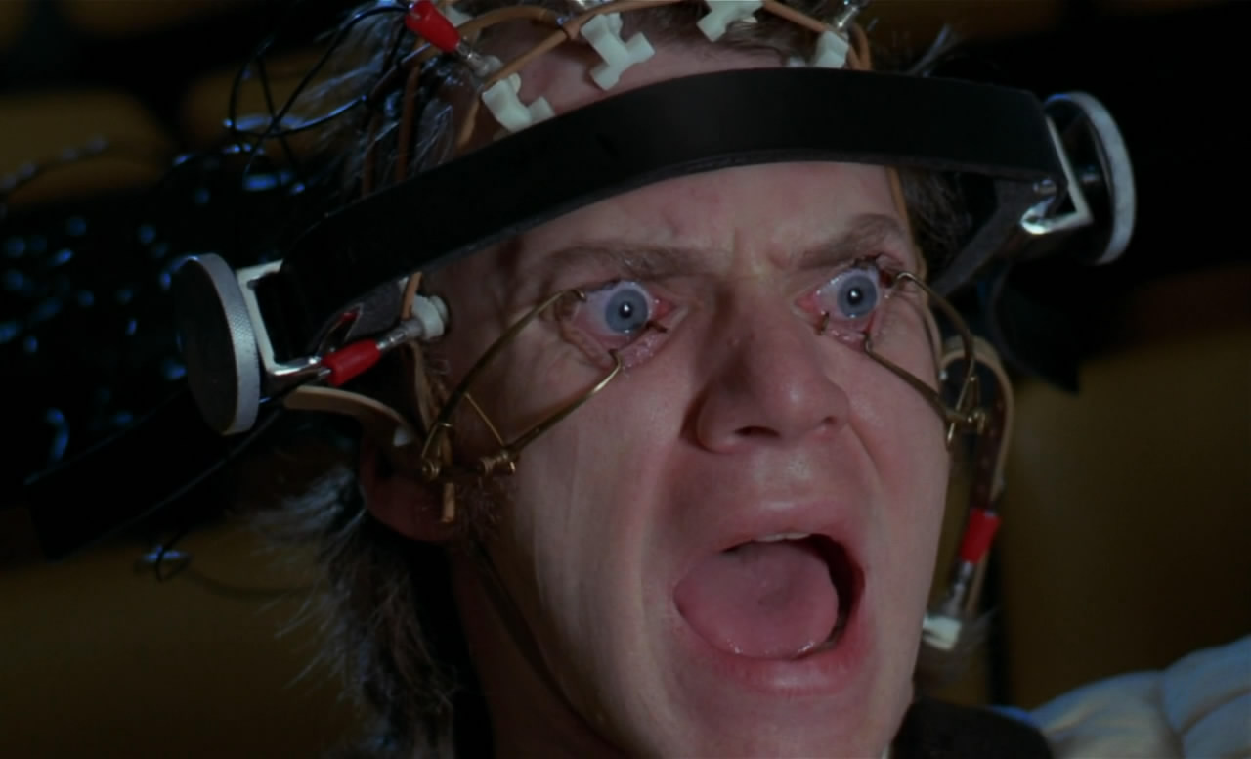
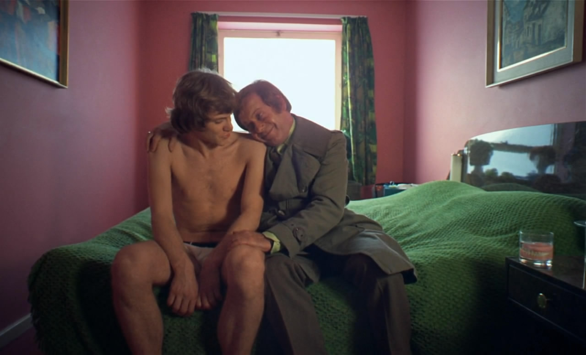
A Clockwork Orange
The painting consists of reflections on the essence of human aggression in adolescents example, of free will and adequate punishment. The protagonist - the charismatic teenager Alex (Malcolm McDowell), in love with the music of Beethoven, is the leader of the gang, consisting besides him of three young people who engaged in acts of "ultranasiliya": robbery and rape, disturbing the peace of civilians futuristic Britain.

Slide 7

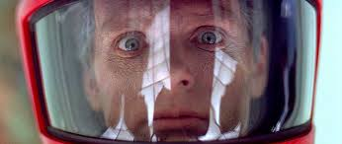
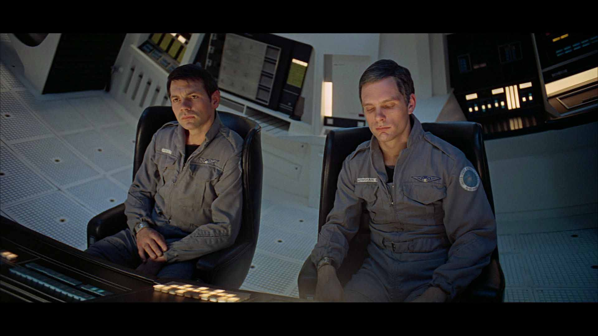
A Space Odyssey
Science fiction film by Stanley Kubrick in 1968, became a landmark in the development of world cinema and the fantasy genre in general. The film went to Arthur C. Clarke's short story "All", which was published in 1951. Clark developed the script with Kubrick before writing the novel "2001: A Space Odyssey" which was first published immediately after the film.
The film tells about a series of meetings with people metaphorical black monoliths that are apparently influenced the course of human evolution. First - took place at the dawn of history.

Slide 8
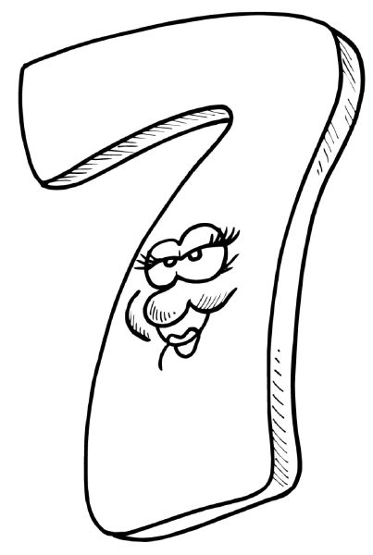
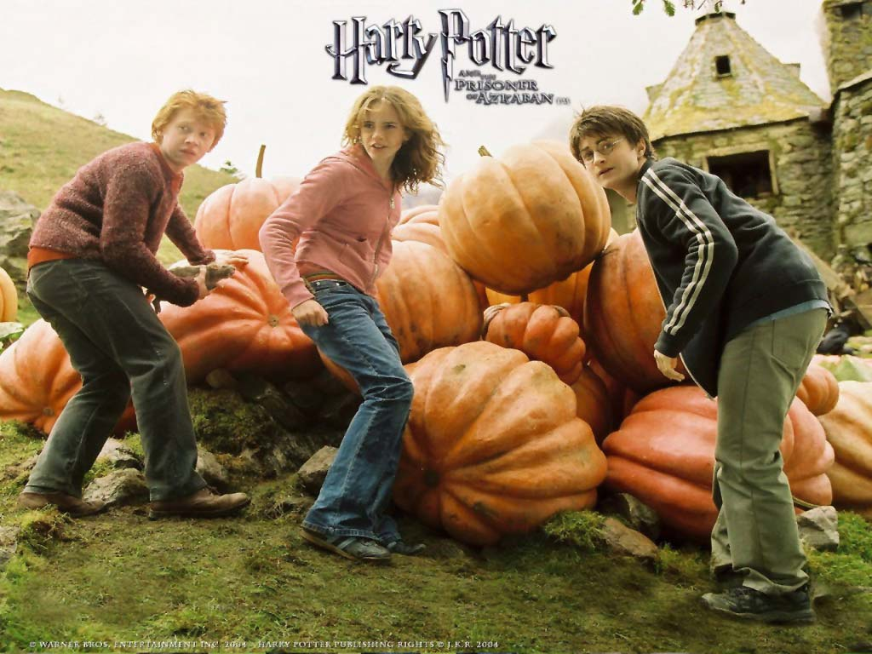
Harry Potter and the Prisoner of Azkaban
The third year of study, Harry and his friends at Hogwarts. Harry once again serious quarrels with the Dursley family, accidentally blew up Aunt Marge spell and leaves the house, taking all things. On the street it seems that someone is watching him. In the bushes, he notices a strange black dog and pulls out his wand, but falls, and then on the road there is a three-storey bus "Night Knight", and the dog is lost…

Slide 9
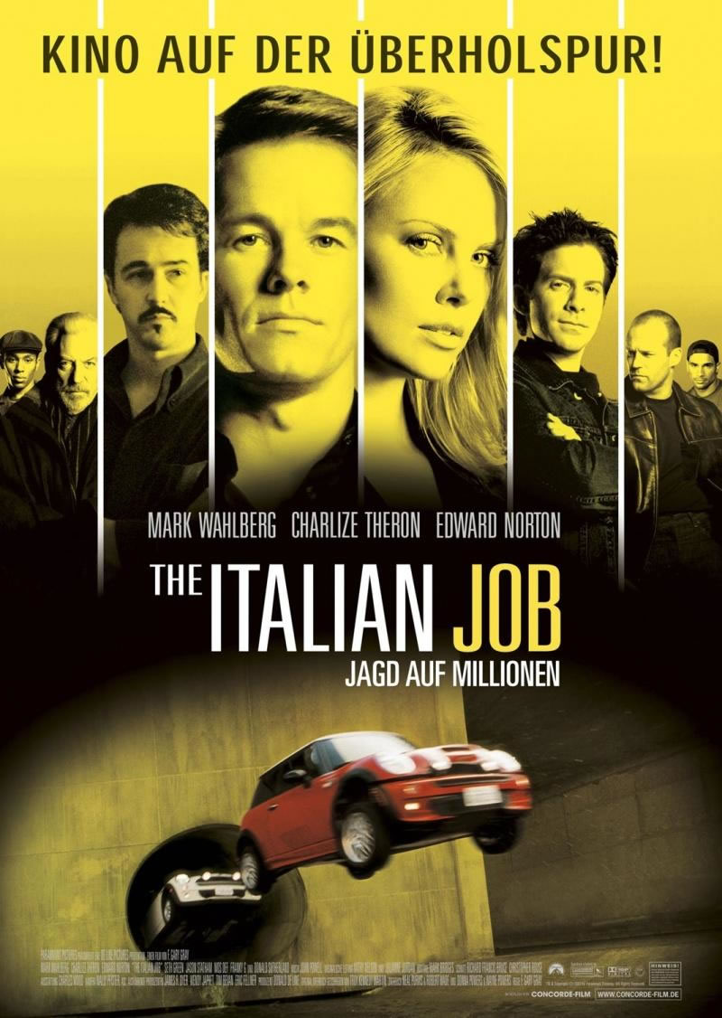

The Italian Job
British heist film directed by Peter Collinson. Taken in 1969 in the UK and Italy to the crime comedy genre with elements of road movie. Along with the actors in the film, people at least several starring the iconic British cars of the 1960s Mini Cooper.

Slide 10
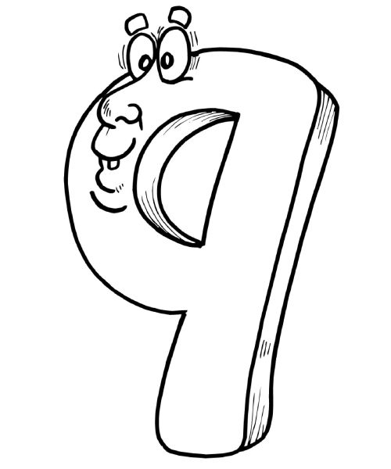
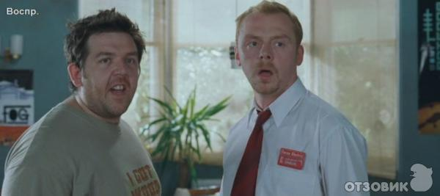
Shaun of the Dead
British satirical horror comedy 2004. One of the first full-length work of director Edgar Wright. Actors - Simon Pegg and Nick Frost. Is the first part of the trilogy "Blood and Ice Cream".
This is a frequent example of the film, when the genre of comedy is closely intertwined with the horror genre.

Slide 11
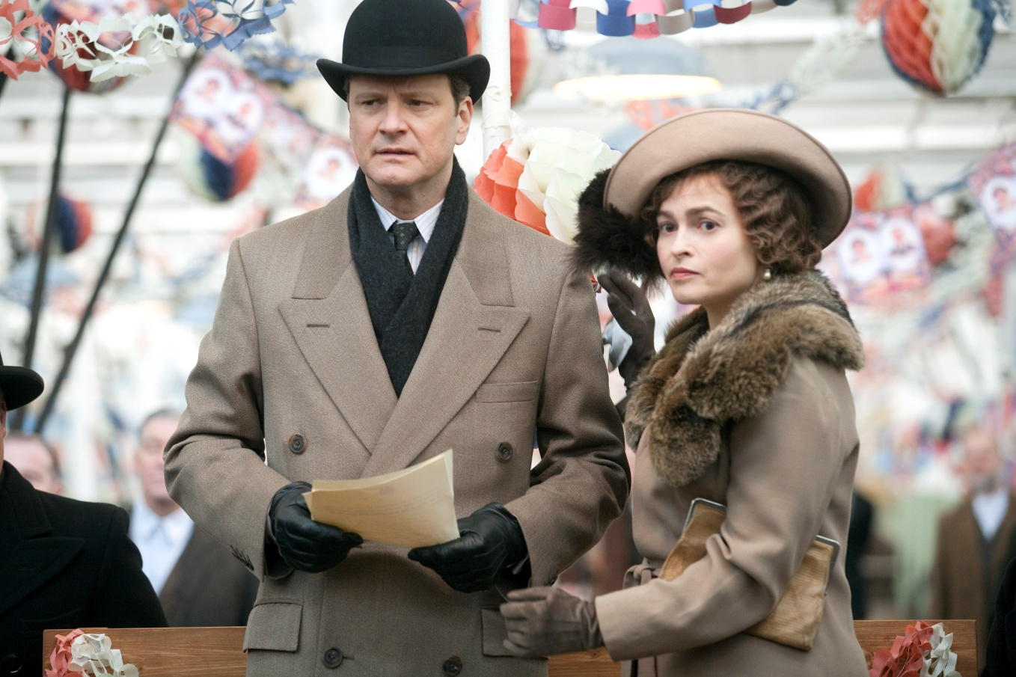
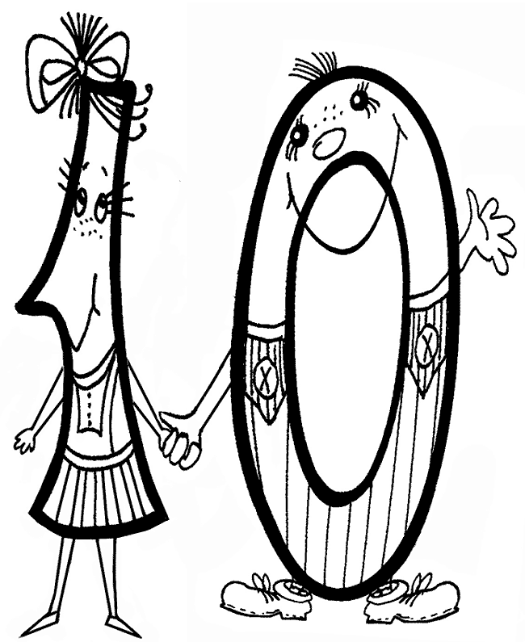
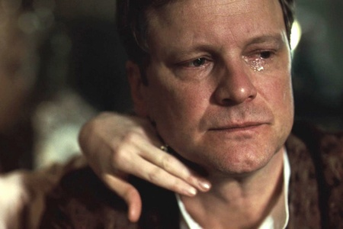
The King’s Speech
The plot tells of the Duke of tape, which is preparing to take office of British King George VI, father of Queen Elizabeth II. After his brother abdicates, the hero reluctantly agrees to the throne. Plagued by a terrible nervous stammer and doubts about their abilities to lead the country, George seeks the help of an unorthodox speech therapist named Lionel Logue.

Slide 12


