Slide 1
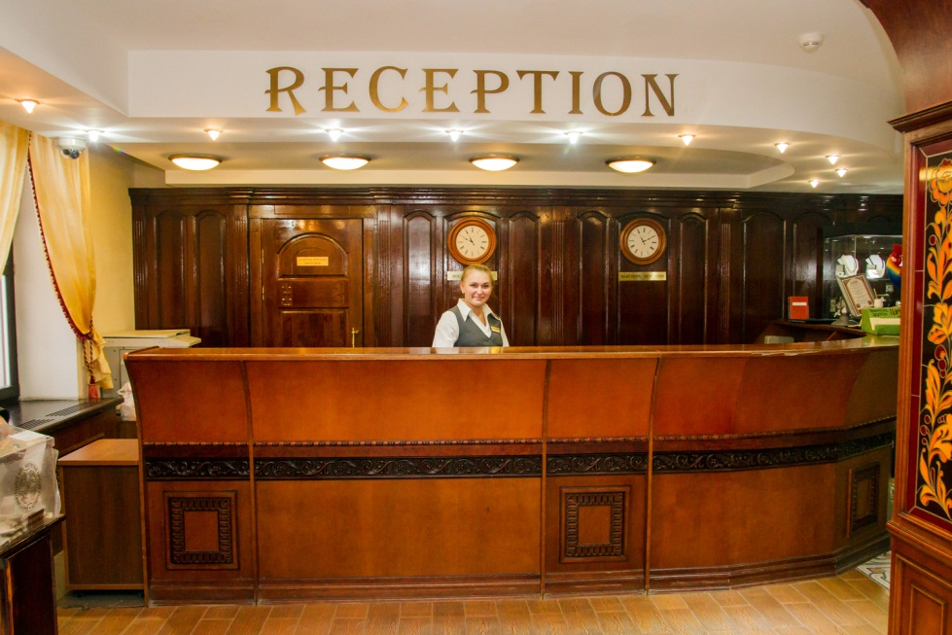
the hotel receptionist
by Bondarenko svetlana 9-a

Slide 2
the hotel receptionist
If you enjoy meeting and helping all kinds of people, this could be a great job for you.
Hotel receptionists make guests feel welcome, manage room bookings (also known as reservations) and deal with requests that guests make during their stay.
A hotel receptionist also needs to be friendly and professional at all times, be able to look after several things at once and always stay calm, sometimes under pressure

Slide 3

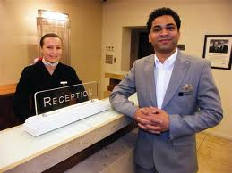
the hotel receptionist

Slide 4

What Education do you need?
Many employers will prefer you to have a good standard of general education and possibly some GCSEs (A-C) in subjects such as English, maths and IT. Some employers may also want you to have experience of using a telephone switchboard or a computerised reservations system.
Although previous experience in customer service or office work would also help you, you can also prepare for this work by taking a relevant college course.

Slide 5
Entry requirements
You will need good administration and customer service skills for this job. IT skills will also be useful to work with computerised booking and payment systems. Many employers will want you to have a good standard of general education, including GCSEs (A-C) in maths and English.
You could prepare for this work by taking a relevant full-time or part-time college course, to gain some of the knowledge and skills needed in this job. Courses include:
Level 1 Certificate in General Hospitality
Level 1 Award in Introduction to Employment in the Hospitality Industry
Level 1 Award in Introduction to the Hospitality Industry
Level 2 Award in the Principles of Customer Service in Hospitality, Leisure, Travel and Tourism.

Slide 6
Skills, interests and qualities
As a hotel receptionist you will need to have:
excellent written and spoken communication skills
strong customer service skills
a friendly and professional telephone manner
the ability to adapt to different guests
patience and tact
the ability to stay calm under pressure and look after several things at once
good problem solving skills
the ability to use computerised technology
a methodical approach to your work
accuracy and attention to detail
It may also be useful if you speak a foreign language.

Slide 7
More information about this work
As a hotel receptionist, your main duties would include:
dealing with bookings by phone, e-mail, letter, fax or face-to-face
completing procedures when guests arrive and leave
choosing rooms and handing out keys
preparing bills and taking payments
taking and passing on messages to guests
dealing with special requests from guests (like booking theatre tickets or storing valuable items)
answering questions about what the hotel offers and the surrounding area
dealing with complaints or problems.

Slide 8
Training and development
You will normally be trained on the job by experienced staff. Some employers also run their own training schemes and you may be encouraged to work towards qualifications, such as:
Level 2 (NVQ) Diploma in Front of House Reception
Level 2 Certificate In Hospitality and Catering Principles (Front of House Reception)
Level 3 Award in Principles of Supervising Customer Service Performance in Hospitality, Leisure, Travel and Tourism
Level 3 Advanced Diploma in Reception and Front Office Services.

Slide 9
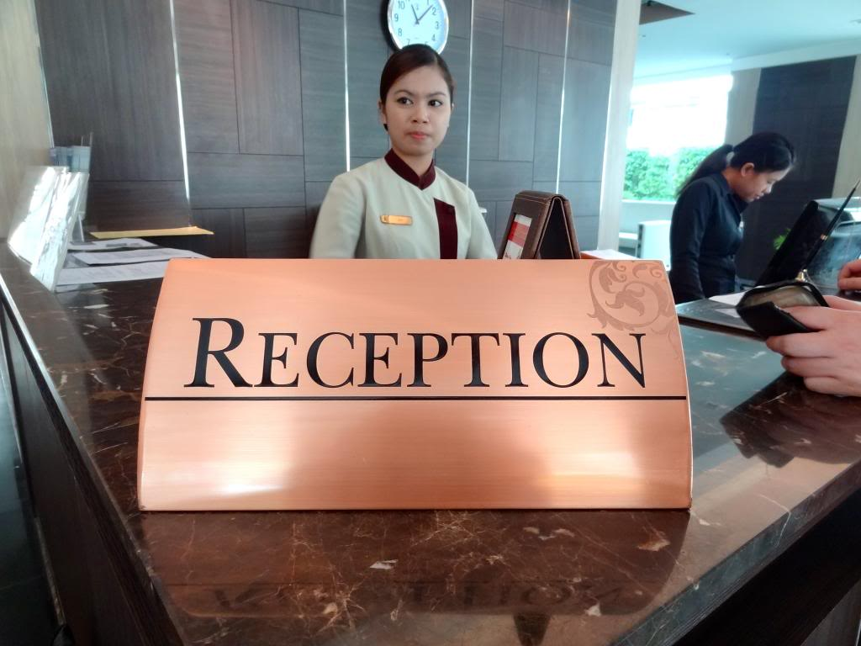
How to Become a Hotel Receptionist (8 steps)

Slide 10

How to Become a Hotel Receptionist (1 step)
Understand the job description.
While job duties will vary from hotel to hotel, there are certain responsibilities that all hotel receptionists are required to manage. These include handling reservations and cancellations, managing payments, answering questions, taking messages, managing the front desk and answering the phone.

Slide 11

How to Become a Hotel Receptionist (2 step)
Prepare to work a variety of shifts.
Working as a hotel receptionist will require you to work days, nights, weekends and sometimes overnight. Be prepared to keep a flexible schedule.

Slide 12
How to Become a Hotel Receptionist (3 step)
Get a well-balanced education. A minimum of a high school diploma will be required, and some college courses will also help you become a hotel receptionist.
Take English and communications classes that will provide you with the ability to communicate effectively verbally and in writing.
Take math and finance classes so you are prepared to handle payments and money.
Look for opportunities to take hospitality courses. Many community colleges and online schools offer classes in travel, tourism and hotel management.

Slide 13
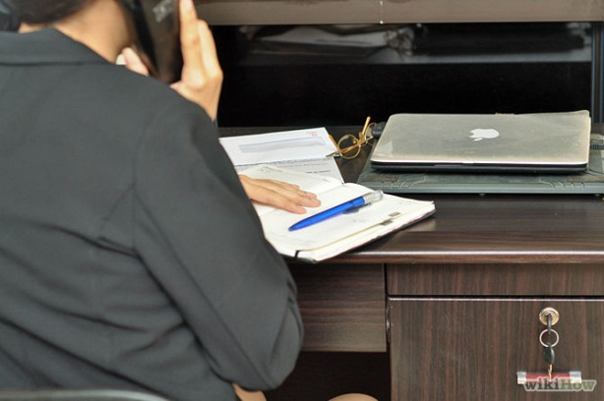
How to Become a Hotel Receptionist (4 step)
Obtain experience in office and front desk functions.
Work as a receptionist or an office assistant in a professional setting. This will help you learn skills required of a hotel receptionist.
Answer phones, greet customers, organize paper and computer files, and get experience managing multiple administrative functions.

Slide 14

How to Become a Hotel Receptionist (5 step)
Sharpen your customer service skills. Working as a clerk in a retail setting, or in a call center will give you the customer service experience that you need to become a hotel receptionist.
Provide answers to questions, resolve complaints, and maintain a cheerful, positive and professional attitude when dealing with customers.

Slide 15

How to Become a Hotel Receptionist (6 step)
Keep up with computer software and technology. Many hotels will have specific databases and online reservation systems that they use. You will need to learn computer programs quickly.
Learn how to use Microsoft Office, including Word, Excel, Access and Outlook

Slide 16

How to Become a Hotel Receptionist (7 step)
Put together a hotel receptionist resume that reflects your education and experience. Make sure you have an objective line, which references your goal of becoming a hotel receptionist.

Slide 17
How to Become a Hotel Receptionist (8 step)
Look for job opportunities.
Check online job search websites such as CareerBuilder, Monster and Indeed. You can perform a search using specific keywords such as "hotel receptionist" and choosing the city or state you want to work in.
Drop off your resume at local hotels where you would like to work. Ask to speak to the manager and introduce yourself. This will give you a chance to demonstrate your professional, positive attitude and personality.

Slide 18
Congratulations! Now you can become a hotel receptionist .

