Slide 1
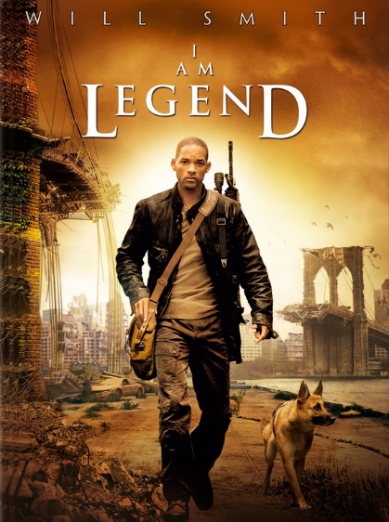
Film Review
I Am Legend

Slide 2
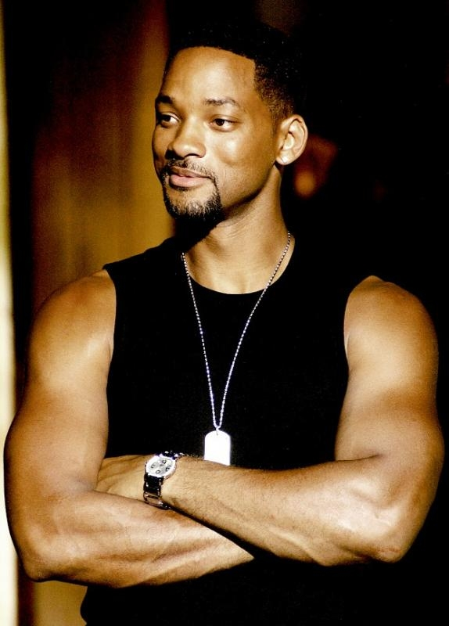
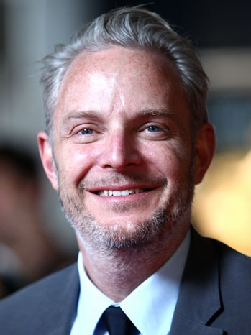
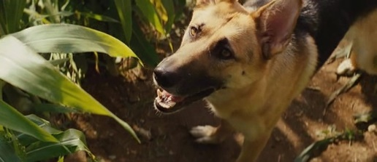
I Am Legent (2007), directed by Francis Lawrence. Is fantasy, thriller, drama film.
The main stars are Will Smith (Robert Nevyll) and his dog Sam (Samanta).

Slide 3
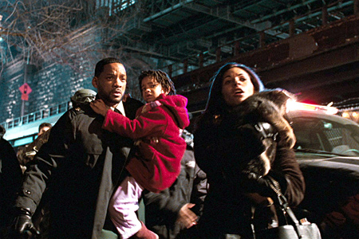
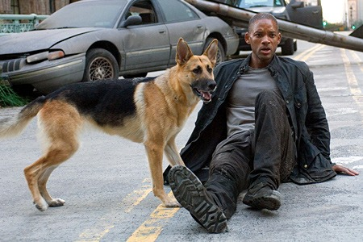
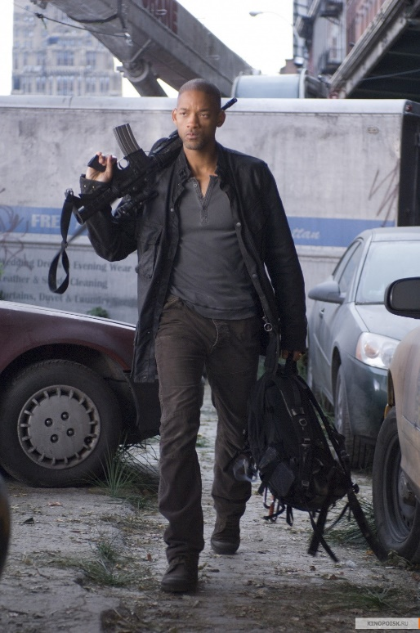
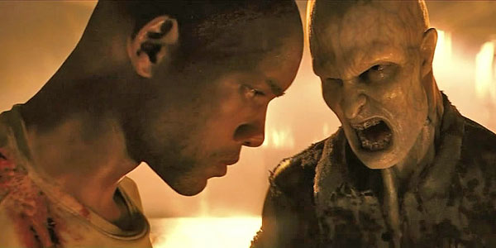
In New York an unknown virus that killed half the population of the globe and the other half turned into a vampire or zombie.

Slide 4
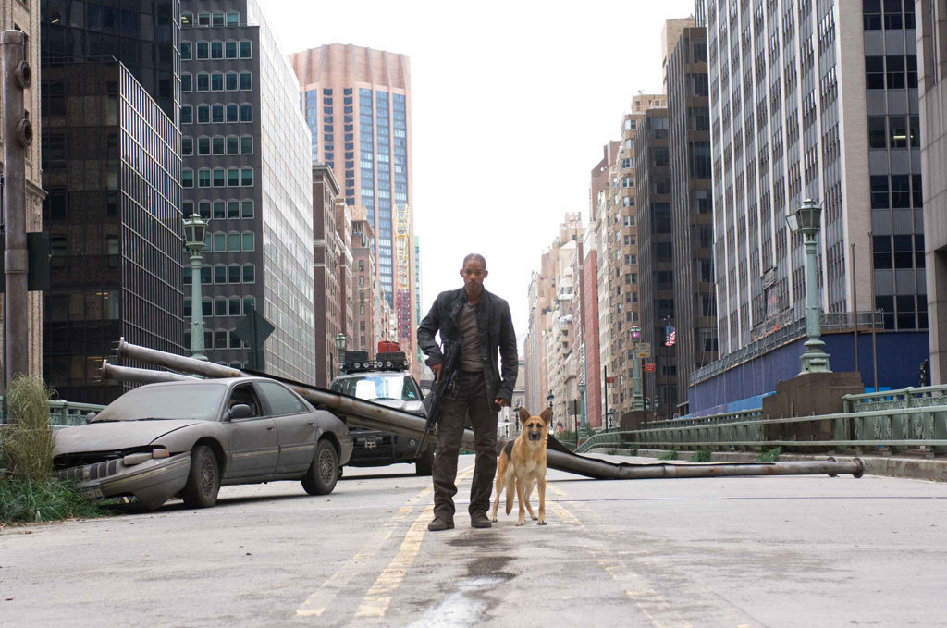
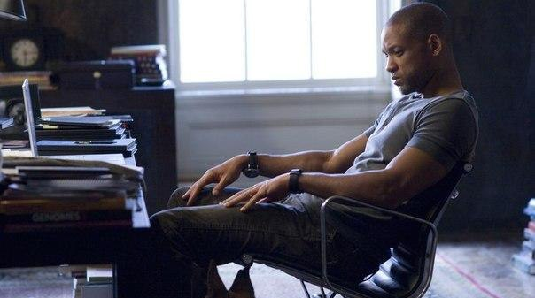
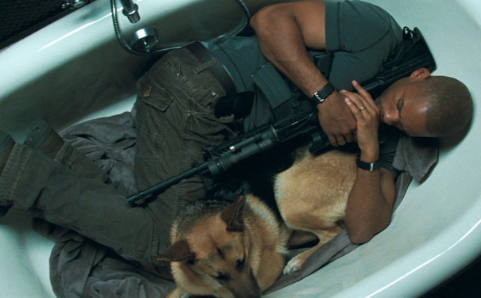
The plot is built around the only surviving person with unexplained immunity, nights holding endless siege of ghouls, and the day trying to find an antidote, and find out the causes of the epidemic.

Slide 5
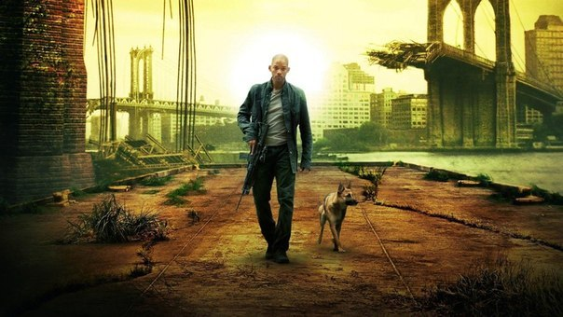
However, most of the special effects are excellent and the acting is good as well.

Slide 6
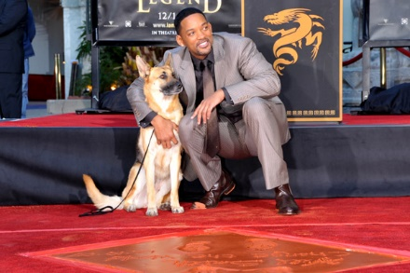
I really enjoyed I Am Legend. It’s really a good film.

