Slide 1
Outstanding People
of Ukraine

Slide 2
In the history of humanity there have always been people whose actions and ideas produced a great impact on the lives of other people.
They have made a great contribution to the science, culture, social life of this country.
That's why they are called outstanding

Slide 3
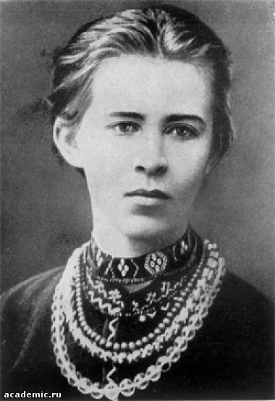
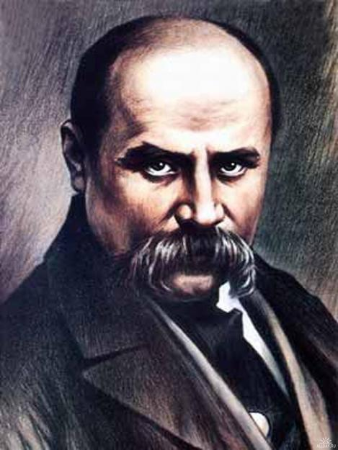
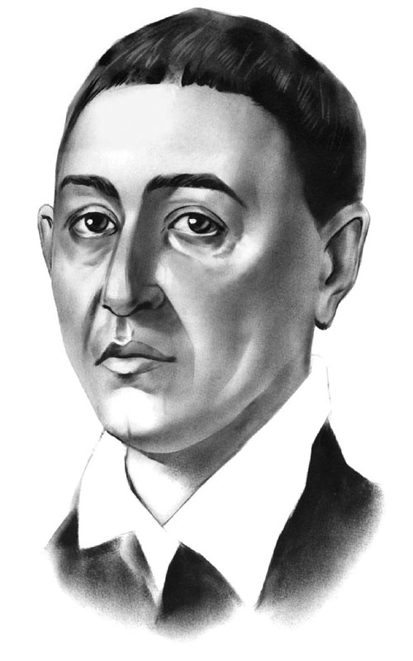
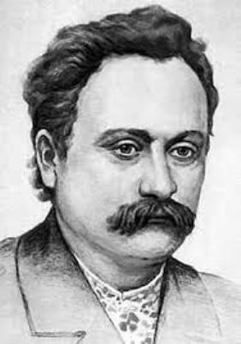
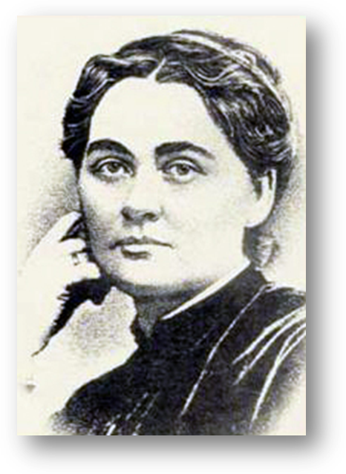
The names of Taras Shevchenko, Lessya Ukrainka, Ivan Franko, Marko Vovchok and Grigoriy Skovoroda won
universal recognition.

Slide 4
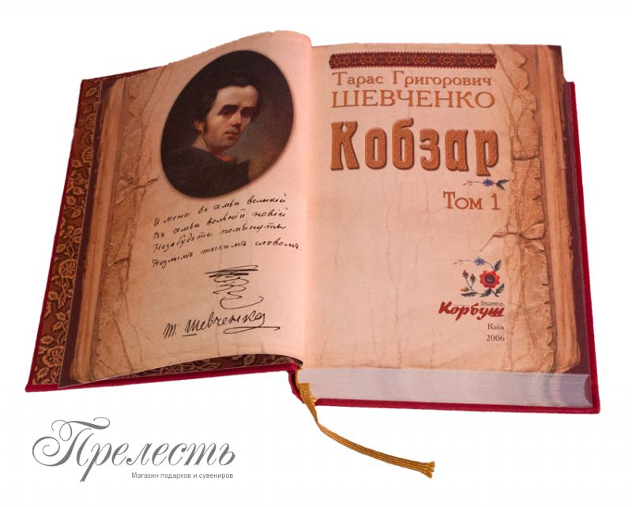
There's hardly a country in the world which doesn't have Taras Shevchenko's poems translated into its language.

Slide 5
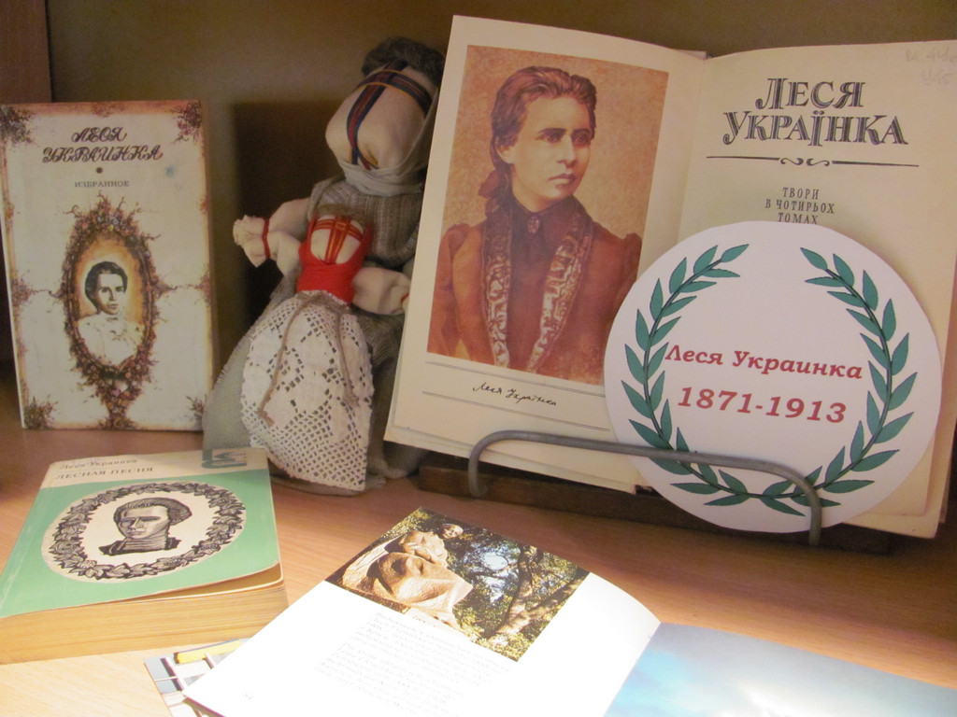
Gentle melodies and deep emotions of Lessya Ukrainka's verses are dear to poetry-lovers throughout the world.

Slide 6
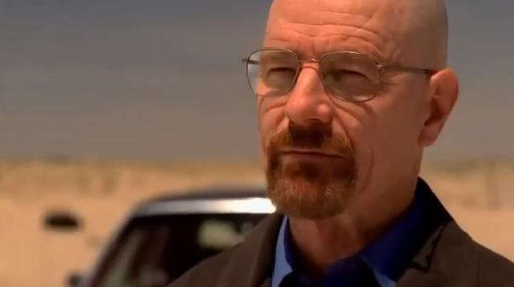
Ukraine has also given the world many outstanding scientists.

Slide 7
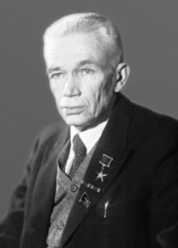
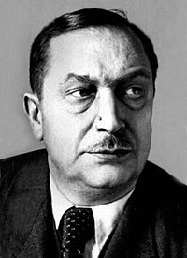
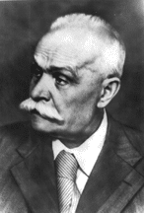
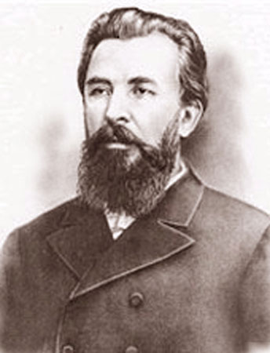
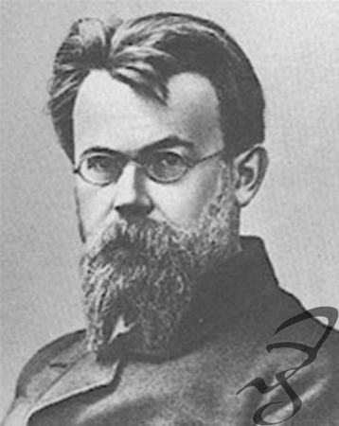
Such names as Vernandskyi, Zabolotnyi, Bogomolets, Sklifosovskyi, Paton, Filatov are well-known all over the world.

Slide 8
Nowadays modern Ukrainian scientists achieved great successes in the field of mathematics, physics, biology and
medicine.

Slide 9
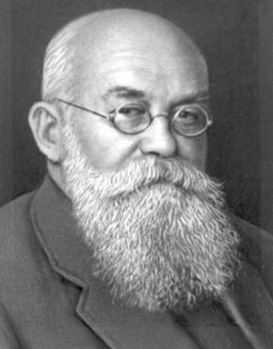
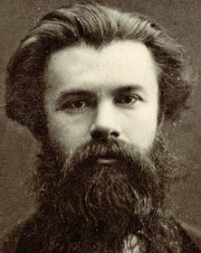
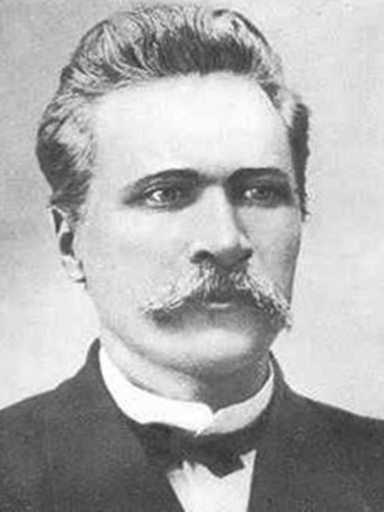
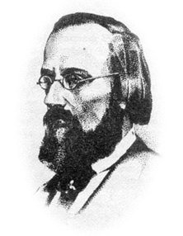
Great contribution to the world's historical science was made by such prominent Ukrainian historians as Mykola
Grushevskyi, Mykhailo Dragomanov, DmytroYavornitskyi, Mykola Kostomarov.

Slide 10
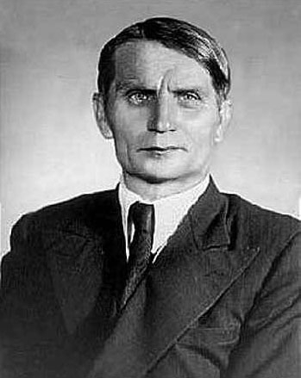
The Ukrainian national composer school is connected with the name of Mykola
Lysenko. M. Lysenko's operas "Taras Bulba", "Nataika Poltavka", "Eneida" are still staged at the world's opera houses.

Slide 11
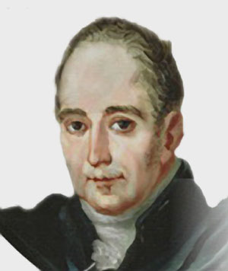
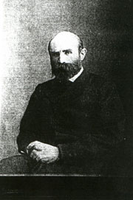
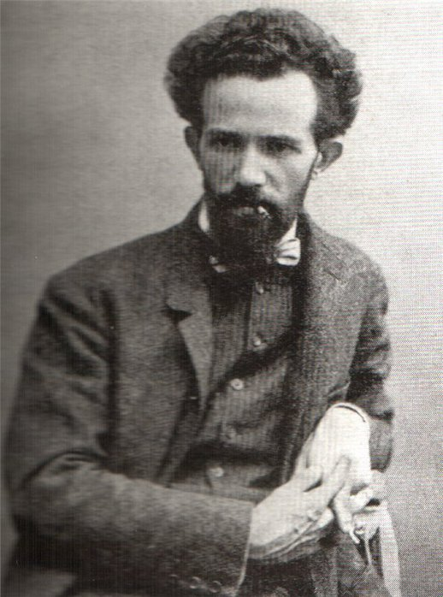
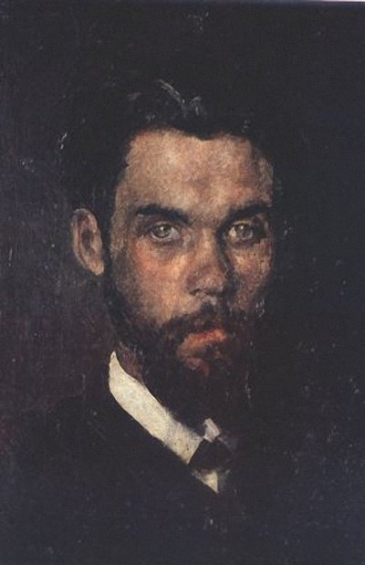
The Ukrainian fine art is represented by the names of Kostandi, Murashko, Borovikovskyi, Pimonenko.

Slide 12
The Ukrainian culture always developed human traditions of the mankind.

Slide 13
END

