Slide 1
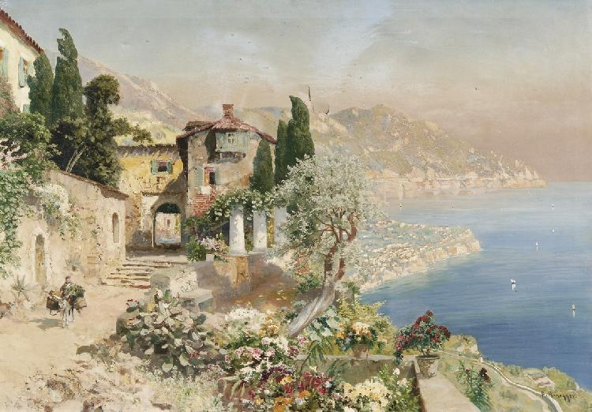
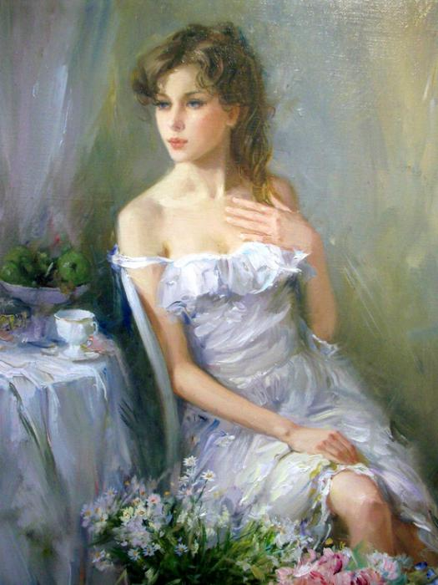
«My favorite artists: Konstantin Razumov and Alois Arnegger»
Prepared by
Julia Khakhaleva

Slide 2
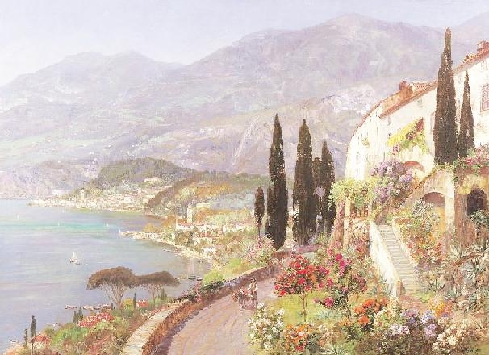
They are so different, but at the same time both incredibly talented. One of them stunning landscape painter, the other a great realist.

Slide 3
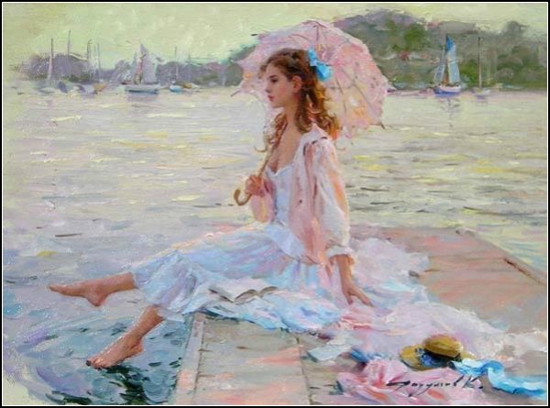
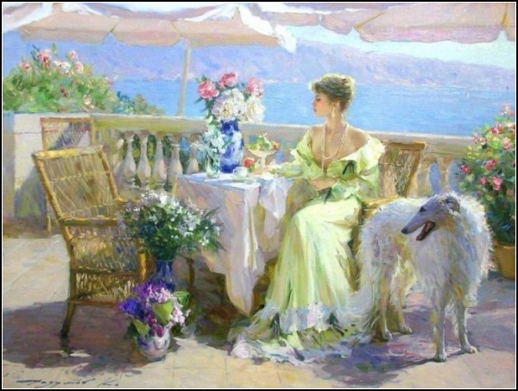
Konstantin Razumov
We always associate the eternal feminine with Konstantin Razumov. In his paintings, he returns to the same image as to preserve the unique features which dear to his heart.

Slide 4
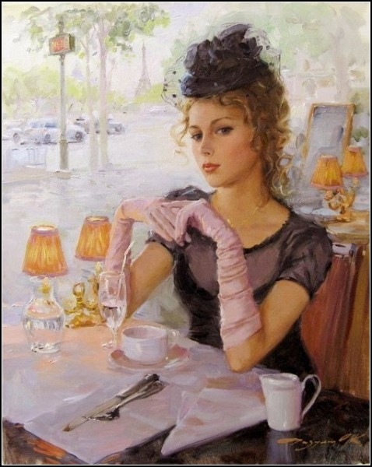
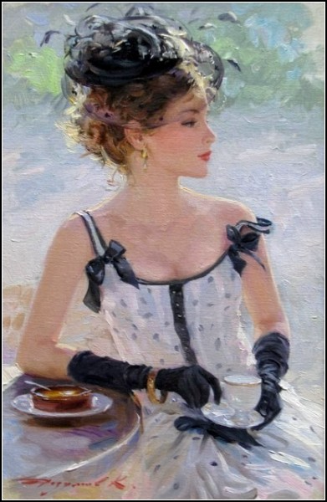
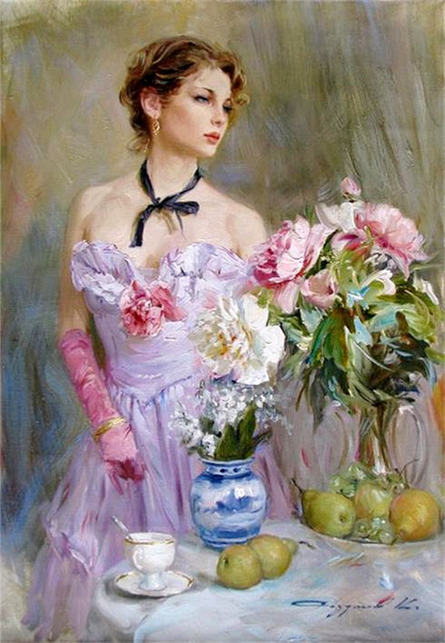
However, the dream of the artist moves to another time, so you will not see a portrait of a modern woman.

Slide 5
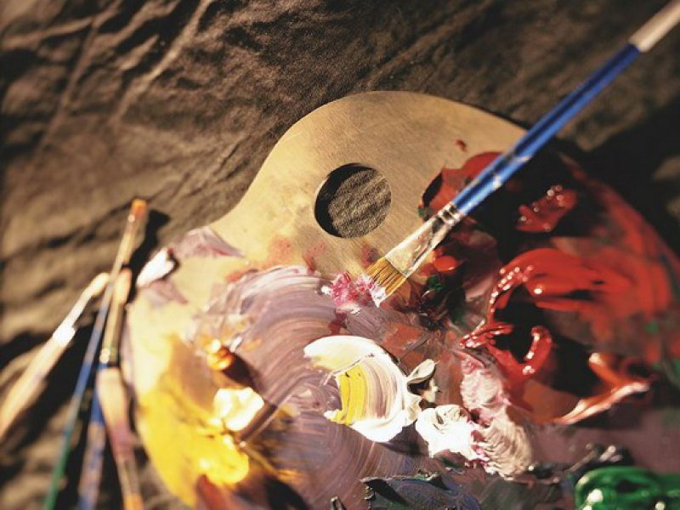
Konstantin Razumov was born in 1974 in Zarinsk. He studied art first at Novoaltaisk Art School, then at the Russian Academy of Painting, Sculpture and Architecture. Now the artist lives and works in Moscow.

Slide 6
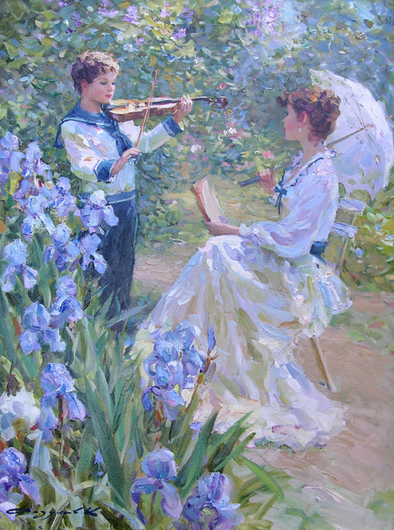
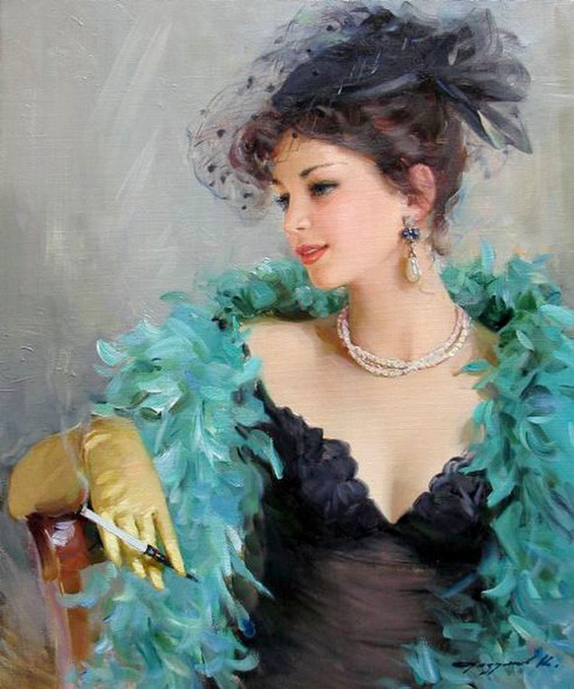
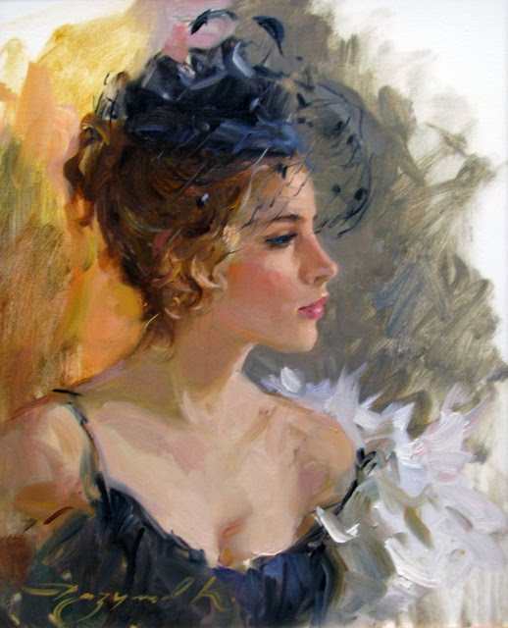
Many styles was influenced on Konstantin Razumov formation as an artist , but in the end he gave the benefit of the combination of realism and impressionism.

Slide 7
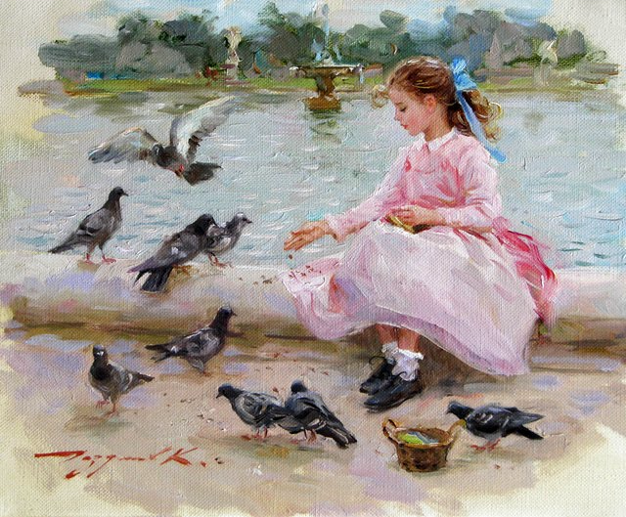
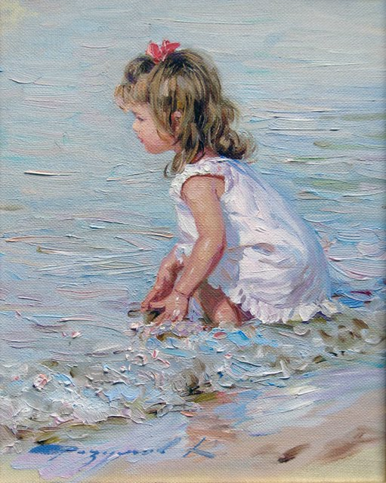
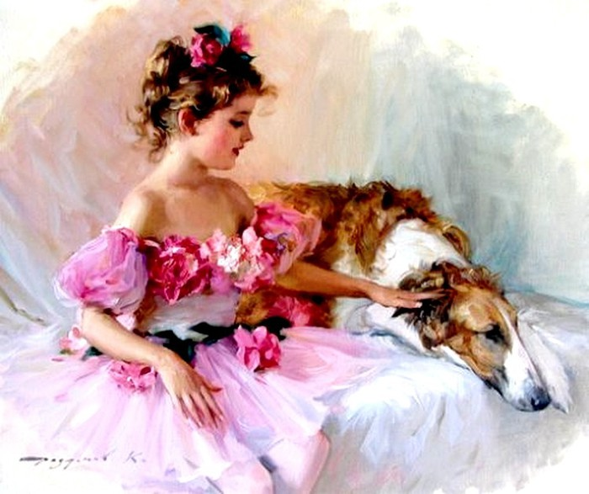
This can be seen in any of his paintings: he writes a realistic portrait, but the backgrounds are usually deprived of specificity which characteristic for Impressionism.

Slide 8
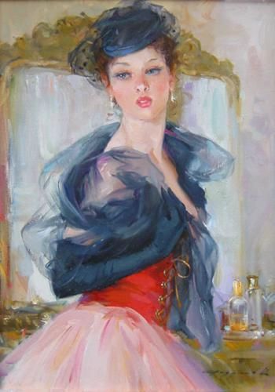
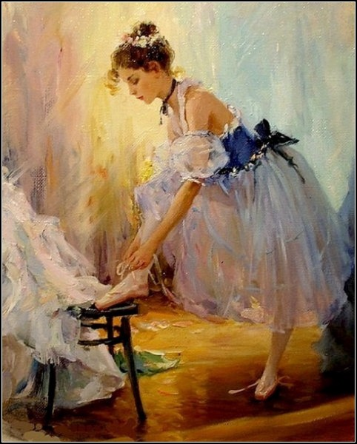
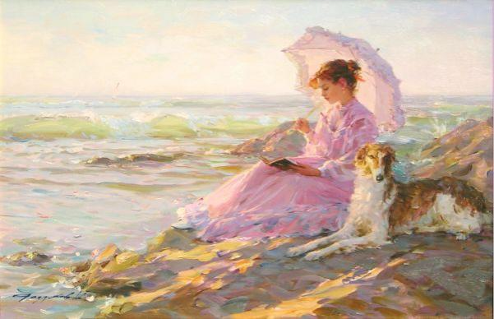
The woman is charming, refined and feminine in paintings by Konstantin Razumov and quite unlike the modern ladies. The artist writes extremely realistic features of the woman. In fact, it is the same lovely lady who passes from one picture to another.

Slide 9
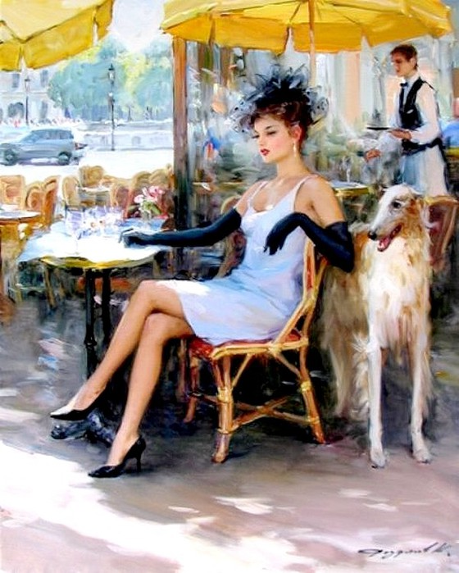
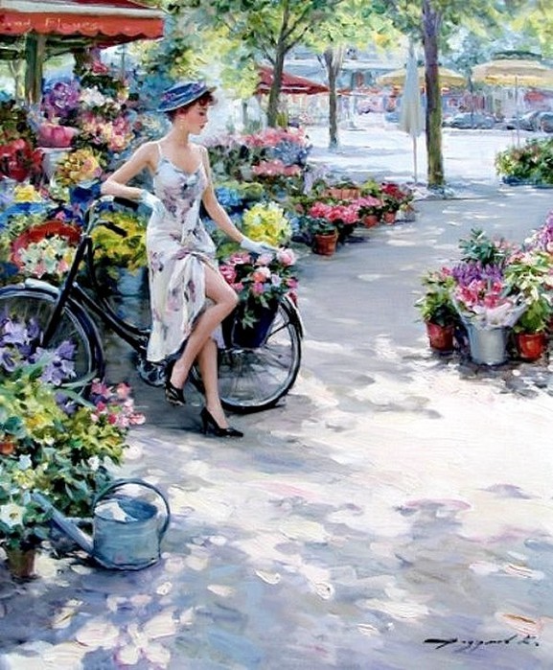
Gallery

Slide 10

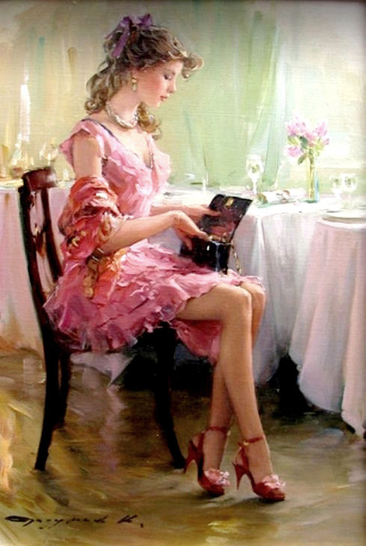
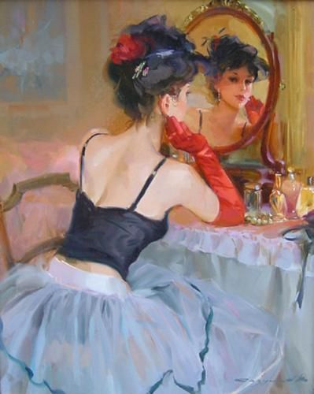

Slide 11
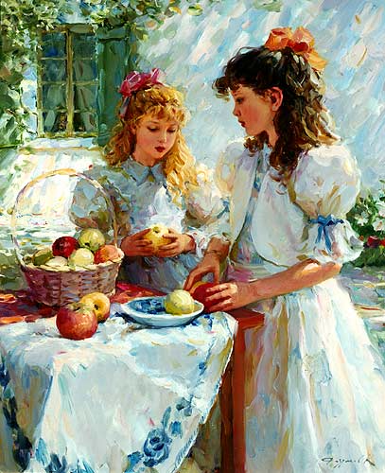
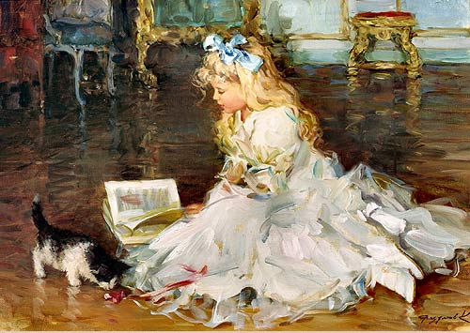
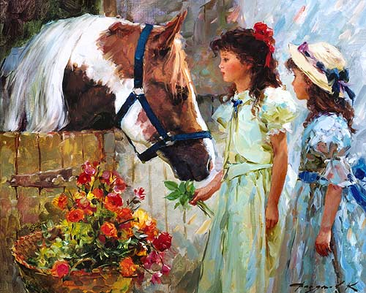

Slide 12

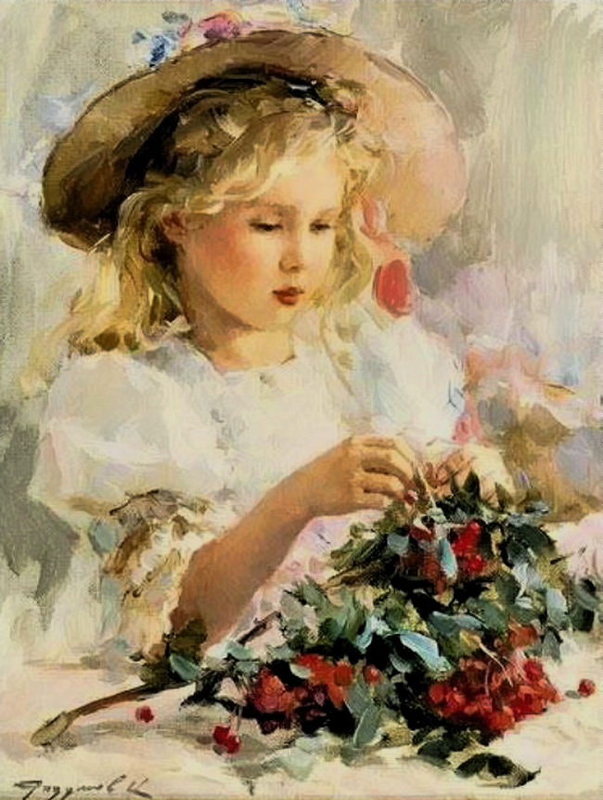

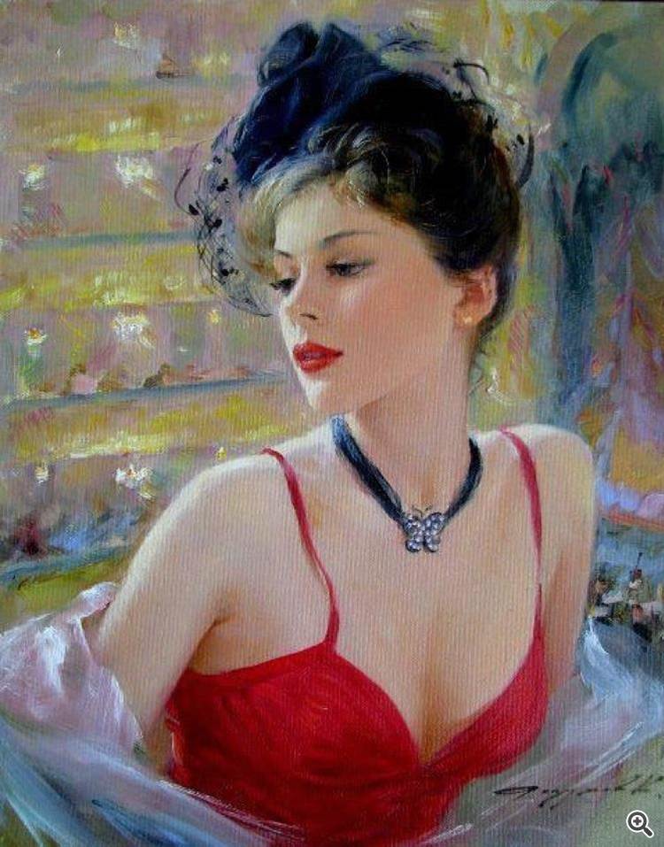

Slide 13
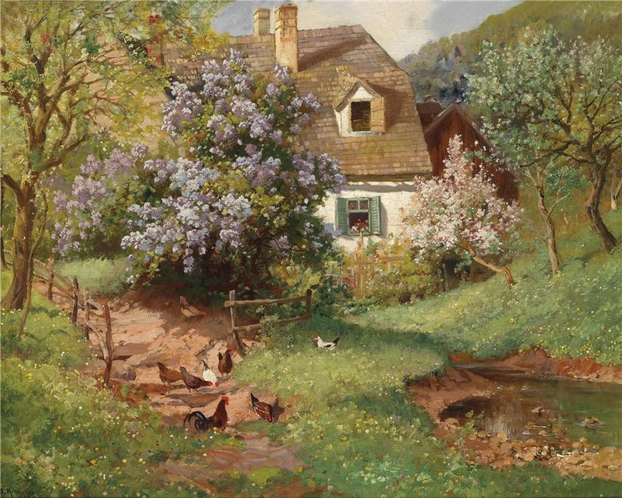
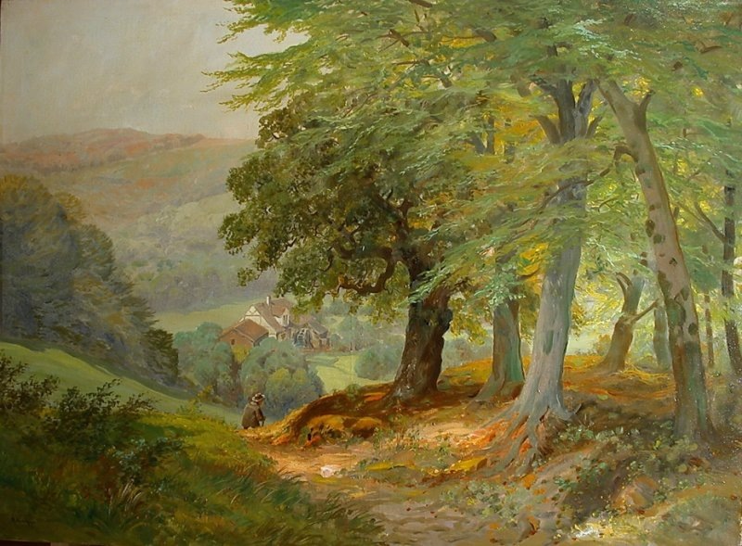
Alois Arnegger
Alois Arnegger (1879 - 1963) - the Austrian landscape painter. You can't but appreciate his paintings, because there is something in his landscapes that reflects our own moods.

Slide 14
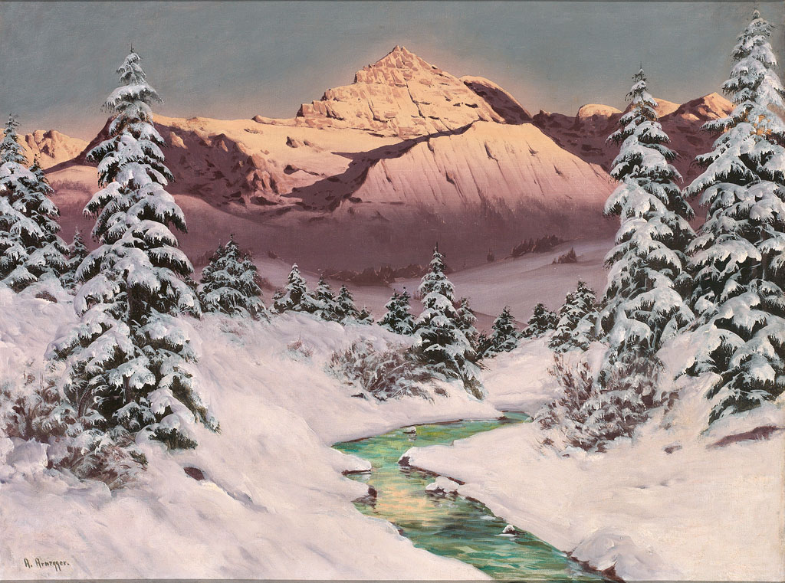
He was born in Vienna and studied art at the Academy of Fine Art. Since 1916 - Member of the Vienna Academy.

Slide 15
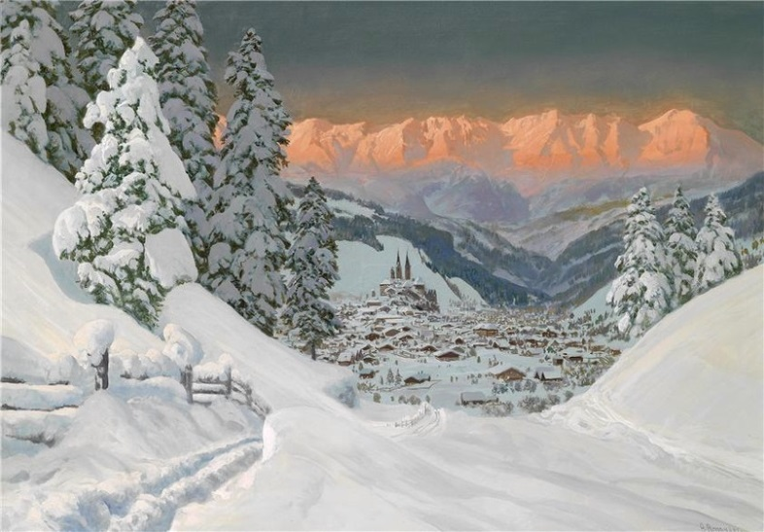
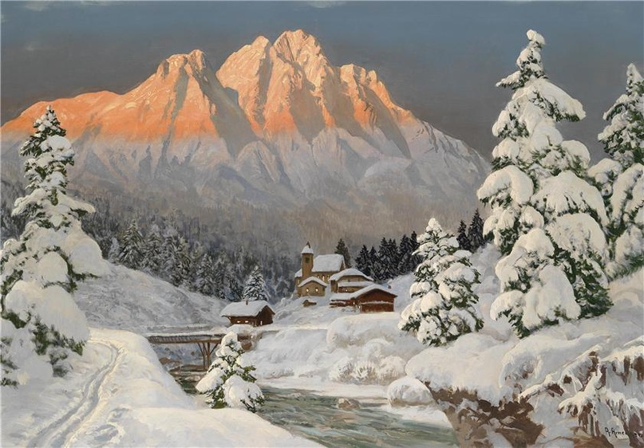
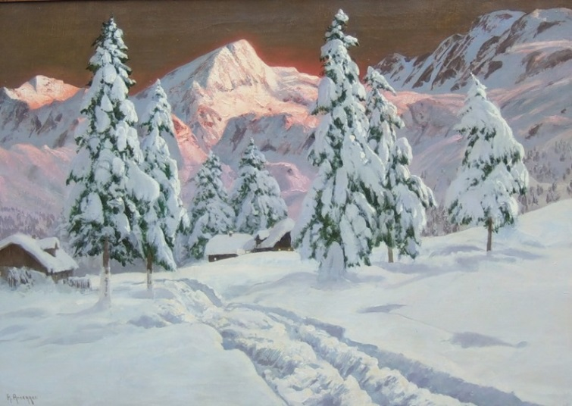
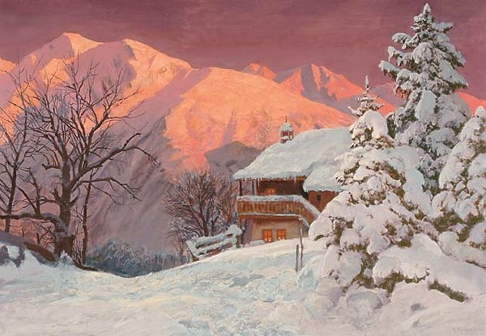
Early in his career Arnegger was focusing on image Austrian landscape. He became known as a landscape painter.

Slide 16
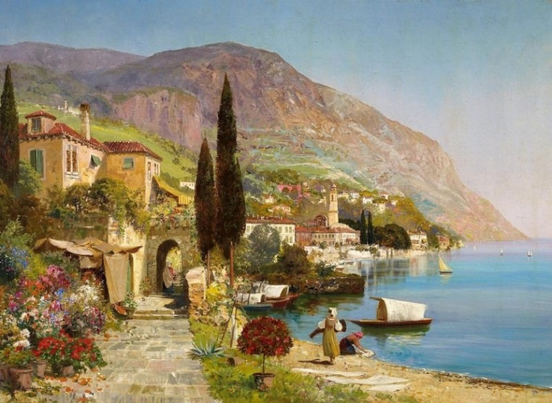
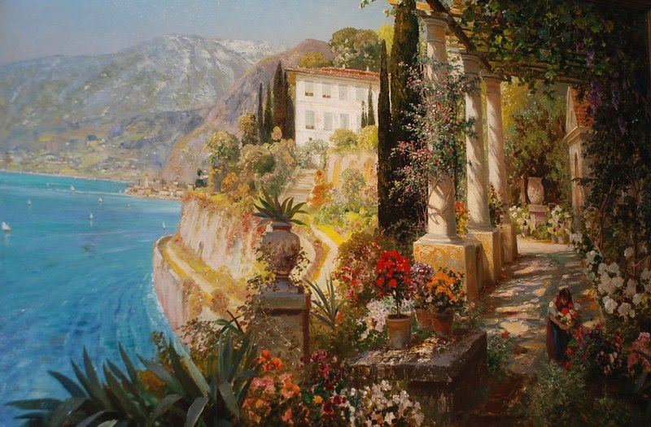
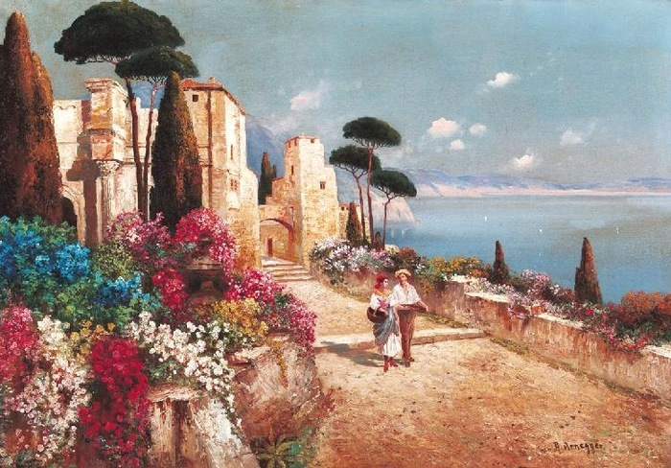
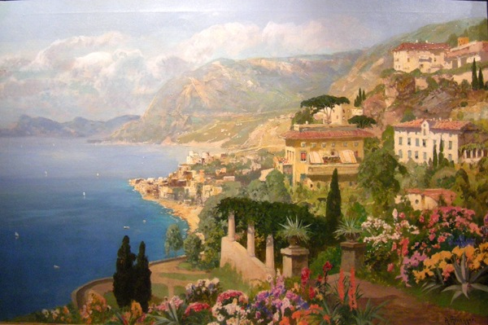
In 1920 Arnegger visited Italy and was fascinated by his coastal views. Since then he has painted a bright and colorful views of Capri, Lake Como and Naples.

Slide 17
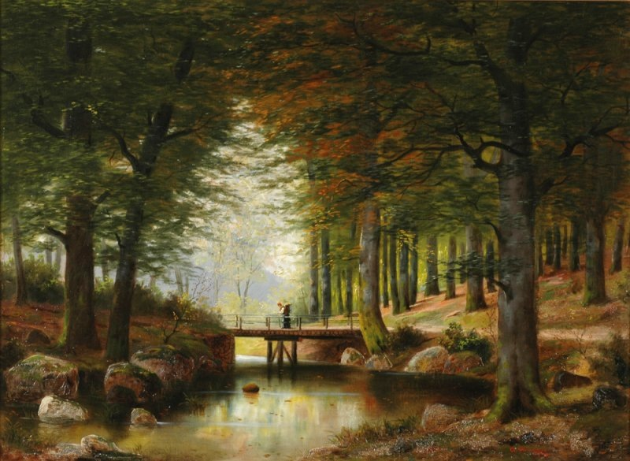
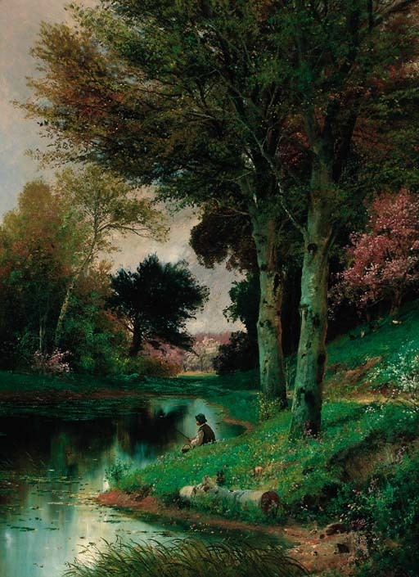
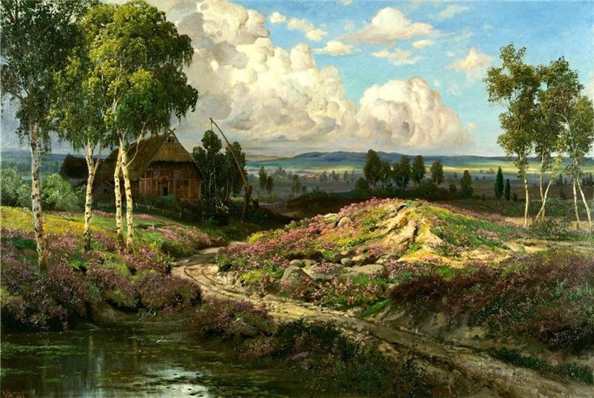
Gallery

Slide 18
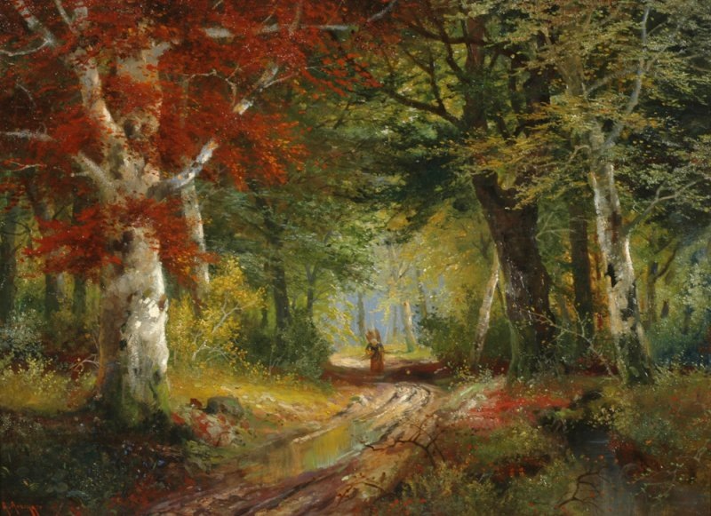
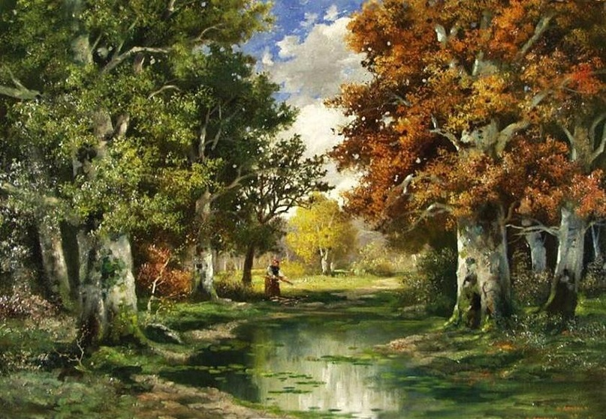
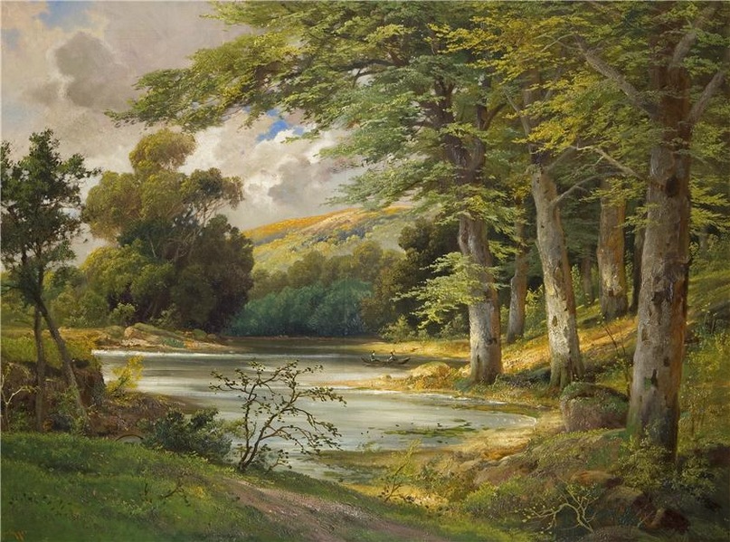
Gallery

Slide 19

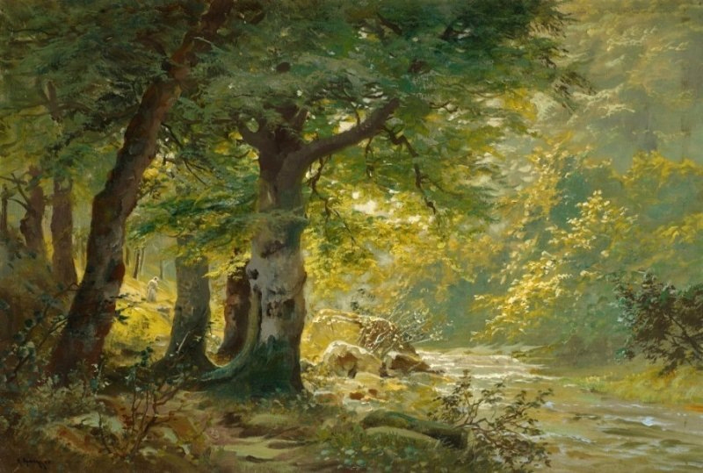
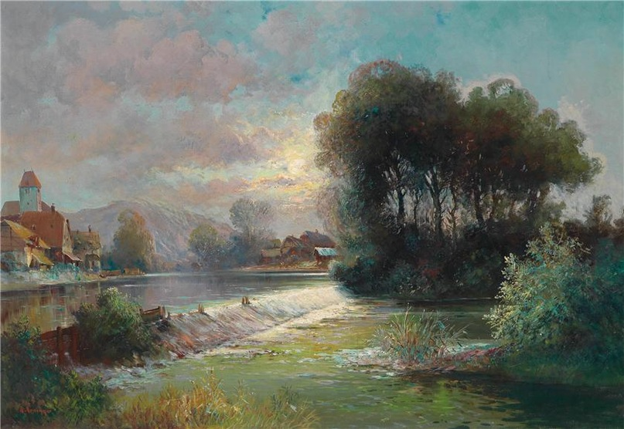
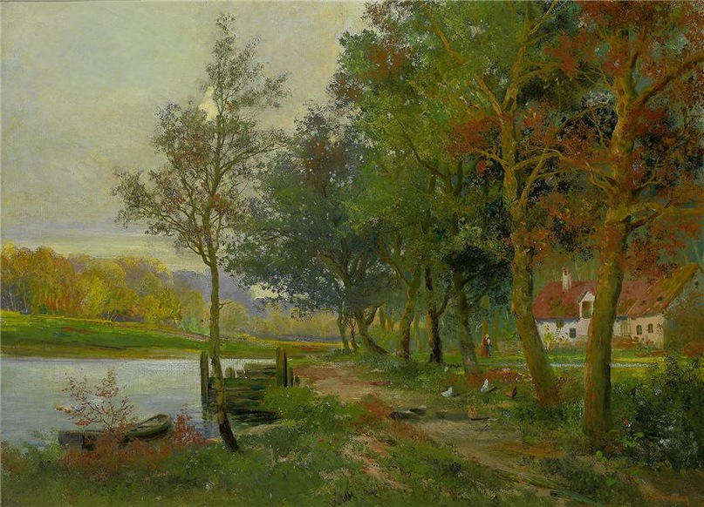
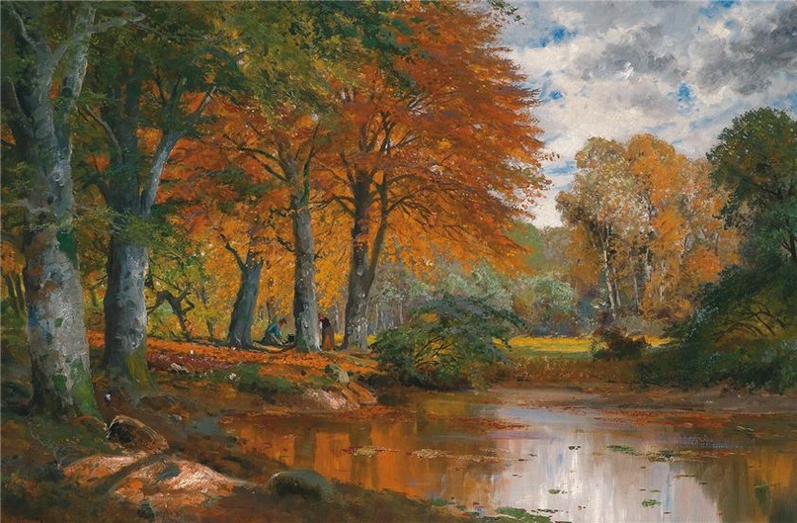

Slide 20

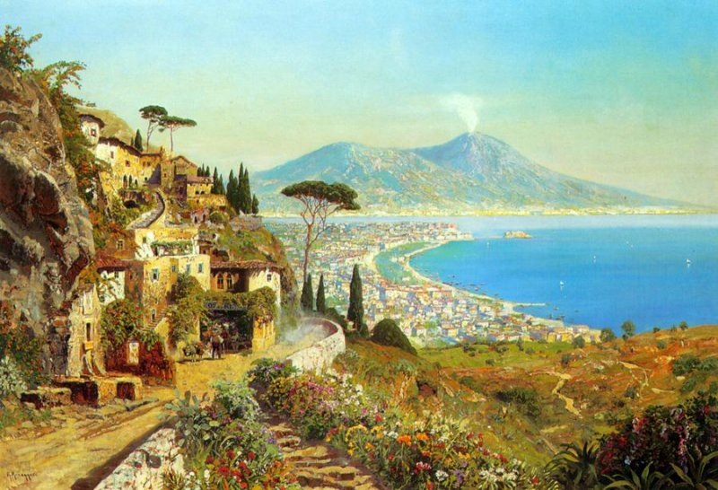
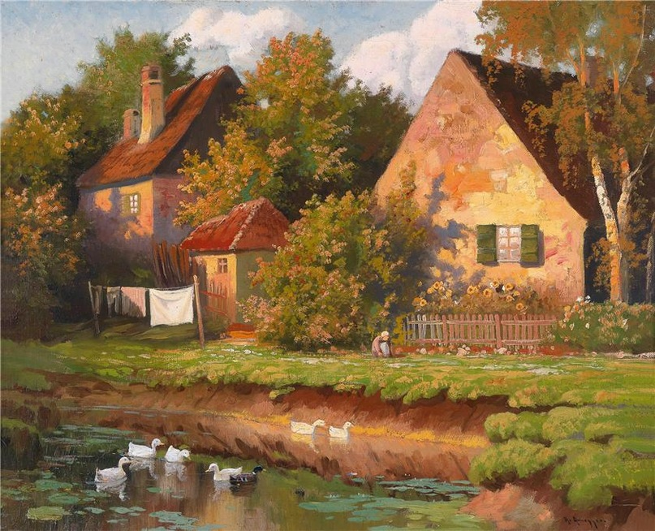



Slide 21


Thank you for
your attention!

