Slide 1
Irish cuisine
Подготовила ученица 10-А Запорожской гимназии № 47 Бабаева Анастасия.

Slide 2
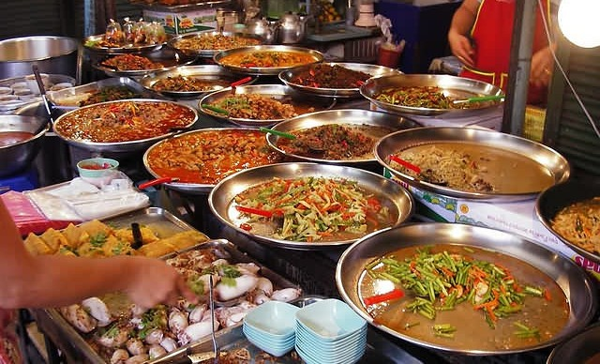
Irish cuisine is simple enough. Close to beach, favorable climate and a large area of the countryside rather strongly influence the products that are prevalent in Northern Ireland. In the XX century Irish cuisine began to experience competition from the wide distribution of Italian, Indian, Chinese cuisines.

Slide 3
If you came to Ireland, the first thing to try is properly cooked Irish Breakfast. This specific set of products that you may require in the restaurant and in the hotel day and night. So, if you are willing to try Irish caloric abundance before the tour day, write down:
Fried bacon.
Fried eggs.
Grilled sausages with a side dish of tomatoes and beans.
The piece of black and white meat puddings.
Potato bread-Fudge.
Sweet tea with milk.
Soda bread soda faris.

Slide 4
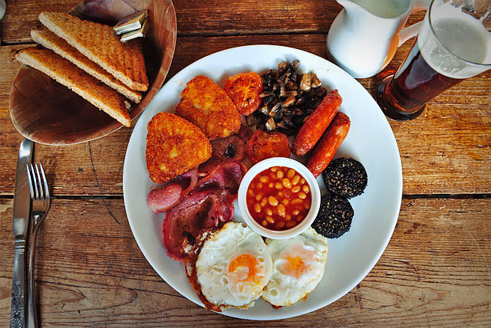
Irish Breakfast

Slide 5
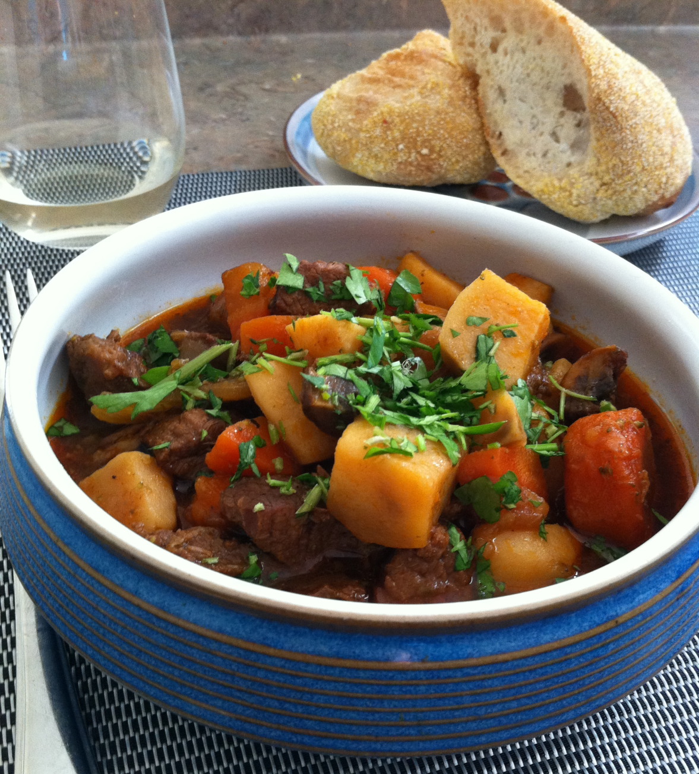
Main dishes in any restaurant - Celtic steak (beef tenderloin with whiskey and Irish Stew Irish stew.
Irish Stew is made from layers of delicious braised lamb brisket with potatoes, onions and spices. Dish long extinguished the small fire, and usually served with pickled red cabbage.

Slide 6
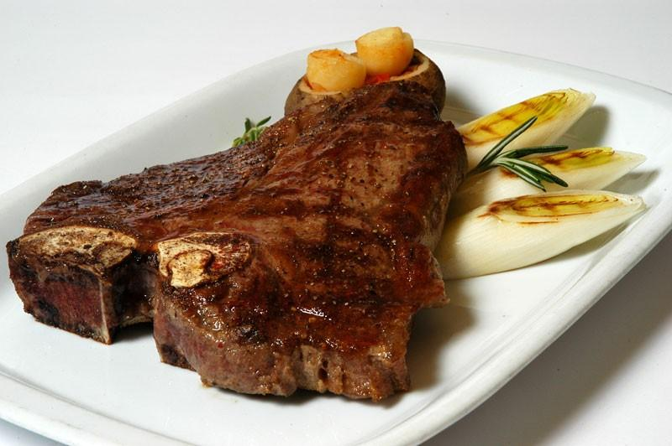
Celtic steak to prepare beef,dark beer,black pepper and salt.Fry steak with two sides on the grill in the oven or BBQ.

Slide 7
The potato has long been the main crop of the country.
Boxty is a traditional pancakes from a mix of grated raw and mashed boiled potatoes with the addition of flour and soda. And in addition to these components, every woman has to boxty their special secret ingredients.
Champ - mashed potatoes with green onions.
Colcannon - mashed potatoes with cabbage and black pepper.

Slide 8
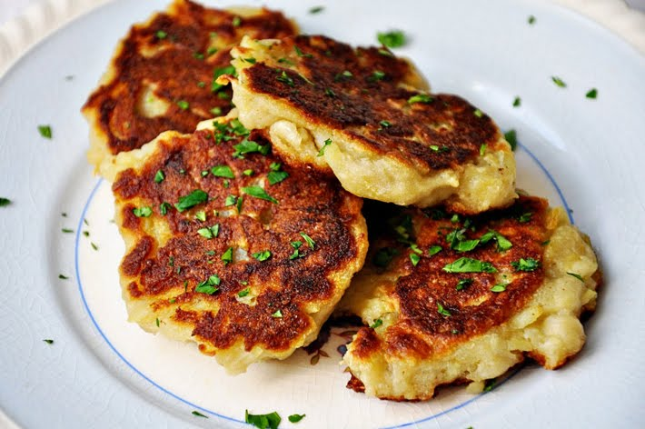
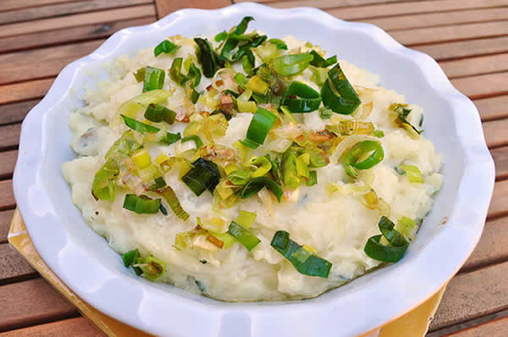
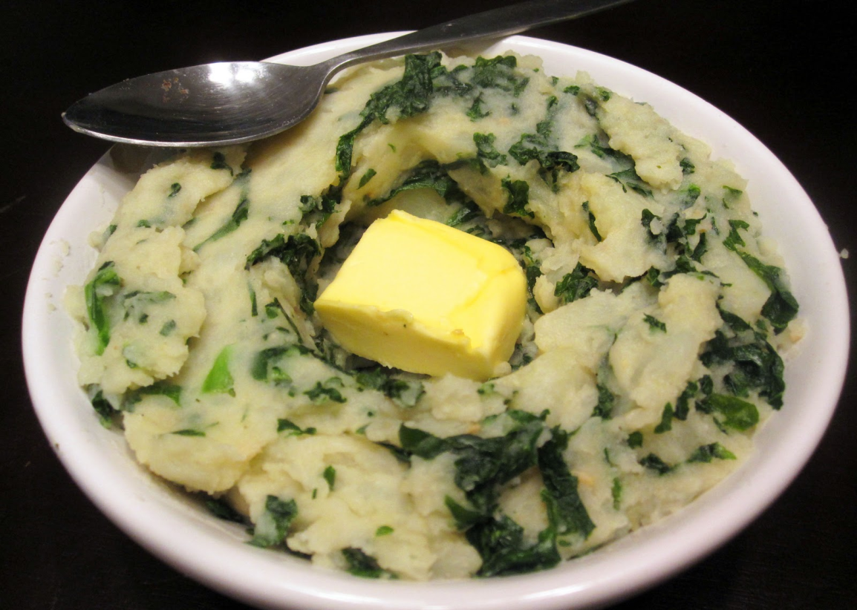

Slide 9
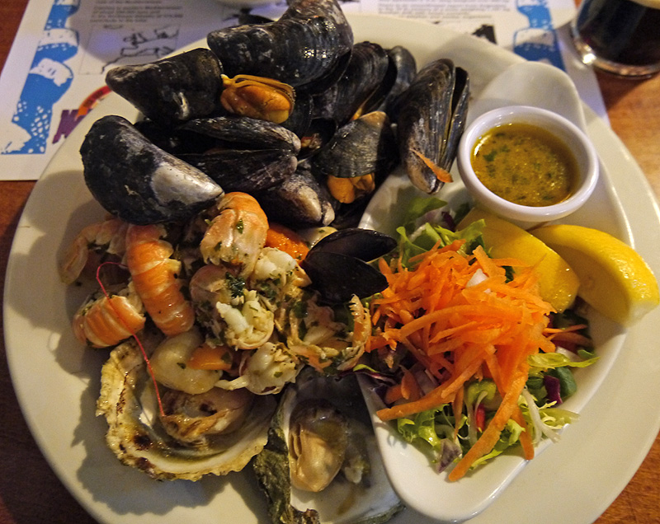
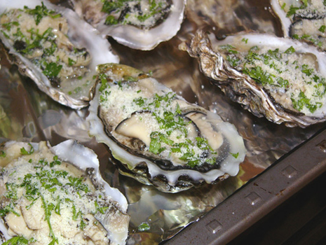
The long coast, of course, makes Ireland a country abundantly consume fish and seafood.
A delicacy here are smoked pink salmon and fresh trout, Irish oysters and crabs from Galway, prawns from the Bay of Dublin, mussels and lobster. On a daily buffet very often you can see pike, eel, perch, cod, mackerel, plaice, whiting and herring.

Slide 10
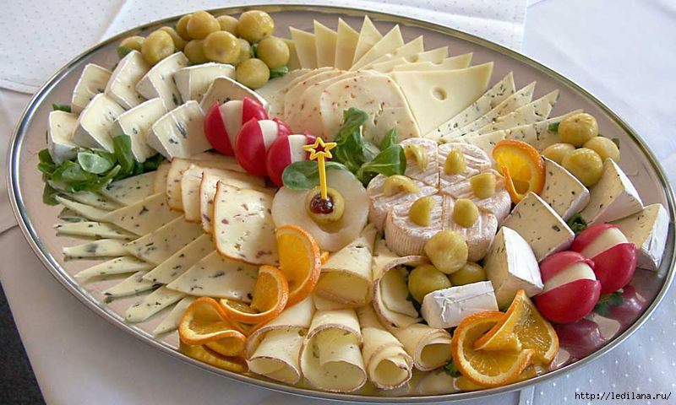
Cheese in Ireland called "white meat". The most delicious varieties: cheese "coolea" with nutty and fruity taste, acute ardrahan"blue mold "cashel blue"and "Milleen", "Doolin", "Blarney castle" and perfectly suitable for beer and whiskey "kahil cheddar" from County Limerick.

