Slide 1
Douglas Adams
Biography and Literary activities
made by
Dariya Karpenko
form 34 Ph

Slide 2

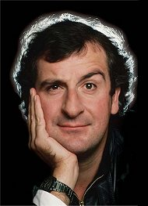
Biography
Was born on the 11th of March 1952 in Cambridge.
Got educated in Brentwood School, then in St John's College, Cambridge.
His first published work was a short story about a man who lost his memory in Eagle comic, age 11.
Started writing and peforming seriously at Cambridge.
Participated for the "Monty Python's Flying Circus" last series.
Worked as the script editor for Doctor Who.
Became famous as an author of “The Hitchhiker’s Guide to the Galaxy”
Died on the 11th of May, 2001 of a heart attack.
«There is an art to flying ... or rather a knack. The knack lies in learning how to throw yourself at the ground and miss.» (с)

Slide 3
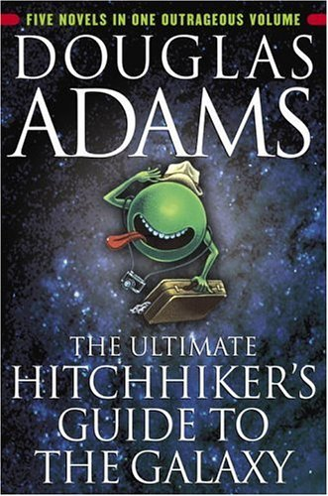
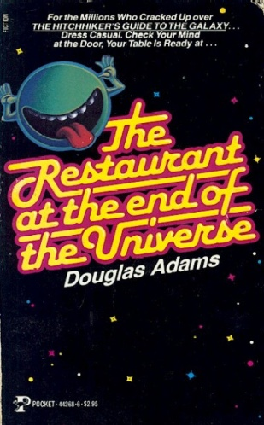
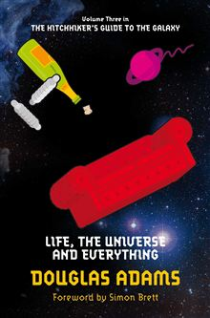
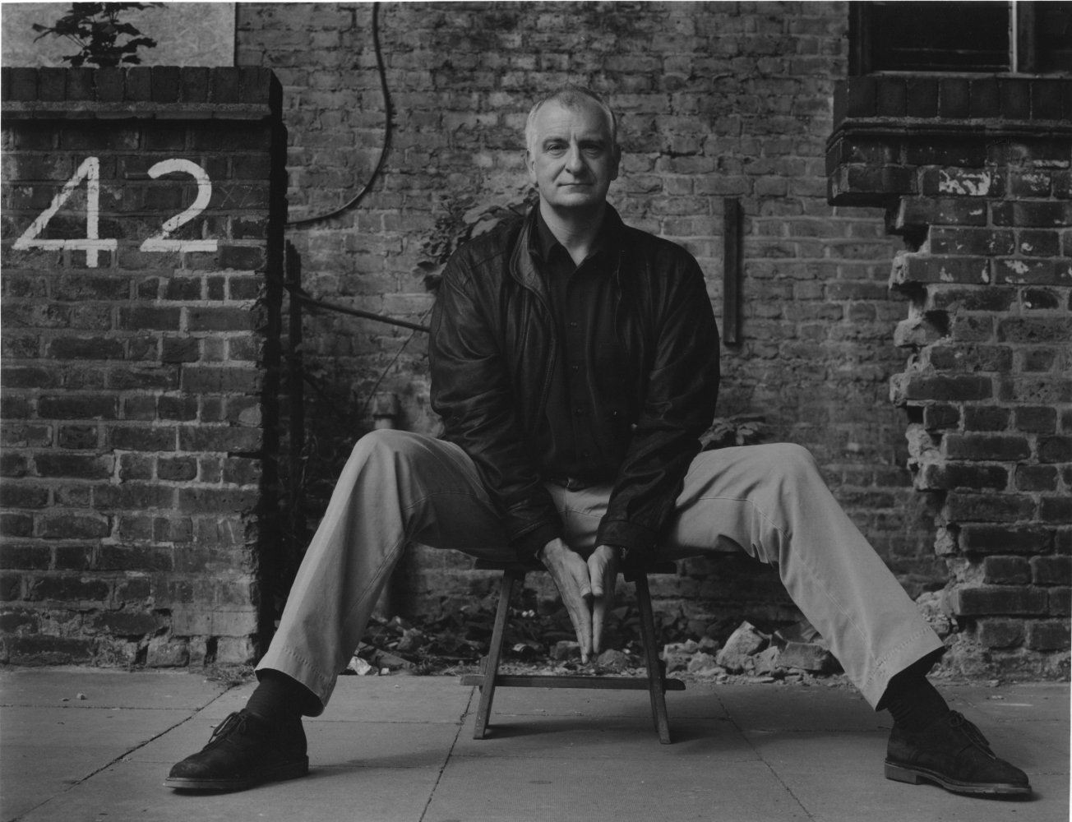
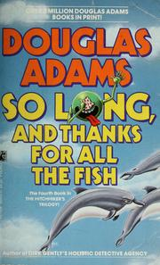
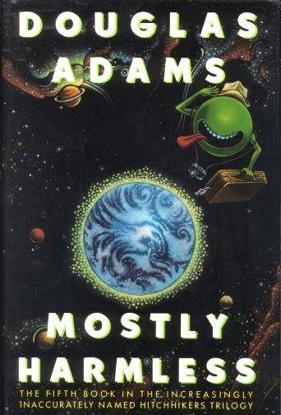
The Hitchhiker's Guide to the Galaxy
A comedy science fiction “trilogy” of 5 books
Was written between 1979 and 1992
A bestseller with circulation 15 millions books

Slide 4

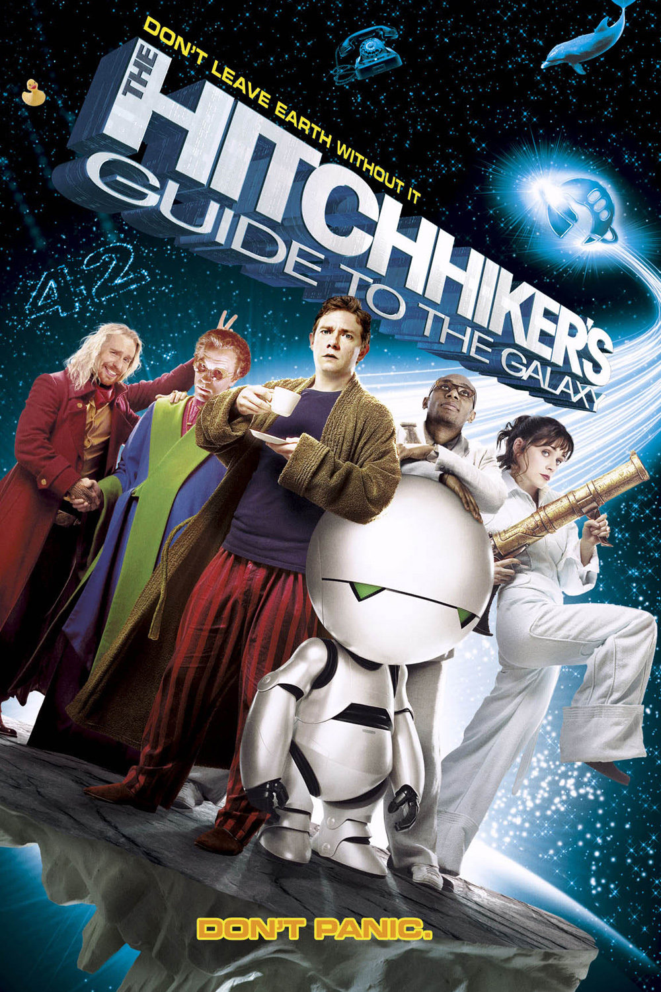

Brief description of the books
The Hitchhiker's Guide to the Galaxy, the main Adam’s work, is a comedy science fiction so-called "trilogy" of five books published between 1979 and 1992.
It tells about the adventures of the unfortunate Englishman Arthur Dent, who with his friend Ford Prefect (a native of a small planet somewhere near star Betelgeuse, working in the editorial "The Hitchhikers Guide to the Galaxy”, where you can learn about absolutely every thing in the Galaxy) miraculously escapes death when the Earth was destructed by alien race Vogons. Zaphod Beeblebrox, Ford’s relative and pluralistically the President of Galaxy, accidentally saves Arthur and Ford from death in outer space. On the board of the stolen by Zaphod spaceship "Heart of Gold" are also depressed robot Marvin and Trillian, aka Tricia McMillan that Arthur once met at a party, who is the only other human survivor of Earth's destruction. During five books heroes have got into incredible scrapes, searching for legendary planet Magrateya, trying to find a question to the Answer to the Ultimate Question of Life, the Universe, and Everything, preventing galactic war and doing many other things, and, doubtlessly, having fun during it.

Slide 5

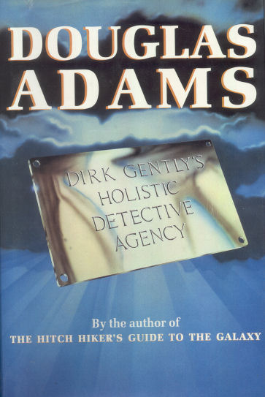

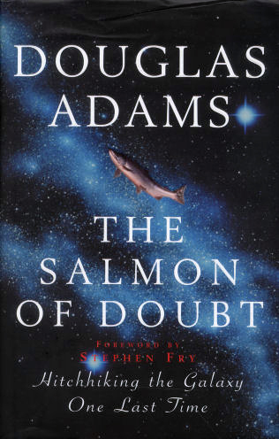
Dirk Gently series
The Salmon of Doubt has to be the third book in the series, but it hasn’t been completed in case of unexpected death of author.
The first book “Dirk Gently's Holistic Detective Agency” was first published in 1987
Was described by author as "a kind of ghost-horror-detective-time-travel-romantic-comedy-epic, mainly concerned with mud, music and quantum mechanics."
A second novel, The Long Dark Tea-Time of the Soul (1988), was published a year later.
Objective genre is a “humorous fantasy detective novel”

Slide 6
Comprehension questions and tasks
1. Which event made Douglas Adams follow a career in writing?
2. What was the name of the TV series, on which Douglas Adams worked as a scriptwriter?
3. What is the genre of “The Hitchhiker's Guide to the Galaxy”?
4. Which number of copies of “The Hitchhiker's Guide to the Galaxy” was sold in the UK?
5. What is the title of a book, on which Douglas Adams started working in the end of his life and which hasn’t been completed?

