Slide 1
Professions
Before each person at a certain time there is a question about choosing a career.
To solve it you need to know about their individual characteristics, interests, preferences. On the basis of strong interest generated addiction a person wants a particular type of activity.

Slide 2
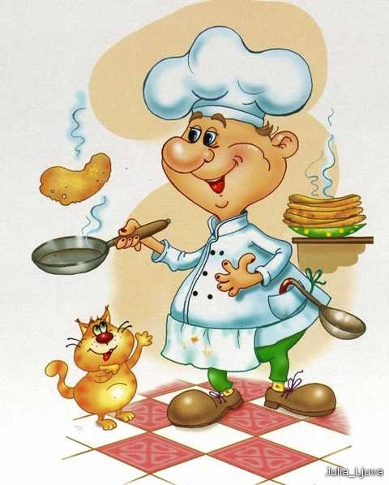

Cook

Slide 3
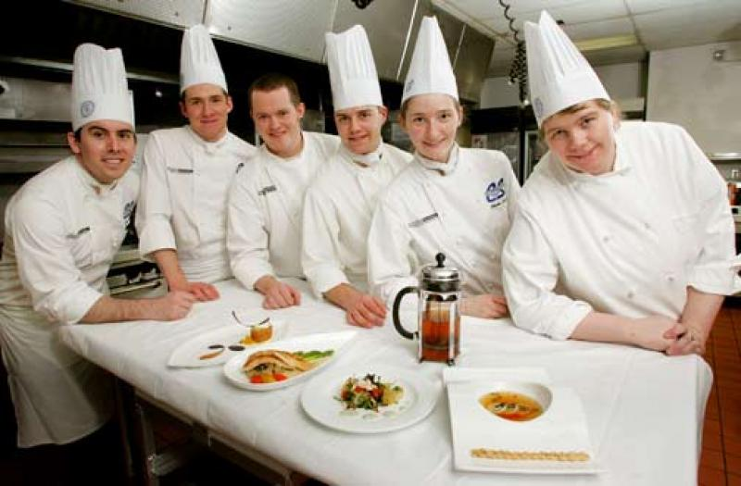
Cook - a person who is engaged in the preparation of food public catering. But these are dry and boring words can not fully describe cookery profession. Because the chef, sometimes called a true magician who can most common products to make a meal, whose name - a masterpiece of taste.

Slide 4

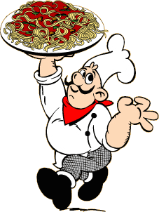
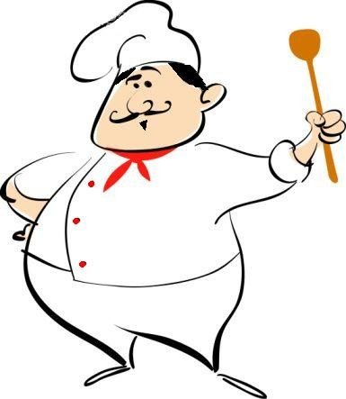
The chef must be an aesthetic taste, imagination, creative inclinations, or on sandwiches and eggs he leaves.

Slide 5


riddles

Slide 6
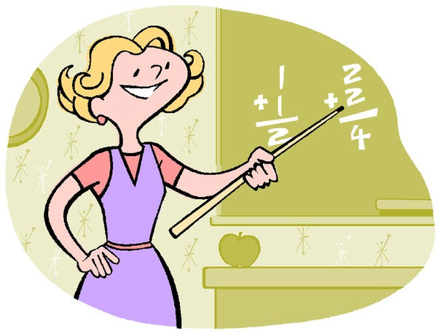
Who teach children to read and write,
The nature of love, respect the elderly?

Slide 7

Who sits at the bedside?
And as a treat, all he says;
Who is sick - he drops offer to accept,
Anyone who is healthy - allow a walk.

Slide 8

Lay the glass eye
Clicked again - and remember you.

Slide 9

With fire fight we must,
With water we companions.
We all need people very,
Reply soon, what are we?

Slide 10

Tell me, who is so delicious
Preparing cabbage soup,
Fragrant meatballs,
Salads, vinaigrettes,
All breakfasts, lunches?

Slide 11

He returned from the flight,
After flying - his job.
All those in the air, boys,
Called ...

