Slide 1
Engineering
Katerina krepak
6-b

Slide 2
Plan
What is engineering?
Main branches of engineering
Skills needed
Pluses / minuses
Greatest Engineering Achievements of the 20th Century

Slide 3
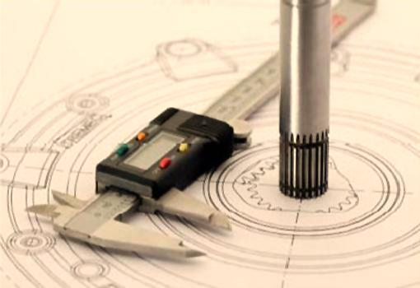
Engineering
Engineering is the application of scientific, economic, social, and practical knowledge in order to design, build, and maintain structures, machines, devices, systems, materials and processes.

Slide 4


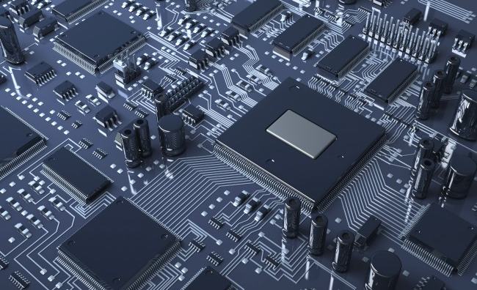
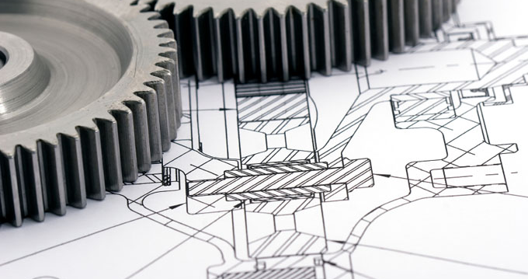
Main branches of engineering
Chemical engineering
Civil engineering
Electrical engineering
Mechanical engineering

Slide 5
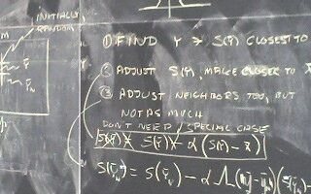

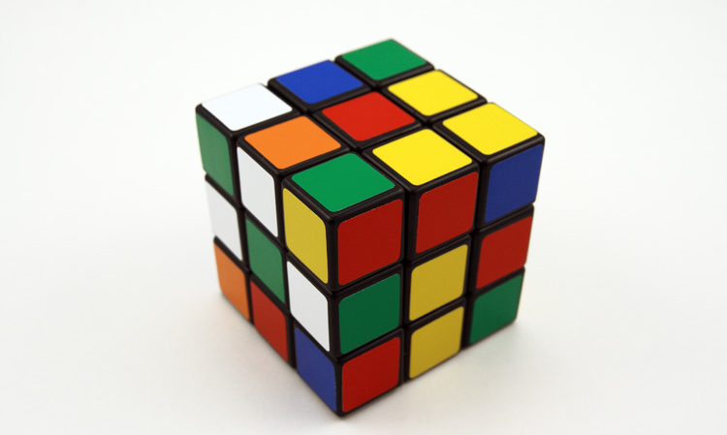

Skills needed
Math skills
Curiosity
Easily solving problems
Communication skills

Slide 6
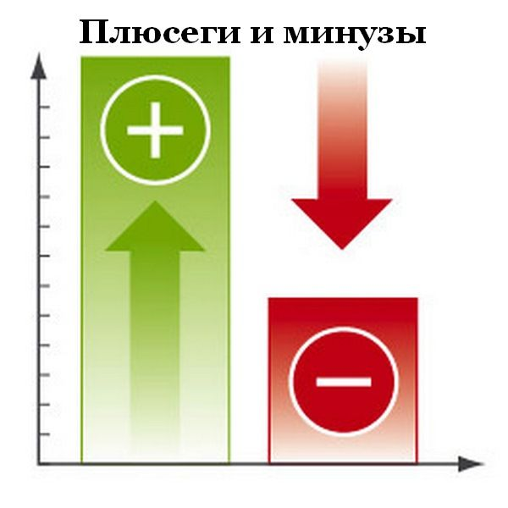
Financial security
Creative work
You must be up-to date
Too long working hours
Many reports

Slide 7
Greatest Engineering Achievements of the 20th Century

Slide 8

Electrification

Slide 9
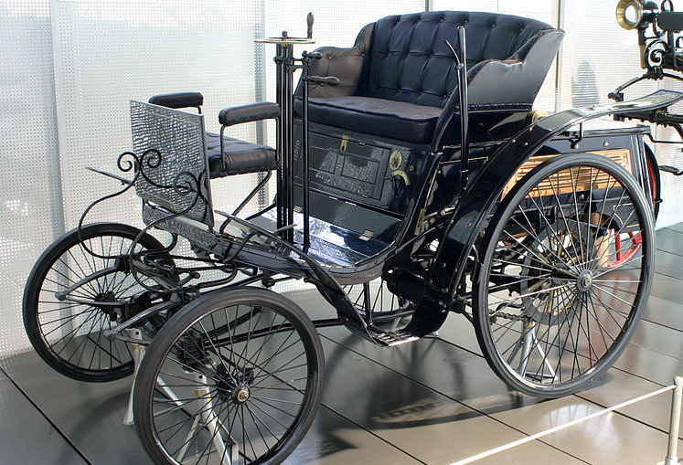
Automobile

Slide 10

Airplane

Slide 11
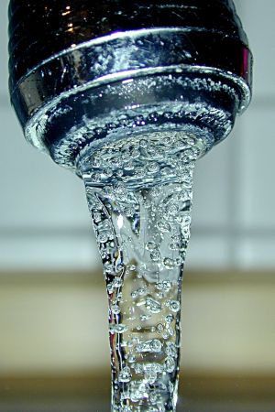
Water supply

Slide 12

Radio

Slide 13
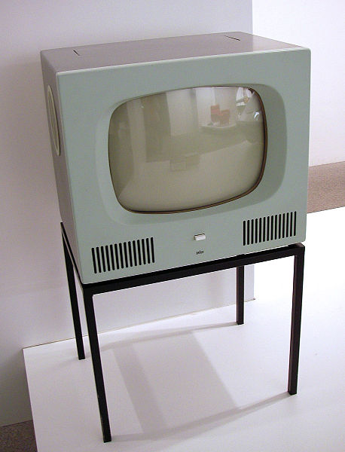
Television

Slide 14
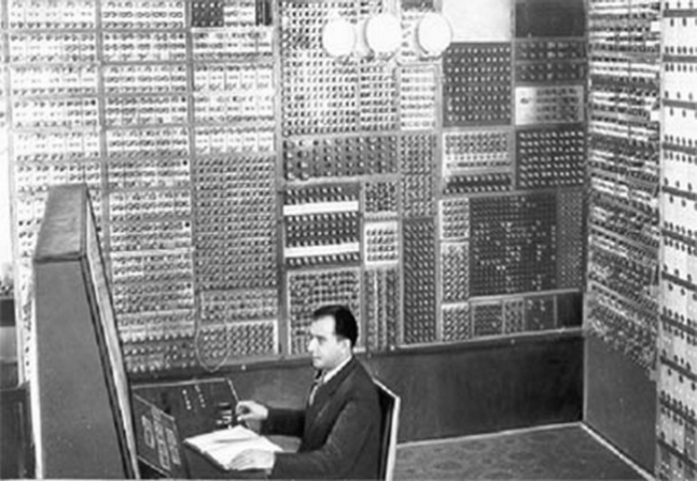
Computer

Slide 15

Telephone

Slide 16
Thank you for your attention

