Slide 1
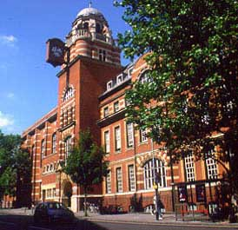
city university london

Slide 2
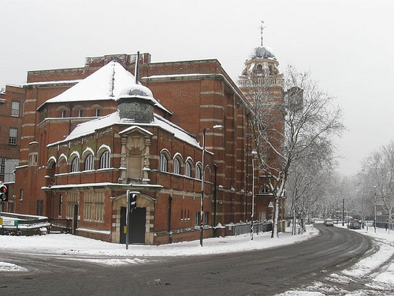
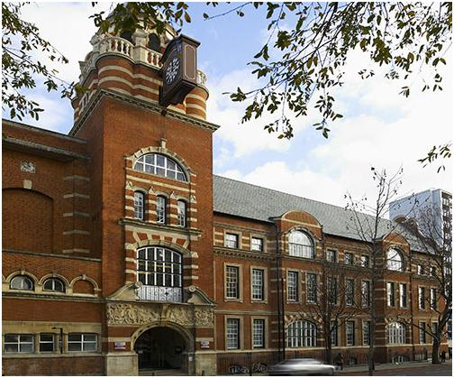
City University London, usually just known in
the UK as City University, is a British university based in Northampton Square.

Slide 3
It was founded in 1894 as the Northampton Institute on its present site and awarded full university status in 1966.

Slide 4
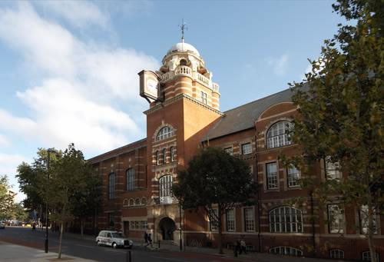
The university has a research experience of over 100 years and has often been highly ranked for its graduate employability and graduate salaries.

Slide 5
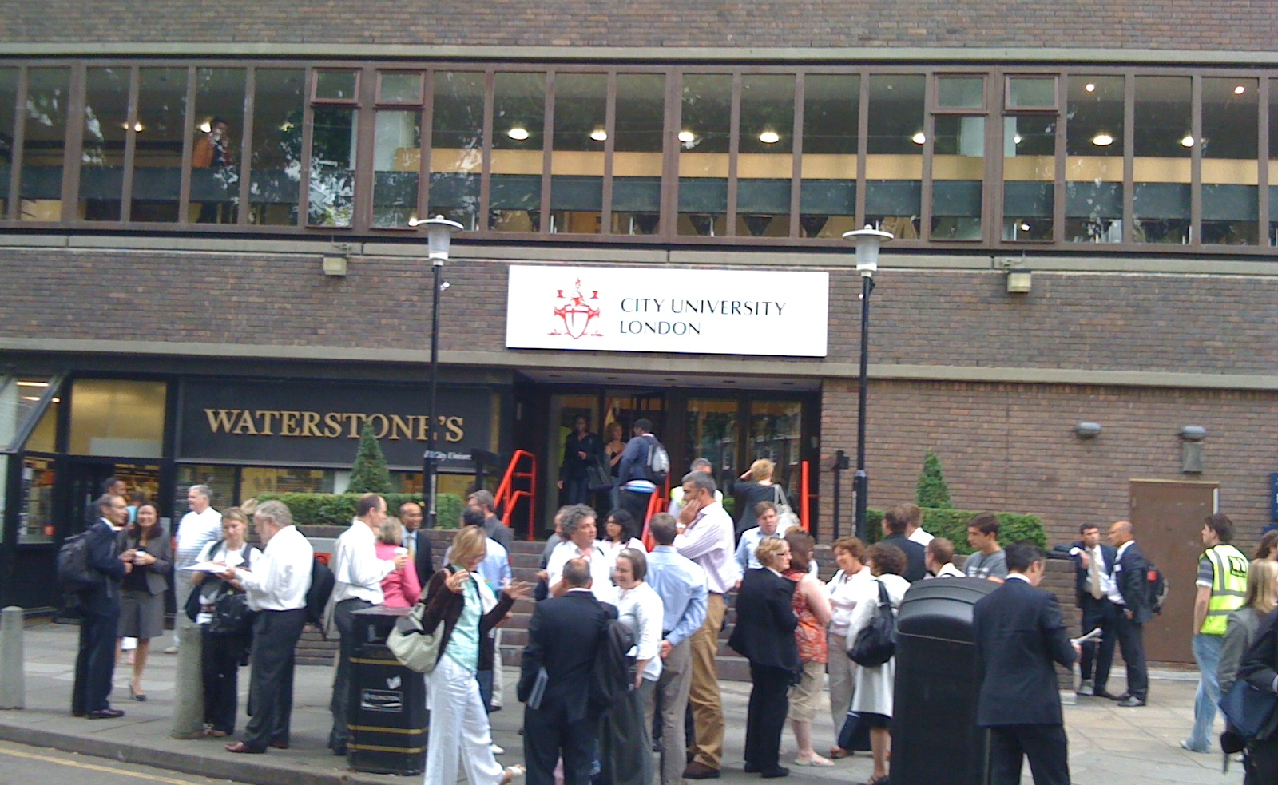
The University's mission is to "lead London in education, research and knowledge transfer for businesses and the professions".

Slide 6

The university has special links with the City of London and play an active role in the business and professional life of the capital. City University has close contacts with the leading professional institutions and with business and industry.

Slide 7
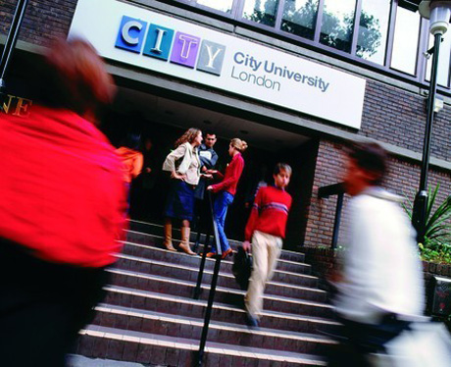
The success of the university is demonstrated by graduate employment record, which is one of the best in the country.

Slide 8

It is the one of the most popular universities in the UK for student applications. Its reputation extends worldwide: more than 30 per cent City University London students are international.

Slide 9

The university has substantial expertise in health, business and law, mathematics, engineering and informatics, social sciences, creative and cultural subjects.

Slide 10

The University offers Bachelor's, Master's, and Doctoral degrees as well as certificates and diplomas at both undergraduate and postgraduate level.

Slide 11
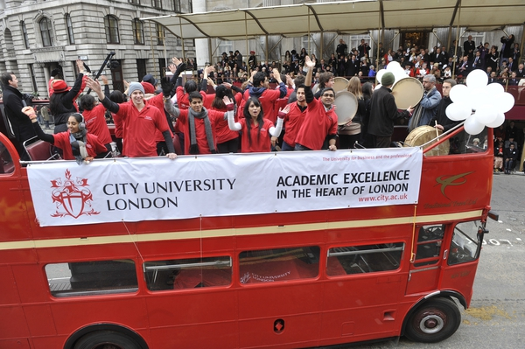
The Chancellor of the University is the Lord Mayor. For a number of years, students have taken part in the annual Lord Mayor's Show, representing the University in one of the country's largest and liveliest parades.

Slide 12

The Students' Union organises a range of sporting activities.

Slide 13

The university has clubs for engineers, entrepreneurs, chess lovers, electronic music enthusiasts and Russian speakers.

Slide 14
THE END

