Slide 1
11-Day Italian Adventure Tour
Prepared by
Nellia Aldarkina
Margarita Butkova
Polina Kochurova
Viktorija Rubalka
Form 10a
Specialized school # 11

Slide 2
Have you ever wanted to visit to the Opera, try real pizza? Have you always dreamed of water trips on the canals of Venice? If you haven’t lived your dream holiday yet,here’s your chance to do all these things and more!

Slide 4
Italy is one of the mysterious and ancient countries of the world. When you arrive in Italy, you find yourself in a fairy tale where there are no problems and concerns. The air is filled with the freshness, and your holiday suggest to make a comfortable and delightful.

Slide 5
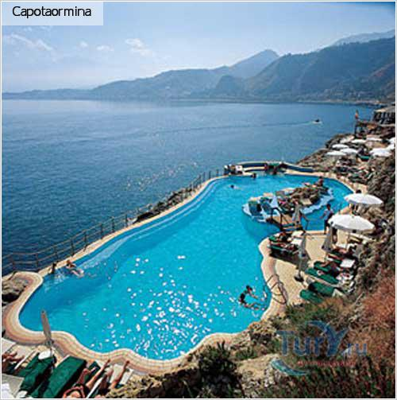
Accommodation
Stay in family luxorious 5-star hotels-single or double rooms and suites available.

Slide 6
Entertainment
Skiing in the Alps.
Sunbathe on the beautiful beaches of Sardinia, Tuscany.

Slide 7
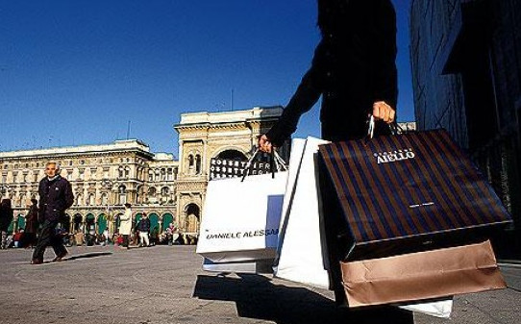
Entertainment
To do shopping in the famous boutiques of the world.

Slide 8
Entertainment Try a variety of delicacies:
Pizza
Pasta

Slide 9
Italian Salumi
Italian cheese

Slide 10
Italian meat
Italian Fish

Slide 11
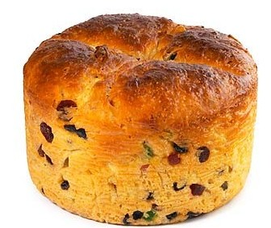
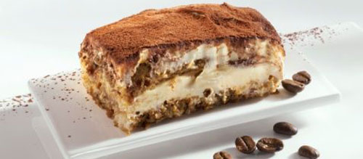
Italian Sweets

Slide 12
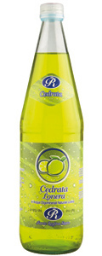
Italian fruits
Cedro

Slide 13
Italian wines

Slide 14
Other activities
Visit all important cities of Italy with their galleries, museums, monuments of history.
Bue souvenirs.
Relax.

Slide 15
Important cities
Rome
Coliseum

Slide 16
Trevi Fountain
Pantheon

Slide 17
Vatican
San Pietro Square
Swiss Guards

Slide 18
The pope
The head of catholic organization

Slide 19
Milan
Milan Dome

Slide 20
Venice
Venice Channel. Tipical Venice boat: Gondola
San Marco Square

Slide 21
Other Famous monuments
Pisa Tower
Florence Dome

Slide 22
Genoa Port
Pallio di Siena

Slide 23
Total cost
Single room: €3.500
Double room: €5.000
Suite: €6.000

Slide 24
Thank you!

