Slide 1
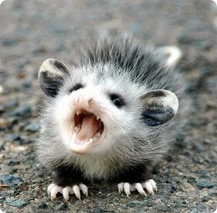
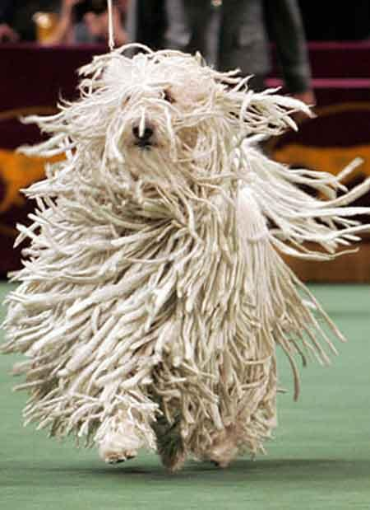
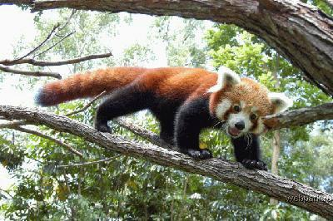
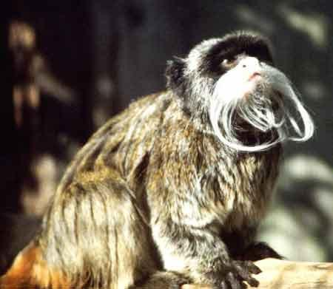
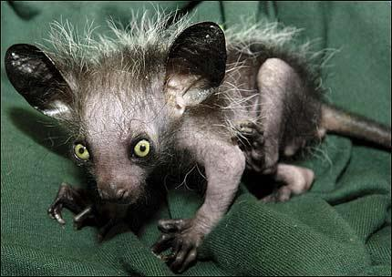
Animals

Slide 2
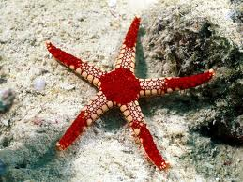
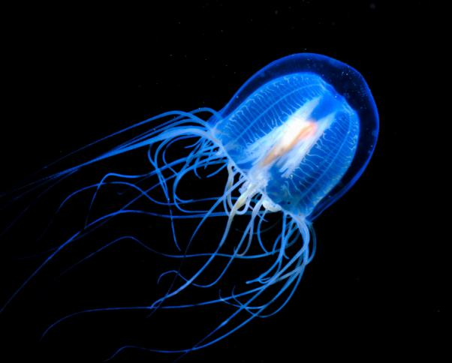
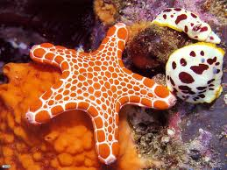
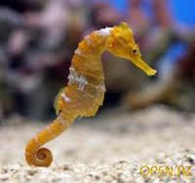
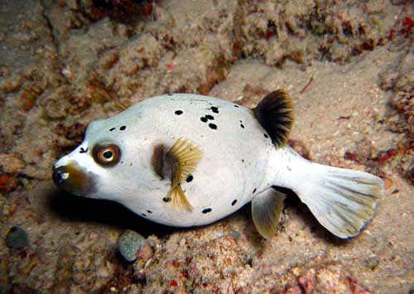
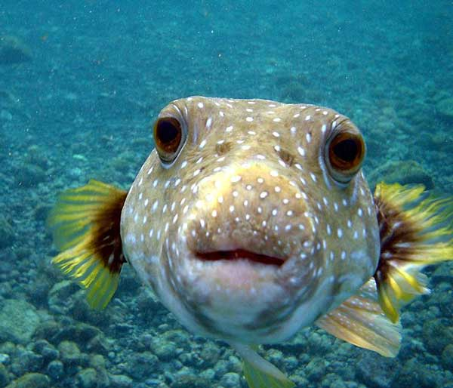
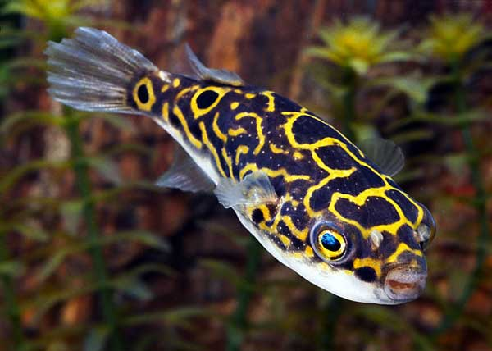

Slide 3
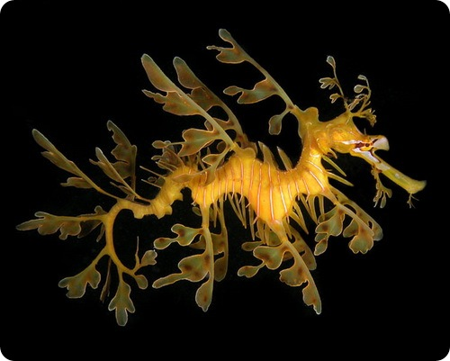
Leafy seadragon

Slide 4
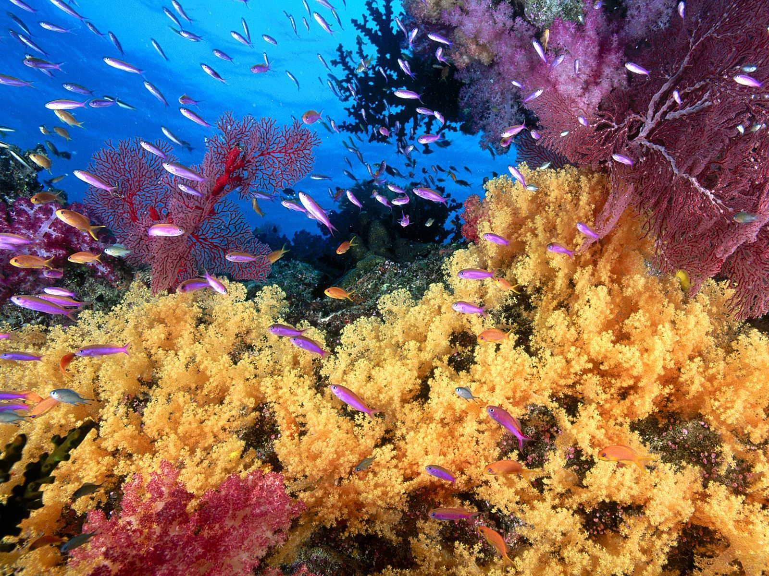
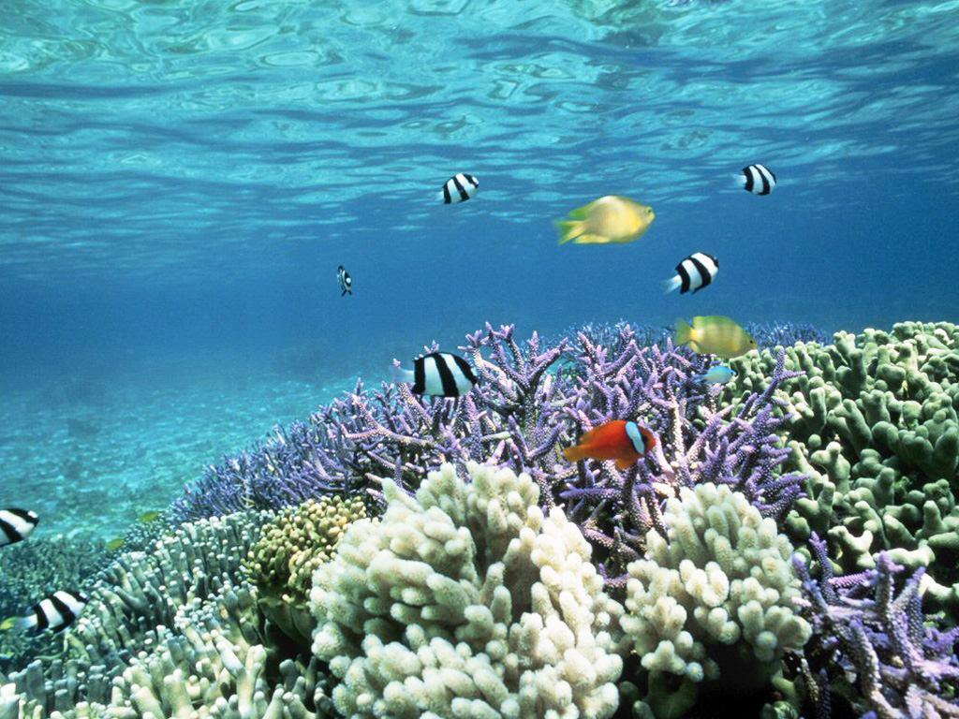
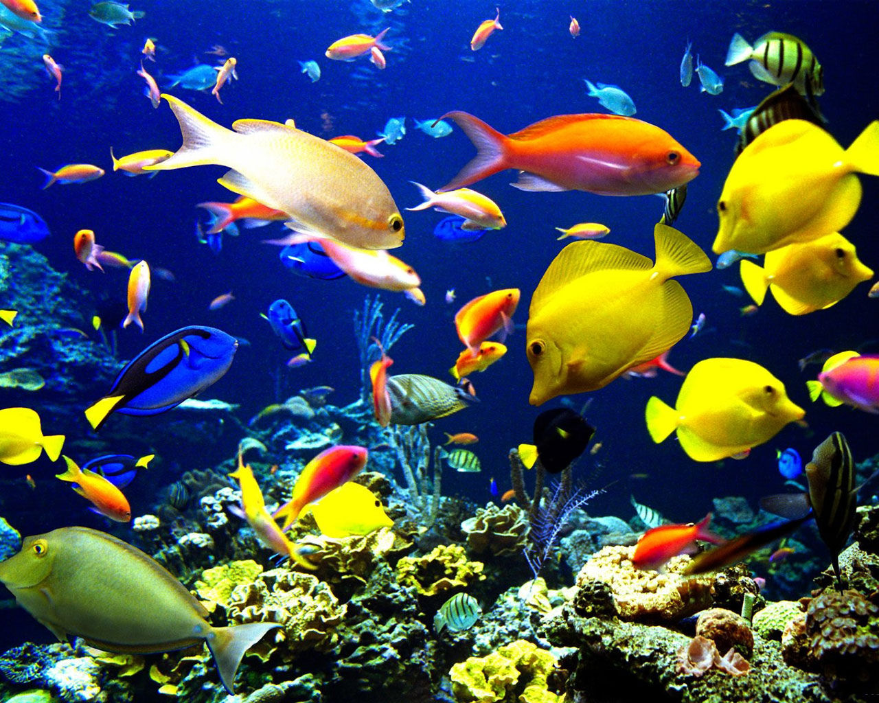
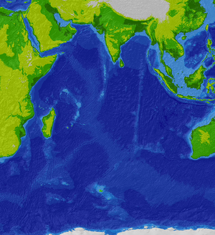
The habitats
From 4 to 30 m
in the waters of moderate temperature

Slide 5
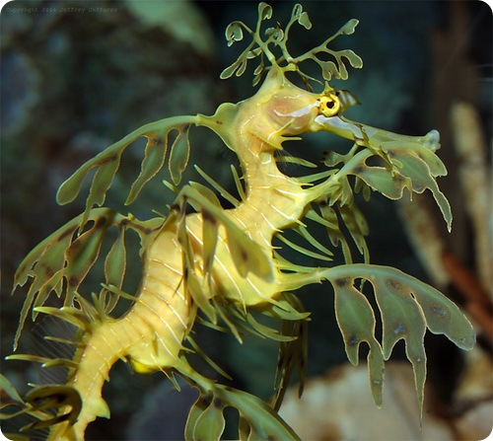
The description
It is 35 сm
Body and head are covered with spikes, simulating thallus algae
That spikes do not take part in swiming, they serve to mask
It moves through pectoral and dorsal fins.
It swims slowly, its maximum speed - up to 150 m / h

Slide 6
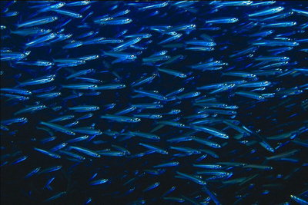
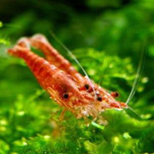
Food

Slide 7
Protection
industrial emissions
poachers
They are in danger of extintion!!!
This type is taken under the protection of the Australian government.

Slide 8
Interesting facts

Slide 9
It can eat about 3000 shrimps by 1 day
In contrast to seahorses, which are hooked their tail for algae in the period of sea swell, Leafy seadragon do not know how to do it, so they often die during storms, because they washed ashore.
It is the official emblem of South Australia.

Slide 10
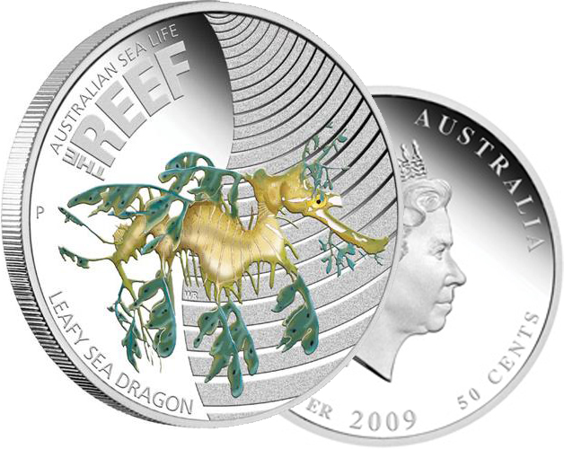
Mint Australian city of Perth has released the second coin of the new series of silver coins "Australian marine life - the reefs." It shows a picker. Coins of 50 Australian cents minted from silver 999, each weighing 15.573 grams, diameter - 36.6 mm, circulation - no more than 10 000. Rag-picker image adorns the reverse of the coin, on the obverse - the portrait of Her Majesty Queen Elizabeth II. Value of a coin is over then 1,300 Russian rubles.

Slide 11
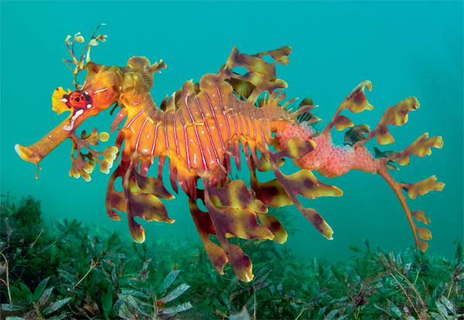
Thank you for your attantion!

