Slide 1

Ethnical diversity
Name
School

Slide 2

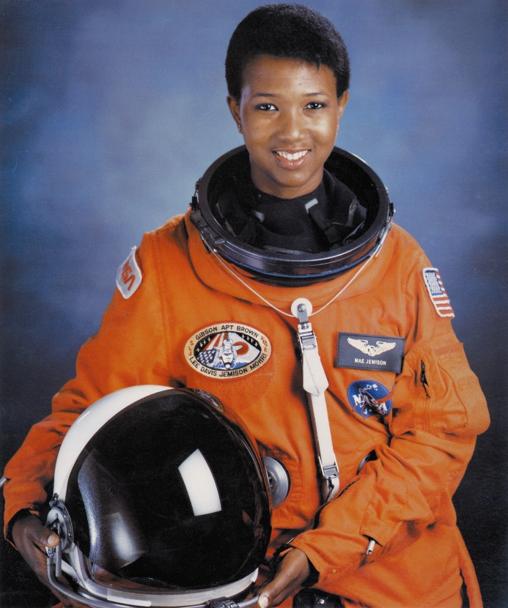
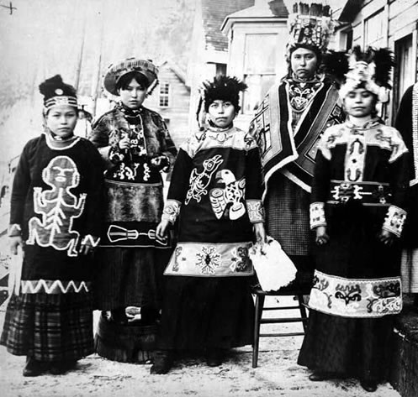
Ethnic and racial categories

Slide 3
Races of the USA

Slide 4
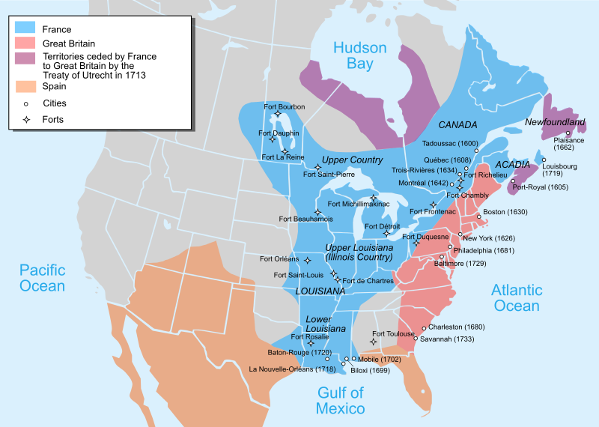
Colonial period

Slide 5

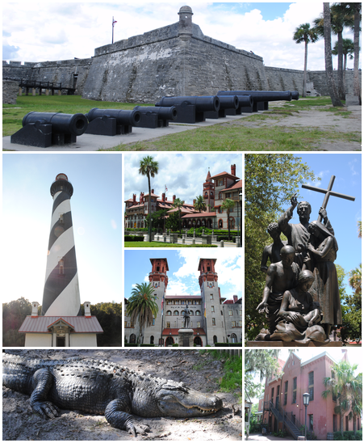
French colonies
St Augustine – the oldest city in the USA was found in 1564

Slide 6

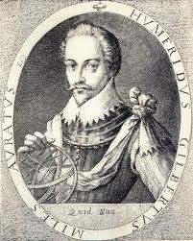
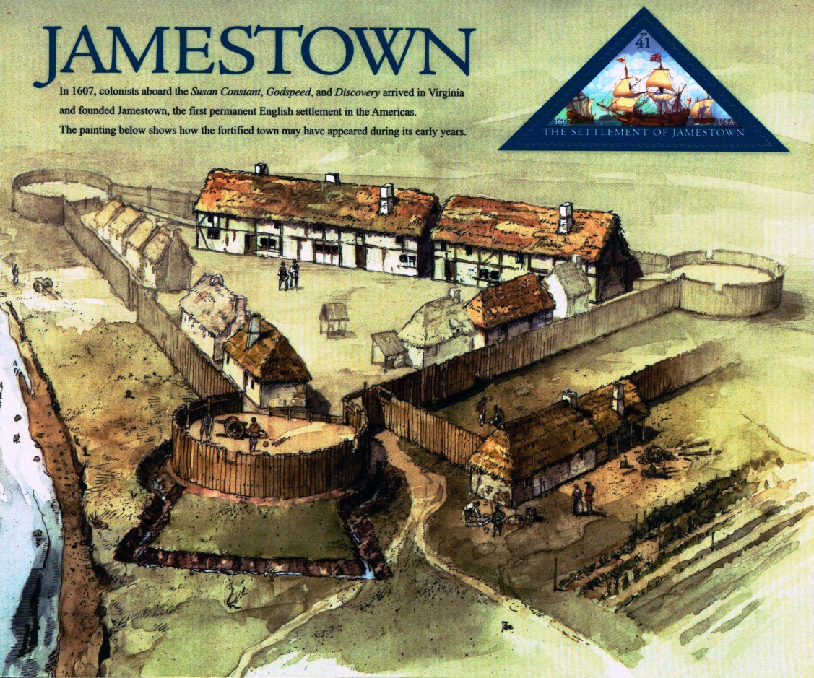
British colonies
Humphrey Gilbert

Slide 7





Spanish colonies

Slide 8
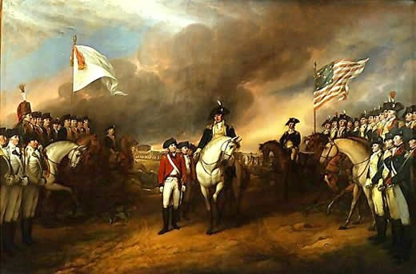
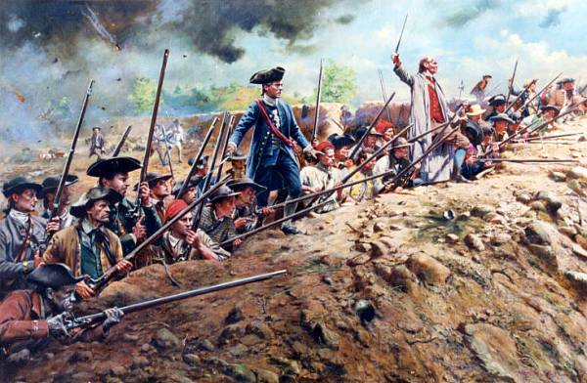
Revolutionary war

Slide 9
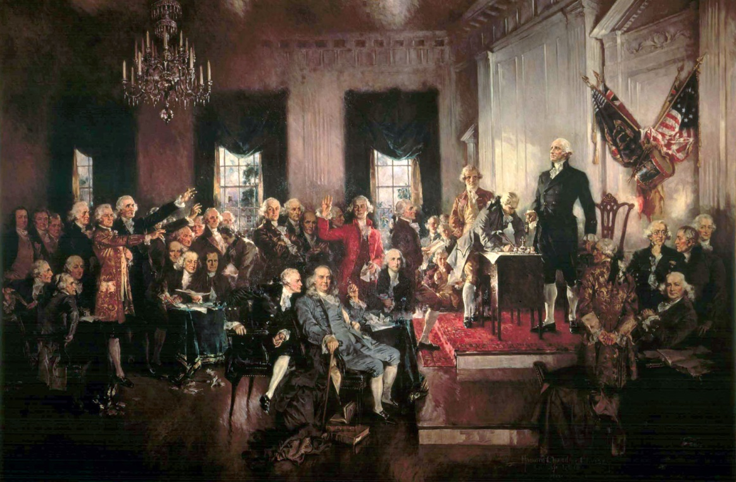
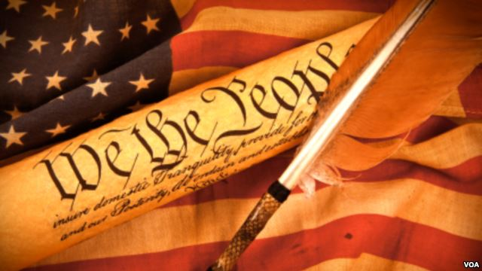
The US’s constitution

Slide 10
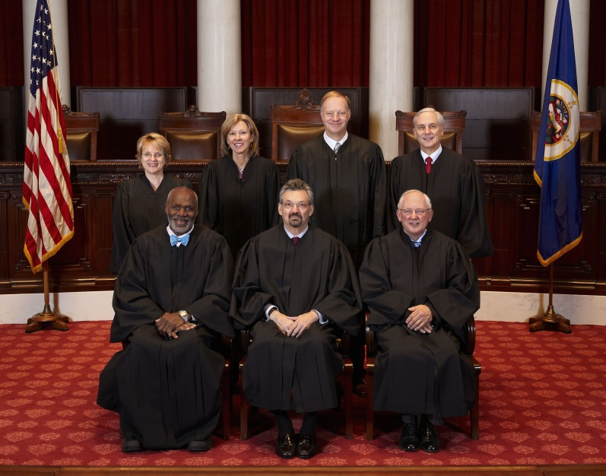
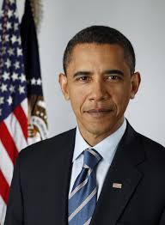
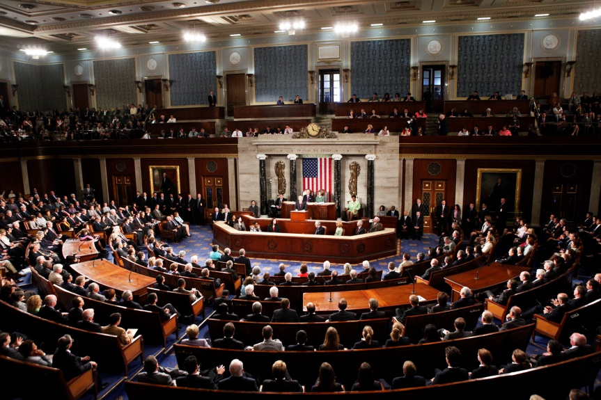
Three branches of power
Legislative
Executive
Judical
The Congress
The Supreme Court
The President

Slide 11
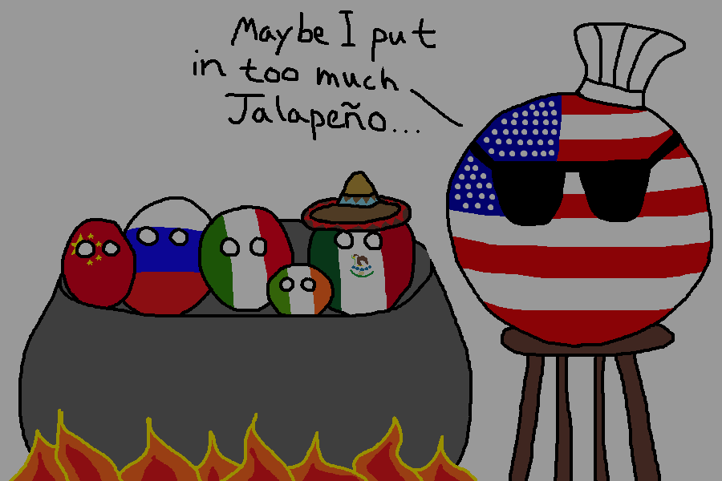
Thank you for your attention!

