Slide 1
Canada’s History

Slide 2
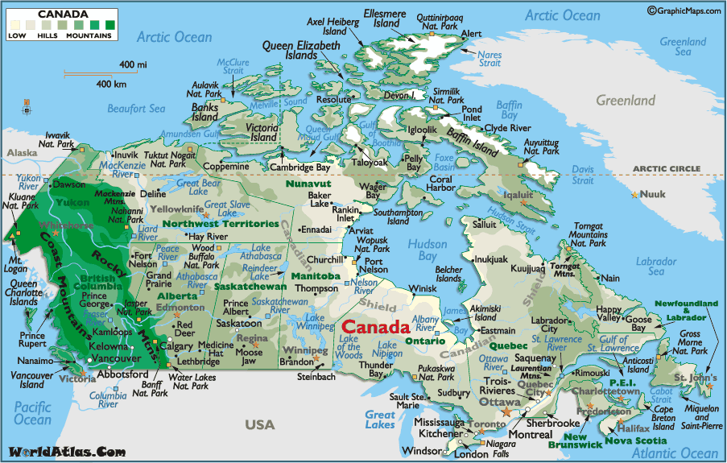

When Europeans explored Canada they found all regions occupied by native peoples they called Indians, because the first explorers thought they had reached the East Indies.

Slide 3
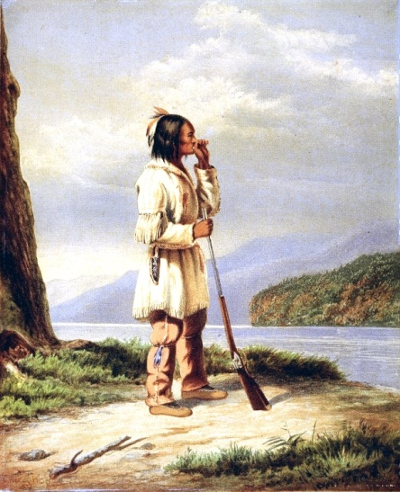
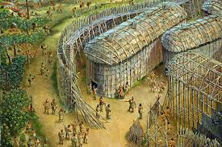
The Huron-Wendat of the Great Lakes region, were farmers and hunters.

Slide 4
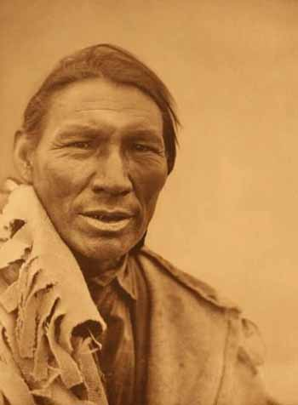
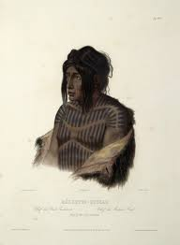
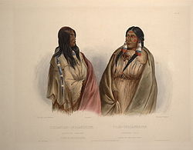
The Cree and Dene of the Northwest were hunter-gatherers.

Slide 5
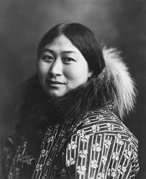
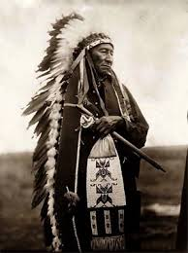
The Sioux were nomadic.
The Inuit lived off Arctic wildlife. Warfare was common among Aboriginal groups.

Slide 6
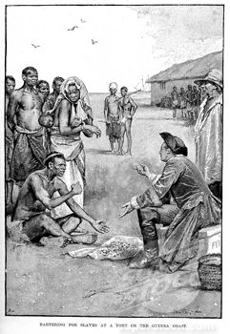
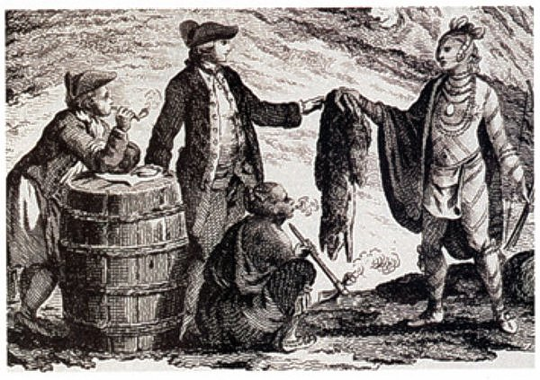
The arrival of European traders, missionaries, soldiers and colonists changed the native way of life

Slide 7
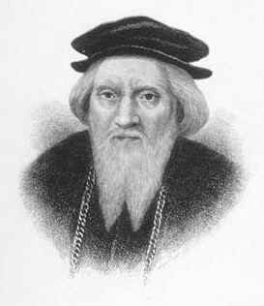
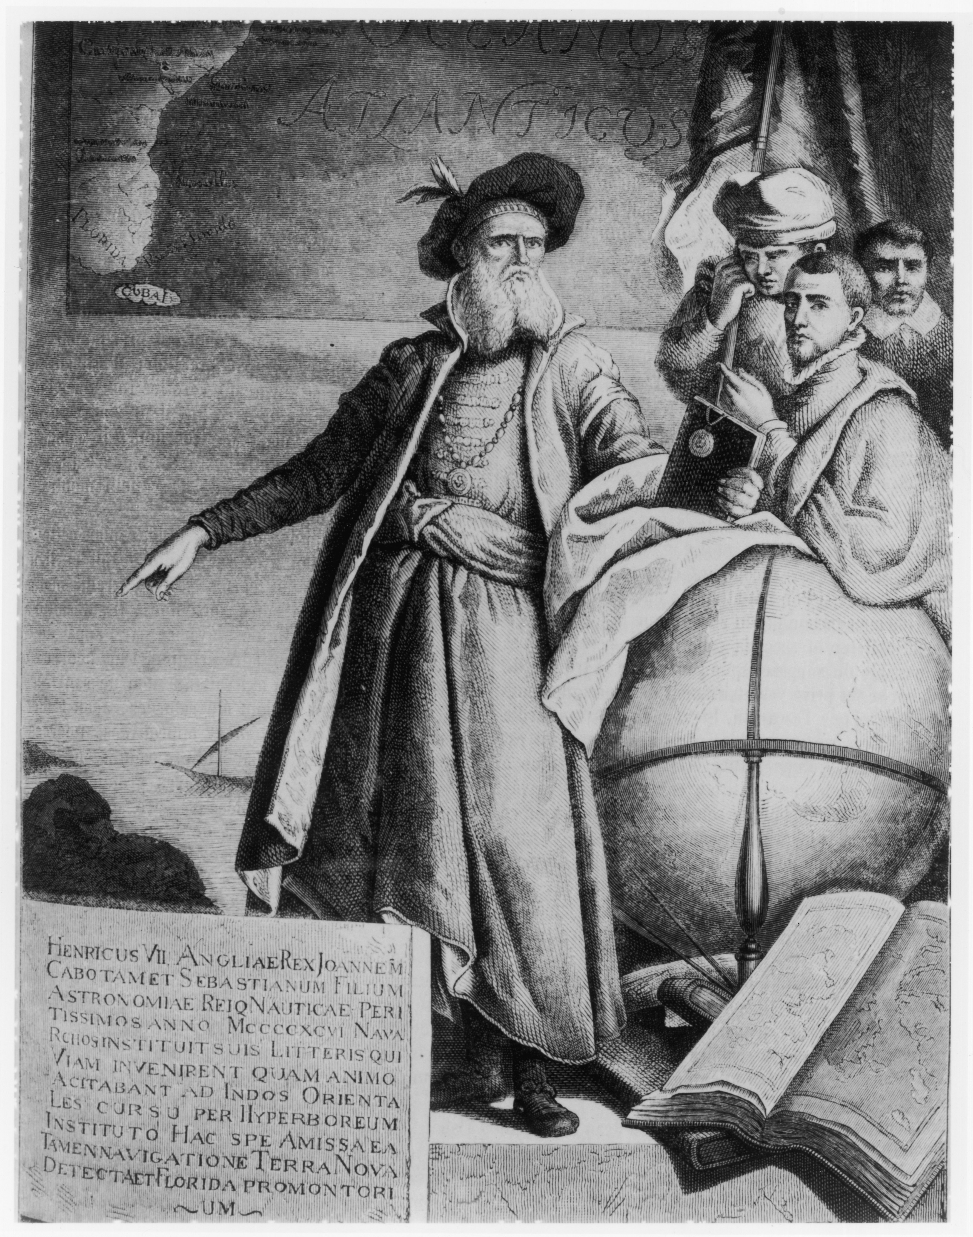
European exploration began in earnest in 1497 with the expedition of John Cabot.

Slide 8
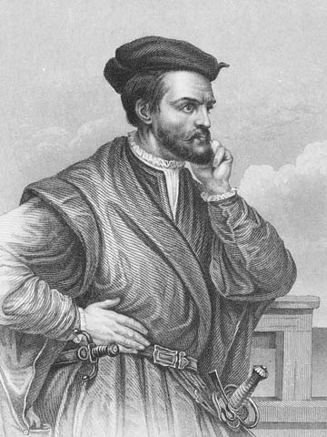
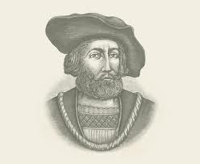
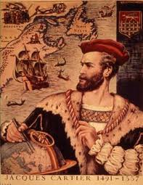
Canada was taken for France in 1534 by Jacques Cartier.

Slide 9
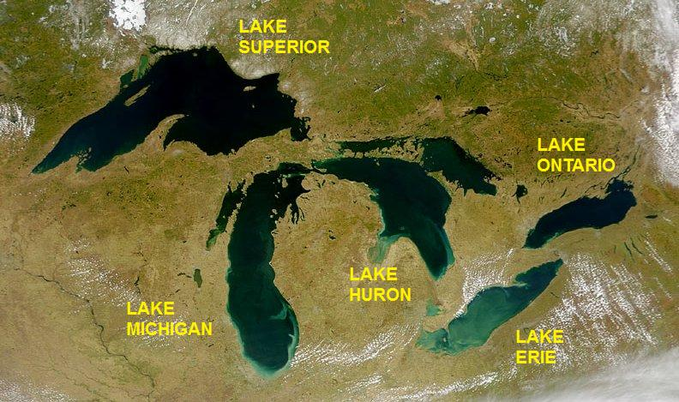
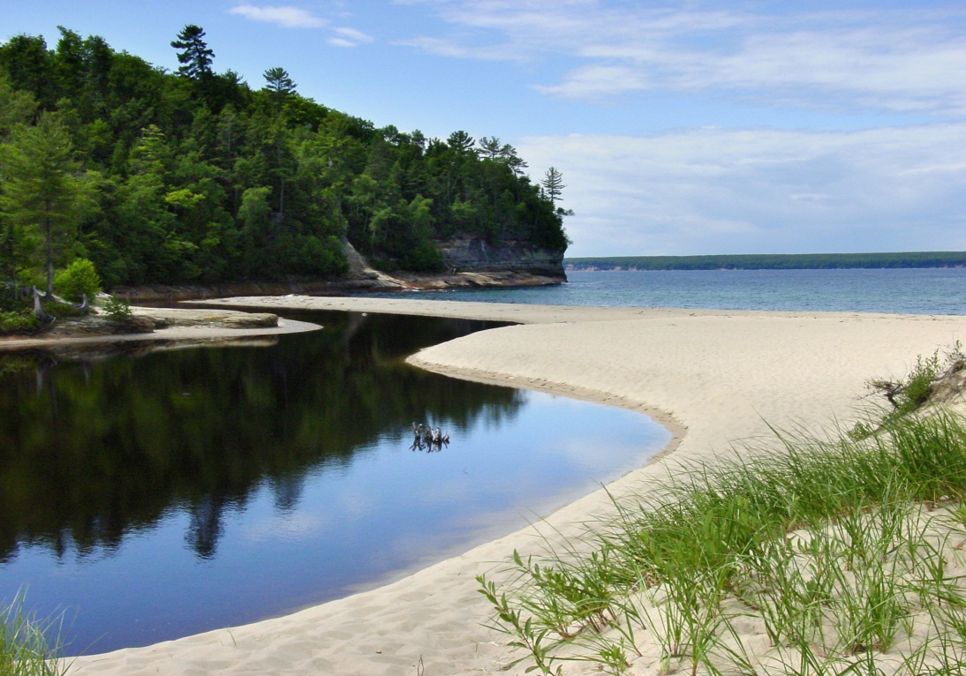
French explorers by the end of the 17th century had explored the Great Lakes.

Slide 10
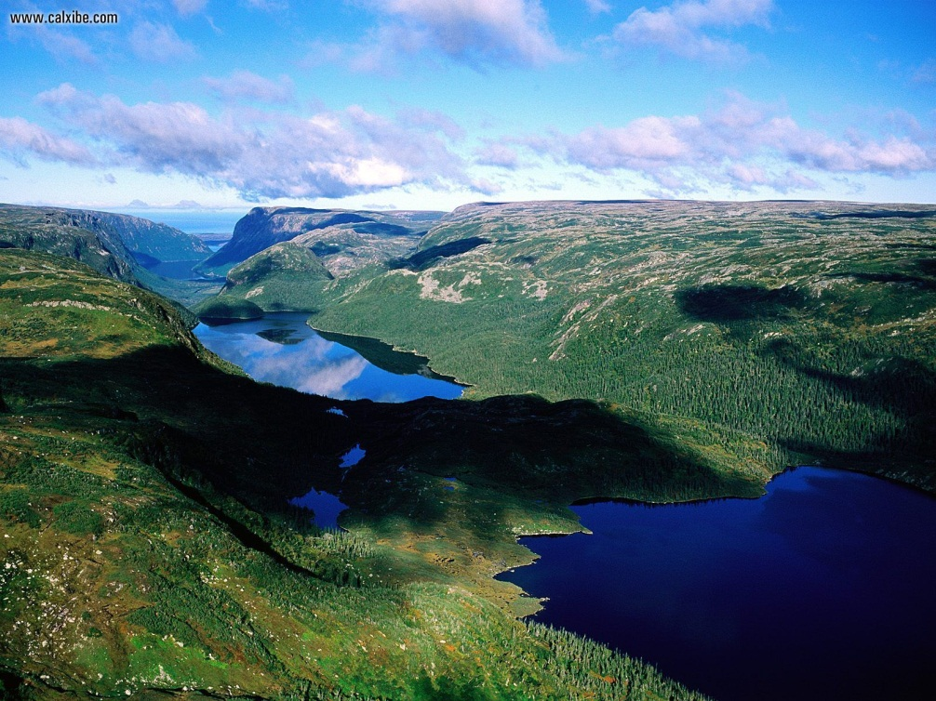
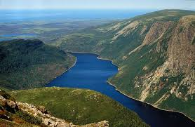
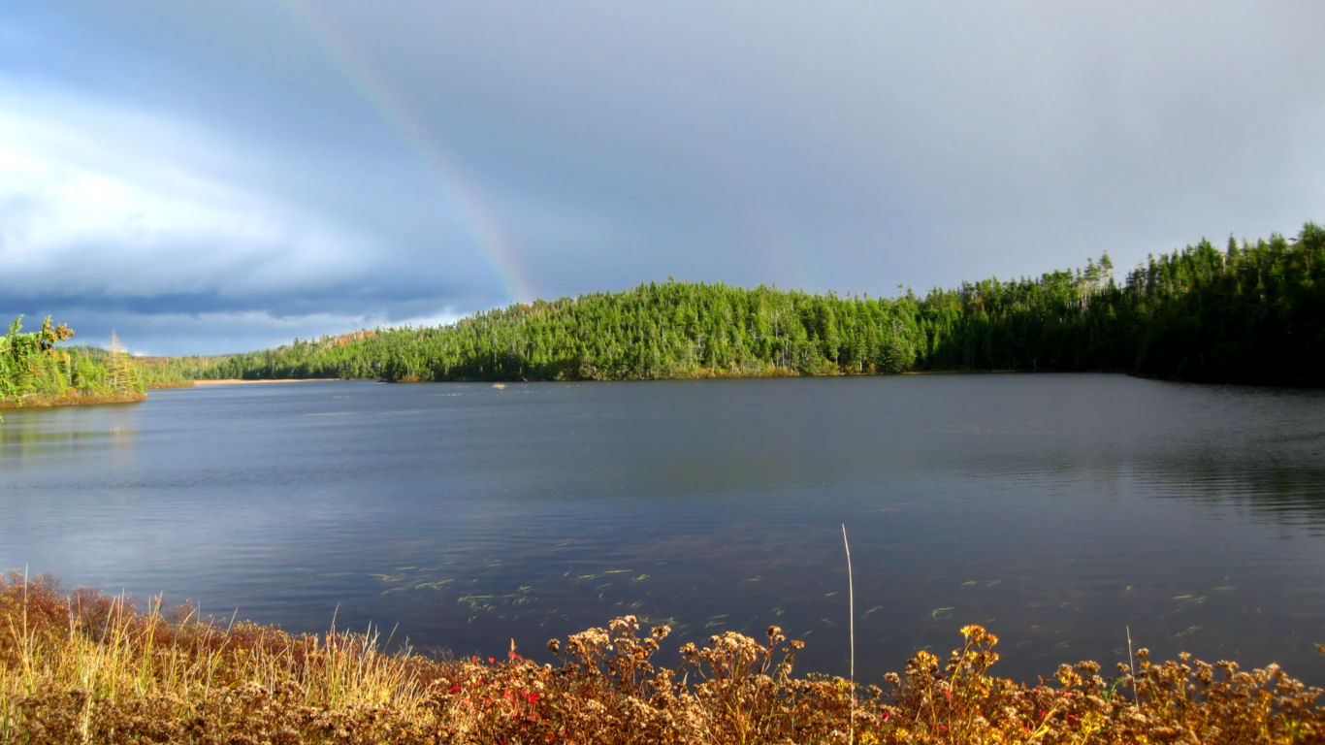
In 1713, Newfoundland, Hudson Bay, and Nova Scotia were lost to England.

Slide 11
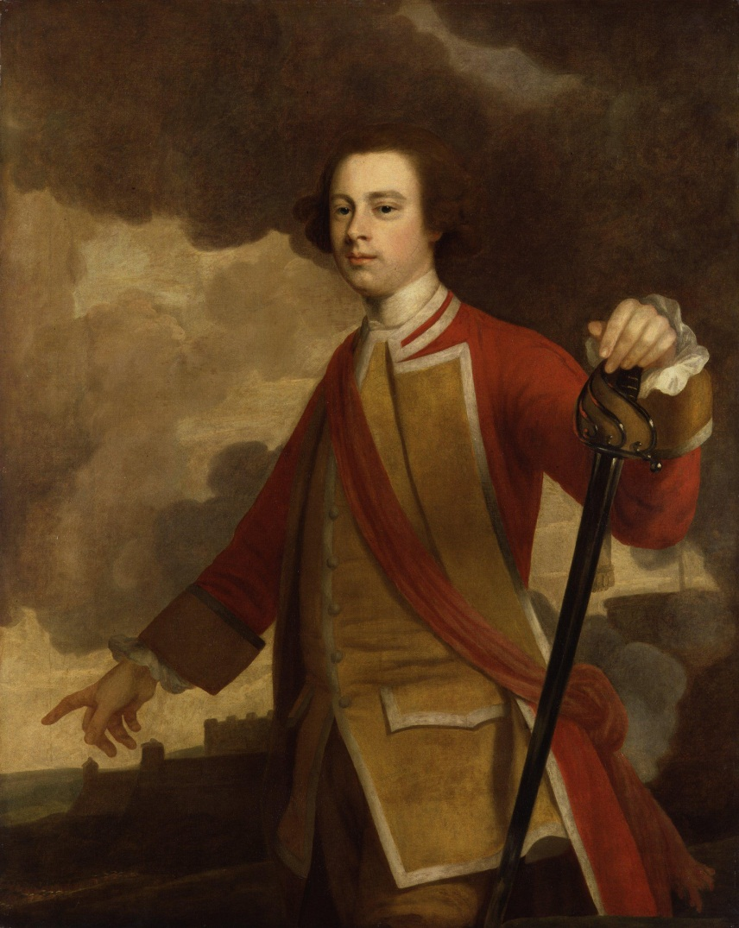
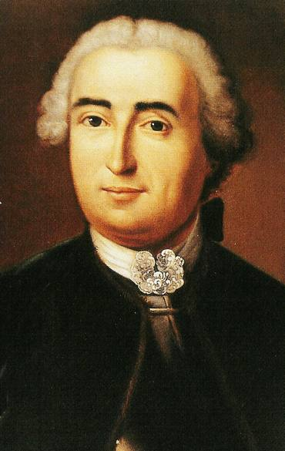
During the Seven Years' War (1756–1763), England extended its conquest, and the British general James Wolfe.

