Slide 1
Presentation
“Life and education of my peers in Sweden"

Slide 2

Youth policy
In Sweden, youth policy is part of a "Swedish model". It is based on the priority of youth in various branches of state activity. There is a Minister of Youth, which is responsible for supporting of youth organizations.
In Sweden, the Minister of Youth even has the right to stop taking any decision of government if it does not comply with the principles and objectives of youth policy. If the discussion of such issues does not give the desired result, the minister of youth may appeal to the Prime Minister. Youth policy in Sweden have to solve
such problems of youth as crime,
alcoholism and drug addiction.
All students receive a monthly stipend
of about $ 500.

Slide 3

Teens and crime
If the offense was committed by teen under 15 years old, he
exempt from criminal liability, from 15 to 18 years - pay a fine of 200-300 crowns without imprisonment. Thus, crime in the country is practically absent.

Slide 4
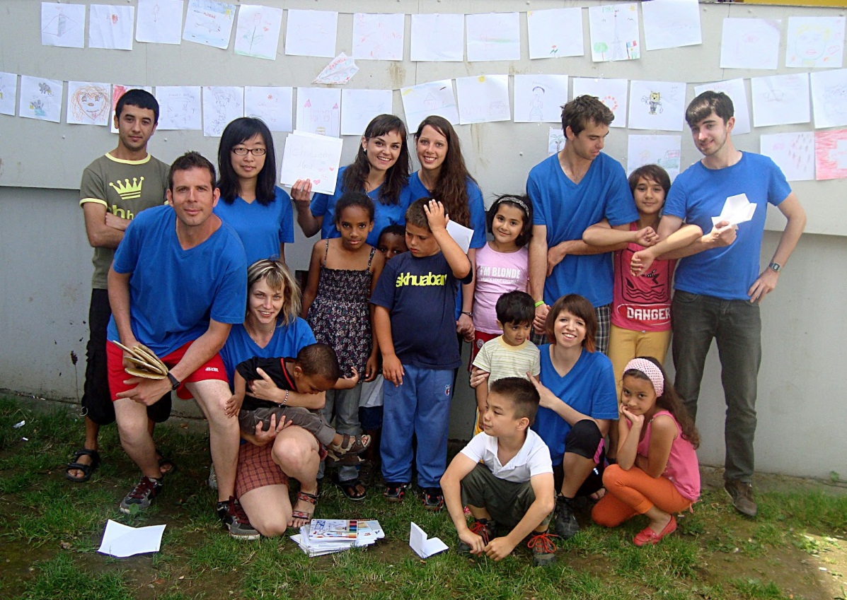
Teens and leisure
In Stockholm, there are more than seventy teen clubs. Teenage clubs - the most important link in the education and socialization of youth and the formation of active human solidarity on peers. There is a "democratic project". It includes ten teen recreation centers. The basis of the experiment was the idea of the cooperation of teachers club members where they have equal rights. The main items are three "no" – no racism, no violence and no drugs.
This new democratic style of
relations of solidarity and
co-operation does not interfere
with the organization and
conduct of such forms of
entertainment like parties, discos,
meeting interesting people, hiking
and ecological tours, conversely,
teenagers’ behave became
more relaxed.

Slide 5

Students on the labor market
Sweden is proud of the professional training innovators for teamwork. Its universities encourages students to disclose and develop their strengths and talents. Many programs offer a close collaboration between research institutions and industry, give students a lot of advantages during entering to the job market.

Slide 6
Education in Sweden
Swedish universities are the gateway to the wide range of industries: IT, telecommunications, mining, automotive, forest industry and banking.
How can such a small country like Sweden has managed to use innovation and entrepreneurship, to create a world-famous symbol of perfection, as the Nobel Prize? As the 9 millionth country may have the fourth place in competitiveness of the economy?
Much is explained by the level of education and science in Sweden. The higher education universities in Sweden are always present in the list of the top universities around the world.
Education at all levels - from middle to high school - free of charge. The status of educational institutions belong to the public sector.
Education school level starts at the age of 7 years. Secondary school education lasts 9 years at three levels - junior, middle and senior. After completing secondary education is the opportunity to continue education in the high school, or start a career and further education combined with work.
In fact, now almost 100% of Swedish students continue schooling in high school.
There aren’t any exams after 9 years. Continuing education is based on the skills and aptitudes of pupils.
Sweden takes an active part in international educational projects, such as ERASMUS, TEMPUS, COMETT, both at the state. Swedish universities have large autonomy in choosing partners and determining its foreign policy.
Many universities have special international program where the language of education is English.

Slide 7
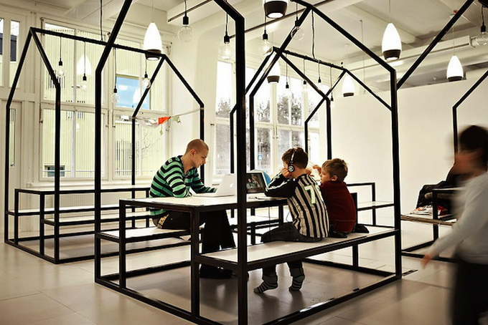
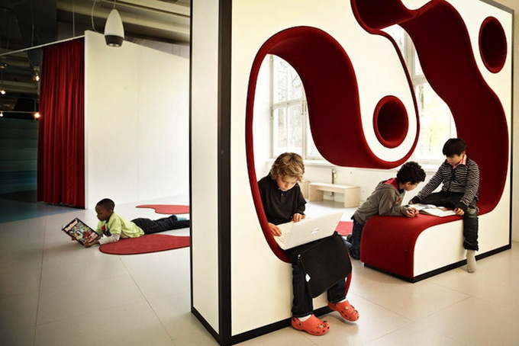
Vittra Telefonplan School
Students of the school Vittra Telefonplan are lucky! Headquartered in Stockholm is the Swedish free school based on the concept of creating a place where "the physical space is the most important tool for school" in the development of students.
In light of this, the team of architect Bosch Rosan has created an unconventional space where classroom abolished as such. Instead, the students relax on neon chairs, benches, whimsical art deco, or gather around the giant blue amphitheater that looks like an iceberg, rising middle of the room.

Slide 8
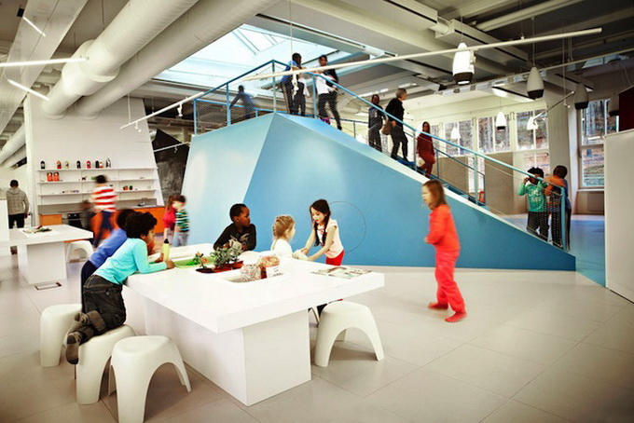
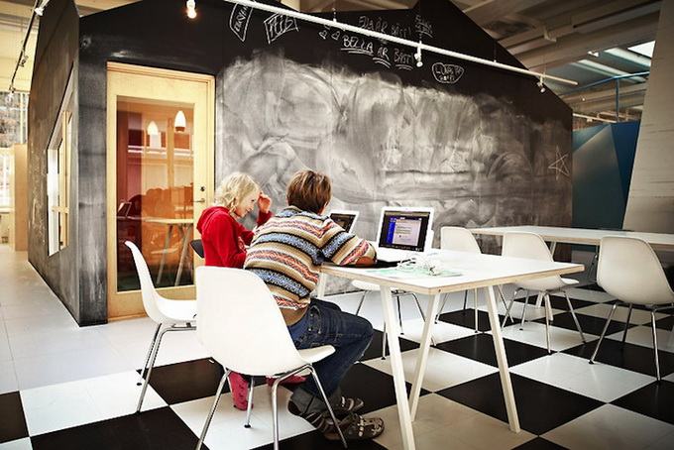
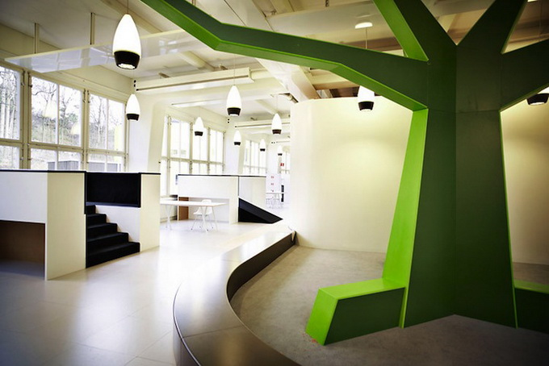
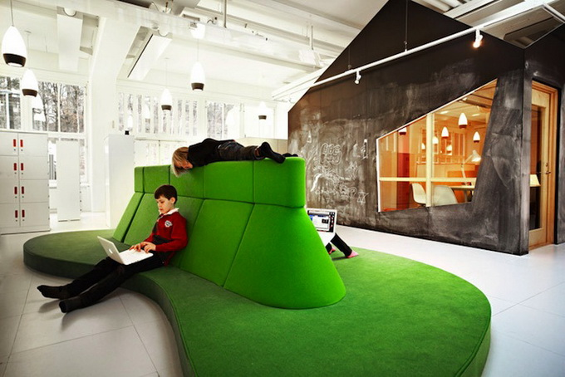

Slide 9

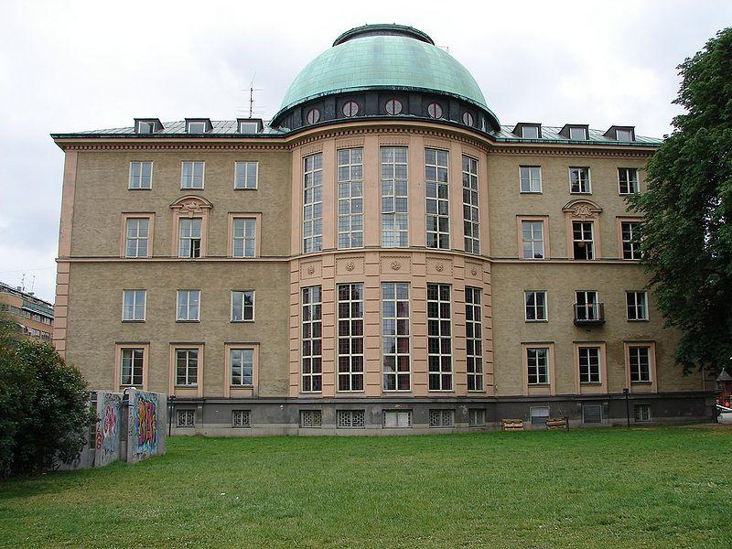
Stockholm School of Economics
Stockholm School of Economics - a specialized institution of higher education in Sweden. The school was founded in 1909 by a group of Swedish entrepreneurs to train qualified managers and executives during the rapid industrialization of the country. It is the oldest private economic university in Sweden. Now 85% of the funding agencies accounts for private contributions.
Now school has about 1,900 students. The master's program of the school is the second in northern Europe and 13 in Europe rated the Financial Times.

Slide 10
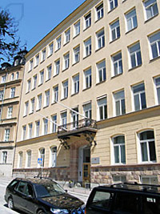
International School in Stockholm
International School in Stockholm (Stockholm International School), was founded in 1951 in Stockholm It is a private school for children from 5 to 18 years. The school offers a variety range of courses from kindergarten to upper school. The training is conducted in English by qualified experts of teaching. After school, students receive a diploma of international standard. At present, the school has 440 children from 53 countries. Campus schools is well equipped with spacious classrooms, computer labs, library, sports facilities, gym, internet.

Slide 11

“Help me!”
"Friends" - an organization dedicated to the elimination of the problem of harassment, mostly in school, but also outside of it - for example, during sporting events. Since its establishment in 1997, the organization "Friends" has already cooperated with about 1500 schools. "Save the Children - Sweden" - another organization that protects the rights of children. In her more than 80 000 participants.

Slide 12

Hobbies
Like most of the world's children, young Swedes love listening to music and spending time with friends. Encouraged private interests of each. Singing and playing a musical instrument - popular extra-curricular activities. 29% of girls and 26% boys, 13-15-year-olds play on any musical instrument. Encourages the employment of children in sports, and 68% of children aged 13-15 years are members of sports clubs. The most popular sport for boys and girls - football. More girls should be riding. Boys prefer to floorball, as well as swimming and hockey. Interest in the sport comes to the highest level - Sweden is ranked seventh in the world in number of received medals.

Slide 13

Internet and Television
Young Swedes spend time online as watching television. Almost a third of 13-5-year-olds are watching TV at least three hours a day. The same number of 12-6-year-olds spend such time on the internet. Half of the children of four years old already have experience of searching for information on the Internet. Live TV and YouTube - are the most popular resources, but what children are doing online, depending on their age and gender. These may be homework, blogging, chat, social networking, applications for smart phones - the most common options for children.

Slide 14
Thank you for watching!

