Slide 1
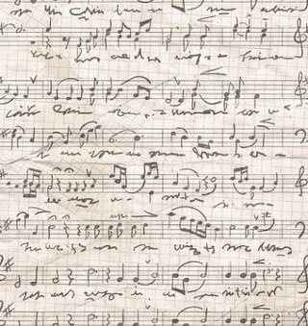
Project
“Music”

Slide 2
Music is an art form whose medium is sound and silence. Its common elements are pitch (which governs melody and harmony), rhythm (and its associated concepts tempo, meter, and articulation), dynamics, and the sonic qualities of timbre and texture.
The creation, performance, significance, and even the definition of music vary according to culture and social context. Music ranges from strictly organized compositions, through improvisational music to aleatoric forms.
Music can be divided into genres and subgenres, although the dividing lines and relationships between music genres are often subtle.

Slide 3
Within the arts, music may be classified as a performing art, a fine art, and auditory art. It may also be divided among art music and folk music. There is also a strong connection between music and mathematics. Music may be played and heard live, may be part of a dramatic work or film, or may be recorded. To many people in many cultures, music is an important part of their way of life.
Common sayings such as "the harmony of the spheres" and "it is music to my ears" point to the notion that music is often ordered and pleasant to listen to. However, 20th-century composer John Cage thought that any sound can be music, saying, for example, "There is no noise, only sound."

Slide 4
History:
Prehistoric eras
Ancient Egypt
Asian cultures
References in the Bible
Antiquity
Ancient Greece
The Middle Ages
The Renaissance
The Baroque
Classicism
Romanticism
20th- and 21st-century music

Slide 5
The Renaissance
Renaissance music was more focused on secular themes. Around 1450, the printing press was invented, and that helped to disseminate musical styles more quickly and across a larger area. Thus, music could play an increasingly important role in daily life. Musicians worked for the church, courts and towns. Church choirs grew in size, and the church remained an important patron of music. By the middle of the 15th century, composers wrote richly polyphonic sacred music. Prominent composers from this era are Guillaume Dufay, Giovanni Pierluigi da Palestrina, Thomas Morley, and Orlande de Lassus. However, musical activity shifted to the courts. Kings and princes competed for the finest composers. Many leading important composers came from Holland, Belgium, and northern. Other countries with vibrant musical lives include Germany, England, and Spain.

Slide 6
The Baroque
The Baroque era of music took place from 1600 to 1750, as the Baroque artistic style flourished across Europe; and during this time, music expanded in its range and complexity. Baroque music began when the first operas were written and when contrapuntal music became prevalent. German Baroque composers wrote for small ensembles including strings, brass, and woodwinds, as well as choirs, pipe organ, harpsichord, and clavichord. During this period several major music forms were defined that lasted into later periods when they were expanded and evolved further, including the fugue, the invention, the sonata, and the concerto.[20] The late Baroque style was polyphonically complex and ornamental and rich in its melodies. Composers from the Baroque era include Johann Sebastian Bach, George Frideric Handel, and Georg Philipp Telemann.

Slide 7
Classicism
The music of the Classical Period (1750 to 1830).New genres were discovered. The main style was the homophony, where prominent melody and accompaniment are clearly distinct. Importance was given to instrumental music. It was dominated by further evolution of musical forms initially defined in the Baroque period: the sonata, the concerto, and the symphony. Others main kinds were trio, string quartet, serenade and divertimento. The sonata was the most important and developed form. One of the most important evolutionary steps made in the Classical period was the development of public concerts.
The best known composers of Classicism are Carl Philipp Emanuel Bach, Christoph Willibald Gluck, Johann Christian Bach, Joseph Haydn, Wolfgang Amadeus Mozart, Ludwig van Beethoven and Franz Schubert. Beethoven and Schubert are also considered to be composers in evolution towards Romanticism.

Slide 8
Romanticism
Romantic music (c. 1810 to 1900) turned the rigid styles and forms of the Classical era into more passionate and expressive pieces. The emotional and expressive qualities of music came to take precedence over technique and tradition. Romantic love was a prevalent theme in many works composed during this period. In some cases the formal structures from the classical period were preserved, but in many others existing genres, forms, and functions were improved. Opera and ballet continued to evolve.
In 1800, the music developed by Ludwig van Beethoven and Franz Schubert introduced a more dramatic, expressive style. In Beethoven's case, motifs, developed organically, came to replace melody as the most significant compositional unit. Later Romantic composers such as Pyotr Ilyich Tchaikovsky, Antonín Dvořák, and Gustav Mahler used more elaborated chords and more dissonance to create dramatic tension. The late 19th century saw a dramatic expansion in the size of the orchestra, and in the role of concerts as part of urban society.

Slide 9
20th- and 21st-century music
With 20th-century music, there was a vast increase in music listening as the radio gained popularity and phonographs were used to replay and distribute music. The focus of art music was characterized by exploration of new rhythms, styles, and sounds Igor Stravinsky, Arnold Schoenberg, and John Cage were all influential composers in 20th-century art music.
Jazz evolved and became an important genre of music over the course of the 20th century, and during the second half of that century, rock music did the same.
Rock music is a genre of popular music that developed in the 1960s from 1950s rock and roll, rockabilly, blues, and country music. The sound of rock often revolves around the electric guitar or acoustic guitar. In the late 1960s and early 1970s, it branched out into different subgenres, ranging from blues rock and jazz-rock fusion to heavy metal and punk rock, as well as the more classical influenced genre of progressive rock and several types of experimental rock genres.

Slide 10
Music styles:
Rock
Jazz
Reggae
Blues
Funk
Hip-Hop
Country music
Pop
Electronic
Folk
DJ
Dance
R&B
Rap
Classical music
Rock’n’roll
Gospel music
Drum&Bass
Dubstep
House
Trance
Screamo
Grime

Slide 11



Slide 12
Rock 'n' roll
Rock and roll is a genre of popular music that originated and evolved in the United States during the late 1940s and early 1950s. Though elements of rock and roll can be heard in blues records from the 1920s and in country records of the 1930s, the genre did not acquire its name until the 1950s.
The term "rock and roll" now has at least two different meanings, both in common usage: referring to the first wave of music that originated in the US in the 1950s and would later develop into the more encompassing international style known as "rock music", and as a term simply synonymous with the rock music and culture in the broad sense.
In the earliest rock and roll styles of the late 1940s and early 1950s, either the piano or saxophone was often the lead instrument, but these were generally replaced or supplemented by guitar in the middle to late 1950s.Classic rock and roll is usually played with one or two electric guitars (one lead, one rhythm), a string bass or (after the mid-1950s) an electric bass guitar, and a drum kit.

Slide 13
The most famous rock 'n' roll representatives:
Chuck Berry
James Brown
Ray Charles
Fats Domino
Everly brothers
Jerry Lee Lewis
Little Richard
Sam Cooke
Buddy Holly
Elvis Presley

Slide 14
Elvis Presley
Elvis Aaron Presleya (January 8, 1935 – August 16, 1977) was an American singer and actor. A cultural icon, he is commonly known by the single name Elvis. One of the most popular musicians of the 20th century, he is often referred to as the "King of Rock and Roll" or "the King"
His music career began there in 1954, when he started to work with Sam Phillips, the owner of Sun Records. Presley's first RCA single, "Heartbreak Hotel", released in January 1956, was a number-one hit in the US. He became the leading figure of rock and roll after a series of network television appearances and chart-topping records. His energized interpretations of songs and sexually provocative performance style, combined with a singularly potent mix of influences across color lines that coincided with the dawn of the Civil Rights Movement, made him enormously popular—and controversial. He was nominated for 14 Grammys and won three, receiving the Grammy Lifetime Achievement Award at age 36, and has been inducted into multiple music halls of fame.

Slide 15
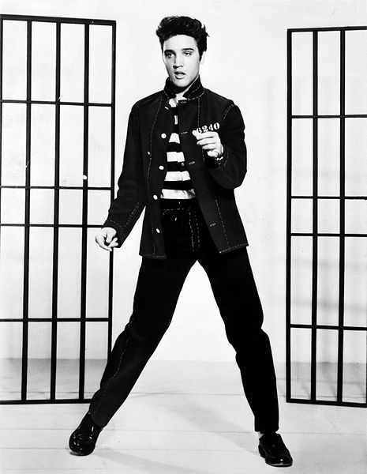
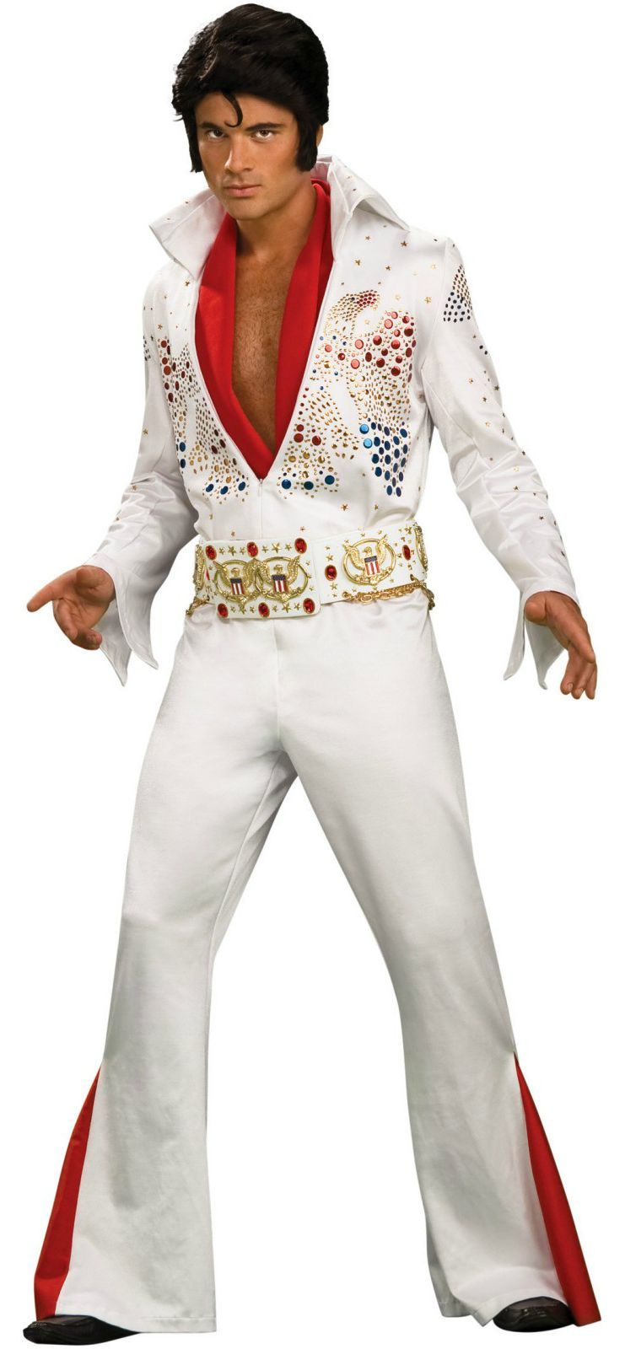

Slide 16
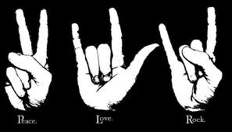
Rock

Slide 17
Rock
Rock music is a genre of popular music that originated as "rock and roll" in the United States in the 1950s, and developed into a range of different styles in the 1960s and later, particularly in the United Kingdom and the United States.
Musically, rock has centered on the electric guitar, usually as part of a rock group with bass guitar and drums. Typically, rock is song-based music usually with a 4/4 time signature using a verse-chorus form, but the genre has become extremely diverse. By the late 1960s, referred to as the "golden age" or "classic rock" period, a number of distinct rock music sub-genres had emerged, including hybrids like blues rock, folk rock, country rock, and jazz-rock fusion. Rock music has also embodied and served as the vehicle for cultural and social movements, leading to major sub-cultures including mods and rockers in the UK and the hippie counterculture that spread out from San Francisco in the US in the 1960s. Similarly, 1970s punk culture spawned the visually distinctive goth and emo subcultures.

Slide 18
Subgenres:
Alternative rock
Art rock
Baroque pop
Beat music
Britpop
Emo
Experimental rock
Garage rock
Glam rock
Gothic rock
Group Sounds
Grunge
Hard rock
Heartland rock
Heavy metal
Instrumental rock
Indie rock
Jangle pop
Krautrock
Madchester
Post-Britpop
Power pop
Progressive rock
Protopunk
Psychedelia
Punk rock
Soft rock
Southern rock
Surf music
Symphonic rock

Slide 19
The most famous rock representatives:
Alice Cooper
Avril Lavigne
AC/DC
Aerosmith
The Beatles
Blink-182
Bon Jovi
Coldplay
3 Doors Down
Depeche Mode
Evanescance
Green Day
Good Charlotte
My Chemical Romance
Nirvana
Nickelbacl
Korn
Limp Bizkit
Linkin Park
Muse
Mettalica
Papa Roach
Pink Floyd
Rammstein
The Rasmus
Red Hot Chili Peppers
Skillet
System Of A Down
Sum 41
Simple Plan
Scorpions
30 Seconds To Mars
Three Days Grace
Queen

Slide 20
The Beatles
The Beatles were an English rock band formed in Liverpool in 1960. With John Lennon, Paul McCartney, George Harrison, and Ringo Starr, they became widely regarded as the greatest and most influential act of the rock era.
Starting in 1960, the Beatles built their reputation playing clubs in Liverpool and Hamburg over a three-year period. They gained popularity in the United Kingdom after their first hit, "Love Me Do", in late 1962. From 1965 on, the Beatles produced what many critics consider their finest material, including the innovative and widely influential albums Rubber Soul (1965), Revolver (1966), Sgt Pepper's Lonely Hearts Club Band (1967), The Beatles (White Album) (1968), and Abbey Road (1969). After their break-up in 1970, they each enjoyed successful musical careers. Lennon was shot and killed in December 1980, and Harrison died of lung cancer in November 2001. McCartney and Starr, the remaining members, remain musically active.
They have received ten Grammy Awards, an Academy Award for Best Original Score and fifteen Ivor Novello Awards. Collectively included in Time magazine's compilation of the 20th century's 100 most influential people, they are the best-selling band in history, with estimate sales of over 600 million records worldwide.

Slide 21
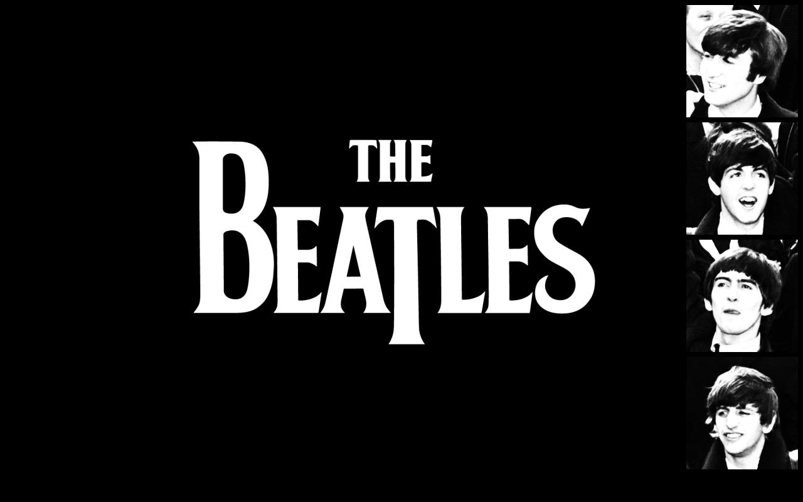
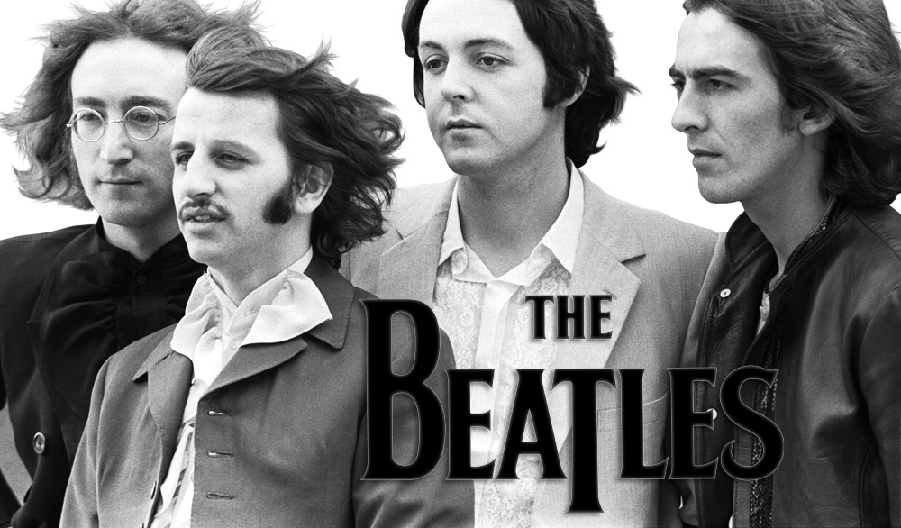

Slide 22
Jazz
Jazz is a music genre that originated at the beginning of the 20th century.
As the music has developed and spread around the world it has, since its early American beginnings, drawn on many different national, regional and local musical cultures, giving rise to many distinctive styles
Louis Armstrong, one of the most famous musicians in jazz, said to Bing Crosby on the latter's radio show, "Ah, swing, well, we used to call it syncopation, then they called it ragtime, then blues, then jazz. Now, it's swing. White folks - yo'all sho is a mess!"
In a 1988 interview, trombonist J. J. Johnson said, "Jazz is restless. It won't stay put and it never will".

Slide 23
Subgenres:
Avant-garde jazz
Bebop
Big band
Chamber jazz
Cool jazz
Free jazz
Gypsy jazz
Hard Bop
Latin jazz
Mainstream jazz
M-Base
Neo-bop
Post-bop
Soul jazz
Swing
Third stream
Traditional jazz

Slide 24
Louis Armstrong
Louis Armstrong (August 4, 1901 – July 6, 1971),nicknamed Satchmo or Pops, was an American jazz trumpeter and singer from New Orleans, Louisiana.
Coming to prominence in the 1920s as an "inventive" cornet and trumpet player, Armstrong was a foundational influence in jazz, shifting the focus of the music from collective improvisation to solo performance. With his instantly-recognizable gravelly voice, Armstrong was also an influential singer, demonstrating great dexterity as an improviser, bending the lyrics and melody of a song for expressive purposes.

Slide 25
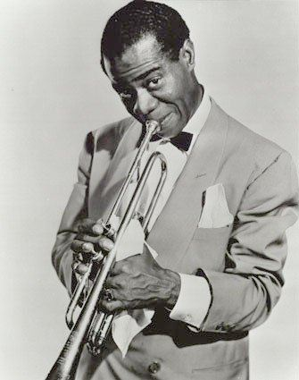
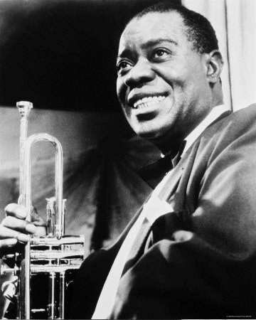
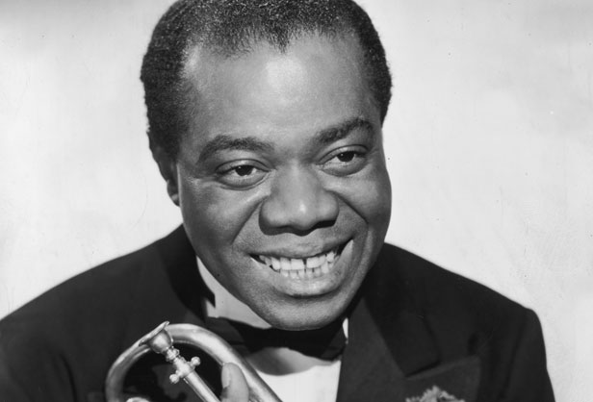

Slide 26
Reggae
Reggae is a music genre first developed in Jamaica in the late 1960s. While sometimes used in a broad sense to refer to most types of popularJamaican dance music, the term reggae more properly denotes a particular music style that evolved out of the earlier genres ska and rocksteady.
Subgenres:
Roots reggae
Lovers rock
Reggae en Español

Slide 27
Bob Marley
Robert Nesta Marley OM (6 February 1945 – 11 May 1981) was a Jamaican singer-songwriter who achieved international fame through a series of crossover reggae albums.Starting out in 1963 with the group the Wailers, he forged a distinctive songwriting and vocal style that would later resonate with audiences worldwide. The Wailers would go on to release some of the earliest reggae records with producer Lee Scratch Perry.After the Wailers disbanded in 1974, Marley pursued a solo career which culminated in the release of the album Exodus in 1977 which established his worldwide reputation. He was a committed Rastafarian who infused his music with a profound sense of spirituality.

Slide 28
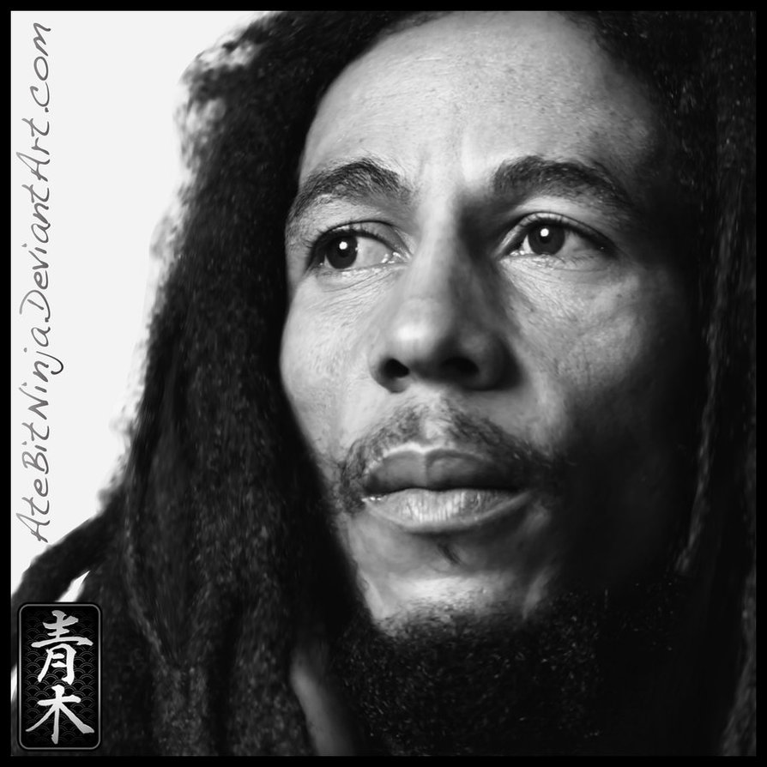
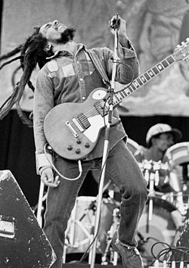
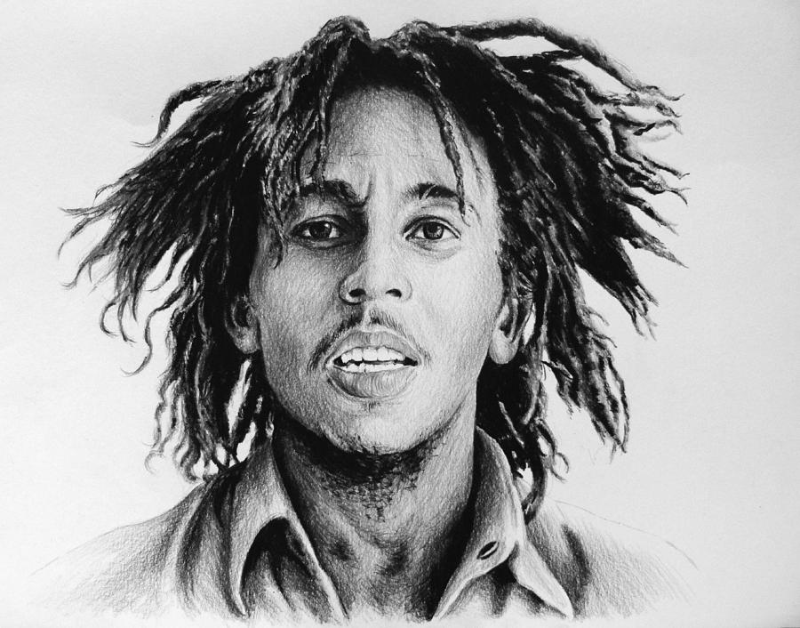

Slide 29
Blues
Blues is the name given to both a musical form and a music genre that originated in African-American communities of primarily the "Deep South" of the United States around the end of the 19th century from spirituals, work songs, field hollers, shouts and chants, and rhymed simple narrative ballads.The blues form, ubiquitous in jazz, rhythm and blues, and rock and roll is characterized by specific chord progressions, of which the twelve-bar blues chord progression is the most common.
The blues genre is based on the blues form but possesses other characteristics such as specific lyrics, bass lines, and instruments. Blues can be subdivided into several subgenres ranging from country to urban blues that were more or less popular during different periods of the 20th century. Best known are the Delta, Piedmont, Jump, and Chicago blues styles. World War II marked the transition from acoustic to electric blues and the progressive opening of blues music to a wider audience, especially white listeners. In the 1960s and 1970s, a hybrid form called blues-rock evolved.

Slide 30
Eric Clapton
Eric Patrick Clapton, (born 30 March 1945) is an English musician, singer and songwriter.
In the mid-1960s, Clapton left the Yardbirds to play blues with John Mayall & the Bluesbreakers. Immediately after leaving Mayall, Clapton joined Cream, a power trio with drummer Ginger Baker and bassist Jack Bruce in which Clapton played sustained blues improvisations and "arty, blues-based psychedelic pop." Two of his most popular recordings were "Layla", recorded by Derek and the Dominos, another band he formed, and Robert Johnson's "Crossroads", recorded by Cream. Following the death of his son Conor in 1991, Clapton's grief was expressed in the song "Tears in Heaven", which featured in his Unplugged album.
Clapton has been the recipient of 17 Grammy Awards, and the Brit Award for Outstanding Contribution to Music. In 2004, he was awarded a CBE at Buckingham Palace for services to music.

Slide 31
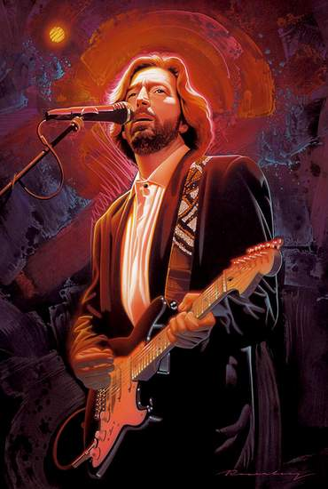
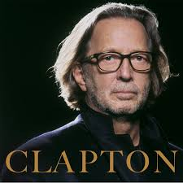
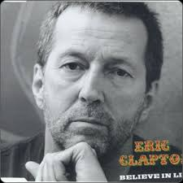

Slide 32
Funk
Funk is a music genre that originated in the mid-late 1960s when African-American musicians created a rhythmic, danceable new form of music through a mixture of soul music, jazz, and R&B. Funk de-emphasizes melody and harmony and brings a strong rhythmic groove of electric bass and drums to the foreground. Funk songs are often based on an extended vamp on a single chord, distinguishing it from R&B and soul songs, which are built on chord progressions.
Subgenres:
Go-go
P-Funk
Deep funk
Nu-funk

Slide 33
Country music
Country music is a genre of American popular music that originated in the rural regions of the Southern United States in the 1920s. It takes its roots from the southeastern genre of American folk music and Western music. Country music often consists of ballads and dance tunes with generally simple forms and harmonies accompanied by mostly string instruments such as banjos, electric and acoustic guitars, fiddles, and harmonicas.
The term country music gained popularity in the 1940s in preference to the earlier term hillbilly music; it came to encompass Western music, which evolved parallel to hillbilly music from similar roots, in the mid-20th century. The term country music is used today to describe many styles and subgenres. In 2009 country music was the most listened to rush hour radio genre during the evening commute, and second most popular in the morning commute in the United States.

Slide 34
Subgenres:
Bakersfield sound
Close harmony
Honky tonk
Jug band
Lubbock sound
Nashville sound
Neotraditional country
Outlaw country
Red Dirt
Western swing
Texas country

Slide 35
Vernon Dalhart
Vernon Dalhart (April 6, 1883 – September 14, 1948),born Marion Try Slaughter, was a popular American singer and songwriter of the early decades of the 20th century. He is a major influence in the field of country music. Dalhart was born in Jefferson, Texas. He took his stage name from two towns, Vernon and Dalhart in Texas, between which he punched cattle in the 1890s.
From 1916 until 1923, using numerous pseudonyms, he made over 400 recordings of light classical music and early dance band vocals for various record labels. He was already an established singer when he made his first country music recordings which cemented his place in music history.

Slide 36
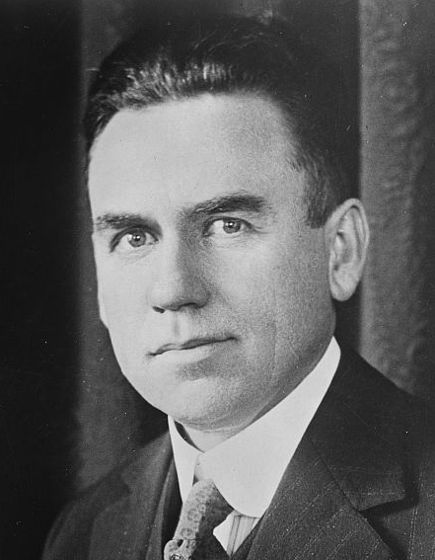

Slide 37
Pop music
Pop music is a genre of popular music which originated in its modern form in the 1950s, deriving from rock and roll. The terms "popular music" and "pop music" are often used interchangeably, even though the former is a description of music which is popular.
As a genre, pop music is very eclectic, often borrowing elements from other styles including urban, dance, rock, Latin and country; nonetheless, there are core elements which define pop. Such include generally short-to-medium length songs, written in a basic format (often the verse-chorus structure), as well as the common employment of repeated choruses, melodic tunes, and catchy hooks.
So-called "pure pop" music, such as power pop, features all these elements, using electric guitars, drums and bass for instrumentation; in the case of such music, the main goal is usually that of being pleasurable to listen to, rather than having much artistic depth.

Slide 38
Michael Jackson
Michael Joseph Jackson (August 29, 1958 – June 25, 2009) was an American recording artist, actor, producer, dancer, businessman, and philanthropist. Often referred to by the honorific nickname "The King of Pop". The eighth child of the Jackson family, he debuted on the professional music scene along with his brothers as a member of The Jackson 5 in 1964, and began his solo career in 1971. In the early 1980s, Jackson became a dominant figure in popular music. The music videos for his songs, including those of "Beat It", "Billie Jean", and "Thriller", were credited with breaking down racial barriers and with transforming the medium into an art form and promotional tool. Through stage and video performances, Jackson popularized a number of complicated dance techniques, such as the robot and the moonwalk, to which he gave the name. Jackson constantly traveled the world attending events honoring his humanitarianism and the 2000 Guinness Book of Records recognized him for supporting 39 charities.
Jackson died of acute propofol and benzodiazepine intoxication on June 25, 2009, after suffering from cardiac arrest.

Slide 39
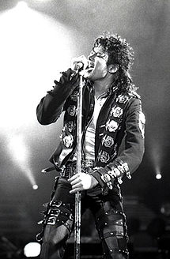
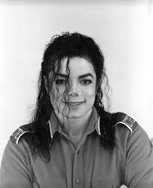

Slide 40
Electronic music
Electronic music is music that employs electronic musical instruments and electronic music technology in its production, an electronic musician being a musician who composed and/or performs such music. In general a distinction can be made between sound produced using electromechanical means and that produced using electronic technology. Examples of electromechanical sound producing devices include the telharmonium, Hammond organ, and the electric guitar. Purely electronic sound production can be achieved using devices such as the Theremin, sound synthesizer, and computer.
Electronic music was once associated almost exclusively with Western art music but from the late 1960s on the availability of affordable music technology meant that music produced using electronic means became increasingly common in the popular domain. Today electronic music includes many varieties and ranges from experimental art music to popular forms such as electronic dance music.

Slide 41
Classical music
Classical music is art music produced or rooted in the traditions of Western music. It encompasses a broad period from roughly the 11th century to the present day. The central norms of this tradition became codified between 1550 and 1900, which is known as the common practice period.
European music is largely distinguished from many other non-European and popular musical forms by its system of staff notation, in use since about the 16th century. Western staff notation is used by composers to prescribe to the performer the pitch, speed, meter, individual rhythms and exact execution of a piece of music. This leaves less room for practices such as improvisation and ad libitum ornamentation, which are frequently heard in non-European art music and in popular music.
The term "classical music" did not appear until the early 19th century, in an attempt to distinctly "canonize" the period from Johann Sebastian Bach to Beethoven as a golden age. The earliest reference to "classical music" recorded by the Oxford English Dictionary is from about 1836.

Slide 42
Drum & bass
Drum and bass is a type of electronic music which emerged in England in the mid-1990s. The genre is characterized by fast breakbeats (typically between 160–180 beats per minute; occasional variation is noted in older compositions[citation needed]) with heavy bass and sub-bass lines.

Slide 43
Dubstep
Dubstep is a genre of electronic dance music that originated in South London, England. It emerged in the late 1990s In the UK the origins of the genre can be traced back to the growth of the Jamaican sound system party scene in the early 1980s. The music generally features syncopated drum and percussion patterns with bass lines that contain prominent sub bass frequencies.
The earliest dubstep releases date back to 1998, These tracks were darker, more experimental remixes with less emphasis on vocals, and attempted to incorporate elements of breakbeat and drum and bass into 2-step.
Towards the end of the decade the genre started to become more commercially successful in the UK, with more singles and remixes entering the music charts. Music journalists and critics also noticed a dubstep influence in several pop artists' work.

Slide 44
House music
House music is a genre of electronic dance music that originated in the American city of Chicago in the early 1980s. It was initially popularized circa 1984 in Chicago, but beginning in 1985, it fanned out to other major cities across North and South America, as well as Europe and later Australia. Since the early to mid-1990s, house music has been infused in mainstream pop and dance music worldwide. Early house music was generally dance-based music characterized by repetitive 4/4 beats, rhythms mainly provided by drum machines, off-beat hi-hat cymbals, and synthesized basslines. House music has also fused with several other genres creating fusion subgenres,[ such as euro house, tech house, electro house and jump house.
House music proved to be a commercially successful genre and a more mainstream pop-based variation grew increasingly popular. Today, house music remains popular in both clubs and in the mainstream pop scene while retaining a strong foothold on underground scenes across the globe.

Slide 45
Trance
Trance is a genre of electronic dance music that developed in the 1990s in Germany. It is characterized by a tempo of between 125 and mid 160 beats per minute, repeating melodic phrases, and a musical form that builds up and down throughout a track.
Trance is a genre on its own, but also will include other styles of electronic music such as techno, house, pop, chill-out, classical music, and film music. A trance refers to a state of hypnotism and lessened consciousness. This drifting sensation is portrayed in the genre by mixing many layers and rhythms to create build and release.
Another common characteristic would be the use of vocals often sung by a female voice ranging from mezzo-soprano to soprano sometimes without verse/chorus structure.

Slide 46
Rap
Rapping (also known as rap music, emceeing, MCing, spitting (bars), or rhyming) refers to "spoken or chanted rhyming lyrics". The art form can be broken down into different components, as in the book How to Rap where it is separated into "content", "flow" (rhythm and rhyme), and "delivery". Rapping is distinct from spoken word poetry in that it is performed in time to a beat. Rapping is often associated with and a primary ingredient of hip hop music, but the origins of the phenomenon can be said to predate hip hop culture by centuries.Since the early 21st century, it has been possible to hear rap in every major language of the world.
Rapping can be delivered over a beat or without accompaniment. Stylistically, rap occupies a gray area between speech, prose, poetry, and singing. Today, the terms "rap" and "rapping" are so closely associated with hip hop music that many use the terms interchangeably.

Slide 47
50 Cent
Curtis James Jackson III (born July 6, 1975), better known by his stage name 50 Cent, is an American rapper, entrepreneur, investor, and actor from New York City, New York. He rose to fame with the release of his albums Get Rich or Die Tryin' (2003) and The Massacre (2005).
After releasing his album Guess Who's Back? in 2002, Jackson was discovered by rapper Eminem and signed to Interscope Records. With the help of Eminem and Dr. Dre, who produced his first major commercial successes, Jackson became one of the world's highest selling rappers. In 2003, he founded the record label G-Unit Records, which signed several successful rappers such as Young Buck, Lloyd Banks, and Tony Yayo.
Throughout his music career, Jackson has sold over 30 million albums worldwide and won several awards, including a Grammy Award, 13 Billboard Music Awards, six World Music Awards, three American Music Awards and four BET Awards. Cent is currently working on his fifth studio album, Street King Immortal, which is to be released in 2014.

Slide 48
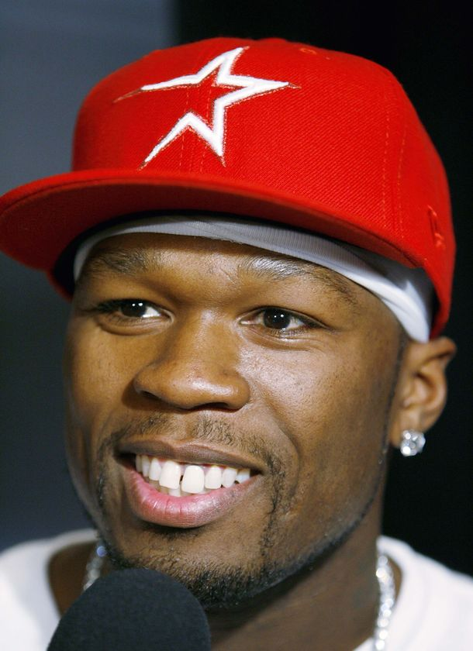
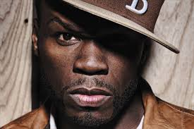

Slide 49
There is a traditional subdivision of music into classical, folk and pop music; young people normally listen to different styles of popular music including rock music, hip hop, rhythm and blues, jazz and so on. The genre of rock features characterize vocals, electric guitars, a bass guitar and a strong back beat; it emerged in the USA in the 1950s.Hip hop was initiated by city youth. Hip hop as music and culture formed during the 1970s in New York City, particularly among African American youth residingin the Bronx.Hip hop culture is characterized by the four elements of rapping, DJing, breaking and graffiti. Kool DJ Herc, the godfather of hip-hop. Rappers usually tell semi autobiographic tales in a rhythmic lyrical form using rhyme , they are accompanied by an instrumental track and a beat performed by a DJ, often other sounds are synthesized or performed.Punk rock has fast tempos, its instrumentation includes drums, electric guitars, an electric bass, and vocals are usually nasal or throaty.The first concrete punk rock scene appeared in the mid '70s in New York.England's punk scene had political and economic roots.This is where the beginnings of punk fashion.

Slide 50
Best punk rock bands are The Ramones, The Sex Pistols, The Clash, Social Distortion. Blues is characterized by call-and-response patterns in music and lyrics. The blues is a musical style created in response to the hardships endured by generations of African American people. It originated in the rural Mississippi Delta region at the beginning of the 20th century. Early blues frequently took the form of a loose narrative .The most outstanding blues singers were Ma Rainey (Ma Rainey), Bessie Smith (Bessie Smith), a little later Hauling Wolf (Howling Wolf), Robert Johnson (Robert Johnson), John Lee Hooker (John Lee Hooker), BB King (BBKing ). When I feel depressed, I prefer to listen to jazz as it is the kind of music which has a powerful rhythm filling you with energy and strength, it provides a brilliant combination of instrumental tunes and voice. Typical jazz instruments are a saxophone, a trumpet, a trombone, a piano, guitars, drums, and vocals. Jazz is a musical style that originated at the beginning of the 20th century in black communities in the Southern United States. It was born out of a mix of African and European music traditions. Louis Armstrong was an American jazz trumpeter and singer from New Orleans, Louisiana.

Slide 51
Armstrong was a foundational influence in jazz, shifting the focus of the music from collective improvisation to solo performance. Also rock and roll and techno are well-known styles of music too. My favourite style of music is pop music, because it is breathtaking and full of energy. When I listen to pop music it makes me remember happy times and forget the problems of everyday life. It helps me to relax when I'm tired. I also enjoy listening to classical music. I find it tuneful and appealing. Classical music is always a complex of emotions. It gives me delight, pleasure and a sense of happiness. Some pieces of classical music are really wonderful. Famous classical composers are Antonio Vivaldi (Summer III), Frédéric François Chopin (Marriage D'amour), Ludwig van Beethoven (Symphony No. 5 in C minor), Wolfgang Amadeus Mozart (Symphony 4), Johann Sebastian Bach ( Air, Violin Concerto No.1 in A minor ).

Slide 52


