Slide 1
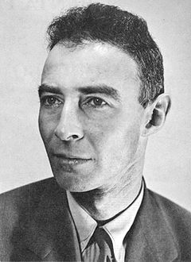
J. Robert Oppenheimer

Slide 2
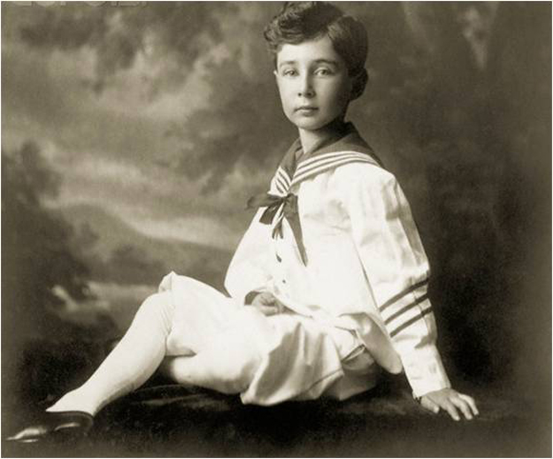
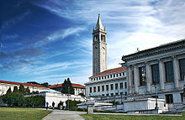
Childhood and education
Oppenheimer was born in New York City on April 22, 1904
Oppenheimer was initially schooled at Alcuin Preparatory School, and in 1911 entered the Ethical Culture Society School
He entered Harvard College a year late, at age 18
In 1924 Oppenheimer was informed that he had been accepted into Christ's College, Cambridge.
The University of California, Berkeley, where Oppenheimer taught from 1929 to 1943

Slide 3
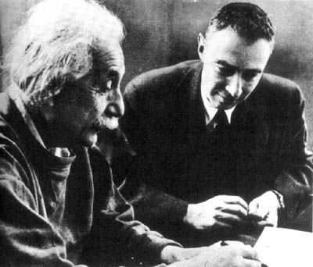
Oppenheimer with Albert Einstein

Slide 4
Manhattan Project
In 1939, in Germany the atomic nucleus were splited . Oppenheimer and other scientists have guessed that they could to get a controlled chain reaction , which is the key of creating a new very destructive weapon .
On October 9, 1941, shortly before the United States entered World War II, President Franklin D. Roosevelt approved a crash program to develop an atomic bomb

Slide 5
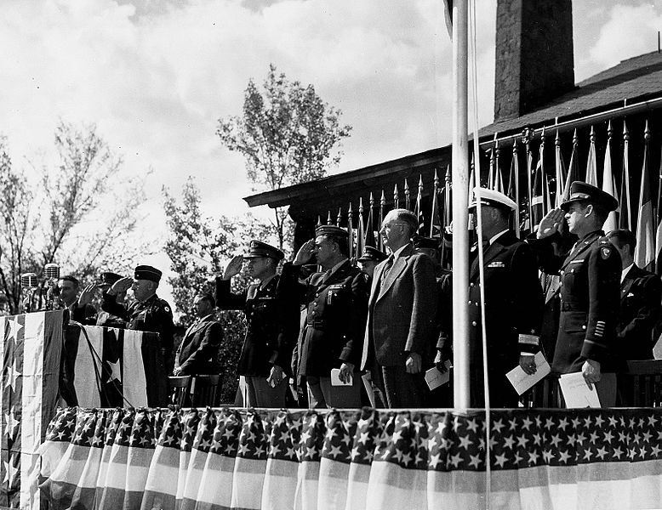
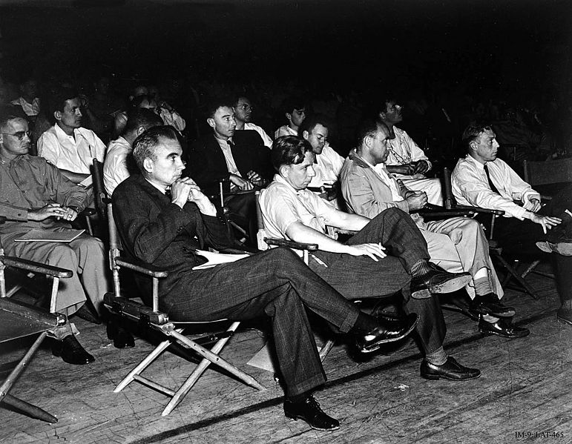

Slide 6

Trinity
The joint work of the scientists at Los Alamos resulted in the first artificial nuclear explosion near Alamogordo on July 16, 1945, on a site that Oppenheimer codenamed "Trinity"

Slide 7
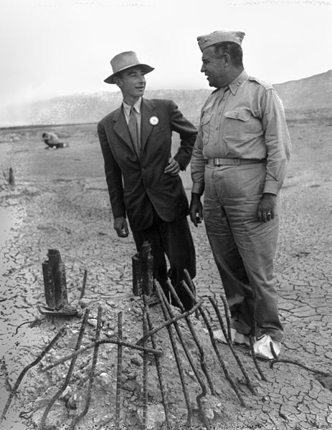
Oppenheimer (left) and Groves (right) at the remains of the Trinity test in September 1945.

Slide 8
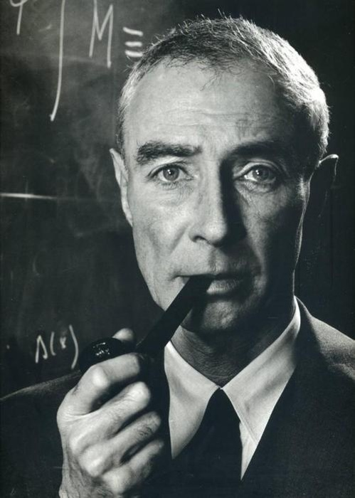
"I am become Death, the destroyer of worlds." (the Hindu holy book)

Slide 9
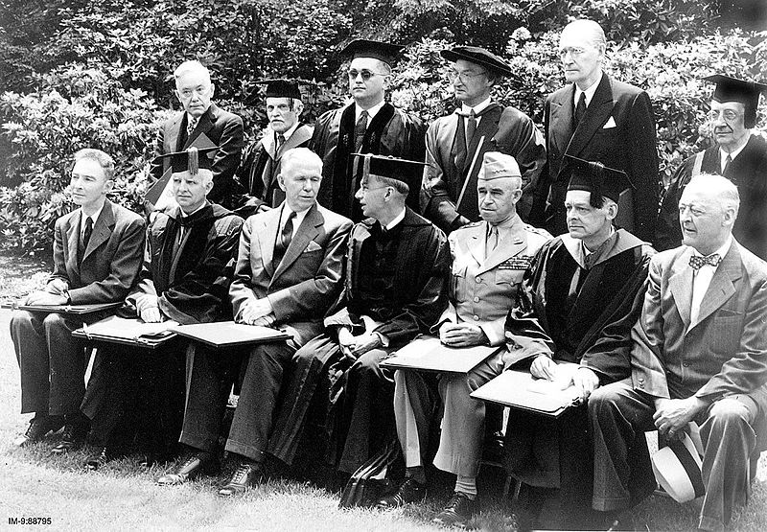
5 June 1947. Award of honorary degrees at Harvard to Oppenheimer (left), George C. Marshall (third from left) and Omar N. Bradley (fifth from left). The President of Harvard University, James B. Conant, sits between Marshall and Bradley.

Slide 10
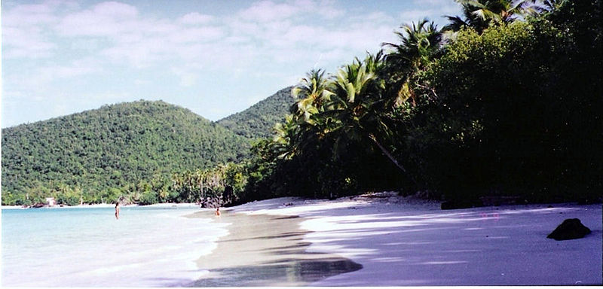
Oppenheimer Beach, in St John, US Virgin Islands
Starting in 1954, Oppenheimer spent several months of the year living on the island of St. John in the Virgin Islands. In 1957, he purchased a 2-acre (0.81 ha) tract of land on Gibney Beach, where he built a spartan home on the beach.

Slide 11
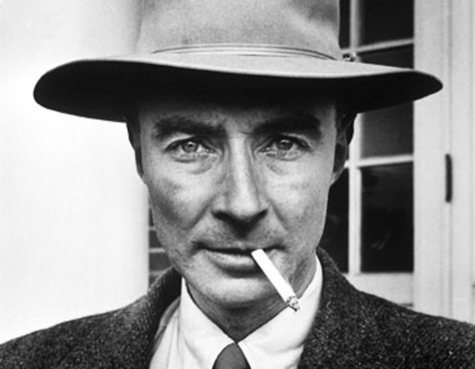
Oppenheimer felt banished from science, smoked a lot . In 1966, his health deteriorated and he died a year later at his home in Princeton from throat cancer .

