Slide 1
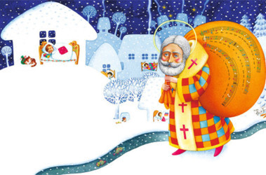
Saint Nickolas Day!!!

Slide 2
Saint Nicolas Day celebrate on nineteenth of December.

Slide 3
This festival is a time of great fan in Ukraine.

Slide 4
On this day, people would invite guests and sleighs would be ridden around the village to see the snow was slippery.

Slide 5
This was the holiday for young children, for they would receive gifts from St. Nickolas, the patron saint of children.

Slide 6
“St.Nickolas” was often accompanied by “angels” and might have quizzed the children on their catechism.

Slide 7
+ BONUS

Slide 15
Zhenia Demchenko

