Slide 1
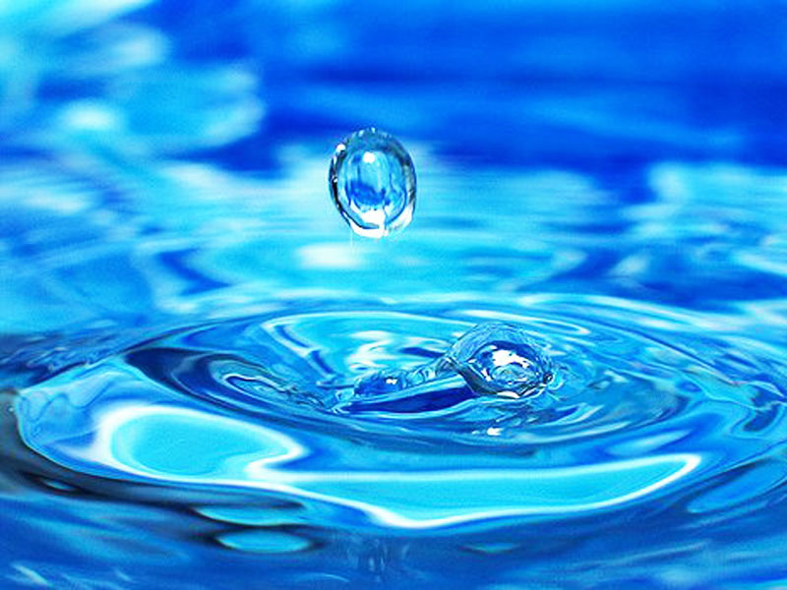
Water Pollution
Рerformed Monyatovska Anastasia

Slide 2
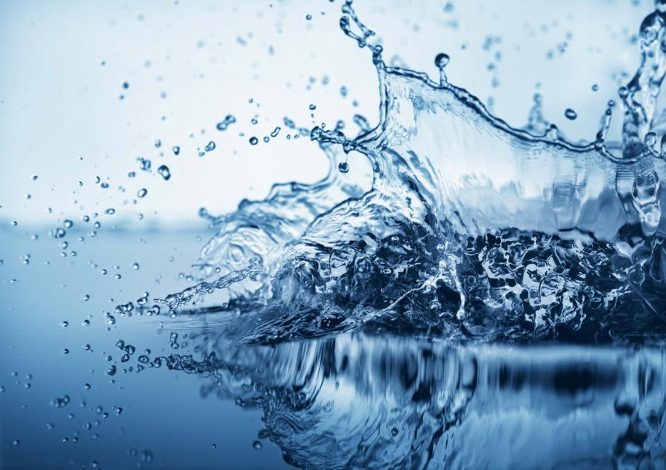
Water pollution occurs mostly, when people overload the water environment such as streams, lakes, underground water, bays or seas with wastes or substances harmful to living beings

Slide 3
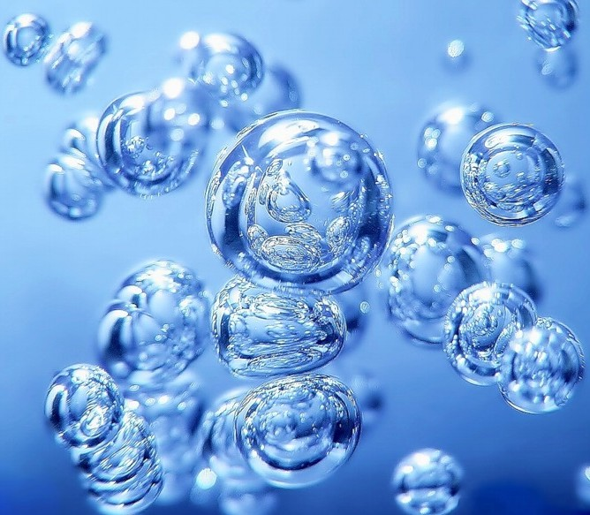
Water is necessary for life. All organisms contain it, some drink it and some live in it. Plants and animals require water that is moderately pure, and they cannot survive, if water contains toxic chemicals or harmful microorganisms. Water pollution kills large quantity of fish, birds, and other animals, in some cases killing everything in an affected area

Slide 4
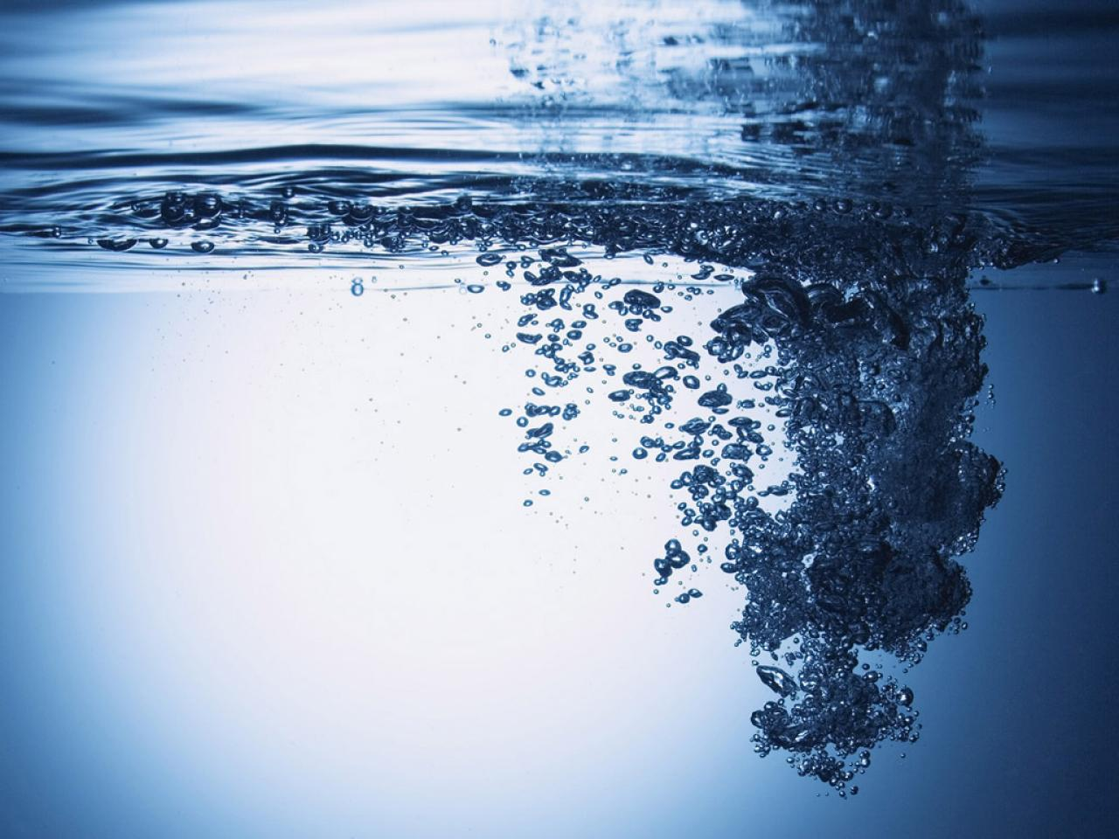
Pollution makes streams, lakes,
and coastal waters unpleasant to swim in or to have a rest. Fish and shellfish harvested from polluted waters may be unsafe to eat. People who polluted water can become ill, if they drink polluted water for a long time, it may develop cancer or hurt their future children.

Slide 5
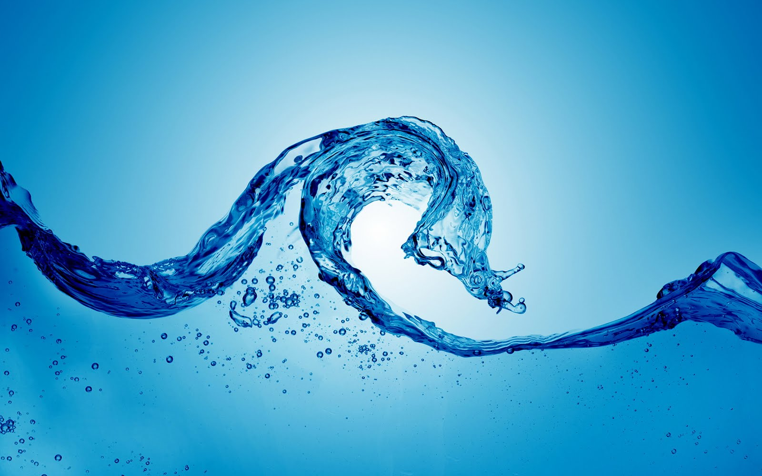
The major water pollutants are chemical, biological, and physical materials that lessen the water quality. Pollutants can be separated into several different classes

Slide 6
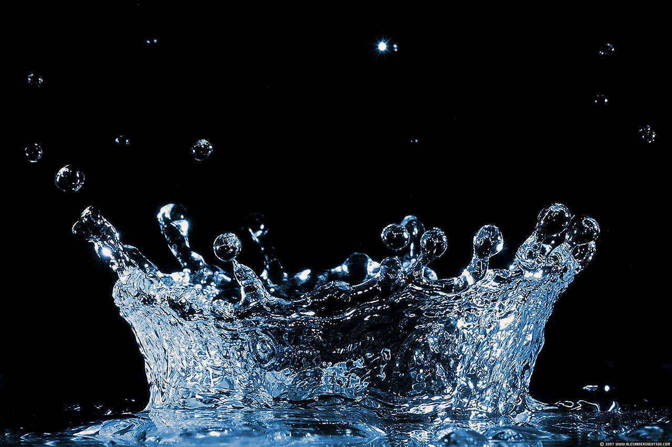
The first class is petroleum products: oil, fuel, lubrication, plastics. The petroleum products get into water by accidental spills from ships, tanker trucks and when there are leaks from underground storage tanks. Many petroleum products are poisonous for animals. Spilled oil damages the feathers of birds and the fur of animals, often it causes death.

Slide 7
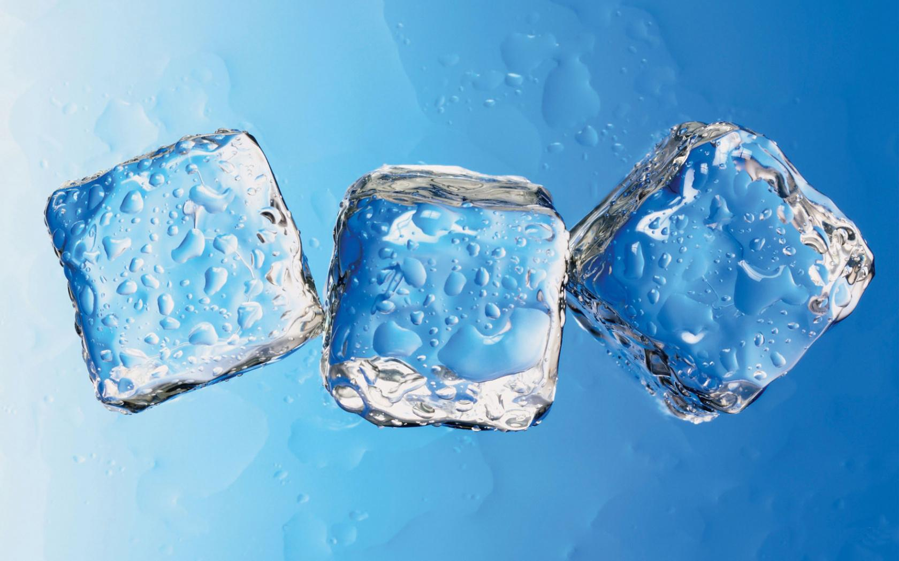
The second class is pesticides and herbicides. There are chemicals used to kill harmful animals and plants. If they penetrate into streams, rivers, lakes, these chemicals can be very dangerous. The chemicals can remain dangerous for a long time. When an animal eats a plant that's been treated with it, the poisons are absorbed into the tissues and organs of the animals.

Slide 8
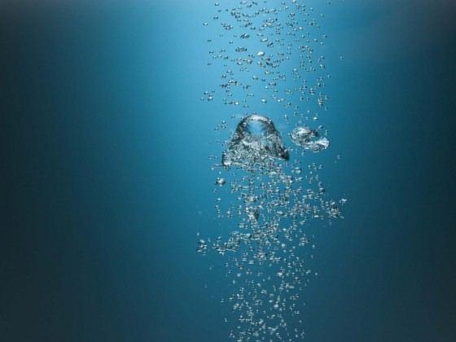
When other animals feed on a contaminated animal, the chemicals are passed up to them. As it goes up through the food chain, the chemical becomes more harmful, so animals at the top of the food chains may suffer cancers, reproductive problems, and death. Nitrates can cause a lethal form of anemia in infants.

Slide 9
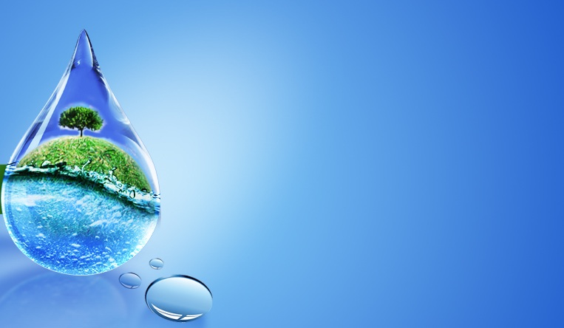
The third class are heavy metals, such as, mercury, selenium, uranium, radium, cesium, etc. They get into the water from industries, automobile exhausts, mines, and natural soil. Heavy metals also become more harmful as they follow the food chain. They accumulate in living being's cells and when they reach high levels of concentration in the organism, they can be extremely poisonous, or can result in long-term health problems. They can sometimes cause liver and kidney damage.

Slide 10
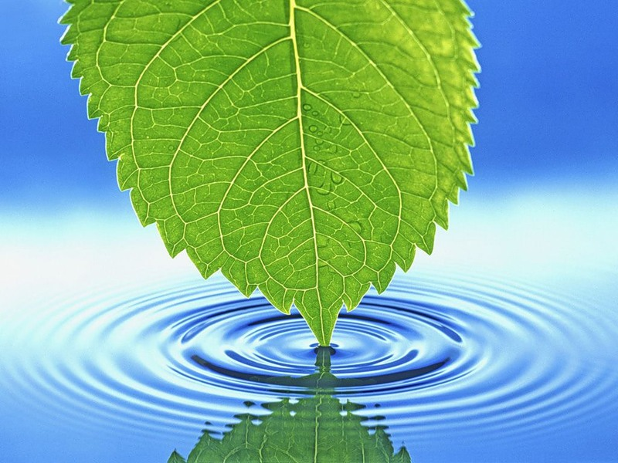
The fourth class is fertilizers and other nutrients used to promote plant growth on farms and in gardens.
The fifth class is infectious organisms and pathogens. They enter water through sewage, storm drains, runoff from farms, etc.

Slide 11
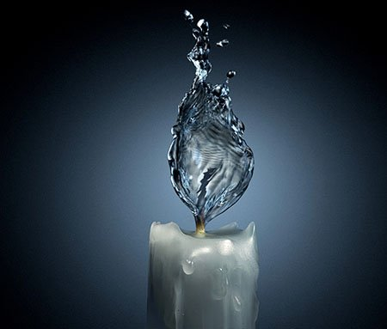
The last one is thermal pollution. Water is often taken from rivers, lakes or seas to be used in factories and power plants. The water is usually returned to the source warmer than when it was taken. Even a small temperature change in a body of water can drive away the fish and other species that were originally there, and attract other species in place of them. It breaks a balance and can cause serious circumstances in future.

Slide 12
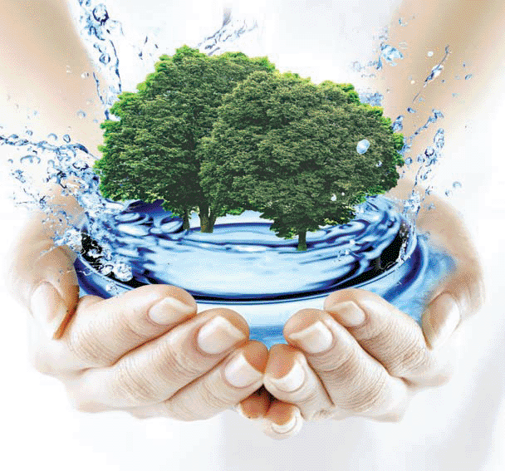
Save water!!!

Slide 13
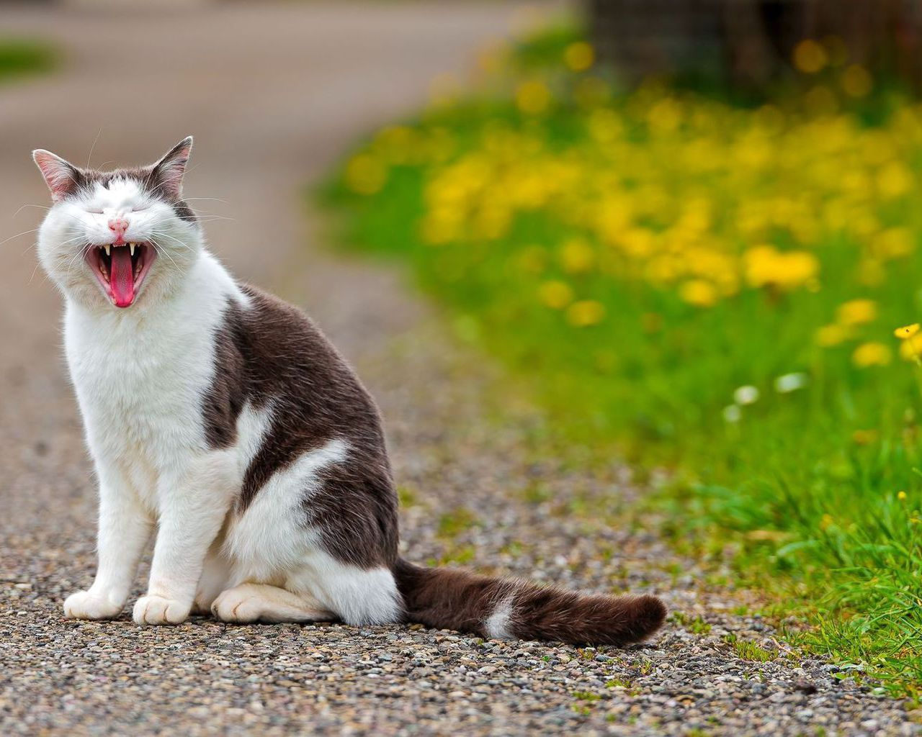
Thank you for your attention☺

