Slide 1
Germany

Slide 2
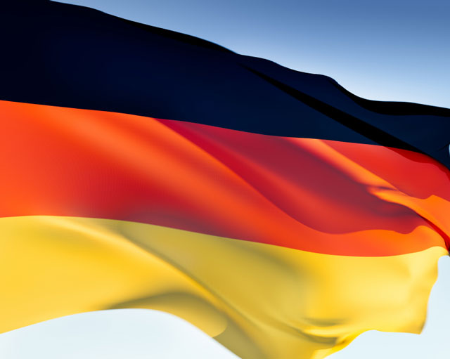
The official name of Germany is the Federal Republic of Germany (Bundesrepublik Deutschland (BRD)). It`s capital is Berlin. It`s total population is about 82 million people. It`s total area is 357,000 square kilometres.

Slide 3
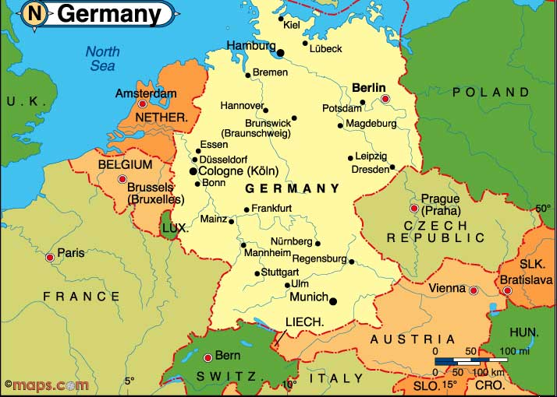
The Federal Republic of Germany is border on with Austria, Poland, Czech Republic, Belgium, Netherlands, France, Switzerland. Germany is bounded by the North Sea and Baltic Sea.

Slide 4
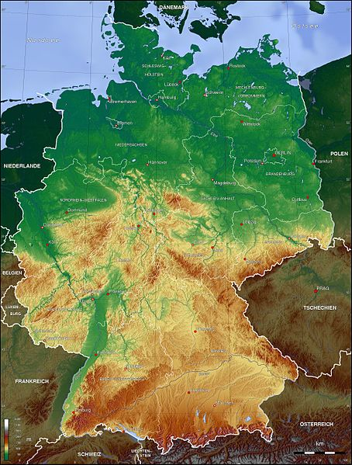
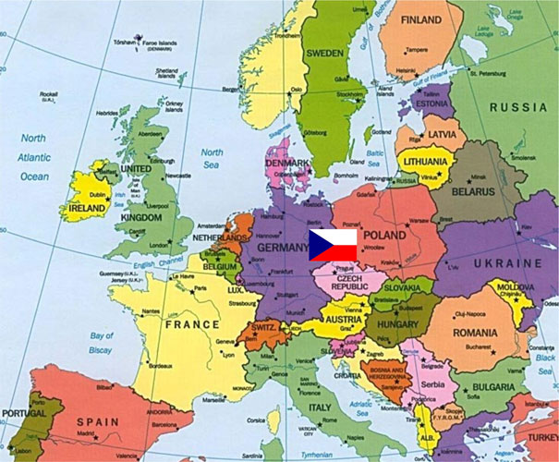
The geographical position, relief
Germany is located in the west central part of Europe.
Germany is located in the Central European plain with rolling hills and lakes. On its shores are washed by the North Baltic and North Seas. In the south of the Alps begin.

Slide 5
Climate, plants and animals
The weather is often fickle nature. In the middle of the summer can be warm and sunny, but the next day can be cold and rain to go. The truly extreme events (severe droughts, tornadoes, storms, bitter cold or heat) are relatively rare. It is also linked to the fact that Germany is in a temperate climate zone in northern maritime climate, the south goes to moderate continental.

Slide 6
Plants and animals
Climate change may lead to loss of 30% of species of flora and fauna Germany. Experts also expect an increase in new pests and carriers of various diseases.
Global warming is not always seen as clearly as in the Arctic from melting ice or in tropical areas with disaster. Thousands of species of animals and plants die unnoticed - including in Germany

Slide 7
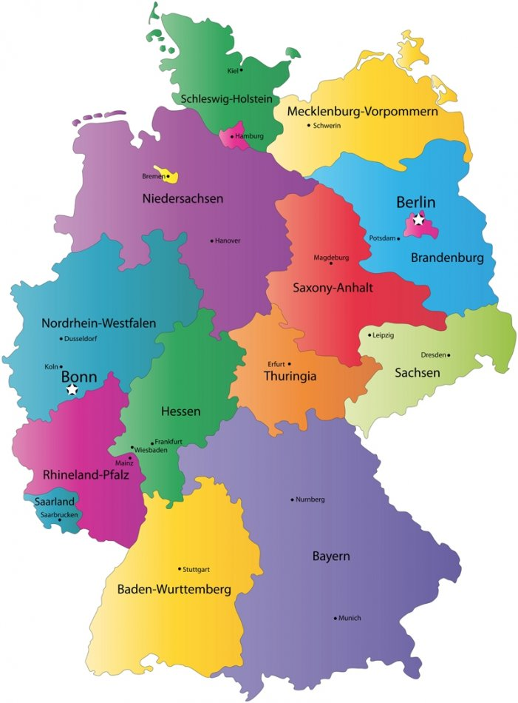
Historically, the territory of Germany is divided into 16 parts. The most famous are Bayern and Brandenburg.

Slide 8
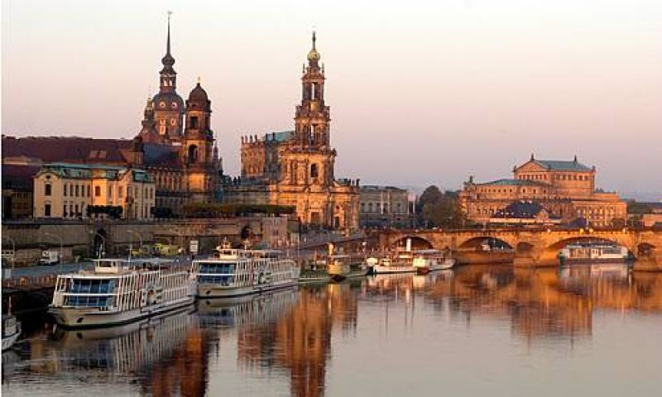
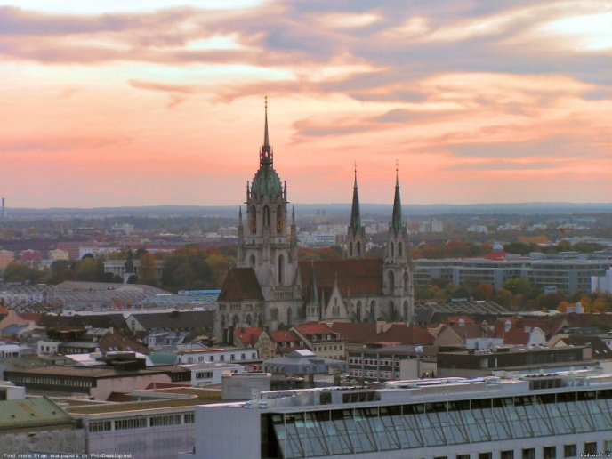
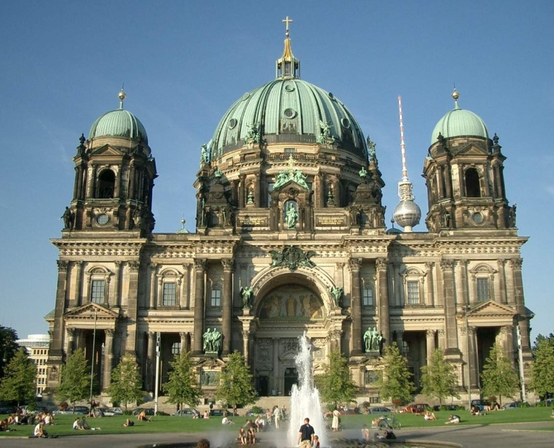
The Germany`s biggest town is Munich, Dresden and Berlin.

