Slide 1
City of ukraine
Lutsk

Slide 2
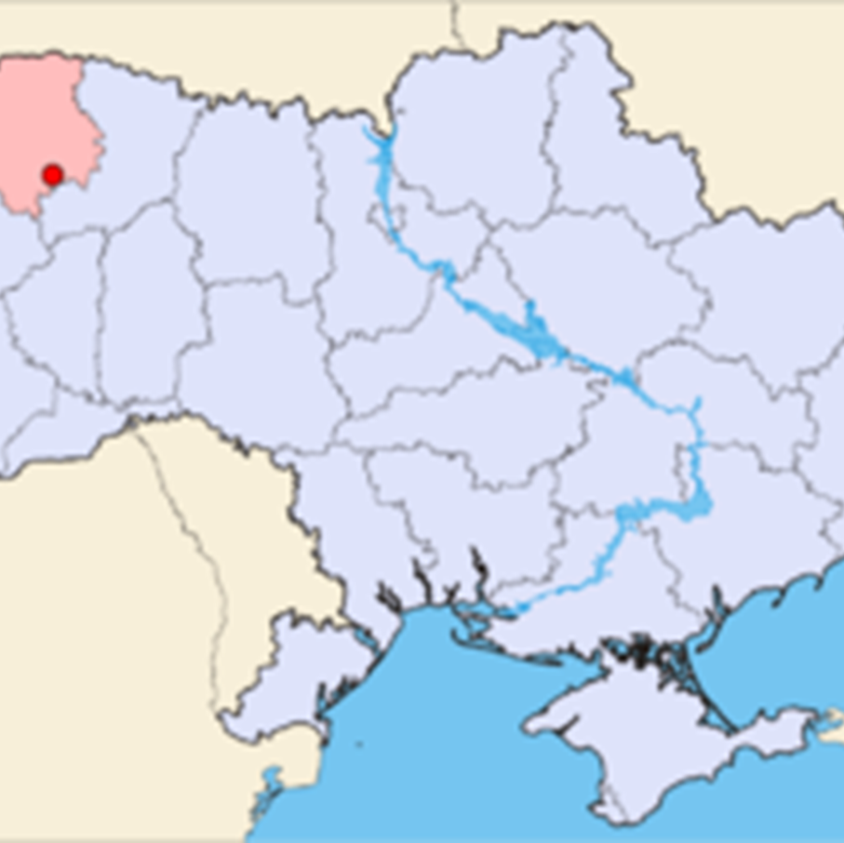
Lutsk is a city located by the Styr River in northwestern Ukraine.

Slide 3
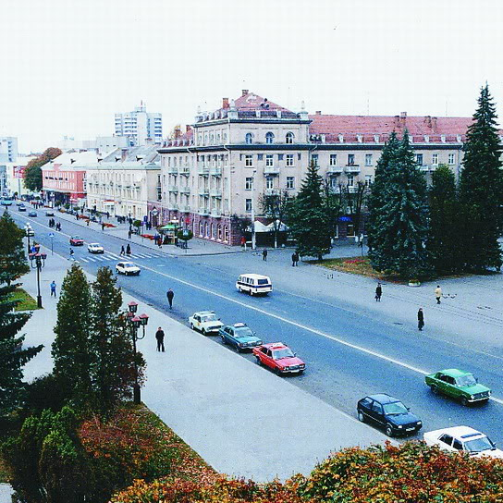
Prospect of Freedom - is one of the most beautiful and longest central avenues of Lutsk

Slide 4
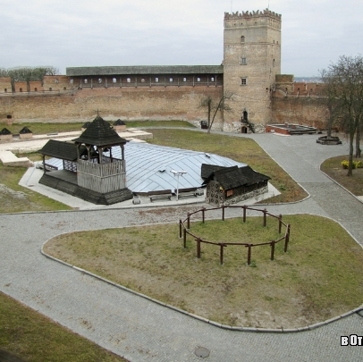
Lutsk High Castle it is the most prominent landmark of Lutsk.

Slide 5
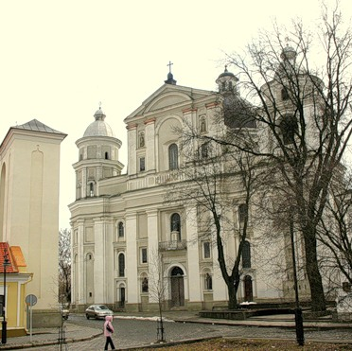
Catholic Cathedral of Saints Peter and Paul Church

Slide 6
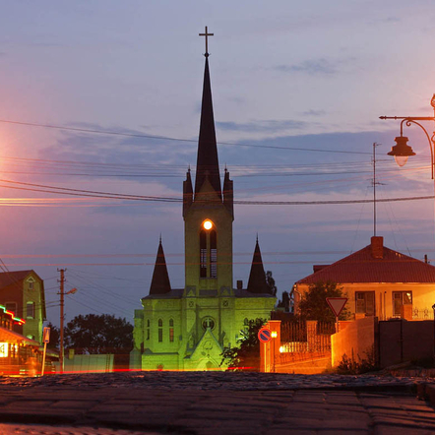
This beautiful building in neo-Gothic style towers in the center of Lutsk…

Slide 7
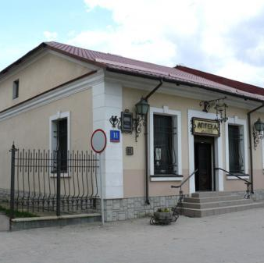
Pharmacy Museum
The oldest chemist’s shop (pharmacy) in Lutsk, which is situated on the former Market Square in the Old City, has been functioning since the 19th century.

Slide 8
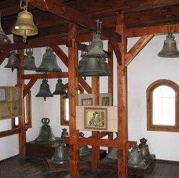
Bell museum
The Bell Museum in Lutsk Castle is the only one of its kind in Ukraine.

Slide 9
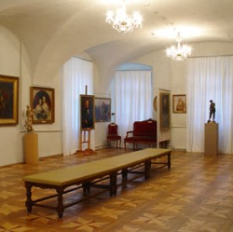
The Art Museum
The Art Museum presents masterpieces of the Ukrainian and foreign art.

Slide 10
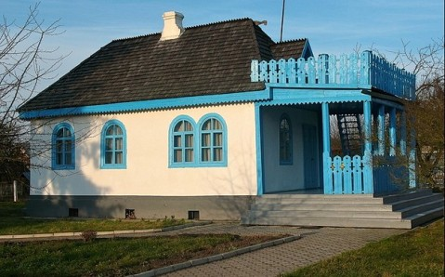
Lesya Ukrainka Museum
Museum of Lesya Ukrainka introduces a biography of the famous writer and Volyn origins of her talent

