Slide 1

Education
in the
United Kingdom

Slide 2




The purpose of education in the UK has three main objectives: to learn
read,
write,
count.

Slide 3
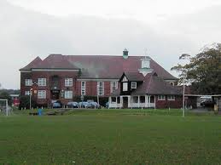
There is a huge variety of schools in England
State education
In the United Kingdom, the term "state school" refers to government-funded schools which provide education free of charge to pupils.
Some state schools have formal links with religious organizations, and are permitted to promote a particular religious ethos and to use faith criteria in their admissions. Schools are partially funded by religious or other charitable bodies.
The oldest state school in England is Beverley Grammar School, which was founded in 700 AD.

Slide 4
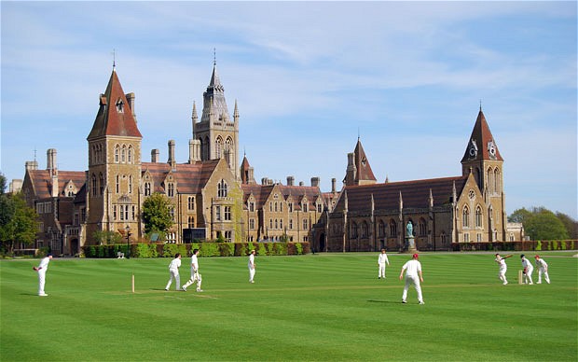
Independent Schools
Independent Schools are considered prestigious. Usually there learn english kids.
In these schools enroll children from 8 to 18 years. Good private school - it's well-equipped independent educational institutions, which own about several hundred acres of land on the territory of which the academic buildings, sports facilities, a swimming pool, a residence for a living.

Slide 5
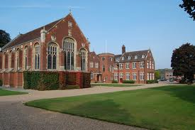
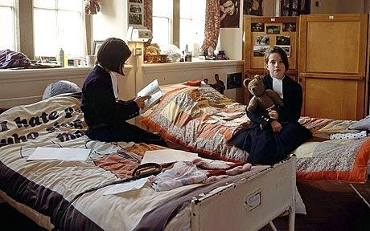
Boarding School
A boarding school is school where some or all people study and live during the school year with their fellow students.

Slide 6


Classification of school-age students:
Elementary School
Elementary school is an institution where children receive the first stage of academic learning .
Secondary School
In England and Wales secondary school is for children from the ages of 11 to 18. After 11 years of compulsory education ends, and young people can decide whether to continue their studies further at school or sixth form college, or leave the education system.

Slide 7

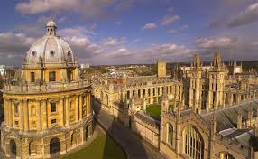
Further Education
Further education is a term mainly used in connection with education in the United Kingdom and Ireland. It is post-compulsory education . It may be at any level above compulsory secondary education, from basic skills training to higher vocational education.
Higher Education
Higher, post-secondary, tertiary or third level education is the stage of learning that occurs at universities, academies, colleges, seminaries, and institutes of technology.
University of Oxford is one of the best universities in the world, best university in England

Slide 8
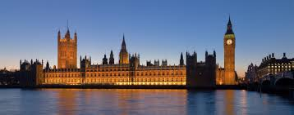
Training in the UK
To study in England you must have
desire to learn,
a great will to overcome all obstacles
and of course
to learn English.
The advantages of studying in England:
you get to know the beautiful country with great culture,
you can get an unforgettable experience in dealing with people,
you can enter the best universities in the world with ease.

Slide 9
GOOD LUCK
Serdeuk Dasha
From 10
School 29

