Slide 1
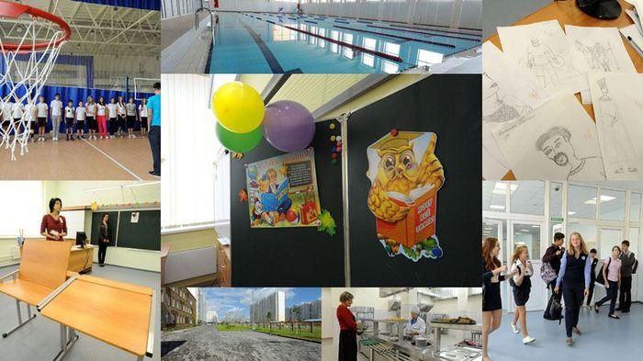
My ideal school
Prepared by the pupil of the 11th form Holub Margaryta

Slide 2
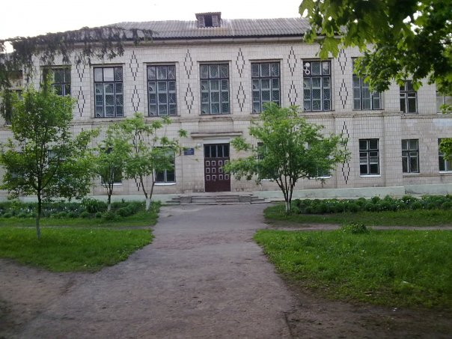
My school
First of all I`d like to tell you about my school. I have been learning in the same school for almost nine years. I like some things, and I don`t like other things. My school-is a school with in-depth study of certain subjects. I think it is certainly a plus. I know negative and positive things, but I will not speak about it. To my mind, my school is not far away from my dream school. Now I`m going to describe my Ideal School.

Slide 3
My ideal school
Homework we usually have a lot to do and it takes me several hours. In my Ideal School homework won`t be given. It would to be checked on the lessons immediately, that the children had free time. Breaks will be the same as in my school-for 10-20 minutes. Education will last for five days a week for five lessons. We need to introduce compulsory free two meals

Slide 4
Innovating my school
Modern computers

Slide 5
Innovating my school
And 2 swimming pools (large and small - for primary school). Three hours of physical education a week, one - the swimming pool.

Slide 6
Innovating my school
The modern school equipment, which includes everything - from stands to the latest multimedia systems.

Slide 7
Innovating my school
Dining room, such as, a healthy diet is extremely important for child’s development

Slide 8
Innovating my school
The presence of various sections of the school and groups that help students realize themselves in different areas.

Slide 9
Innovating my school
Great playgrounds where pupils could play sports

Slide 10
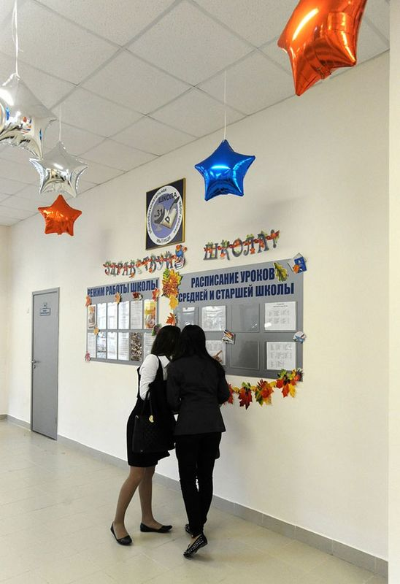
Another side!
But the ideal school is not just a wonderful equipment: sports ground, swimming pool, but also good atmosphere : excellent relationships between pupils and teachers, mutual respect and mutual assistance in the team. From the ideal school requires a high quality education. It depends on several components. First, this is the professional teaching staff. Second, the scientific and methodological work, the teacher spends in the classroom science experiments, draws students of game situations and so on. Ideal school is one that produces well prepared for life, and formed a single-minded youth.

