Slide 1

The Sugar Act
1764

Slide 2

The Sugar Act, also known as the American Revenue Act, was passed on April 5, 1764. The act placed taxes by the British on sugar, wine, coffee and other goods imported in large quantities from England, which caused economic upheaval in the colonies. Many colonists boycotted these products, claiming taxation without representation, as they did not have any representatives within the British Parliament. Despite the unrest, the British had many reasons for the implementation of the Sugar Act.

Slide 3
Reasons for the Sugar Act of 1764
1.French and Indian War
The French and Indian War began in 1756 to determine who would control North America. England won control in 1763, ousting the French and pushing the Native American Indians further westward. The war was incredibly expensive, sending England into enormous debt. In 1764 Prime Minister George Greenville saw an opportunity with the Sugar Act as a way to collect funds to pay off the debt caused by the French and Indian War.
2.Smuggling of Goods
Before the Sugar Act of 1764, there was the Molasses Act of 1733. This was England's answer to the colonists purchasing foreign molasses, which was cheaper. England implemented the Molasses Act, placing taxes on all non-British molasses products shipped to the colonies in an attempt to force colonists to purchase British products. However, the colonists found a way around the Molasses Act through the smuggling of goods. The Sugar Act of 1764 came just before the expiration of the Molasses Act as a way for the British to prevent the smuggling of goods and enforce taxes upon the colonists.

Slide 4

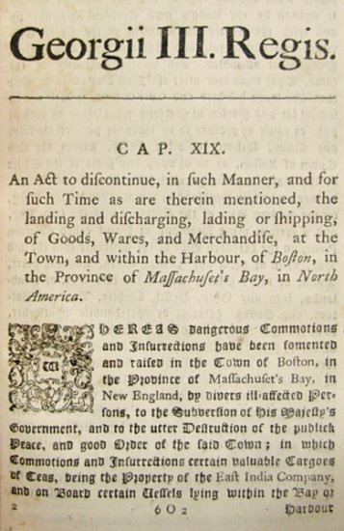
Facts About Sugar Act
The goal of the act was to raise revenue to help defray the military costs of protecting the American colonies at a time when Great Britain's economy was saddled with the huge national debt accumulated during the French and Indian War (Seven Years War).

Slide 5

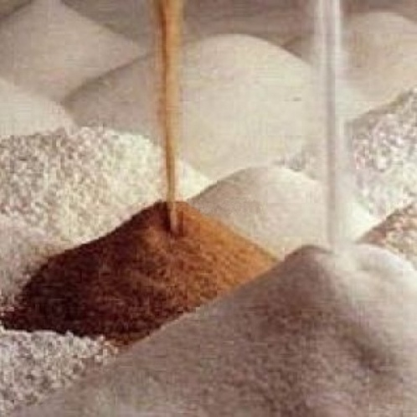
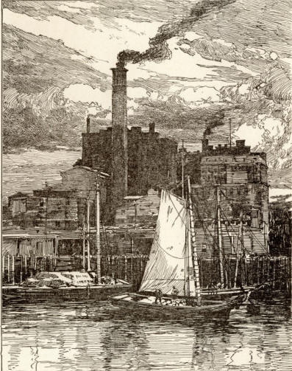
The focus of the Sugar Act was to discourage colonial merchants and manufacturers from smuggling non-British goods to avoid taxes imposed by Parliament.
The Sugar Act increased the number of items that would be taxed when they were imported to the colonies, but it actually reduced the tax on molasses and sugar

Slide 6

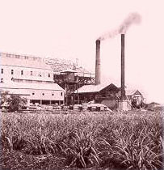
The Sugar Act also increased enforcement of smuggling laws.
The Sugar Act empowered customs officials to have all violations tried in vice admiralty courts rather than local colonial courts where the juries often looked favorably on smugglers.

Slide 7
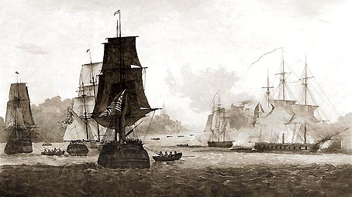
Strict enforcement of the Sugar Act successfully reduced smuggling, but it greatly disrupted the economy of the American colonies by increasing the cost of many imported items, and reducing exports to non-British markets.

Slide 8
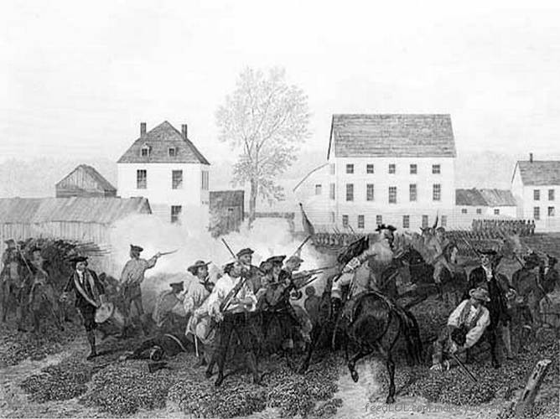
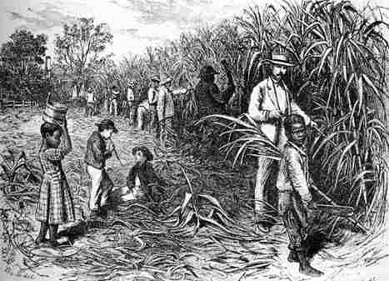
Americans protested the Sugar Act primarily because of its economic impact, but for some "no taxation without representation" became a rallying cry against Parliament's right to tax the colonies.
Protests against the Sugar Act led to boycotts of some British luxury goods, which did boost local manufacturing in some instances.

Slide 9
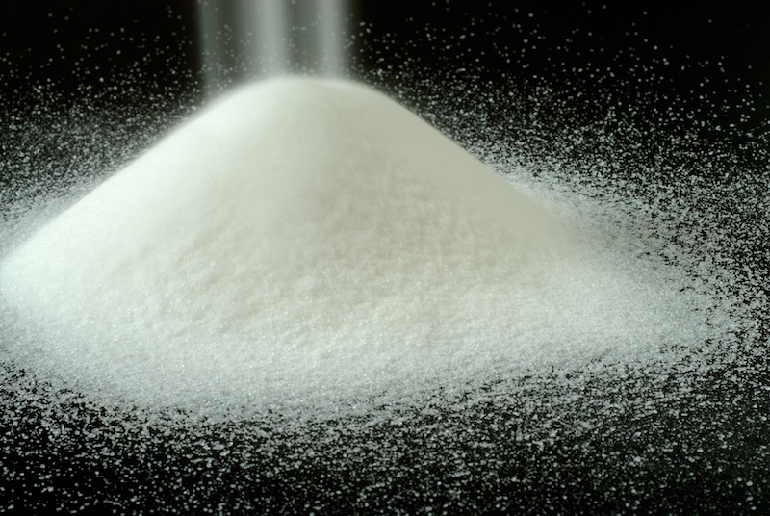
The end

