Slide 1
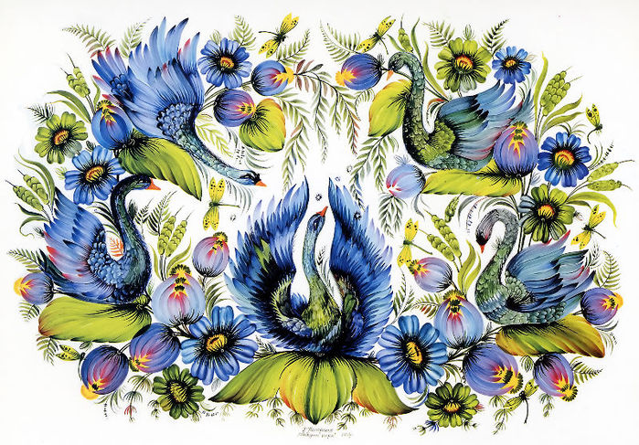
Petrykivsky Painting

Slide 2
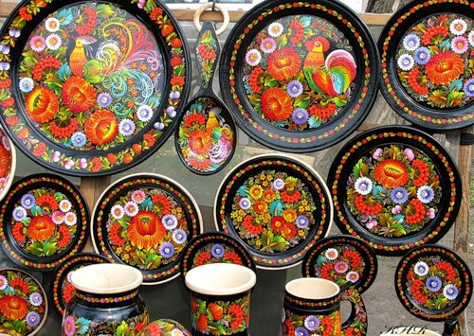
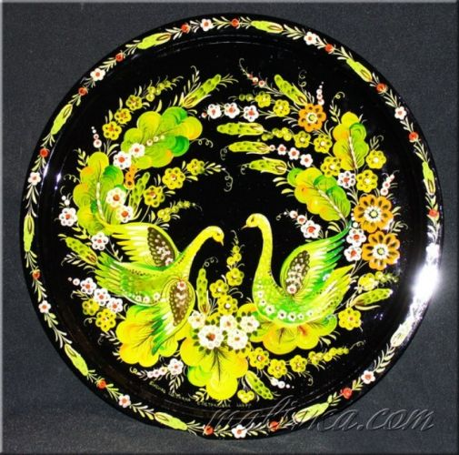
Petrykivsky painting or “petrykivka” is traditional Ukrainian decorative painting, which originates from Dnipropetrovsk oblast of Ukraine,Petrykivka village. Pertykivsky painting traditionally decorated everyday household items, and the earliest samples of it date back to the 17th century.

Slide 3
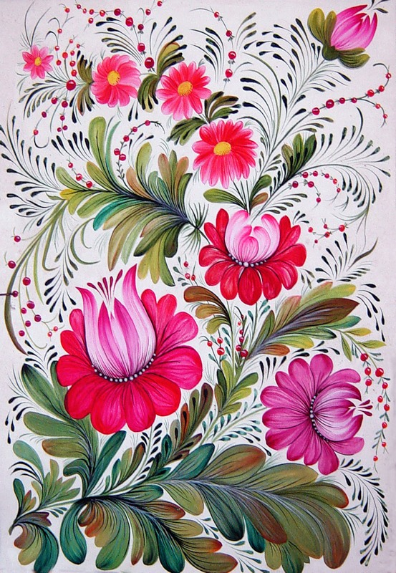
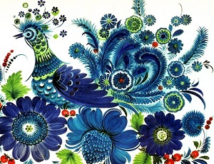
The distinctive features of this handicraft are the patterns, unusual technique and white background.

Slide 4
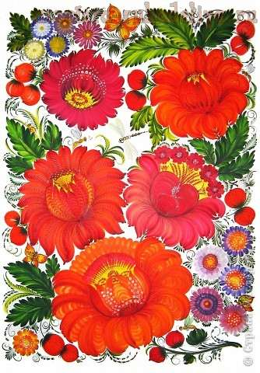
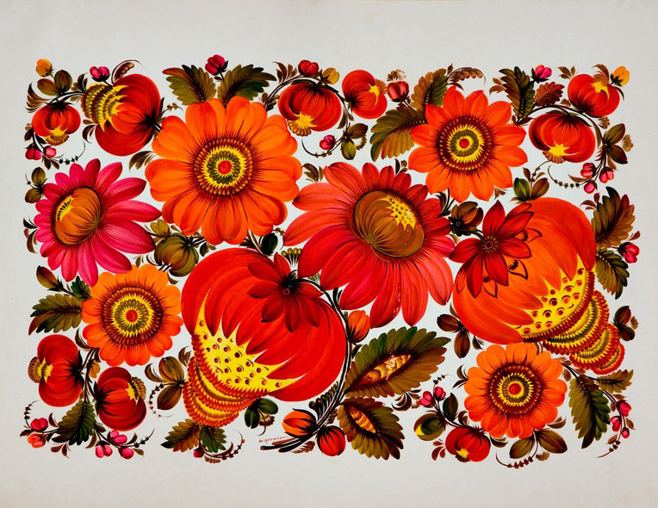
Of the three elders Petrikivsky Pilipenko Irina Ulyanivna most traditional.

Slide 5
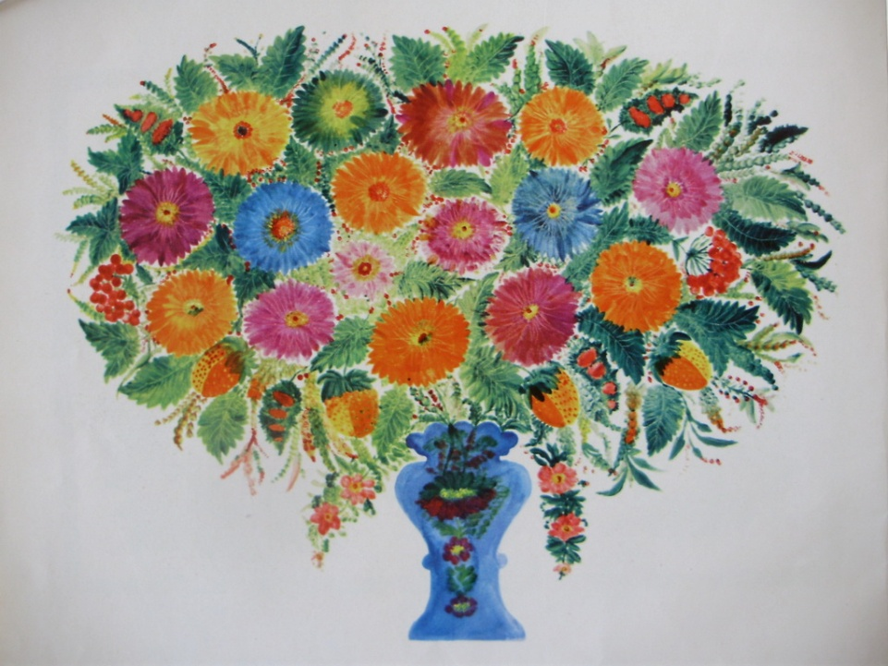
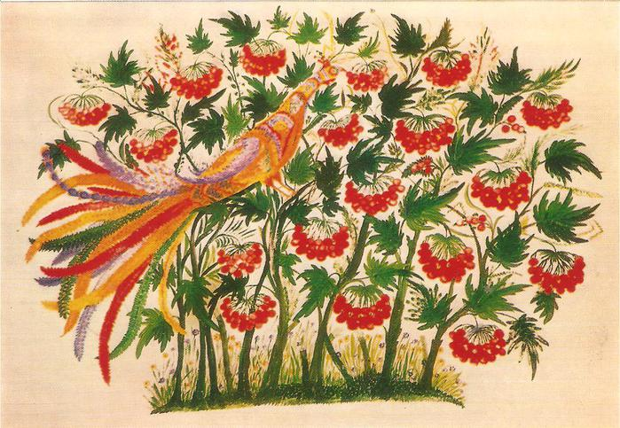
Striking fine artistic taste and artistic skill Tatiana Paty, which "by eye", but his masterly created the paradise bush with simple field and garden flowers, rose from snags and strawberries

Slide 6
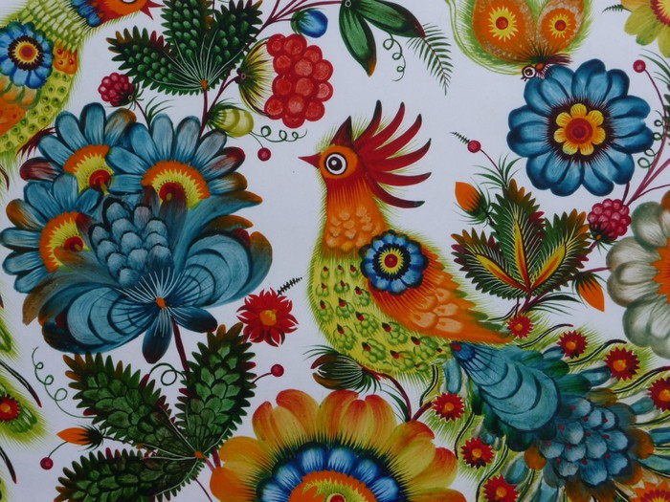

Slide 7
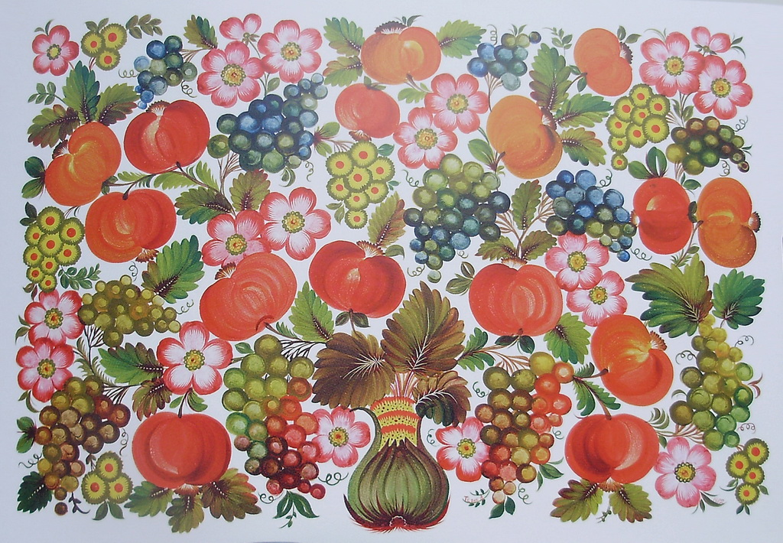

Slide 8
Thank you
for your
attention.

