Slide 1
Black Square
Kazimir Malevich
Prepared by
Oksana Dubinska
Form 11 A
School №3

Slide 2
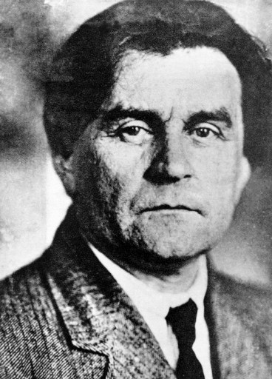
Kazimir Severinovich Malevich (23 February 1879—15 May 1935) was a Russian painter and art theoretician. He was a pioneer of geometric abstract art and the originator of the avant-garde, Suprematist movement.

Slide 3
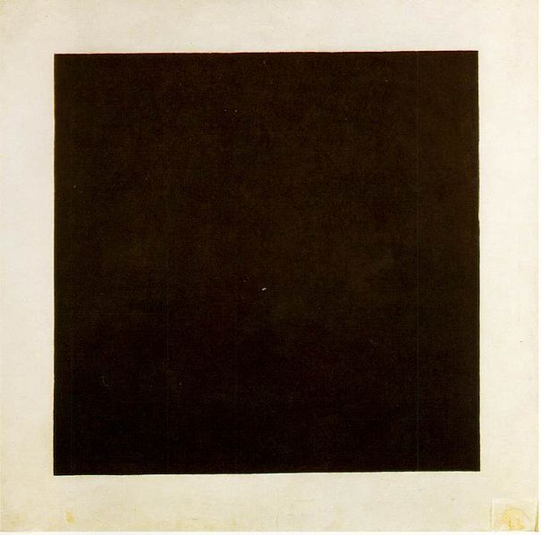
Kazimir Malevich, 1915, Black Suprematic Square, oil on linen canvas, Tretyakov Gallery, Moscow

Slide 4
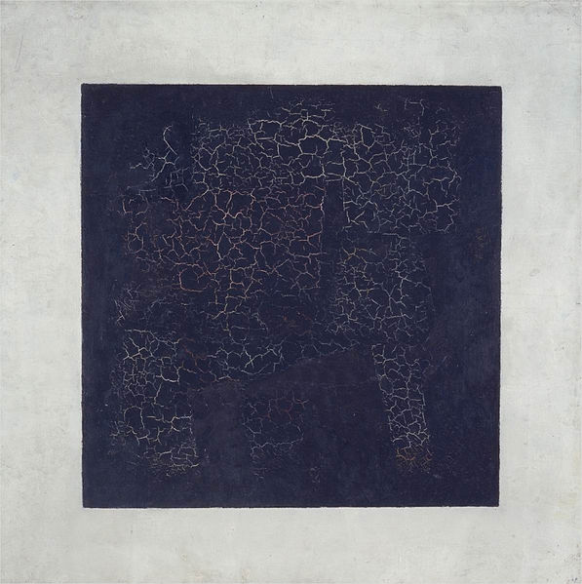
The Black Square of Kazimir Malevich is one of the most famous creations of Russian art in the last century. The first Black Square was painted in 1915 to become the turning point in the development of Russian avant-garde.

Slide 5
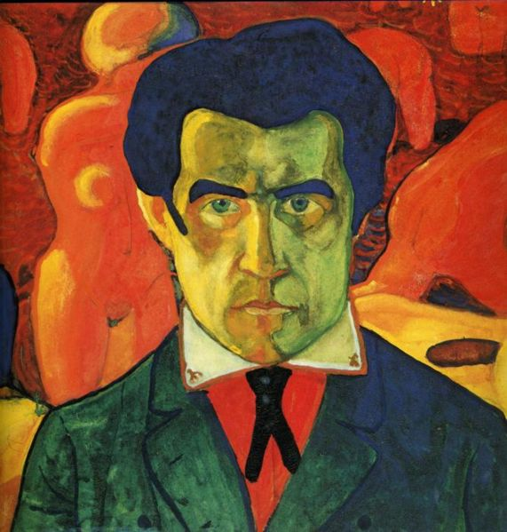
Malevich proclaimed his work as the "zero" of painting, that there was no-thing other that painting presented, no positioning, no certain conventional imaging. A meta painting - more - a painting that has no opposite in representational painting, no painting to its anti-painting.

Slide 6
Malevich saw the square as being that work that would necessarily maintain a spiraling triad into the fourth dimension by being a painting, by negating painting, by bringing painting into a new context, painting beyond painting. Malevich hung a black square in the centre of the world of meaning.

Slide 7
Thank you for your attention!

