Slide 1
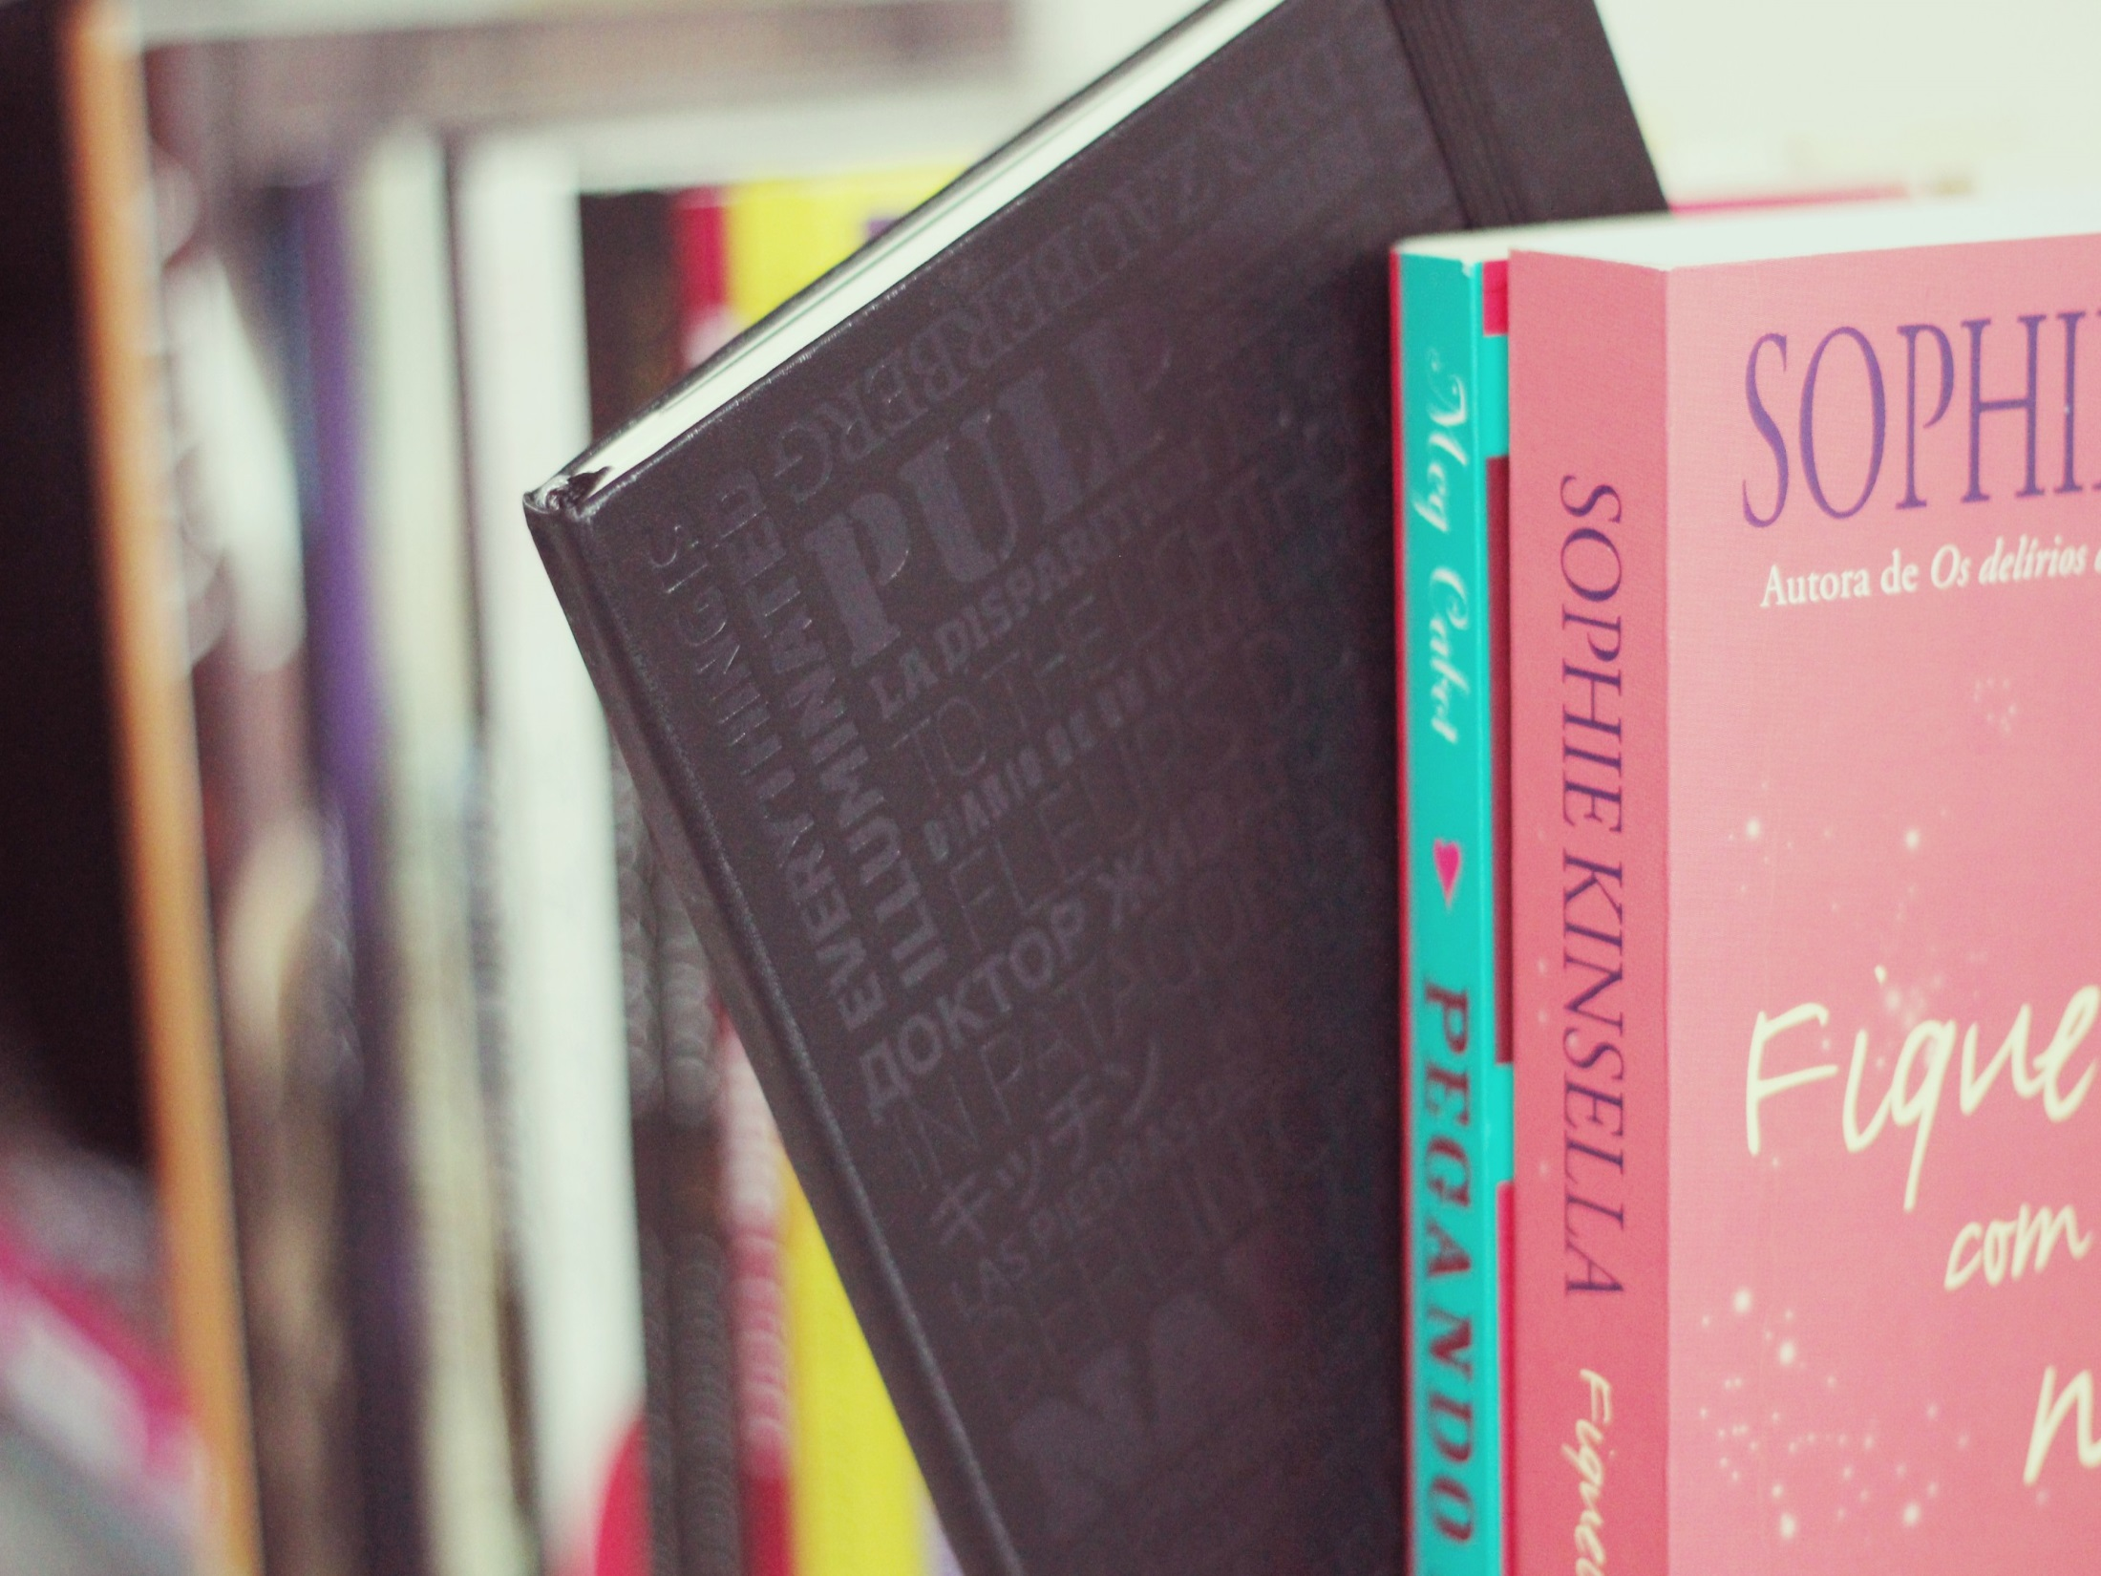
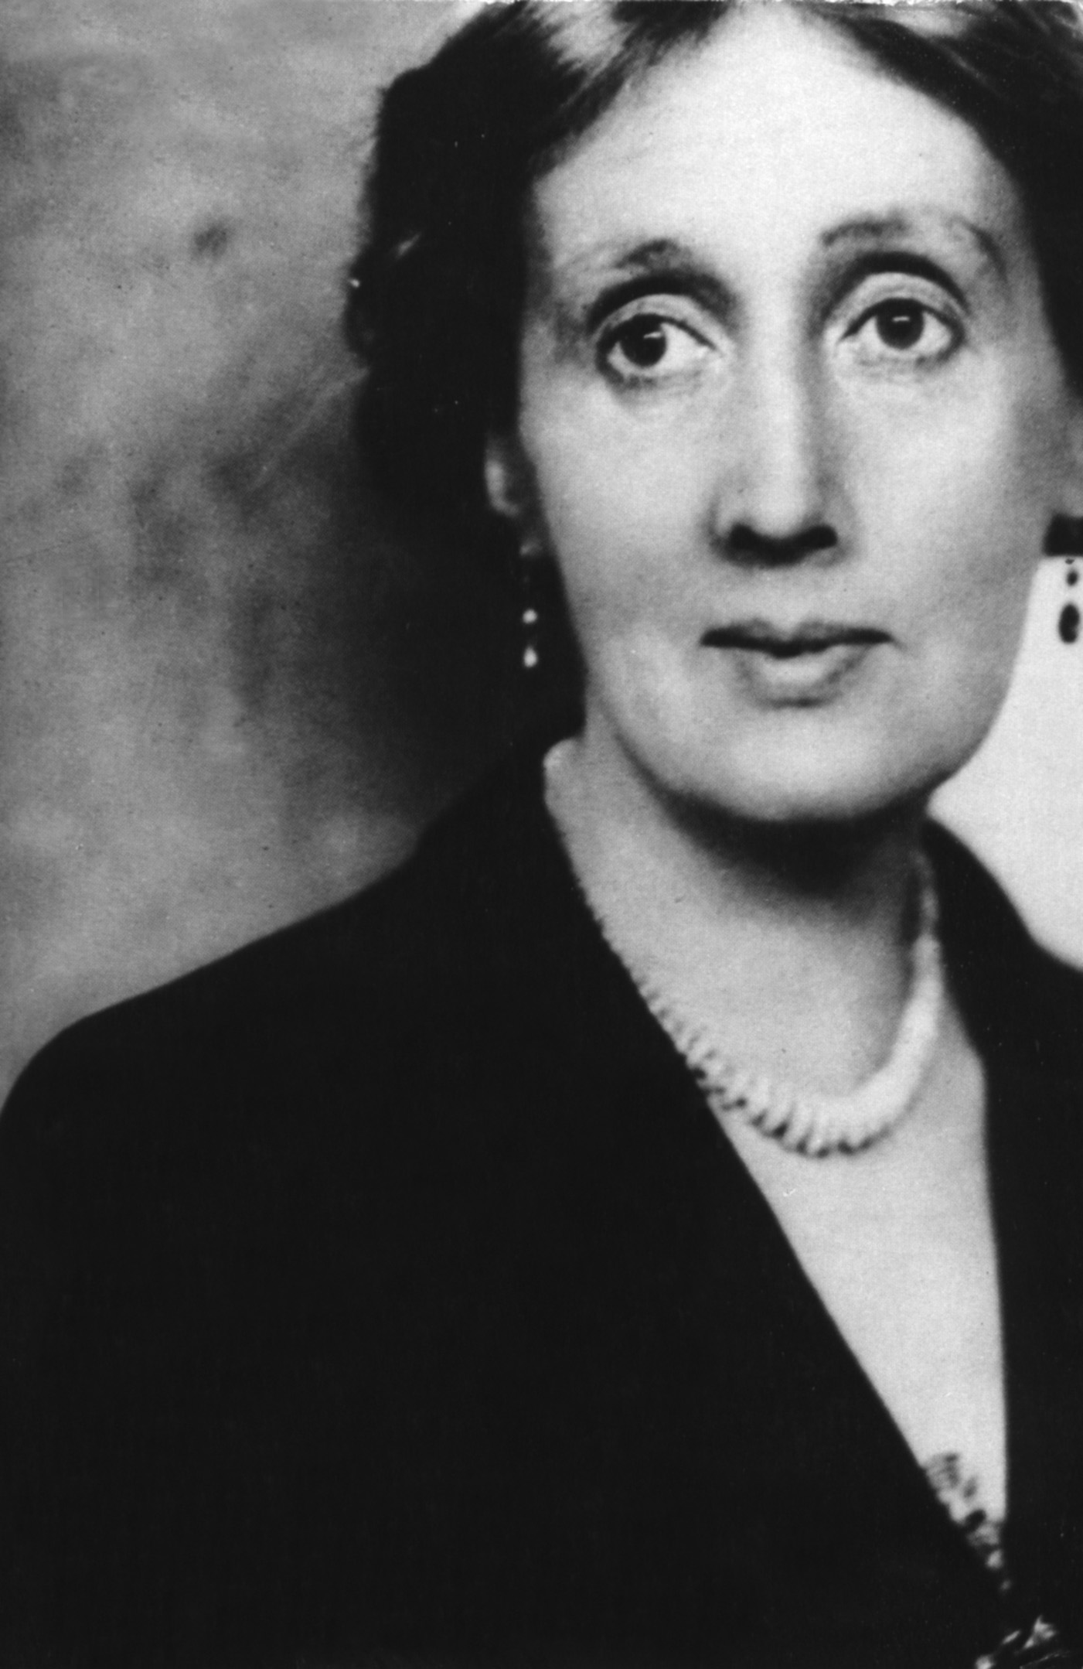
Virginia Woolf
1882-1941

Slide 2
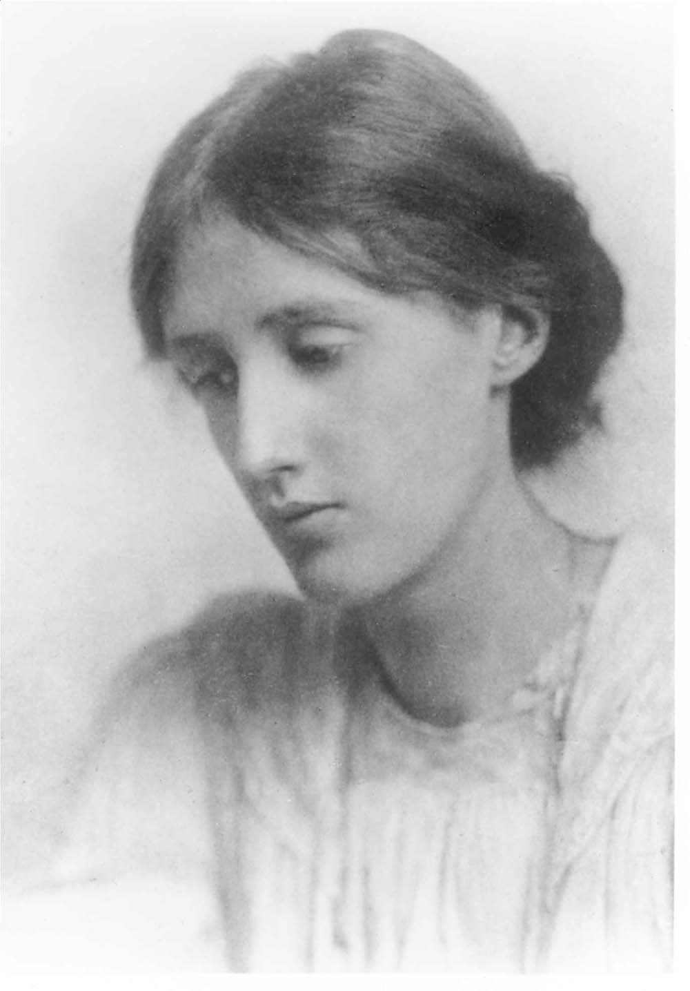
Virginia Woolf was the daughter of a Victorian critic, philosopher, biographer, and scholar Leslie Stephen. She was brought up in a large family where she could read in her father’s impressive library and get in touch with many well-known Victorians.

Slide 3
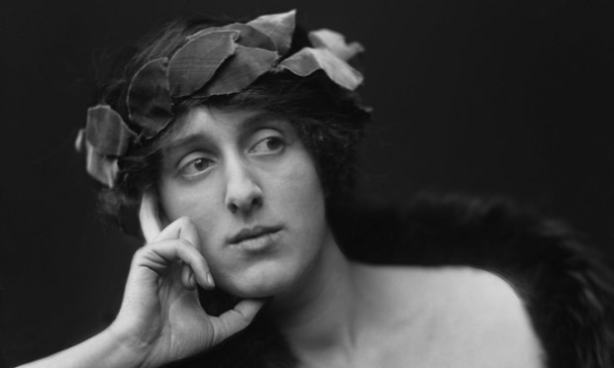
After the death of their father and Virginia's second nervous breakdown, Vanessa and Adrian sold 22 Hyde Park Gate and bought a house at 46 Gordon Square in Bloomsbury.

Slide 4
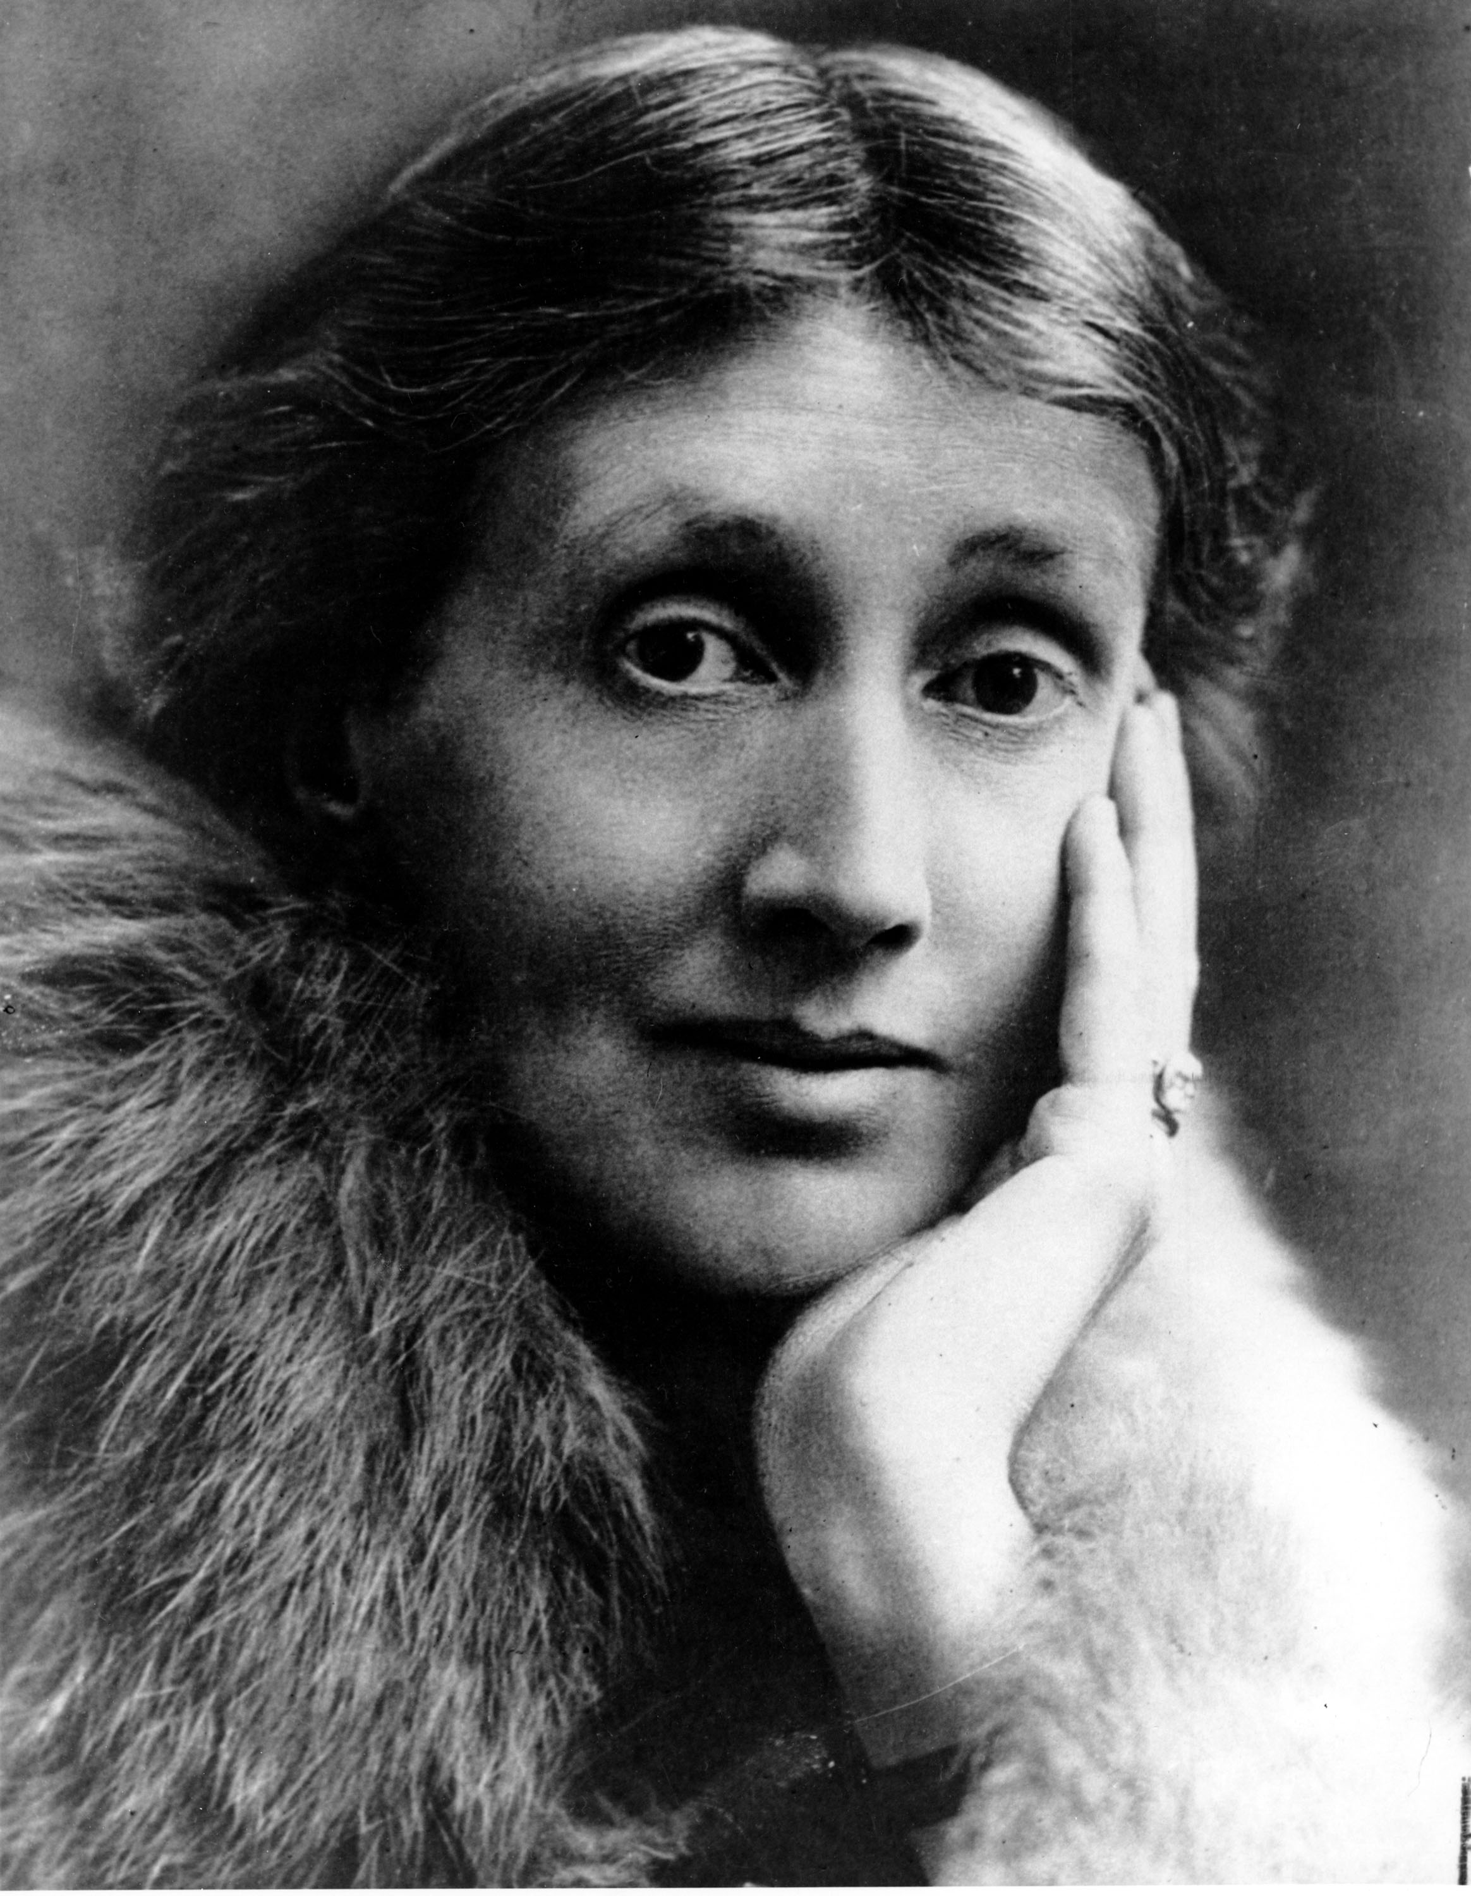
Virginia Stephen married writer Leonard Woolf on 10 August 1912. Despite his low material status the couple shared a close bond. Indeed, in 1937, Woolf wrote in her diary: "Love-making—after 25 years can't bear to be separate ... you see it is enormous pleasure being wanted: a wife. And our marriage so complete."

Slide 5
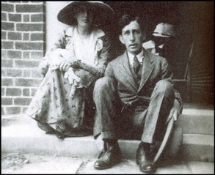
Together they established the Hogarth Press in 1917 that published, among others, Eliot's POEMS(1919) and HOMAGE TO JOHN DRYDEN(1924) the English translations of Freud, and Woolf's own writings.

Slide 6
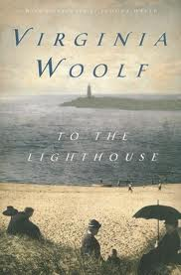
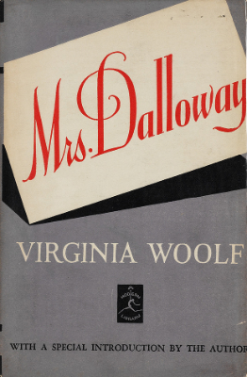
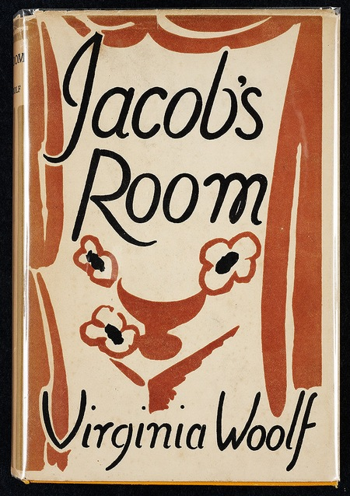

Slide 7
