Slide 1
Shopping

Slide 2
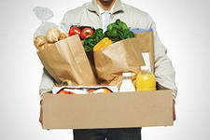
There are different kinds of shops. Some of them sell bread. Others sell tea, sugar, coffee, butter, cheese, sausages, meat, fruit, vegetables.

Slide 3

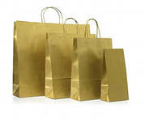
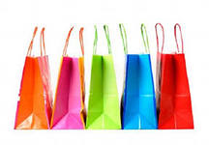
When we want to buy something, we take our shopping-bags and go to the shop. There we can see shop-assistants who sell goods.

Slide 4
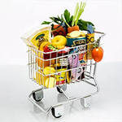

Many people do their shopping at the market. There farmers and other people sell fruit and vegetables which they grow themselves. They sell meat, milk and other things too.

Slide 5
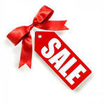

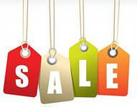
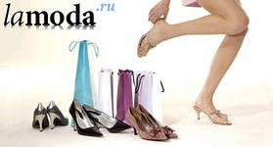
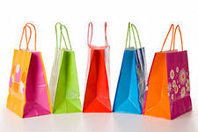
Large shops with many departments are called department stores and supermarkets. In these stores we can buy almost everything we want. In the shop-windows we can see all the goods which they sell – food, suits, dresses, coats, boots, shoes, radio and TV-sets, and many other things.

Slide 6
Buy wisely!

