Slide 1
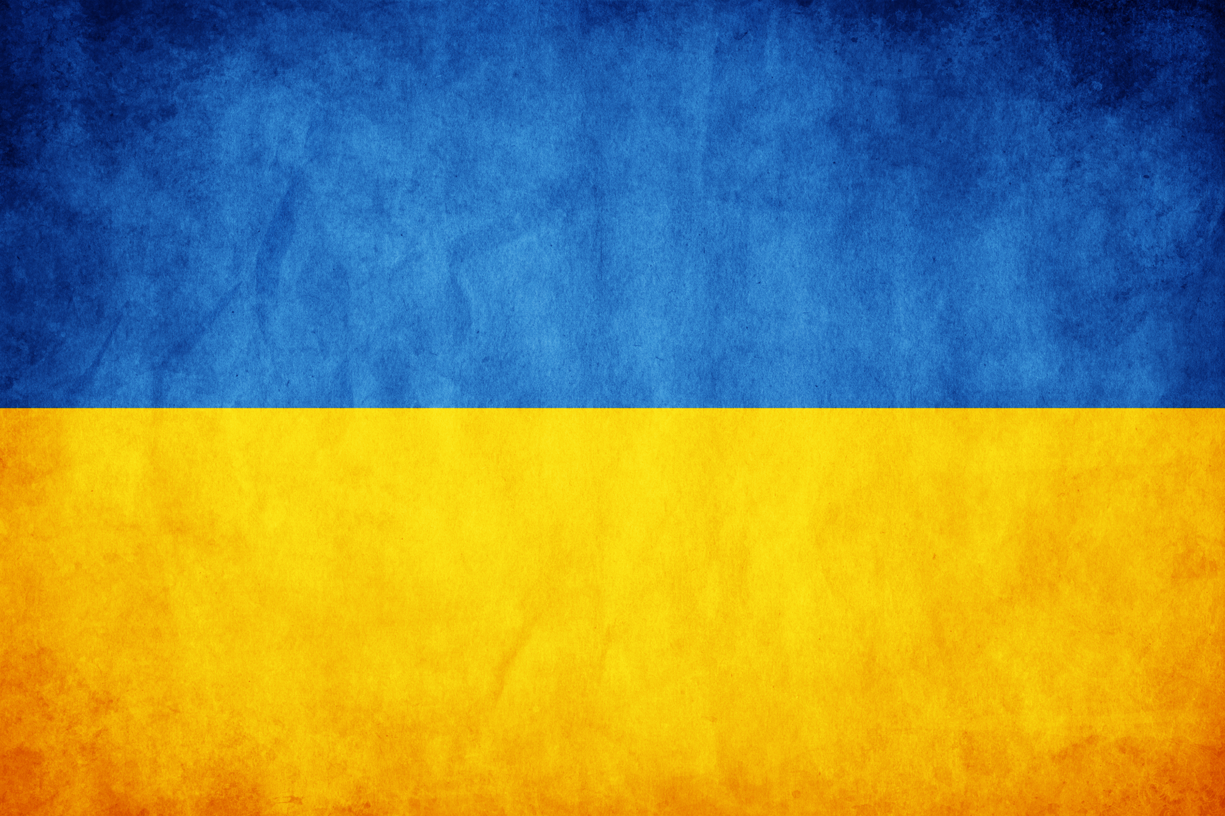
Ukraine

Slide 2

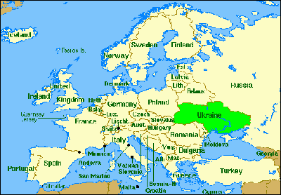
Location of Ukraine in the Europe
Ukraine is located in Eastern Europe
The area is about 233.03196mi² (Texas)
Borders with Russia, Belarus, Moldova, Romania, Slovakia and Hungary

Slide 3

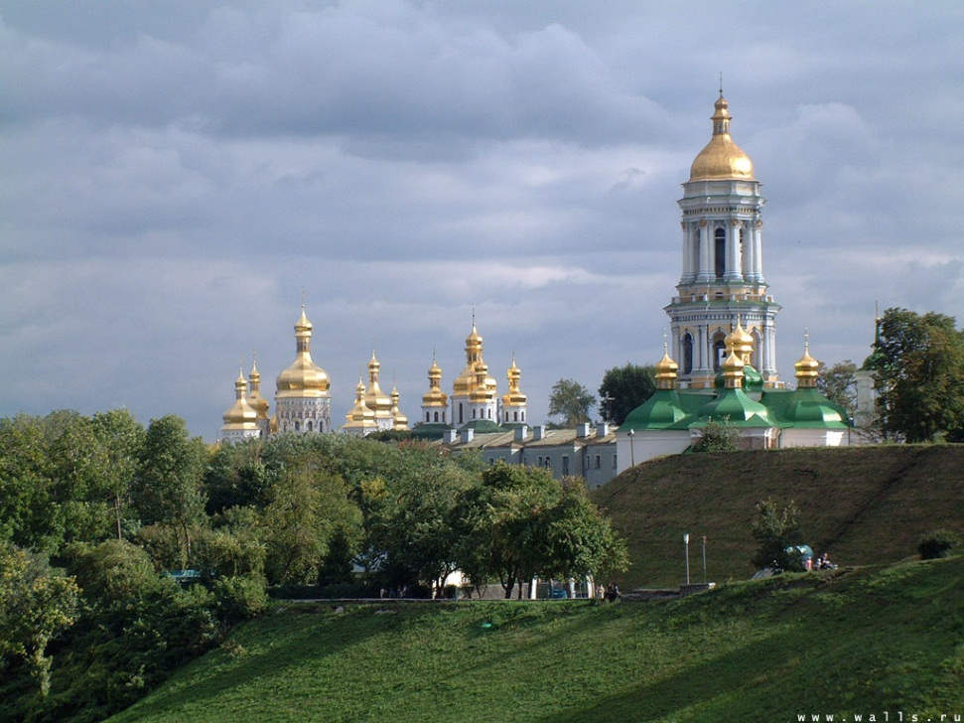
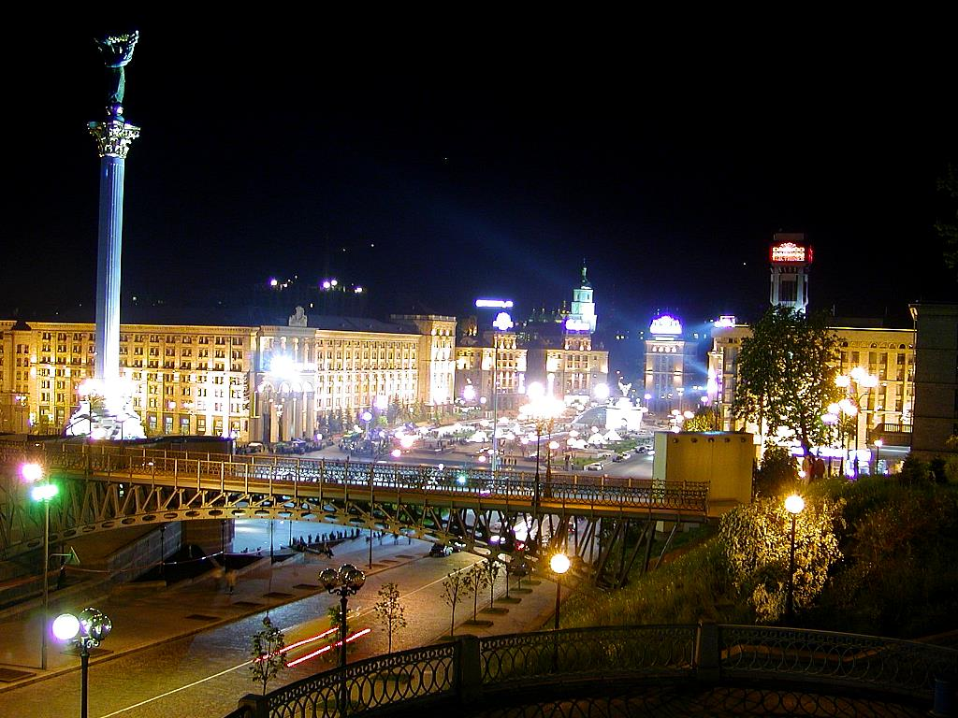
The capital of Ukraine - Kyiv
The population is 2,611,300
Was funded in 10-th and 11-th Centuries
Was the capital of Kyivan Rus

Slide 4
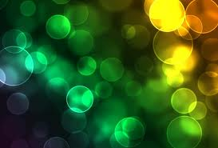
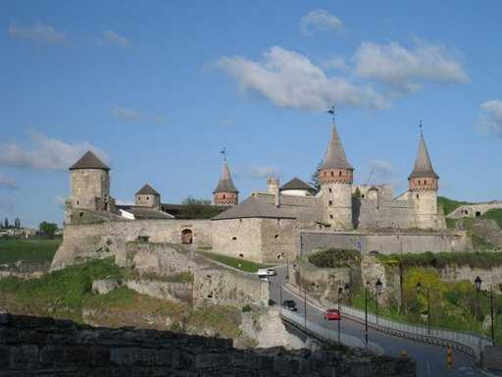
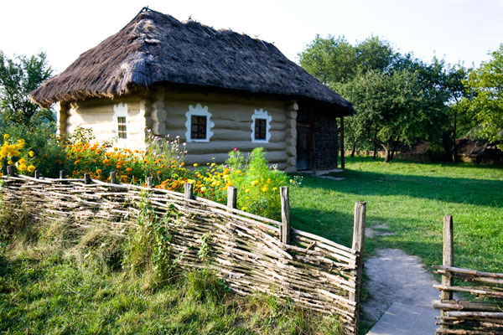
National history
Kyivan Rus was established by the Varangians in the 9th century
Was one of the founding republics of the Soviet Union
Gained independence in 1991

Slide 5

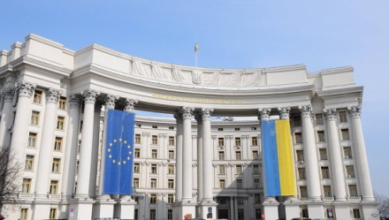
The government of Ukraine
Country’s parliament is called Verkhovna Rada (Supreme Council)
President – Viktor Yanukovych
Prime Minister – Mykola Azarov

Slide 6
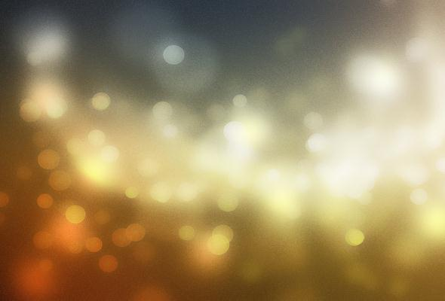
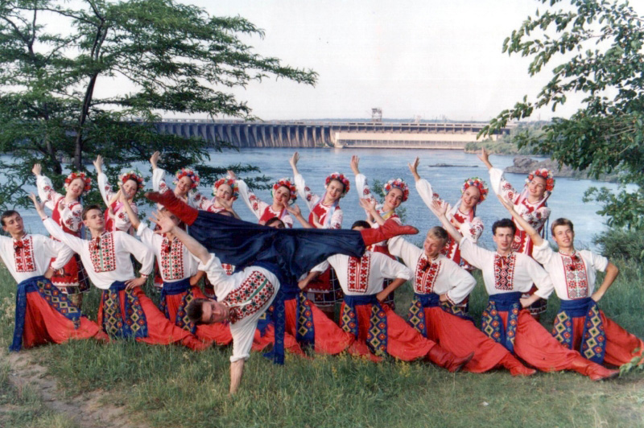
Ukrainian culture
National dances are popular all over the world
Great cultural heritage: songs, paintings, poems
Ukraine is known in Europe as “singing nation”

Slide 7
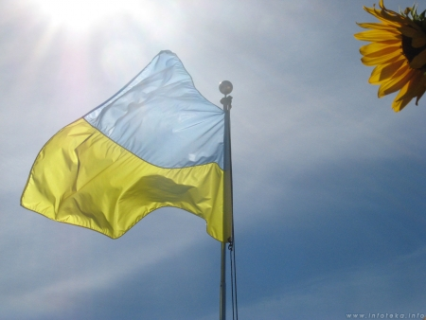
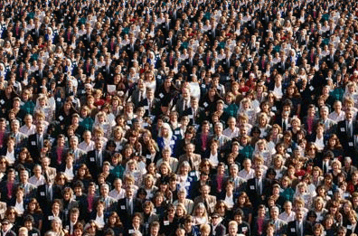
Famous Ukrainians
Taras Shevchenko (1814-1861) – writer, artist, iconic figure of Ukrainian culture
Andriy Shevchenko – famous soccer player
Anna Kournikova – tennis player
Volodymyr and Vitaliy Klichko - boxers

Slide 8
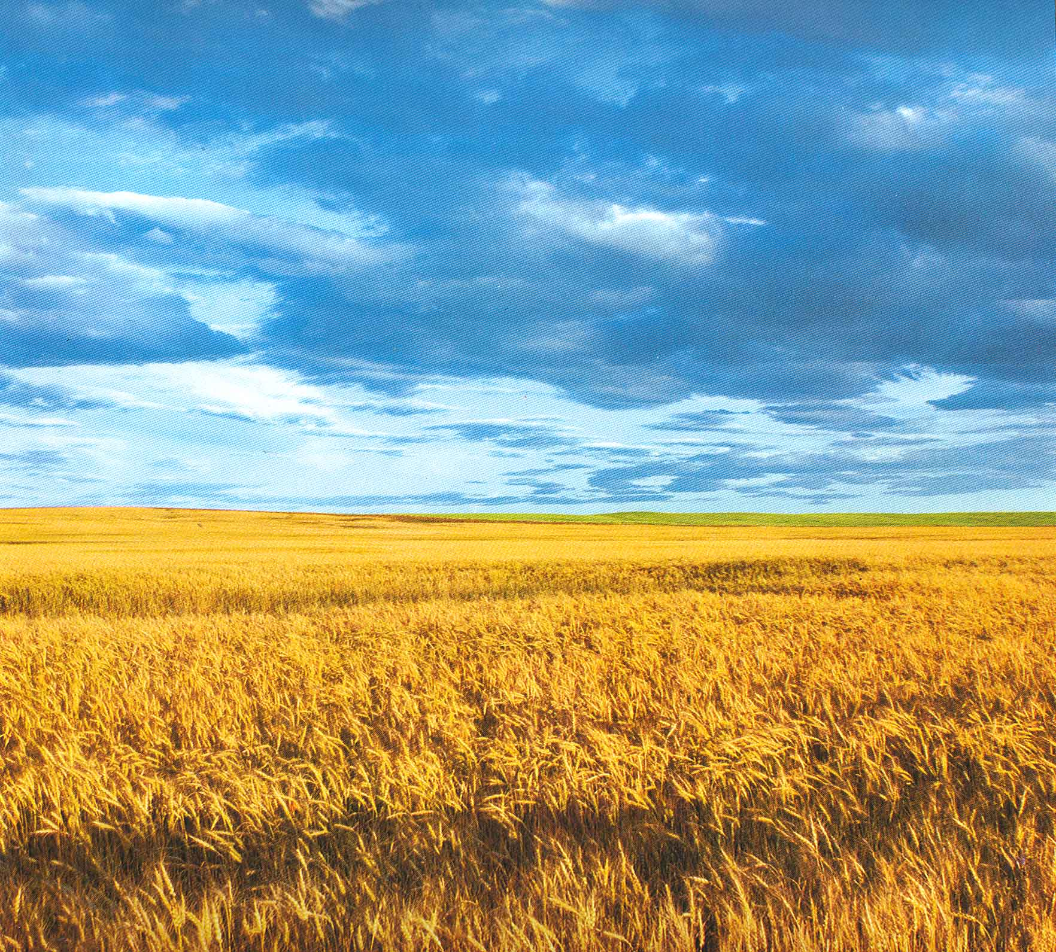
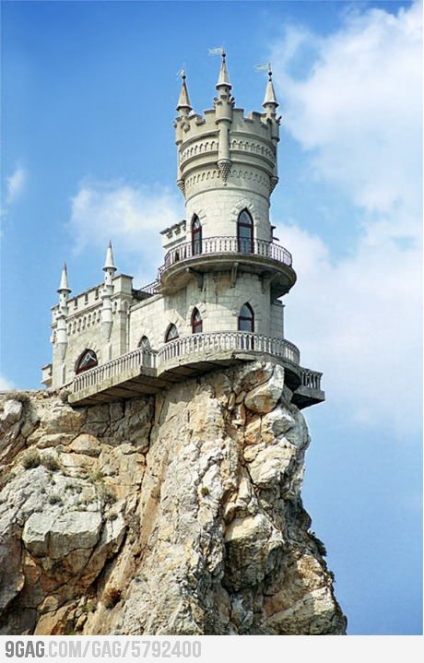
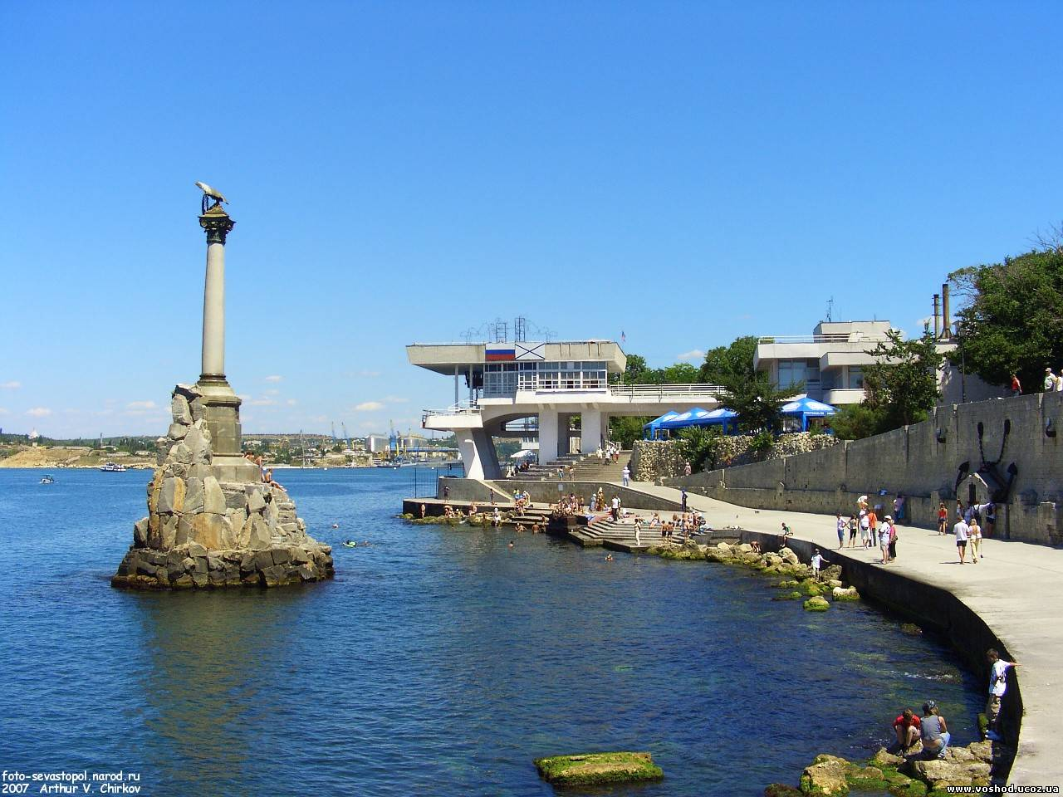
Autonomous republic Crimea
A sub-national unit of Ukraine
Is governed by the Constitution of Crimea
About 60% of the population of Crimea is (ethnic) Russian
Place of interest for tourists all over the world

