Slide 1
made by
Sasha Kas’yanenko
Restaurant ” Food of God’s “

Slide 2
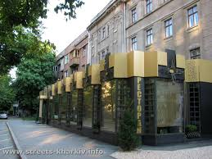

Slide 3
In that presentation I want to tell you :
History of name of the restaurant
Some point from menus
Exclusiveness of restaurant

Slide 4
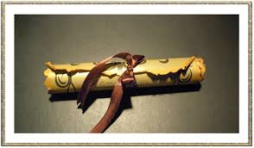
There is a legend which say that ,in ages when the Gods wall on Ears, was live a great cook and his dishes was so tasty that he cooked only for Gods. And the recipe of his dishes was in big secrets , but man afraid to forget a recipe and recorded them on scrolls. With time scroll was missed. But we was find that scroll and
take all recipe from it. In the title of the scroll was written “ food of God’s”

Slide 5
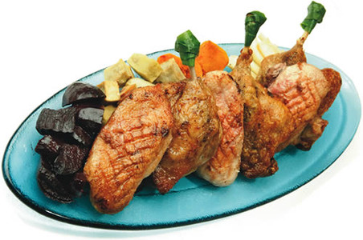
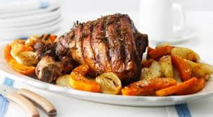
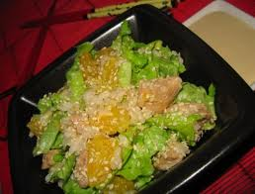
In the menu we have some dishes. First – main dishes with salad.

Slide 6
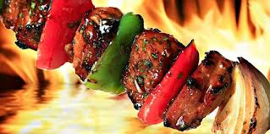
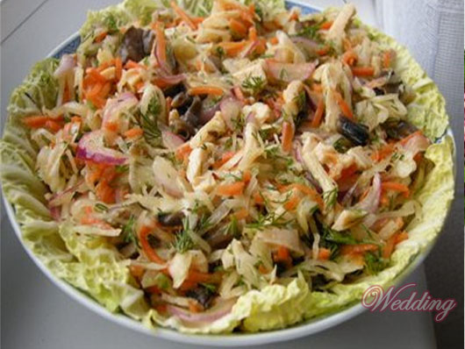
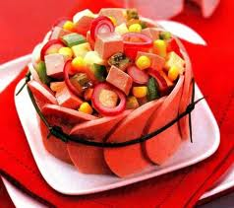

Slide 7
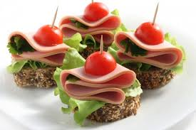
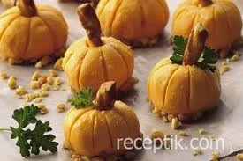
After main dish get ready to second dish, than you can book snack .

Slide 8
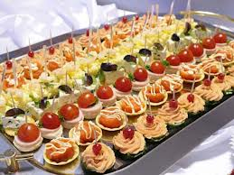
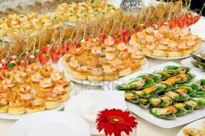
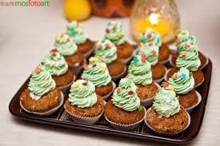

Slide 9
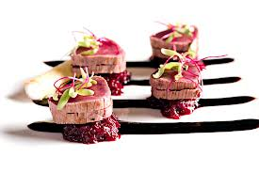
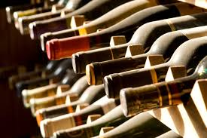

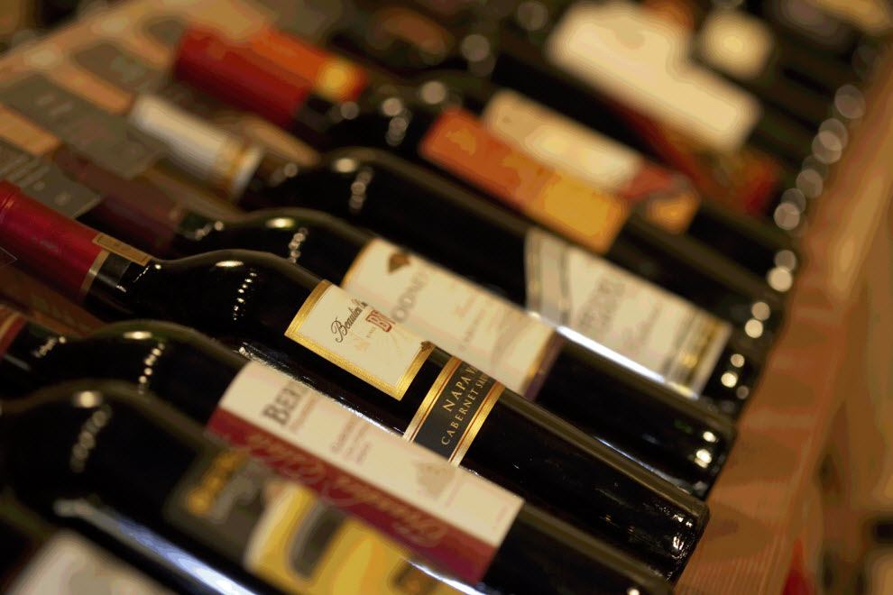
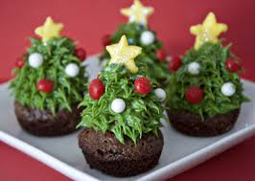
Also you can choose wine on your taste . After all you can select the best chef ‘s sweets.

Slide 10

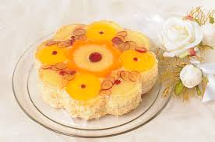

Slide 11
The main difference from other restaurants :
1) low prices – it enables pour people visiting the restaurant and taste best dishes .
2) comfortable design – small but very cozy restaurant will be attractive for all.
3) interesting decorations – inimitable design with beautiful paintings and perfect details
I think that will attract people to restaurant. And I think with time all will go to that restaurant.

Slide 12
