Slide 1
Significant events and famous people of Ireland

Slide 2
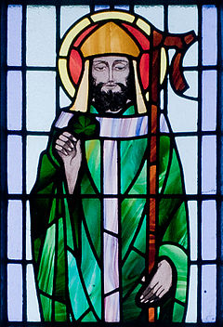
Saint Patrick's Day

Slide 3
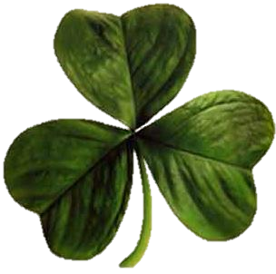
According to legend, Saint Patrick used the three-leaved shamrock to explain the Holy Trinity to Irish pagans.

Slide 4
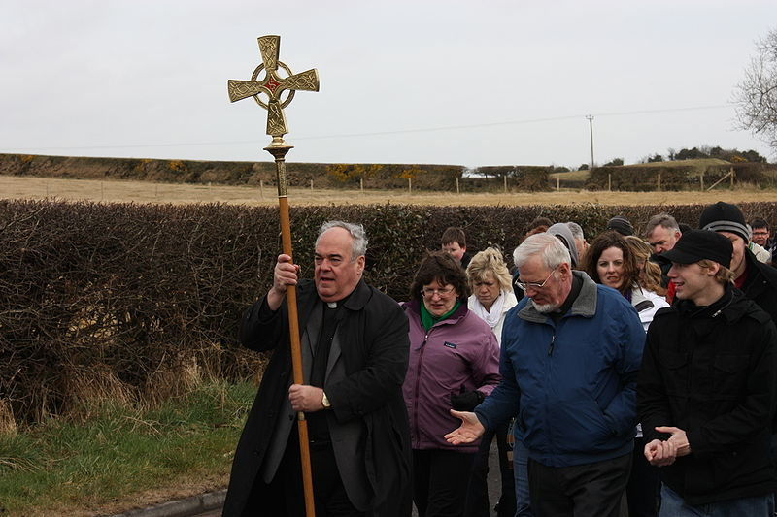
A St Patrick's Day religious procession in Downpatrick, 2010

Slide 5
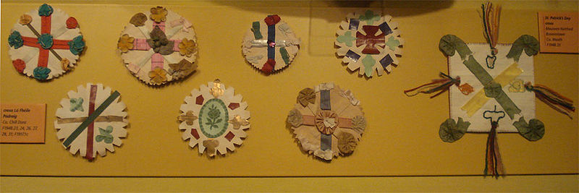
Traditional St Patrick's Day badges from the early 20th century, photographed at the Museum of Country Life in County Mayo

Slide 6
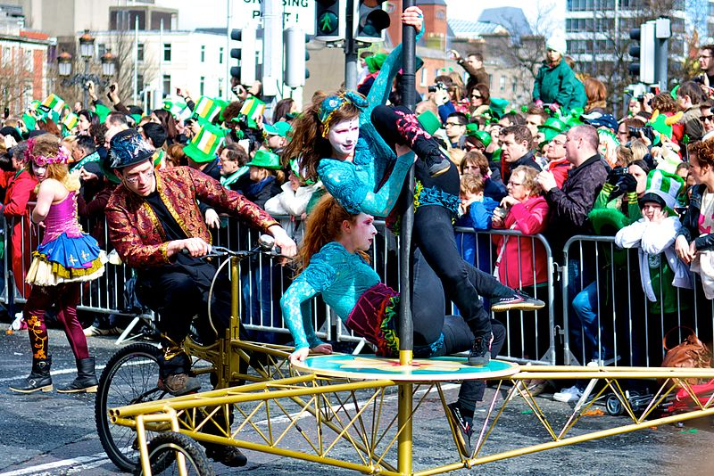
A Saint Patrick's Day parade in Dublin

Slide 7
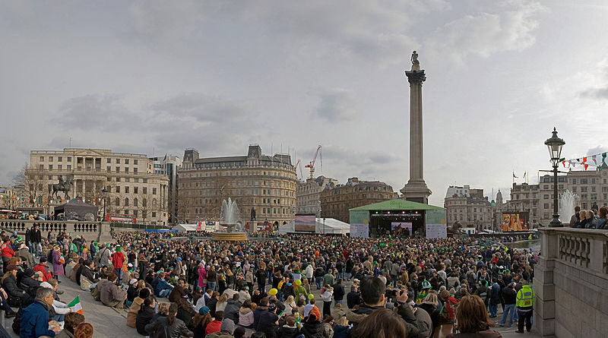
2006 St Patrick's Day celebrations in Trafalgar Square London

Slide 8
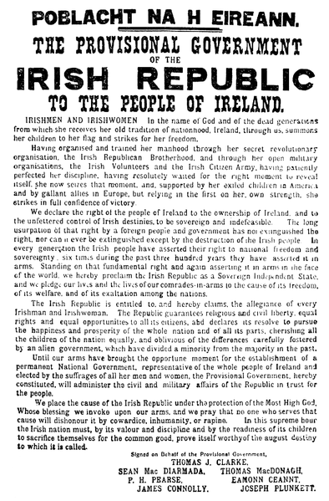
Easter Rising

Slide 9
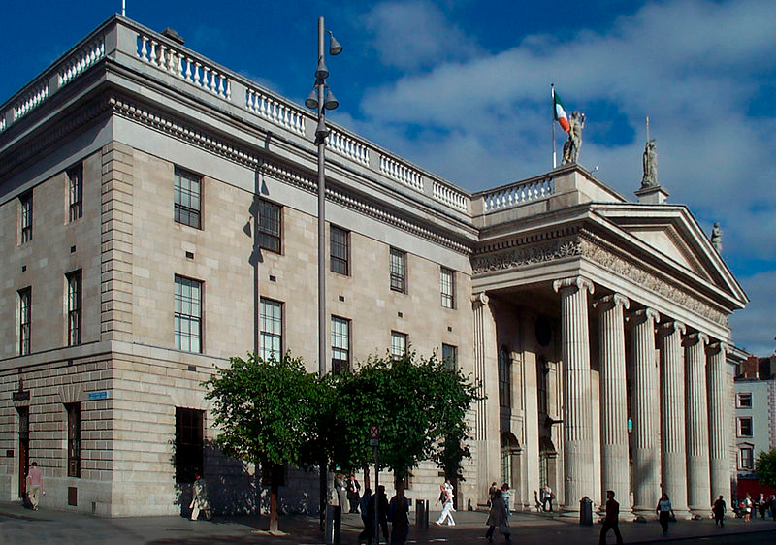
General Post Office, Dublin. Centre of the Easter Rising

Slide 10
One of two flags flown over the GPO during the Rising

Slide 11
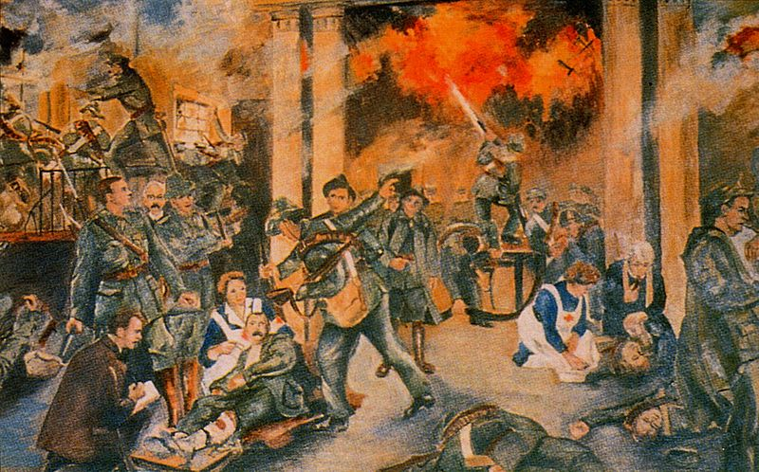
"Birth of the Irish Republic" by Walter Paget, depicting the GPO during the shelling

Slide 12
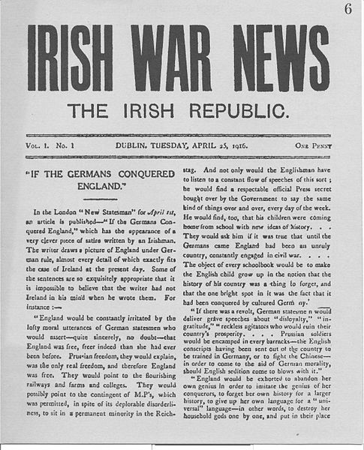
Irish War News, produced during the Rising

Slide 13
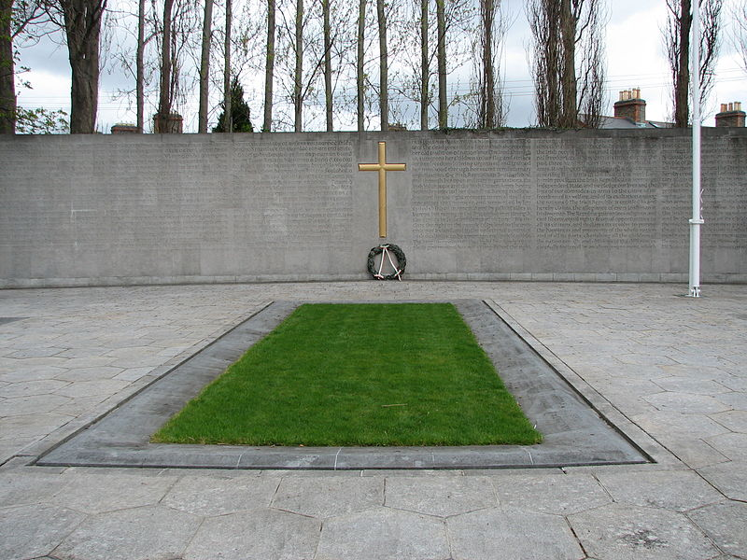
The burial spot of the Leaders of the Rising, in the old prison yard of Arbour Hill prison. The memorial was designed by G. McNicholl.

Slide 14
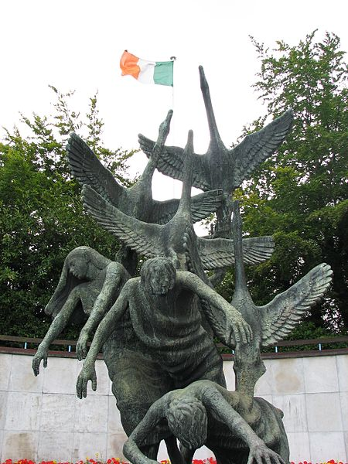
The Garden of Remembrance was opened in 1966, to mark the anniversary of the Rising. The Garden is "dedicated to all those who gave their lives in the fight for Ireland's freedom"

Slide 15
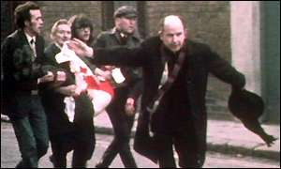
Bloody Sunday (1972)

Slide 16
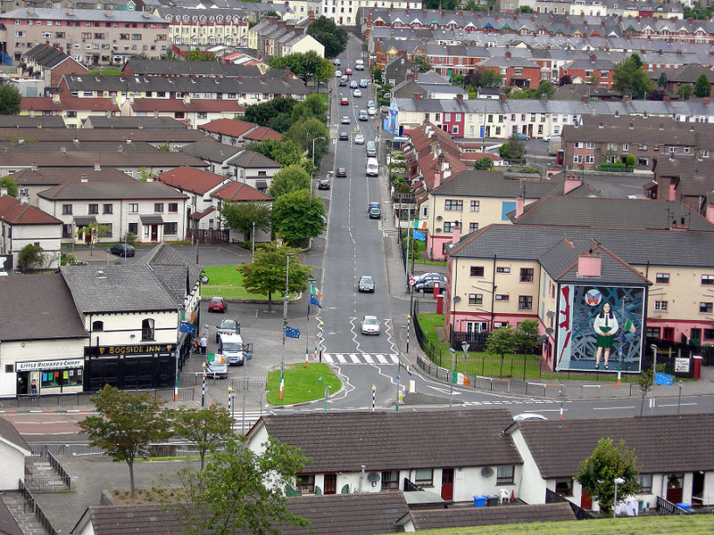
Westland Street in the Bogside viewed from the city wall (31 July 2007)

Slide 17
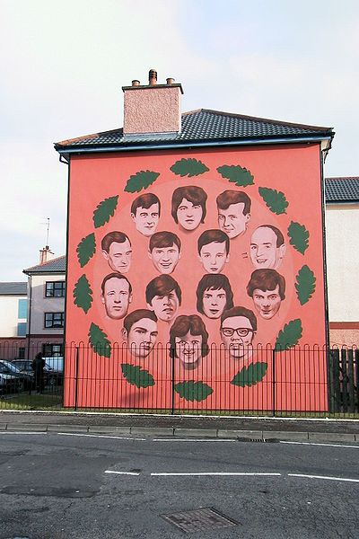
Mural by Bogside Artists depicting all who were killed by the British Army on the day

Slide 18
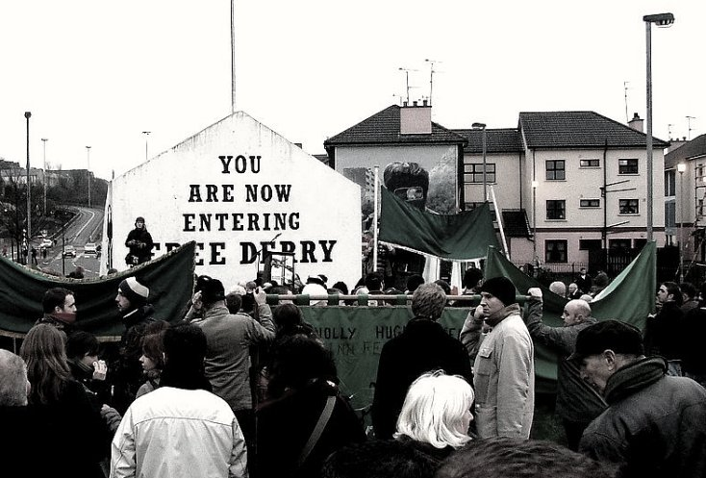
The 35th Bloody Sunday memorial march in Derry, 28 January 2007

Slide 19
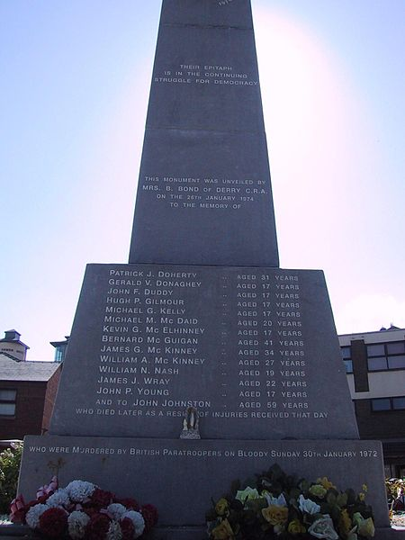
Bloody Sunday memorial in the Bogside

Slide 20
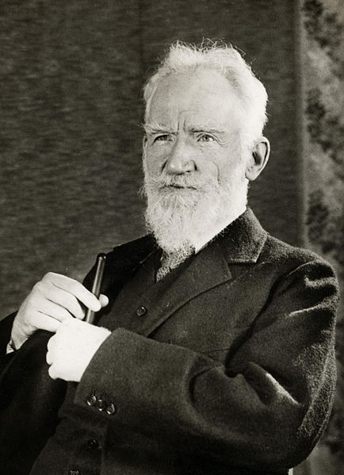
George Bernard Shaw

Slide 21
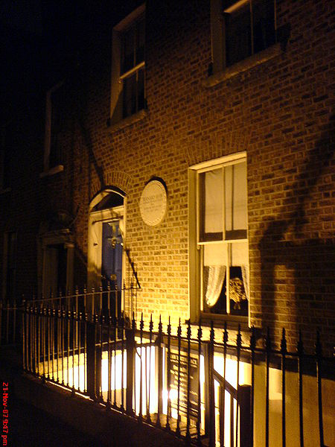
Shaw's birthplace, Dublin

Slide 22
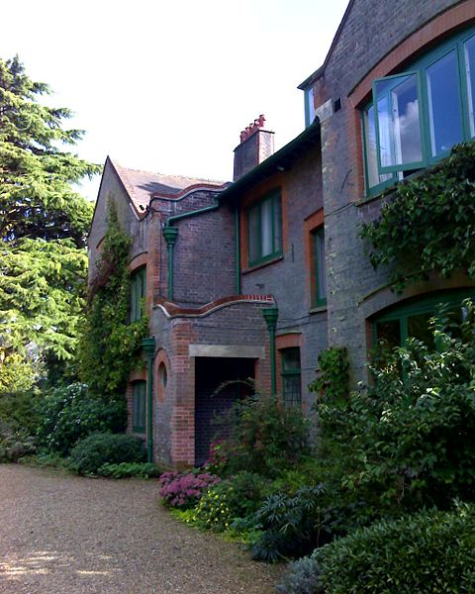
The front of Shaw's Corner as it stands today

Slide 23
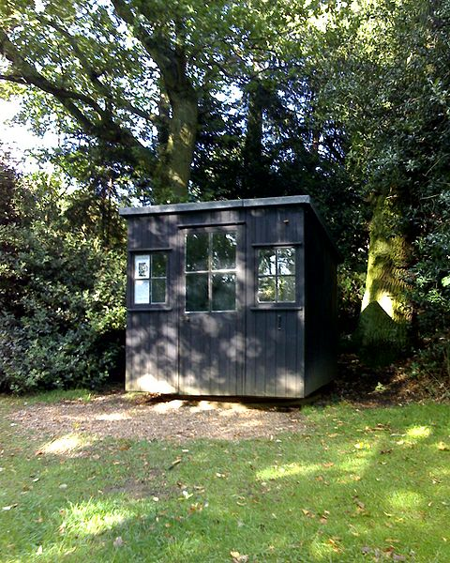
The movable hut in the garden of Shaw's Corner, where Shaw wrote most of his works after 1906, including Pygmalion.

Slide 24
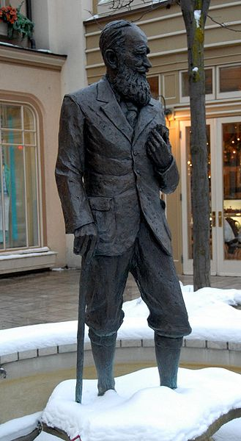
A statue of Shaw in Niagara-on-the-Lake

Slide 25
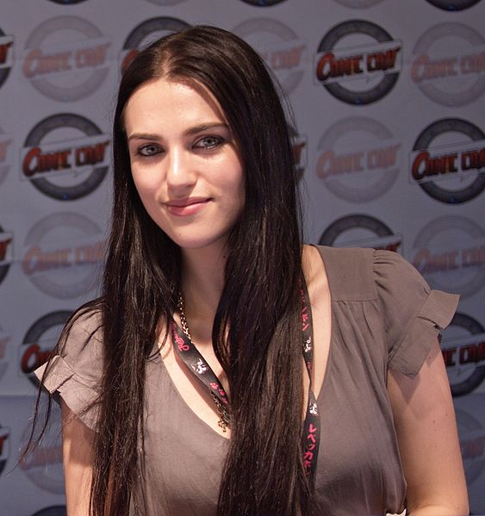
Katie McGrath

Slide 26
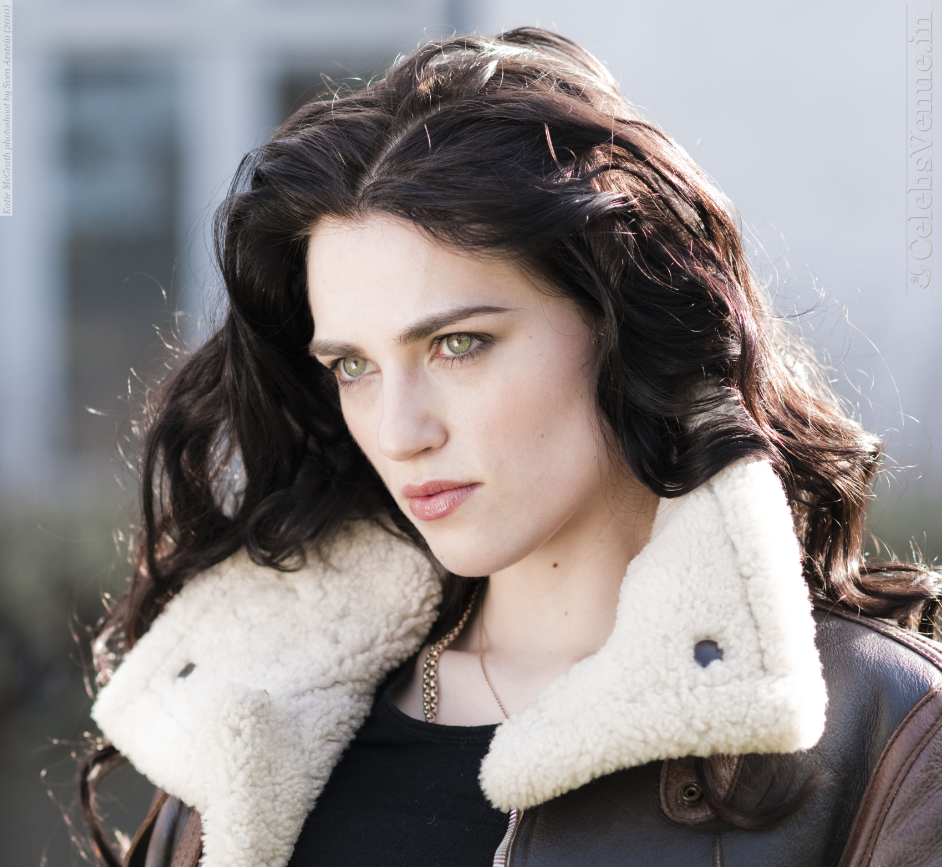

Slide 27
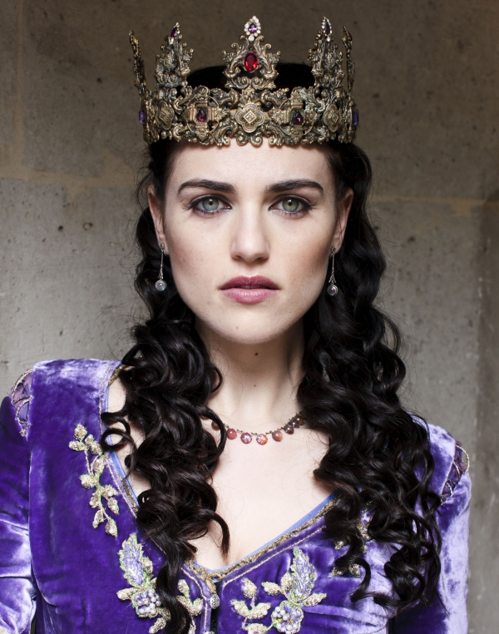

Slide 29
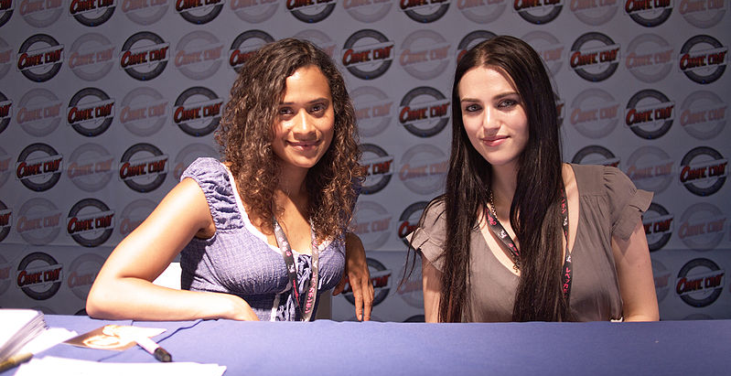
Katie McGrath (right) with Merlin co-star Angel Coulby (left)

Slide 30
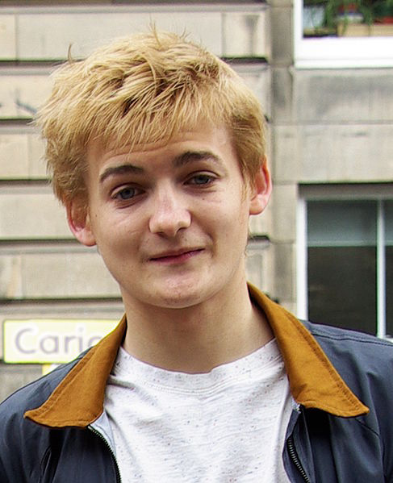
Jack Gleeson

Slide 31
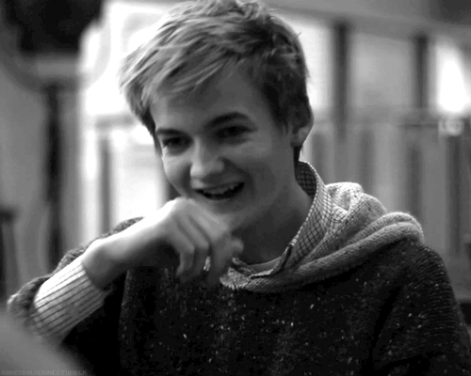

Slide 32
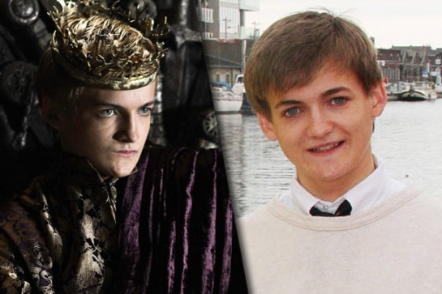

Slide 33
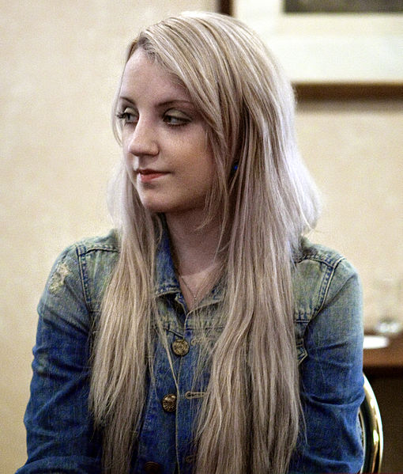
Evanna Lynch

Slide 34
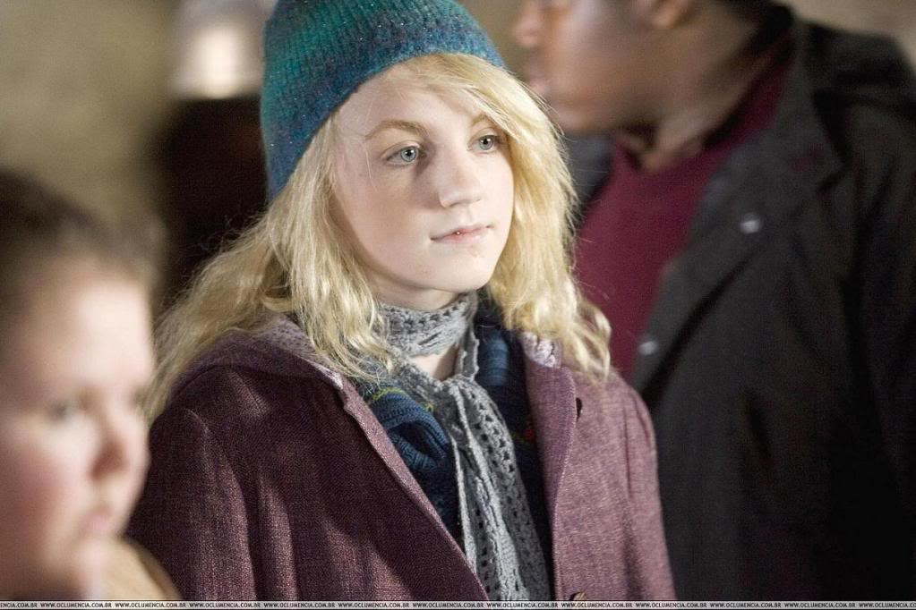

Slide 35
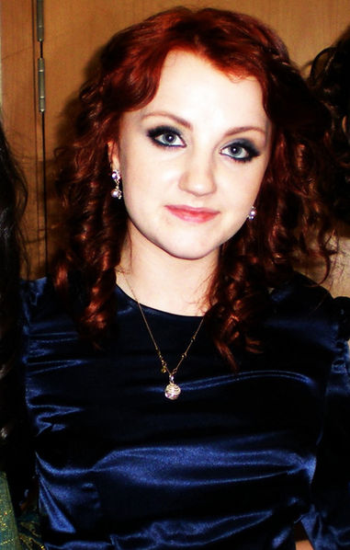
Evanna Lynch in 2011

