Slide 1
Презентація на тему:
“Комп’ютер – шкода здоров’ю

Slide 2
We have tried accessible to people unrelated to medicine, to describe the occupational diseases of computer users, methods of prevention and treatment of these diseases, both recognized and popular, alternative. On this site you will learn how to choose a computer and software , are safe for human health, to organize the workplace , you will find helpful tips and a selection of national experience in handling the computer will be able to discuss on the forum , how to maintain and improve their health.

Slide 3

What kind of injury causes the computer and how to minimize this damage? How to maintain the beauty and health of the person sits for days and nights behind the monitor, how to combine a healthy lifestyle and work at the computer?
The main hazards affecting the health of people working at the computer: sitting position for a long time; effects of electromagnetic radiation monitor; eye fatigue, eye strain; overloading joints of the hands; stress at the loss of information.

Slide 4
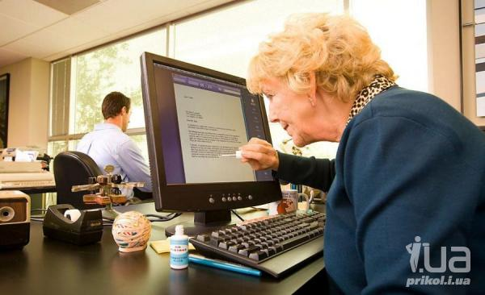
Sitting position.
It would seem that the computer man sits in a relaxed position, but it is to the body forced and unpleasant: strained neck muscles of the head, hands and shoulders, hence the excessive load on the spine, osteochondrosis , and the children - scoliosis. Those who have a lot of sitting between the chair seat and the body formed a kind of heat wrap, which leads to stagnation of blood in the pelvic organs as a consequence - prostatitis , and hemorrhoids , diseases, treatment of which - a long and unpleasant. In addition, a sedentary lifestyle often leads to obesity .
Electromagnetic radiation.
Modern monitors are safe for health, but not completely. And if your table quite old monitor, better keep away from him

Slide 5
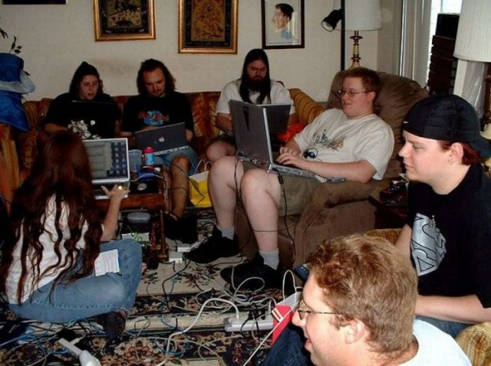
Effects on vision.
Eyes register the finest vibration of the text or images, and even more screen flicker. Overloading the eye leads to loss of sharpness of view . Bad effect on vision unfortunate choice of colors, fonts, layout of windows in the program you use, improper location of the screen.
Overloading of the joints of the hands.
Nerve endings pads of fingers as if broken from the constant attacks on the keys, there are numbness, weakness, and the cushions are running chills. This can cause damage to the articular and ligamentous apparatus of the brush, and subsequently the disease the brush can become chronic.

Slide 6
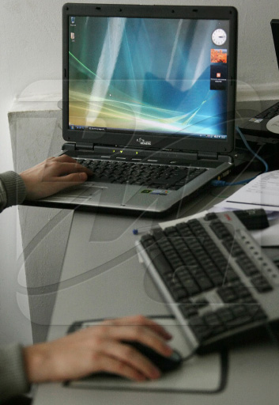
Stress in the loss of information.
Not all users make regular backups of their data. And after all, viruses are not asleep, and drives the best firms, sometimes break down, and the most skilled programmer can sometimes press the wrong button ... As a result of stress and heart attacks occurred.
Dust and dirt: allergy and intestinal infections.
Dust and dirt in the computer and around eventually accumulates a lot , and remove them, it is often very difficult. Where's the dirt, there is all sorts of germs, bacteria and fungi, where the dust and dust mites there. All this can provoke a variety of disease - from allergies to the "disease of dirty hands."

Slide 7

Computer and pregnancy.
Whether computers are dangerous for pregnant women? Of course, some negative impact on the course of pregnancy and fetal development can have a computer, but how much? There is no consensus on this point the doctors still did not work out ...
Effect of a computer on the psyche.
Theme, in our opinion, very debatable. Gambling, Internet addiction - how serious are these problems? How much influence a computer on mental health? We bring to your attention a different perspective on these issues.
Work on your computer and stay healthy!

