Slide 1
Mac OS

Slide 2
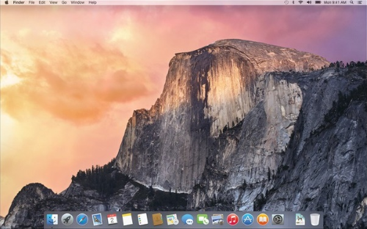
Mac OS
Mac OS is a series of graphical user interface-based operating systems developed by Apple Inc. for their Macintosh line of computer systems.
The original operating system was first introduced in 1984 as being integral to the original Macintosh, and referred to as the "System". Referred to by its major revision starting with "System 6 and "System 7", Apple rebranded version 7.6 as "Mac OS" as part of their Macintosh clone program in 1996. The Macintosh, specifically its system software, is credited with having popularized the early graphical user interface concept.
Macintosh operating systems have been released in two major series. Up to major revision 9, from 1984 to 2000, it is historically known as Classic Mac OS. Major revision 10, from 2001 to present, is branded OS X (originally referred to as Mac OS X). Major revisions to the Macintosh OS are now issued as point revisions, such that, for example, 10.2 is substantially different from 10.5. Both series share a general interface design, and there has been some overlap with shared application frameworks and virtual machine technology for compatibility; but the two series also have deeply different architectures.

Slide 3
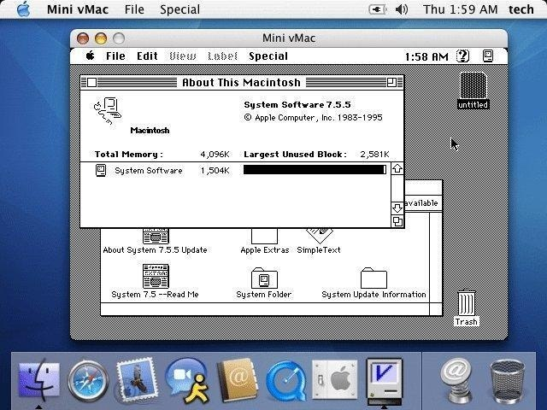
Early versions
Early versions of Mac OS were compatible only with Motorola 68000-family Macintoshes. As Apple introduced computers with Power PC hardware, the OS was ported to support this architecture. Mac OS 8.1 was the last version that could run on a "68K" processor (the 68040). OS X, which has superseded the "Classic" Mac OS, is compatible with only PowerPC processors from version 10.0 ("Cheetah") to version 10.3 ("Panther"). Both PowerPC and Intel processors are supported in version 10.4 ("Tiger", Intel only supported after an update) and version 10.5 ("Leopard"). 10.6 and later versions support only Intel processors.
Early version

Slide 4
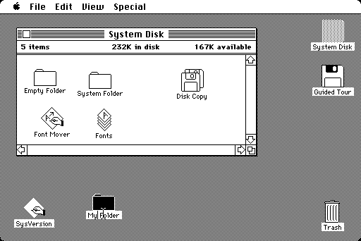
«Classic» Mac OS
The "classic" Mac OS is characterized by its monolithic system. Versions of Mac OS up through System 4 only ran one application at a time. Even so, it was noted for its ease of use. Mac OS gained cooperative multitasking with System 5, which ran on the Mac SE and Macintosh II. It was criticized for its very limited memory management, lack of protected memory, no access controls, and susceptibility to conflicts among operating system "extensions" that provide additional functionality (such as networking) or support for a particular device. Some extensions didn't work properly together, or only worked when loaded in a particular order. Troubleshooting Mac OS extensions could be a time-consuming process of trial and error.
The Macintosh originally used the Macintosh File System (MFS), a flat file system with only one level of folders. Both file systems are otherwise compatible.

Slide 5
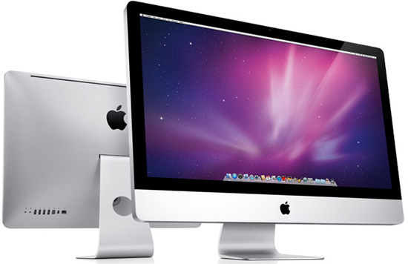
Design
Apple's original concept for the Macintosh deliberately sought to minimize the user's conceptual awareness of the operating system. Tasks which required more operating system knowledge on other systems would be accomplished by mouse gestures and graphic controls on a Macintosh. This would differentiate it from then current systems, such as MS-DOS, which used a command line interface consisting of tersely-abbreviated textual commands.
The core of the system software was held on floppy disk or hard drive in some later models such as the Mac se, with updates originally provided on floppy disk. The user's involvement in an upgrade of the operating system was also minimized to running an installer, or replacing system files using the file manager. This simplicity meant that the early releases lacked any access controls, in effect giving its single user root privileges at all times.

Slide 6
Thank you for your attention!☺

