Slide 1
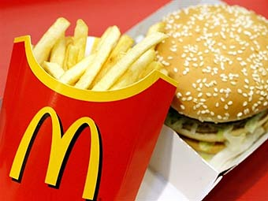
American food.

Slide 2
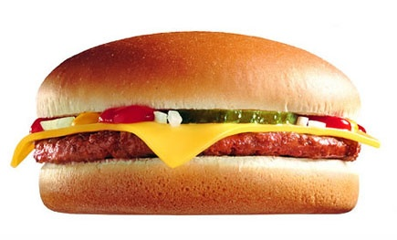
What is American food?
Hamburgers and hot dogs?
Fried chicken and giant steaks?
Well, yes. But spaghetti and pizza are American too, and so is sweet and sour pork. The fact is that Americans eat every kind of food imaginable.
There are, for example, more than 1,000 Chinese restaurants
in New York City alone.

Slide 3
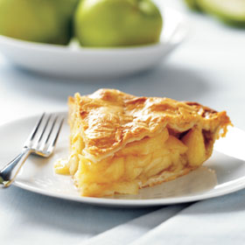
AS AMERICAN AS APPLE PIE.

Slide 4
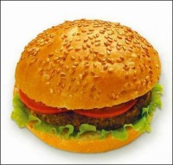
The truth is, though, that families in the US eat together less often than they used to. Instead of meeting at the dinner table, families often meet in the kitchen,
around the refrigerator.
There's no time for old-fashioned cooking. Quick snacks all through the day
have taken its place. And to save trouble, people eat wherever they like,
in the street, in front of the TV,
or at their desks.

Slide 5
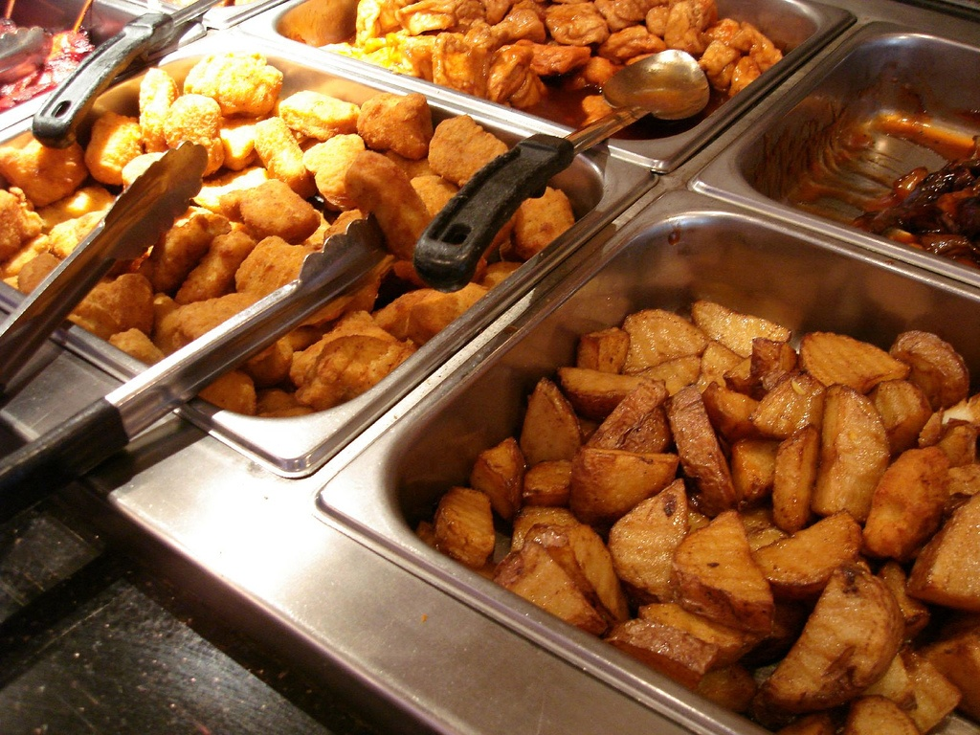

Slide 6
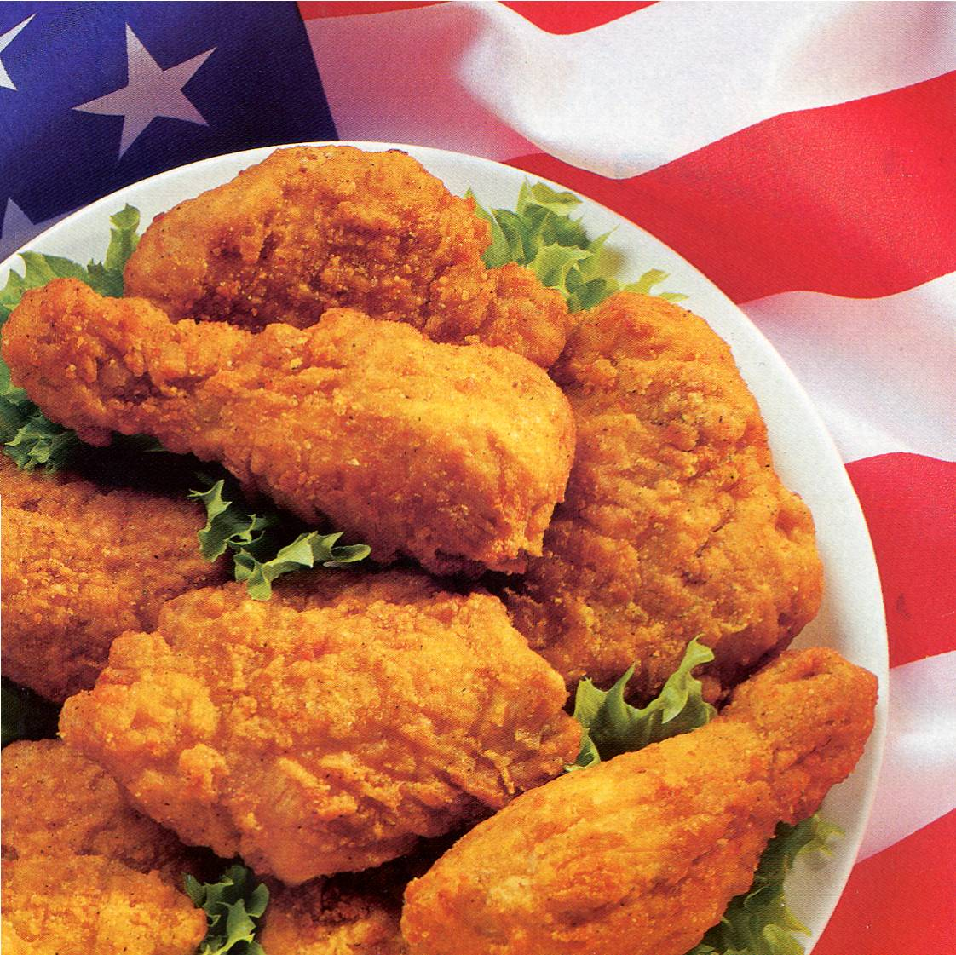

Slide 7
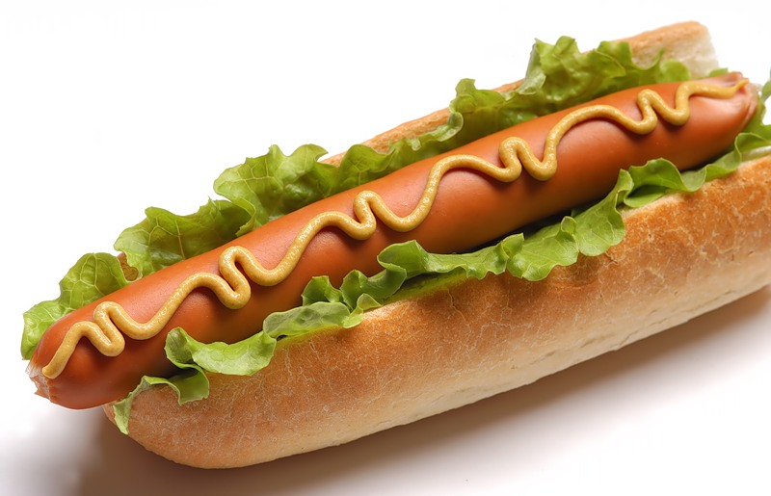
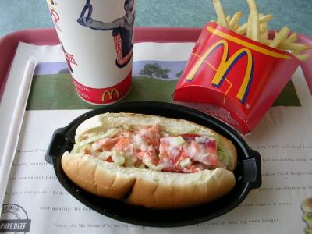
An enormous fast-food industry gives hungry Americans the snacks they want when they want them.
Ice cream, popcorn, and hot dogs are on sale everywhere.
Best known, perhaps,
is the McDonald's
hamburger business.

Slide 8

Popcorn –
A favorite American snack

Slide 9
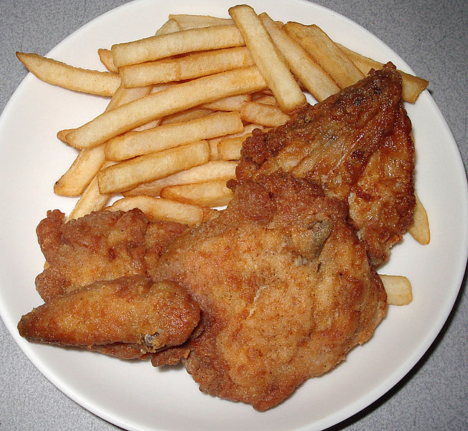
roast chicken with potatoes

Slide 10
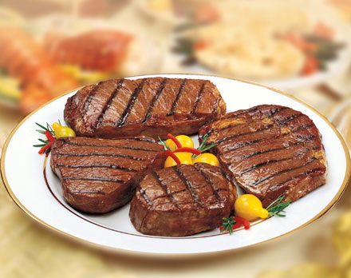
steak

Slide 11

Hot dog

Slide 12
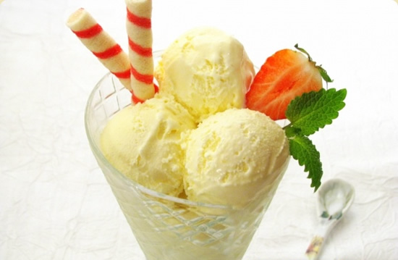
Іce cream

Slide 13
Аnd many others

