Slide 1
My future
profession

Slide 2

To start with, choosing a future profession is one of the most important decisions in our life. A person passes almost half of her/his life at work. There are a lot of interesting and useful professions, and it is not an easy task to choose the right one.

Slide 3

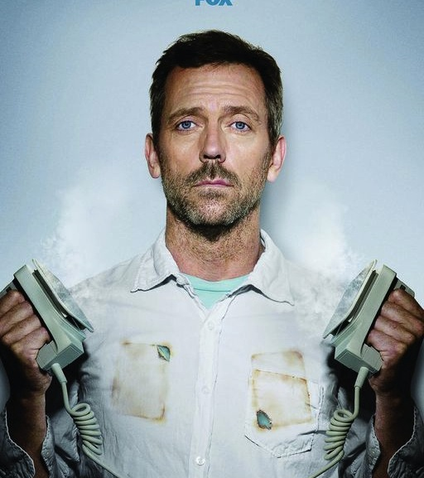
As for me,I want to be a doctor. It is our family tradition: my mother, father and grandmother are doctors,and I hope I will continue the dynasty. This profession requires a big responsibility,so people who want to be a doctor have to be reliable and kind-hearted. I think that I have such trades of character. There is no one on the Earth who does not need a doctor, so that is why this profession is demanded, noble and valued.

Slide 4
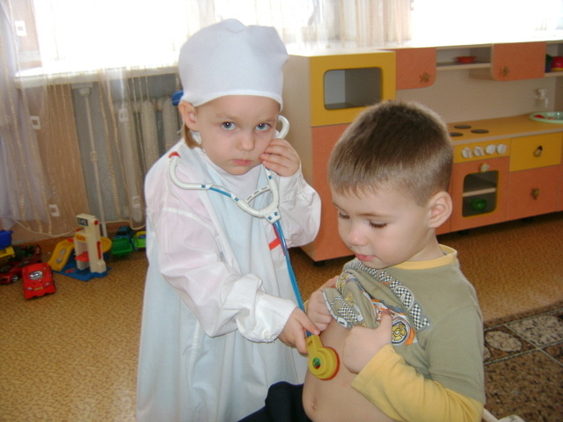

A doctor must be a qualified specialist ,because he is responsible for people’s life and his aim is to diagnose and institute therapy correctly. The doctor examines human body, fights with diseases, improves health of people, prolongs their life. Certainly to become a professional I have to make efforts, and first of all: get a higher education and then improve own skills.

Slide 5
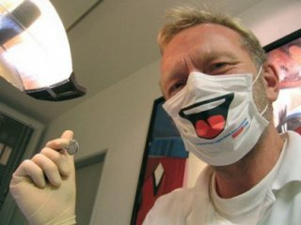

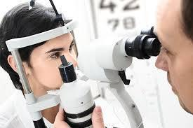
This profession has a lot of advantages. Being a doctor you can take care of yours family. When you become a doctor you learn something new every day because the human body is full of astonishing facts. You will never get bored working as a doctor because a doctor always faces challenging situations. There are so many complicated things that the doctors have achieved.

Slide 6
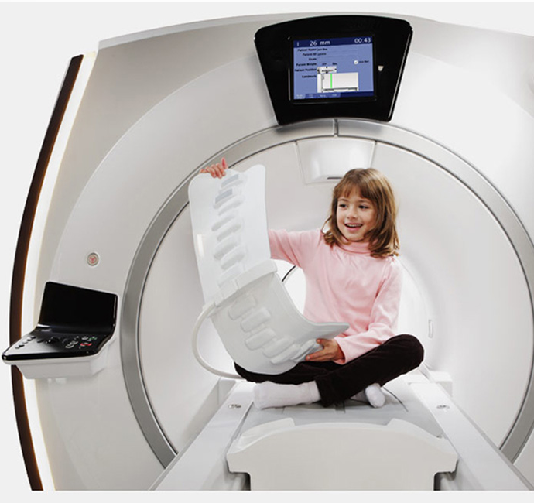
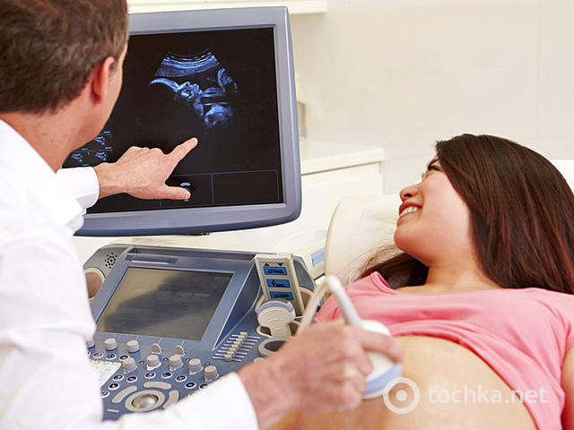
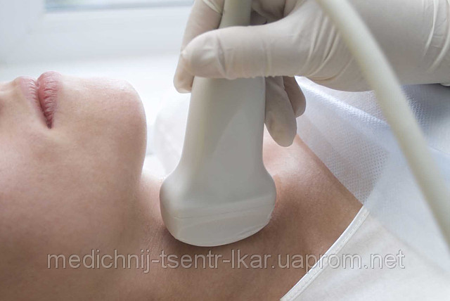
Nowadays there is a huge progress in the medical field. Using new technologies doctors found care for cancer and conduct unique surgeries. I think that I and future doctors have big perspectives in the fight with dangerous and incurable diseases.

Slide 7

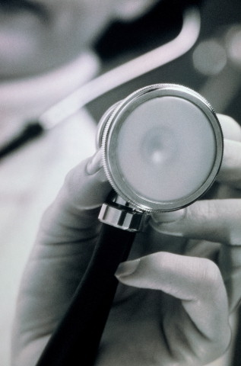
The doctor - is not a profession, but a way of life. Famous writer Chekhov said: ‘It requires purity of soul and thoughts.’ A veritable doctor - is not the one who knows and deeply studies medicine, but one who understands his duty to the people. I think that this kind of career will suit me because I have almost all qualifications that are needed.

Slide 8

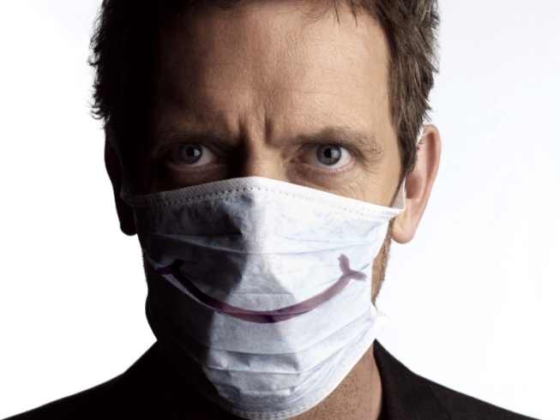
Creative work
In order to become a doctor,you have to be:
D
O
C
T
O
R
daring, dependable, determined
observant ,optimistic, obliging
capable, caring ,conscientious
tolerant, tidy, tactful
organized, objective, open-minded
respectful, reflective, responsible

