Slide 1
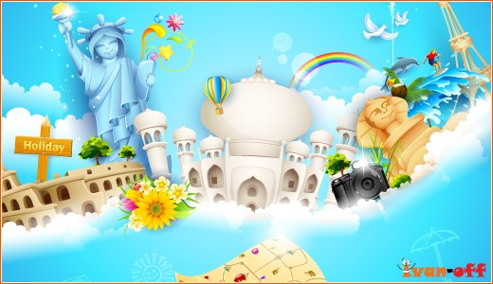
Places to visit in big cities

Slide 2
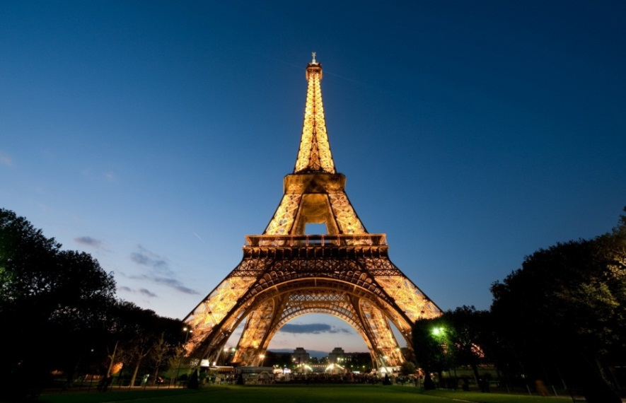
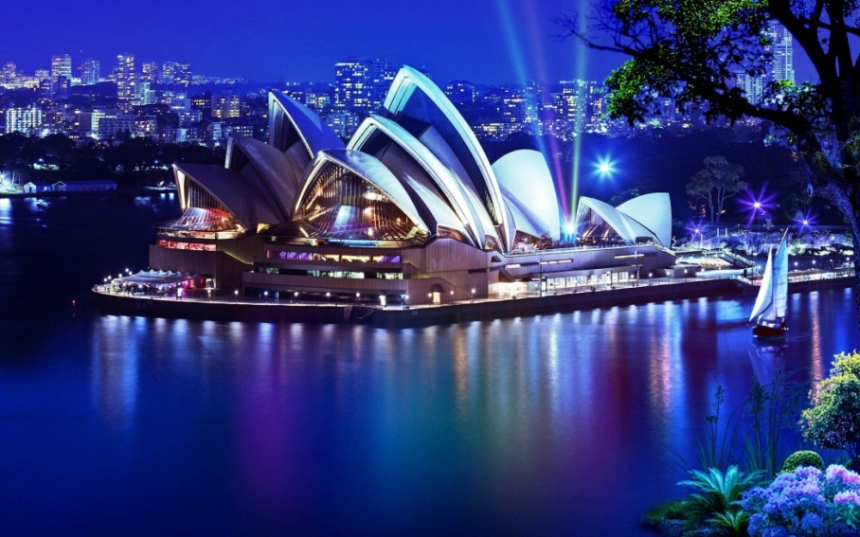
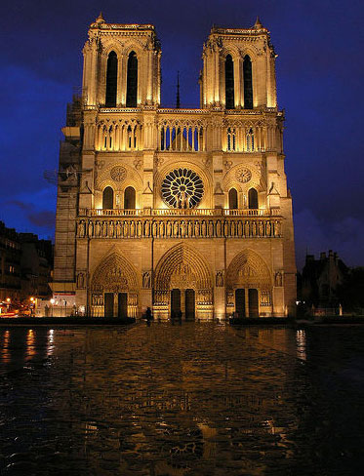
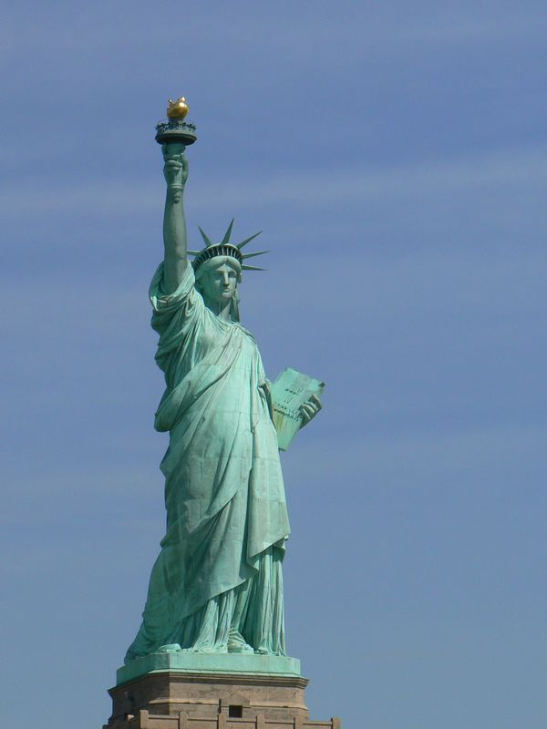
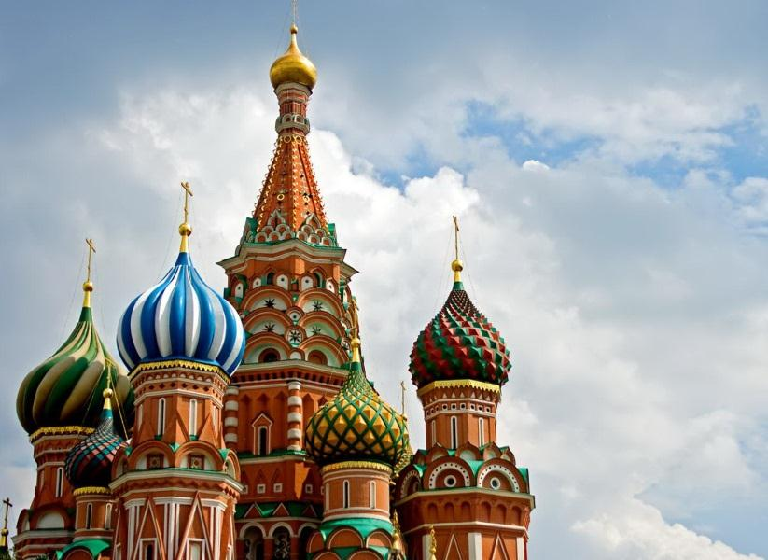
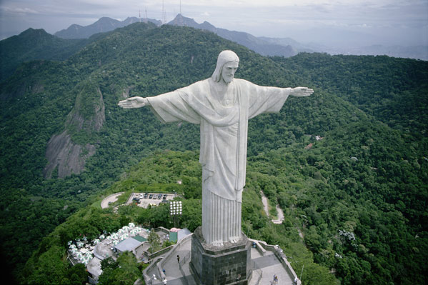
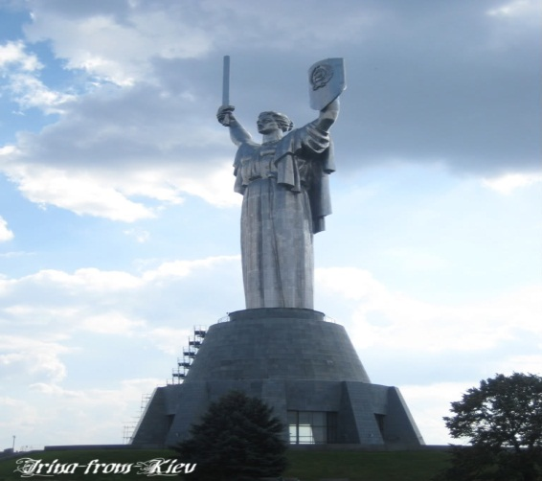
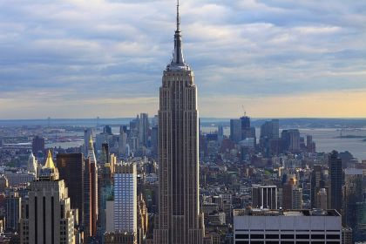
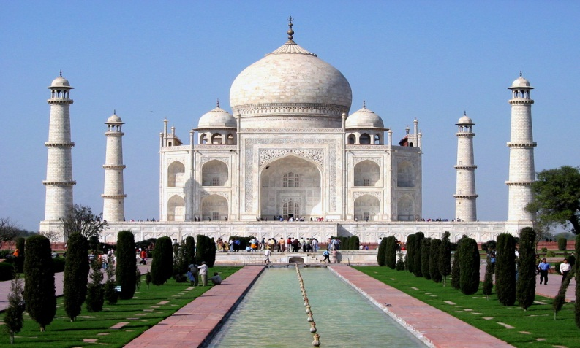

Slide 3
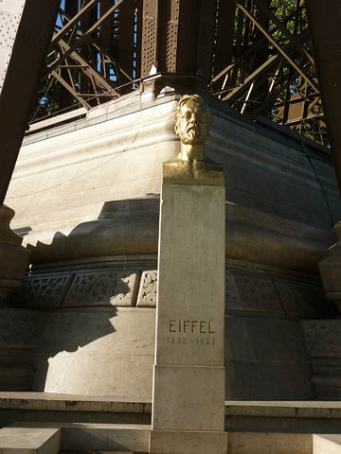
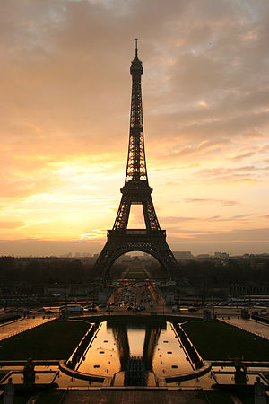
Eiffel Tower
You couldn't possibly visit Paris without seeing the Eiffel Tower. Even if you do not want to visit this world famous structure, you will see its top from all over Paris. The tower rises 300 meters tall (984 ft); when it was completed at the end of the nineteenth century it was twice as high as the Washington Monument, at the time the tallest structure in the world. Gustave Eiffel
The man behind the Eiffel Tower was Gustave Eiffel, known from his revolutionary bridge building techniques, as employed in the great viaduct at Garabit in 1884. These techniques would form the basis for the construction of the Eiffel Tower. He was also known for the construction of the Statue of Liberty's iron framework.
The structure took more than two years to complete. Each one of the about 12,000 iron pieces were designed separately to give them exactly the shape needed. All pieces were prefabricated and fit together using approx. seven million nails.
The Tallest
Inaugurated March 31, 1889, the Eiffel Tower would be the tallest structure in the world until the completion of the Chrysler Building in 1930.

Slide 4
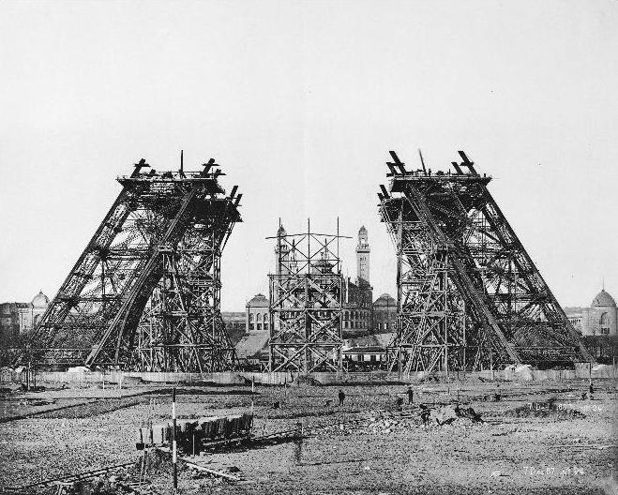
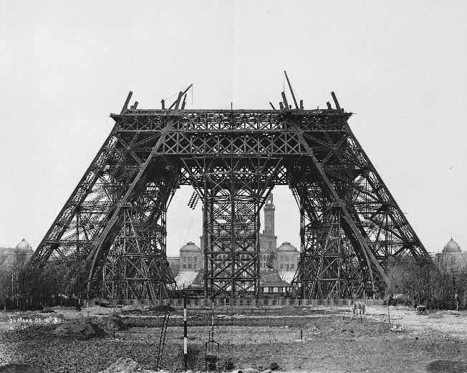
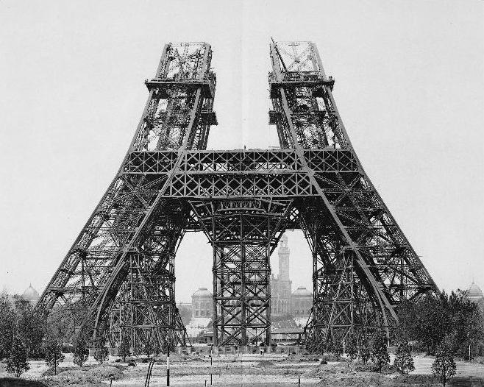
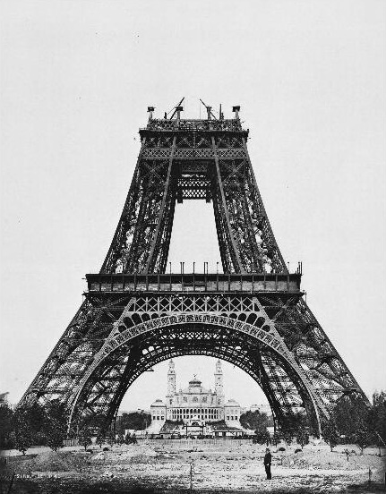
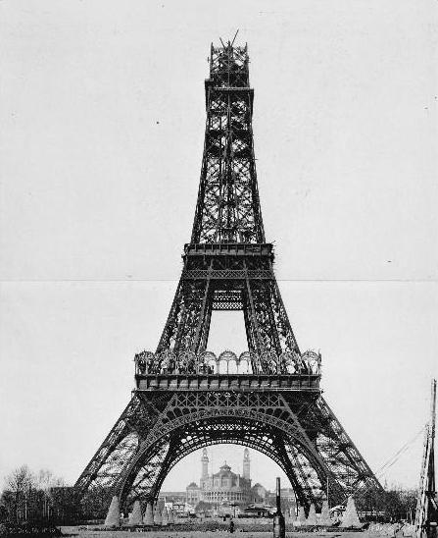
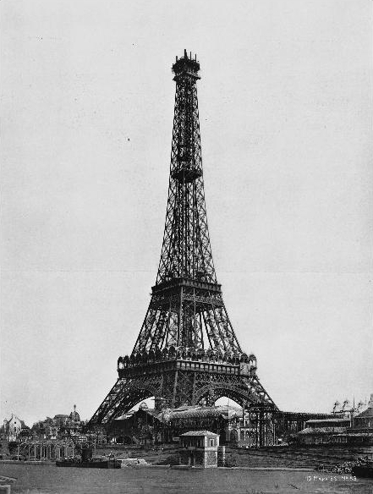
Construction
Work on the foundations started on 28 January 1887

Slide 5
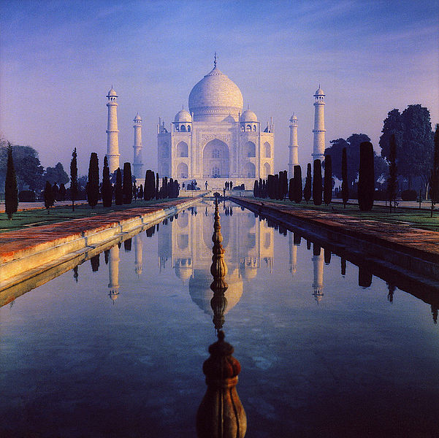
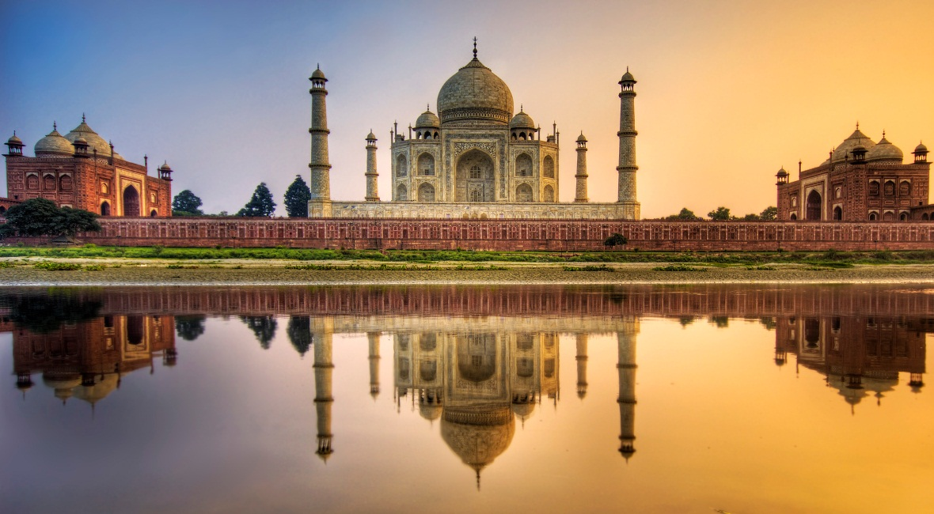
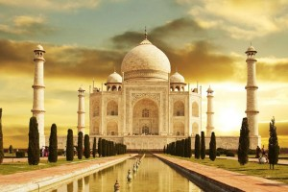
Taj Mahal
Taj Mahal is regarded as one of the eight wonders of the world, and some Western historians have noted that its architectural beauty has never been surpassed. The Taj is the most beautiful monument built by the Mughals, the Muslim rulers of India. Taj Mahal is built entirely of white marble. Its stunning architectural beauty is beyond adequate description, particularly at dawn and sunset. The Taj seems to glow in the light of the full moon.

Slide 6
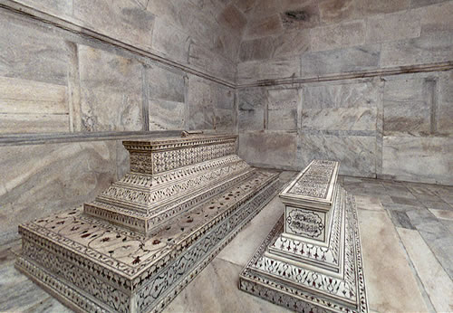
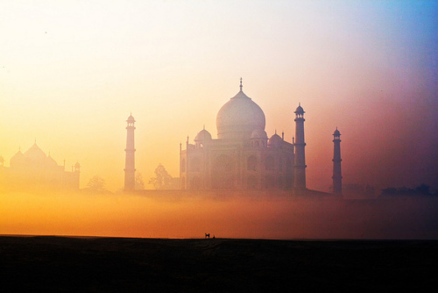
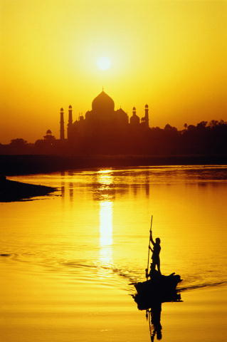
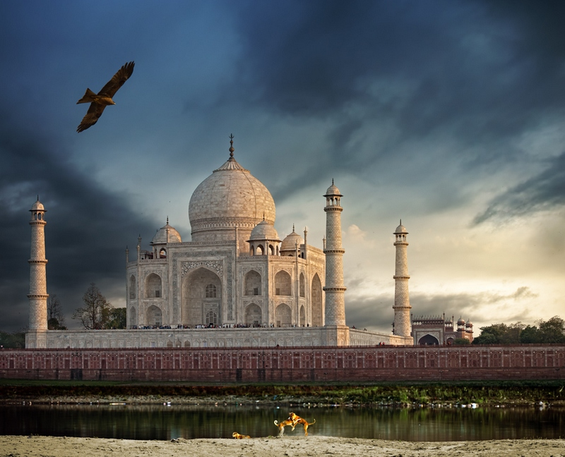
Myth also told that Shah Jahan got the hands of his sculptors and architects cut off so that they would never be able to build a monument as magnificent and beautiful as the Taj again and he even got their eyes pulled out so that they would never be able to witness anything bigger and more beautiful than the monument that they had built during their lifetime.

