Slide 1

‘30 years. Beginning.’
Recently Dima Bilan has performed with solo concert in the Crocus City Hall in Moscow. The programme was named as: “30 years. The beginning”. I asked him why it was the beginning. And he answered that when he was 30, and it means that he was young and that’s why everything only begins. The 1 channel shot the magnificent concert of Dima Bilan when he performed. Tickets cost from 500 roubles to 25000 roubles.

Slide 2
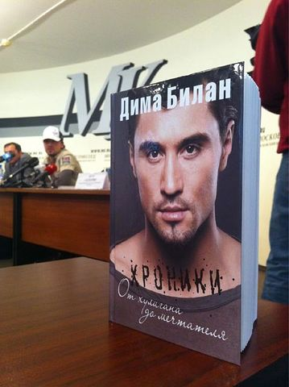
“Chronicles. From the hooligan to the dreamer”
Dima Bilan is not only the actor but also the writer. He has published the autobiographical book which was named ‘’Chronicles. From the hooligan to the dreamer’’. He admitted that 1, 2 and 4 parts of the book he wrote himself in planes, in tours. The book was published on November, 1^{st.}

Slide 3
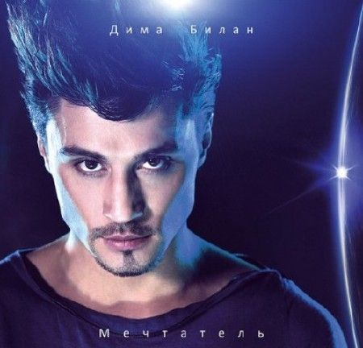
‘’Dreamer”
In summer 2011 Dima Bilan had released an album “dreamer”. It was his 6 album. I think, that Dima Bilan is a talented, creative singer. I like his songs very much. I collect his discs with his songs.

Slide 4
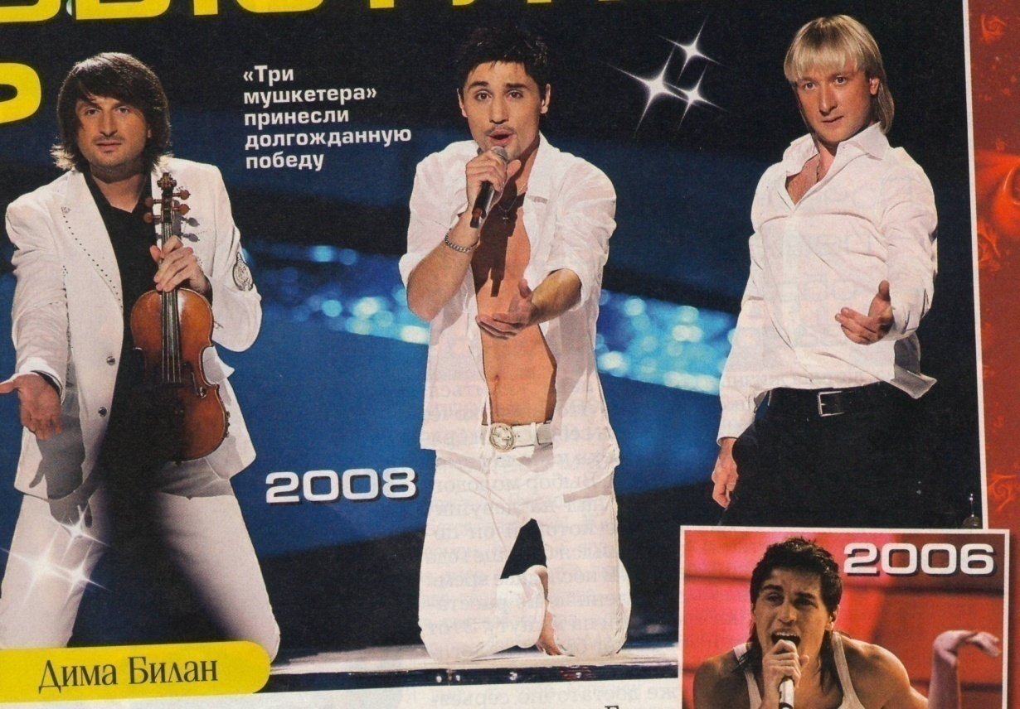
‘’Eurovision’’
Dima Bilan was the winner of the Eurovision 2008. As he admitted that he is going to win Europe once again. He is going to write down a new track with the western star but who it will be he didn’t admit He told that it was a secret. Evgenii Plushchenko helped Dima to achieve a success. He danced on skates on a very little ice scene. Edvin Marton played the famous violin Stradivari. The snow was very wonderful. I also watched this show on TV.

Slide 5
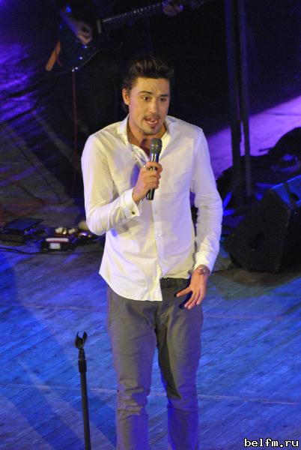
‘’I LIVE”
Dima Bilan came to us Belgorod with the program “I LIVE’’. I was at this concert. It was pleasant for me very much to be at the concert. I was very glad to watch with my eyes Dima and to listen his excellent songs. I took photos and video of the concert. Dima is going with concert all over Russian cities.

Slide 6

“Happy birthday’’
Dima was born on December 24th 1981. This year 2011 Dima is 30 years old. I congratulate Dima with his birthday. I wish him all the best: success in creative life and in the personal life: good health, happiness and love!!!

Slide 7
LITVINOV ARTYOM
2011

